Slide 1
ECE231 Differential Equations Review
Maj Kevin Walchko

Slide 2
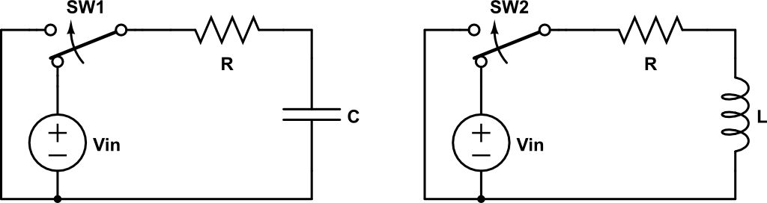
RLC Circuits
Vc = Vin
Ic = Vin/R
0
5 τ
time
0
5 τ
time
Steady State (SS)
Transient
SS
SS
Transient
SS

Slide 3
Diff Eqn Review
Separation of Variables
Method of Undetermined Coefficients

Slide 4
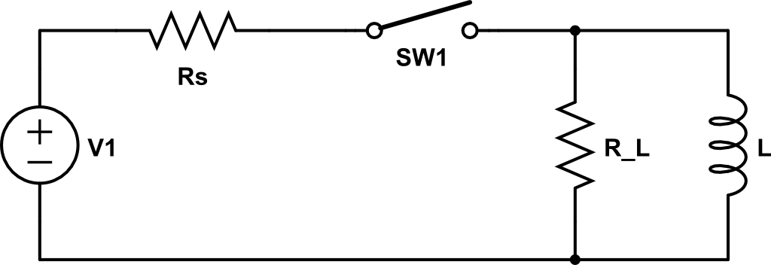
Find inductor current t>0
Switch is opened at t=0

Slide 5
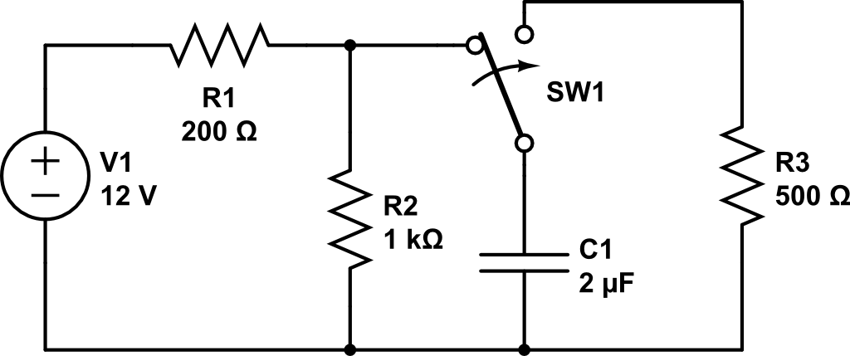
Find V_{c} and i_{c} for t>0
t=0
+
V_{c}
i_{c}
-

Slide 6
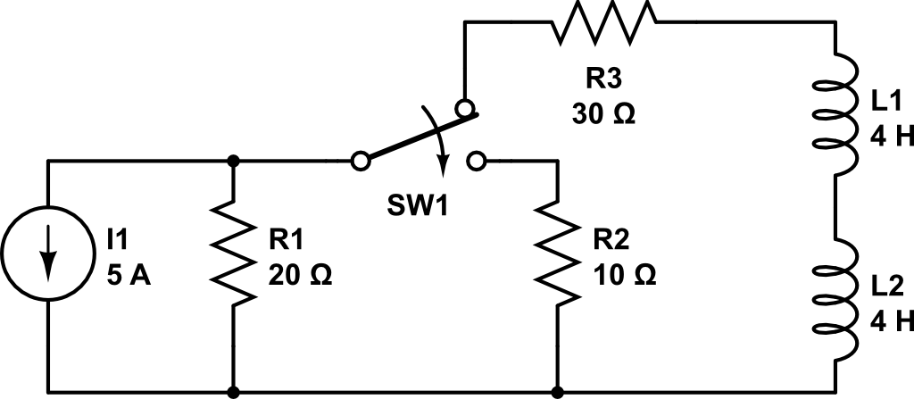
Fin i_{L} and V for t>0
+
i_{L}
V
-

Slide 7
Backups

Slide 8
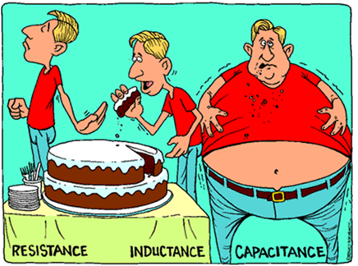

Slide 9
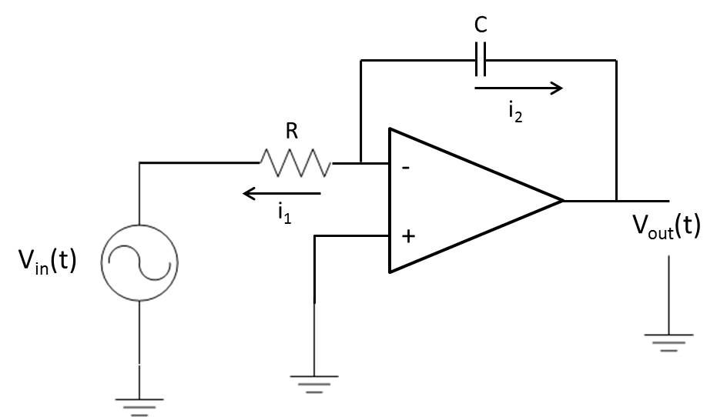
What is V_{out}?
A

Slide 10
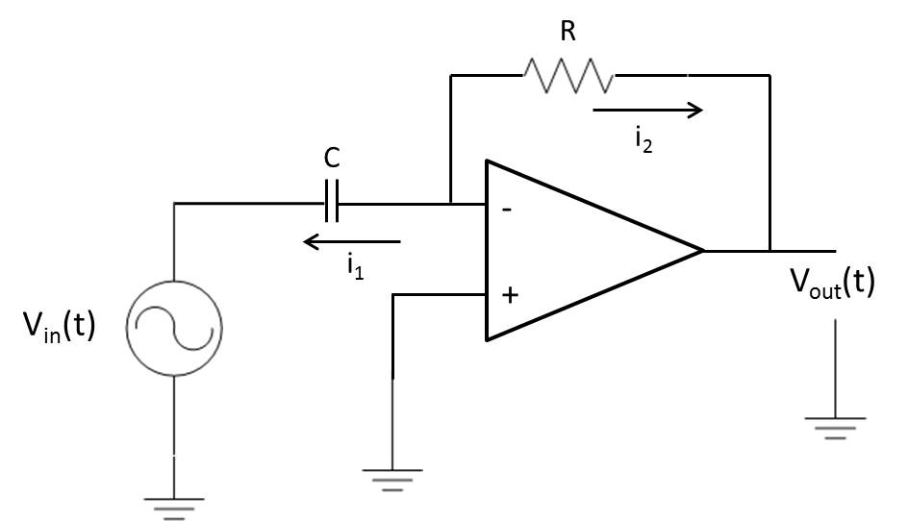
What is V_{out}?
A

