Slide 1
ECE231 RLC Forced Response
Maj Kevin Walchko

Slide 2
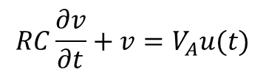



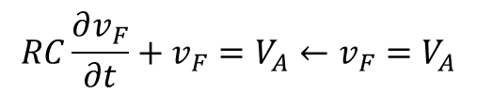
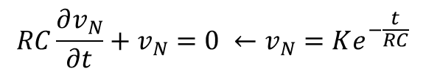
Responses
Up to now we talked about the natural response of a circuit, where there are no traditional voltage/current sources present. Now we are going to look at the forced response of a circuit where there still are voltage/current sources present.
$$g\left(t\right)=g_{N}\left(t\right)+g_{F}(t)$$
Given:
$$RC\frac{∂v}{∂t}+v=V_{A}u(t)$$
Find natural response t<0:
$$RC\frac{∂v_{N}}{∂t}+v_{N}=0 ←v_{N}=Ke^{−\frac{t}{RC}}$$
Find forced response t>0:
$$RC\frac{∂v_{F}}{∂t}+v_{F}=V_{A}←v_{F}=V_{A}$$
Use initial conditions to solve for K
$$v=v_{N}+v_{F}=Ke^{−\frac{t}{RC}}+V_{A}$$
$$v=\left(V_{0}−V_{A}\right)e^{−t/RC}+V_{A}$$

Slide 3
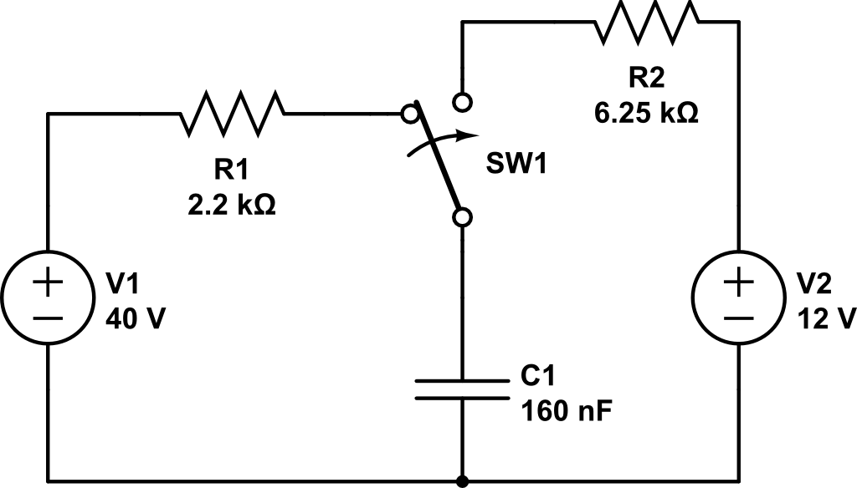
Find V_{c} and i
i
+
Vc
-

Slide 4
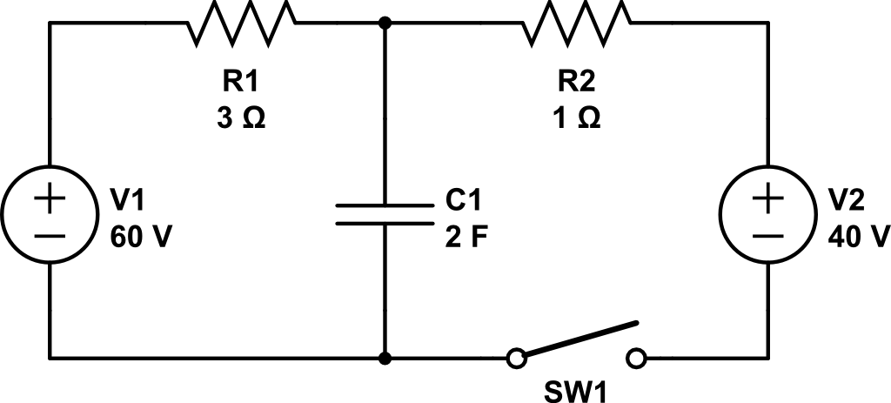
Find V_{c} and i
i
+
Vc
-

Slide 5

Find V_{c}
+
Vc
$$40cos\left(20t\right)V$$
-

Slide 6
Backups

