Slide 1
ECE231 More Stuff
Maj Kevin Walchko

Slide 2
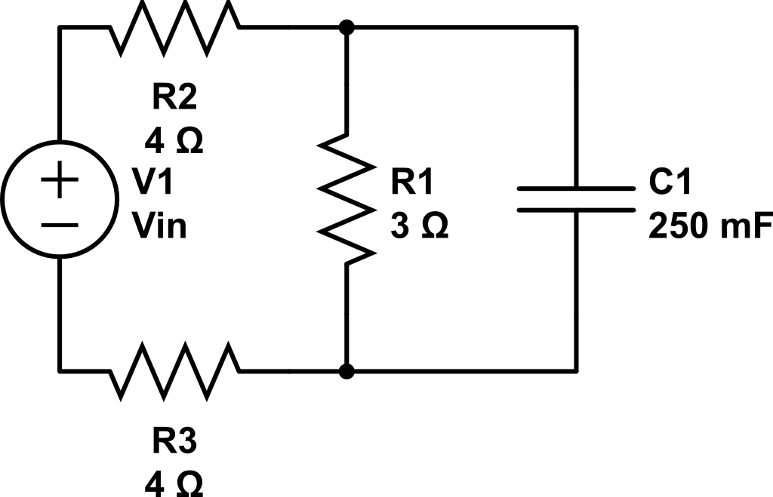
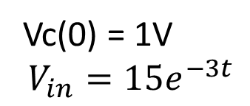
Find Vc
Vc(0) = 1V
$$V_{in}=15e^{−3t}$$

Slide 3
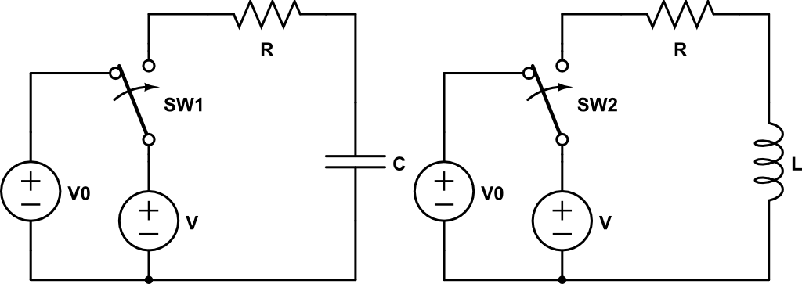
Initial/Final Value Approach
We basically already covered this

Slide 4
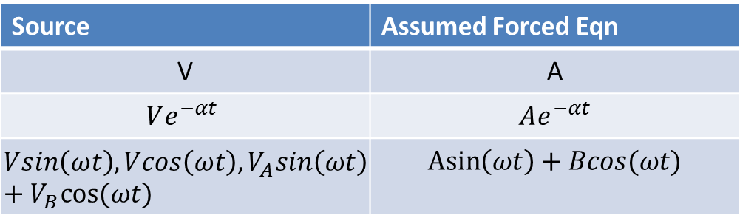

Forced Solution Summary
$$g\left(t\right)=g_{N}\left(t\right)+g_{F}(t)$$
Source | Assumed Forced Eqn
V | A
$$Ve^{−αt}$$ | $$Ae^{−αt}$$
$$Vsin\left(ωt\right), Vcos\left(ωt\right), V_{A}sin\left(ωt\right)+V_{B}cos⁡(ωt)$$ | $$\operatorname{Asin}\left(ωt\right)+Bcos(ωt)$$
Pick your assumed form of the eqn based on what your source is
Don’t change the frequency or time constant

Slide 5
Options
Method of Undetermined Coefficients
Separation of Variables
Integrating Factors
Initial/final value method

Slide 6
Backups

Slide 7
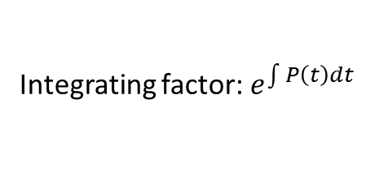



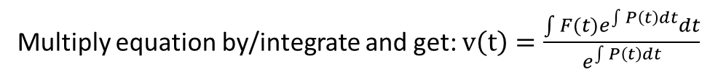
Integrating Factors
Need equations like: $\frac{∂v}{∂t}+P\left(t\right)v\left(t\right)=F(t)$
Integrating factor: $e^{\int{P\left(t\right)dt}}$
Multiply equation by/integrate and get: $v\left(t\right)=\frac{\int{{F(t)e}^{\int{P\left(t\right)dt}}dt}}{e^{\int{P\left(t\right)dt}}}$
Example: $\frac{∂v}{∂t}+10v=4e^{40t}$
Compare to: $\frac{∂v}{∂t}+P\left(t\right)v\left(t\right)=F(t)$
Make sure you read the handout on integrating factors!

Slide 8
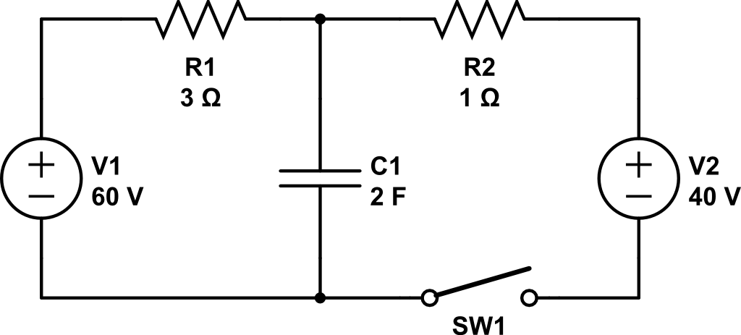

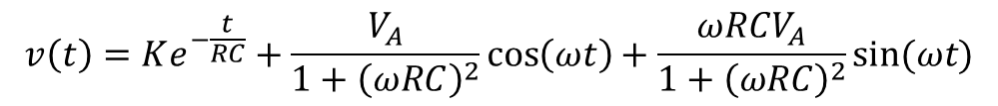
(one more sin ex) Find V_{c}
Finish up from last time
+
Vc
$$40cos\left(20t\right)V$$
-
$$v\left(t\right)=Ke^{−\frac{t}{RC}}+\frac{V_{A}}{1+{\left(ωRC\right)}^{2}}\cos\left(ωt\right)+\frac{{ωRCV}_{A}}{1+{\left(ωRC\right)}^{2}}sin⁡(ωt)$$
Full derivation, (7-26), p339

