Slide 1
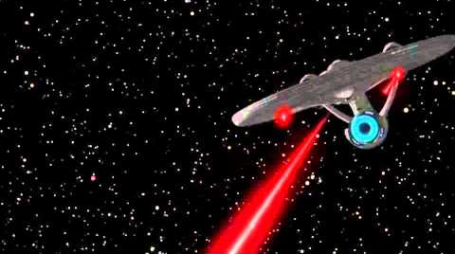
ECE231 Phasors and Impedance
Maj Kevin Walchko

Slide 2
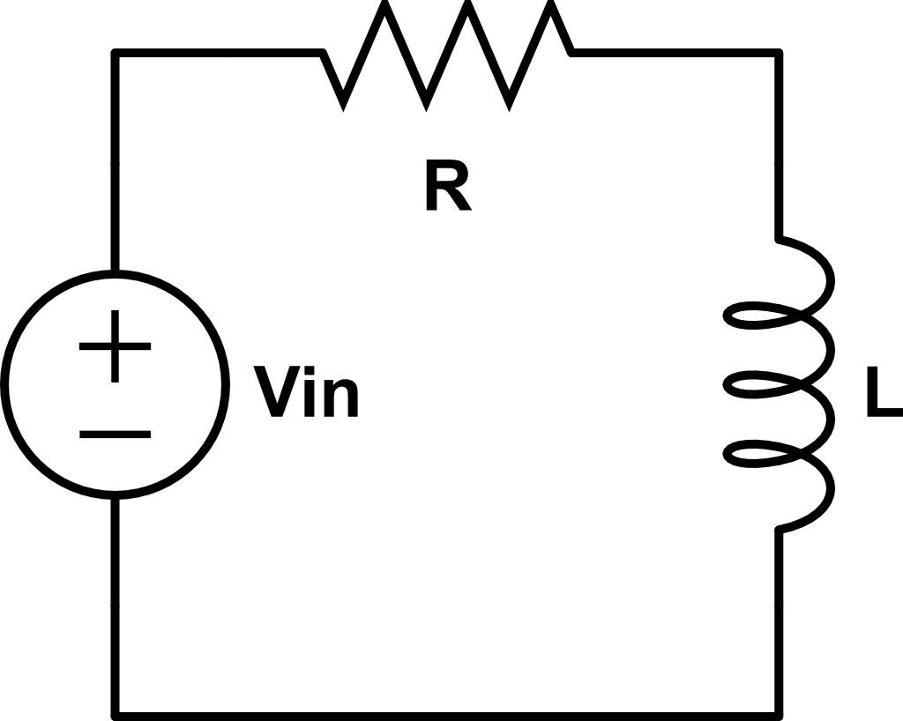

Steady State Analysis
t >> 0
$$V_{in}=V_{m}cos⁡(ωt+α)$$
Find i_{L}(∞)
This gets more complicated as we get more signals … need a better way

Slide 3

Complex Number Review
We can represent complex numbers a couple different ways:
Rectangular
Polar
Exponential
Im
$$a+jb$$
b
c
θ
a
Re

Slide 4
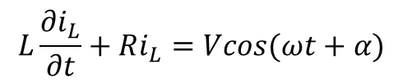



Phasors
$$L\frac{∂i_{L}}{∂t}+Ri_{L}=Vcos(ωt+α)$$
$$i_{Lss}=Icos(ωt+θ)$$
$$Vcos\left(ωt+α\right)=Re\left\{Ve^{j\left(ωt+α\right)}\right\}=Re\{Ve^{jα}e^{jωt}\}$$
$\tilde{V_{s}}=Ve^{jα}$ = $V∠α$
$$Vcos\left(ωt+α\right)=Re\{\tilde{V_{s}}e^{jωt}\}$$
projection
Complex number
Rotation, CCW

Slide 5

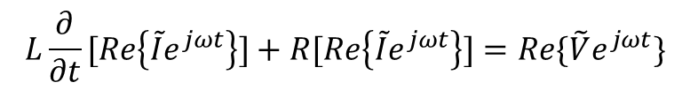
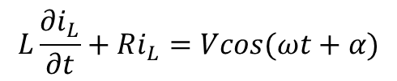
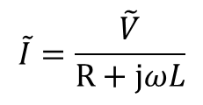

Use Phasors for Inductors
$$L\frac{∂i_{L}}{∂t}+Ri_{L}=Vcos(ωt+α)$$
$$L\frac{∂}{∂t}[Re\left\{\tilde{I}e^{jωt}\right\}]+R[Re\left\{\tilde{I}e^{jωt}\right\}]=Re\{\tilde{V}e^{jωt}\}$$
$$jωL\tilde{I}+R\tilde{I}−\tilde{V}=0$$
$$\tilde{I}=\frac{\tilde{V}}{R+jωL}$$
We have eliminated time and only have frequencies left

Slide 6

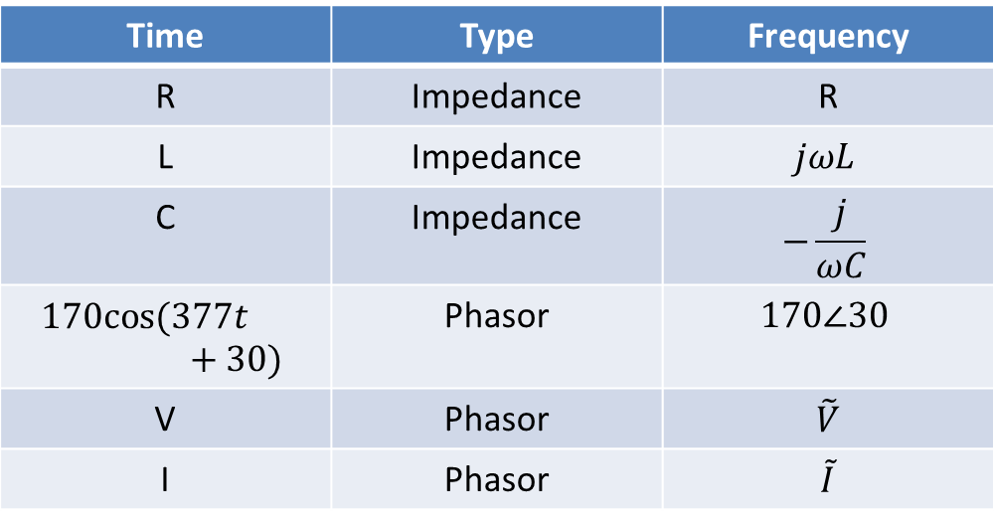
Time to Freq Domain
Turns out, we can use phasor math for all of our components
Time | Type | Frequency
R | Impedance | R
L | Impedance | $$jωL$$
C | Impedance | $$−\frac{j}{ωC}$$
$$170cos⁡(377t+30)$$ | Phasor | $$170∠30$$
V | Phasor | $\tilde{V}$
I | Phasor | $\tilde{I}$
Phasor:
$$\tilde{V_{s}}=Ve^{jα}=V∠α$$

Slide 7
Phasors
Phasors only apply to the Steady State domain where the input is a sinusoid
Impedance behave like resistors in serial and parallel
Impedances are not phasors
You can still use all of your tools:
Nodal
Mesh
Superposition

Slide 8



Again
$$Z_{R}$$
$$V∠α$$
$$Z_{L}$$

Slide 9
Backups

Slide 10
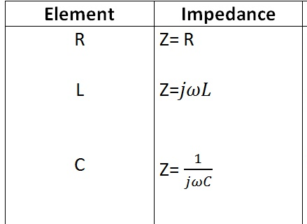
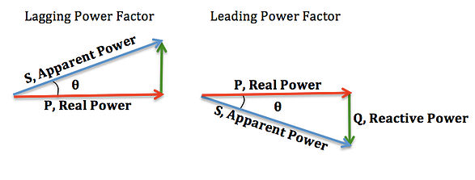

Phasors
Phasors only apply to the Steady State domain where the input is a sinusoid
Behave like resistors in serial and parallel
$$Z=R+jX$$
Always positive
(no negative resistors)
Can be + or -, where:
+ inductive (lag)
- capacitive (lead)

