Slide 1
ECE231 Phasors Circuit Analysis and Design I
Maj Kevin Walchko
Don’t wait until the last minute to get a calculator that can do phasors

Slide 2

Welcome back to Block I but with complex math!

Slide 3
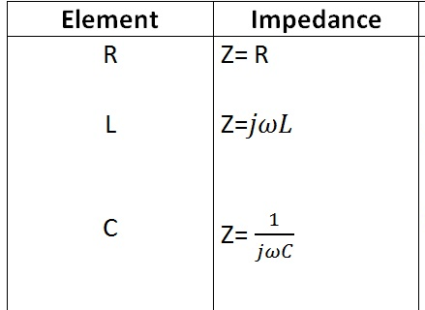
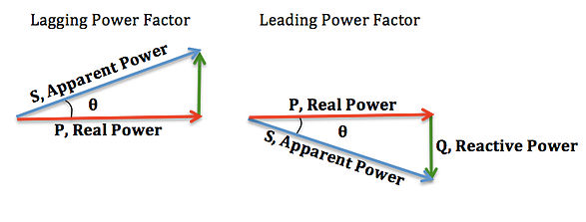

Phasors
Phasors only apply to the Steady State domain where the input is a sinusoid
Behave like resistors in serial and parallel
$$Z=R+jX$$
Always positive
(no negative resistors)
Can be + or -, where:
+ inductive (lag)
- capacitive (lead)

Slide 4


Phasors
$$Vcos\left(ωt+α\right)=Re\left\{Ve^{j\left(ωt+α\right)}\right\}=Re\{Ve^{jα}e^{jωt}\}$$
$$\tilde{V_{s}}=Ve^{jα}=V∠α$$
$$Vcos\left(ωt+α\right)=Re\{\tilde{V_{s}}e^{jωt}\}$$
projection
Complex number
Rotation, CCW

Slide 5

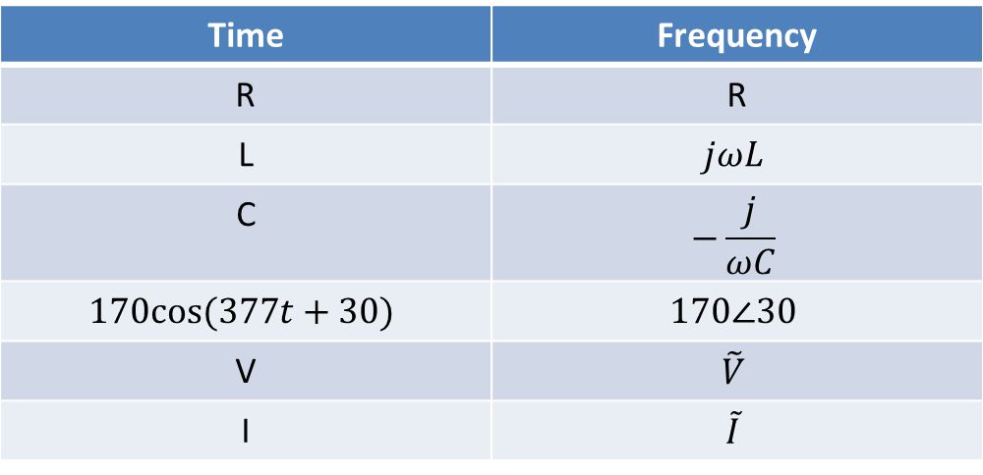
Time to Freq Domain
Time | Frequency
R | R
L | $$jωL$$
C | $$−\frac{j}{ωC}$$
$$170cos⁡(377t+30)$$ | $$170∠30$$
V | $$\tilde{V}$$
I | $$\tilde{I}$$
Where:
$$\tilde{V_{s}}=Ve^{jα}=V∠α$$

Slide 6
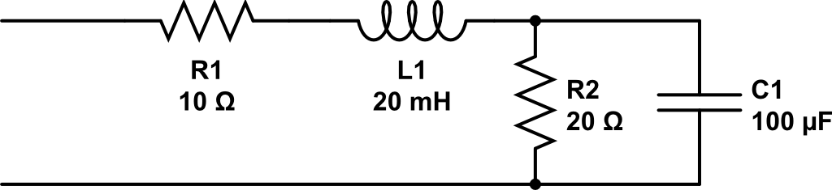

Find Z_{eq}
$$ω=2000$$

Slide 7
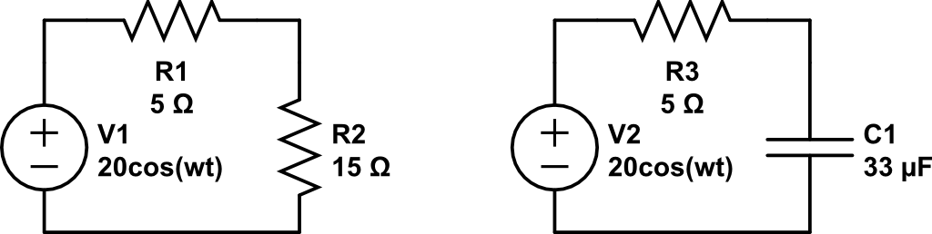

Find V_{out}
$$w=2000$$
V_{out}
V_{out}
You try this one

Slide 8
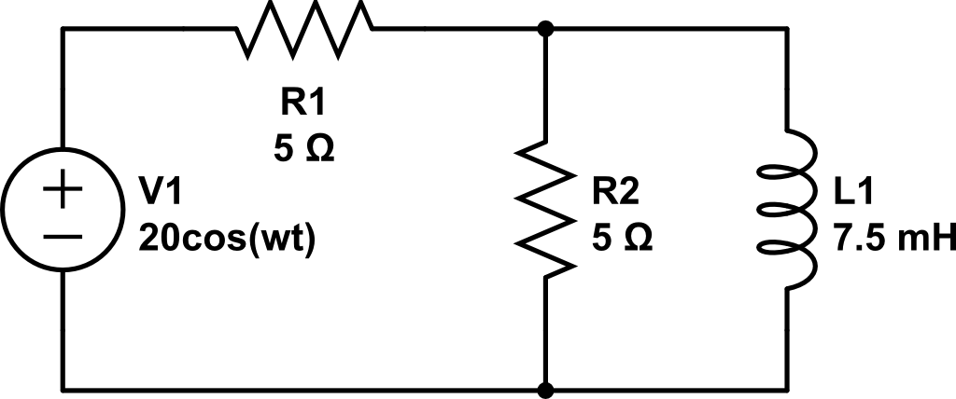
Find current through R1 and L1
$$w=2000$$

Slide 9
Use Nodal to find i_{L}
$$w=2000$$
A
B
Ground

Slide 10
Backups

Slide 11
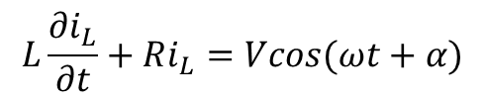



Phasors
$$L\frac{∂i_{L}}{∂t}+Ri_{L}=Vcos(ωt+α)$$
$$i_{Lss}=Icos(ωt+θ)$$
$$Vcos\left(ωt+α\right)=Re\left\{Ve^{j\left(ωt+α\right)}\right\}=Re\{Ve^{jα}e^{jωt}\}$$
$$\tilde{V_{s}}=Ve^{jα}=V<α$$
$$Vcos\left(ωt+α\right)=Re\{\tilde{V_{s}}e^{jωt}\}$$
projection
Complex number
Rotation, CCW

