Slide 1
ECE231 Basics
Maj Kevin Walchko

Slide 2
To Pass this class you must know:
Current division
Voltage division
Nodal analysis
Mesh analysis
Superposition
Thevenin analysis
We’ll talk about this today

Slide 3
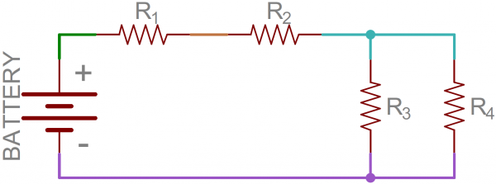
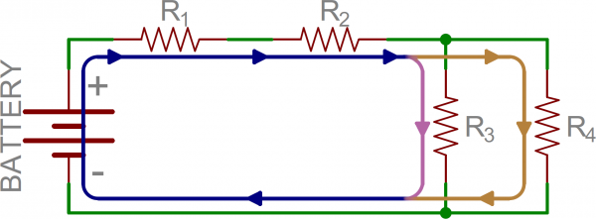
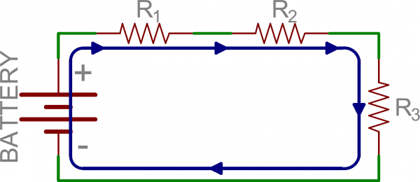
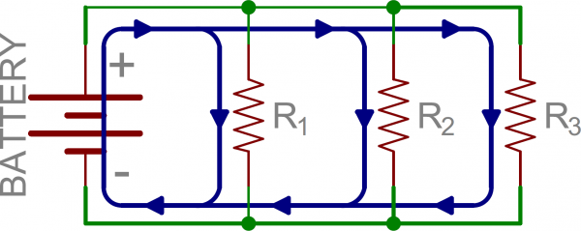


Equivalent Circuits
Given the following circuit, there are multiple nodes and meshes which need to be calculated to determine the current flow through the circuit. However, we can simplify this with the idea of equivalent resistors.
Series (all see the same current)
a node is connect to 1
component
Parallel (all see the same voltage drop)
a node is connected to multiple
components
(this only applies to 2 resistors)

Slide 4
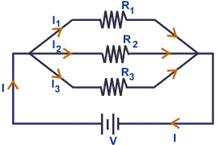
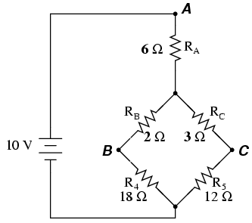
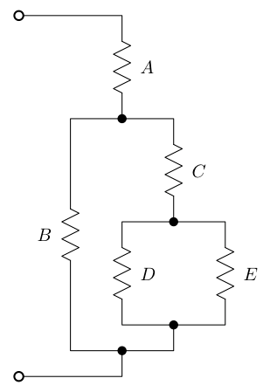
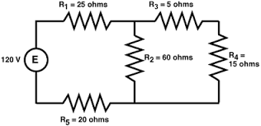
Which Resistors are in Parallel or Series?

Slide 5
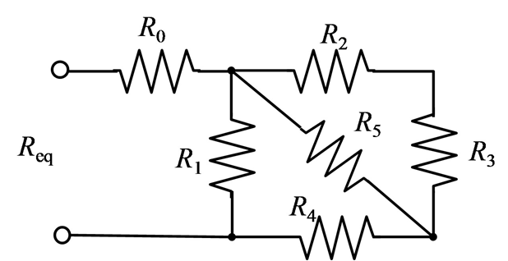
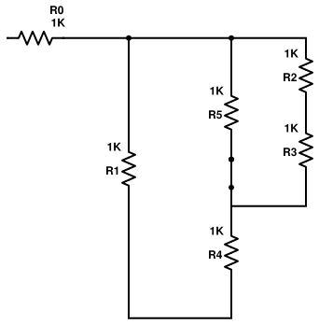
Example
Redraw
Series: Eq1 = R2 & R3
Parallel: Eq2 = R5 & Eq1
Series: Eq3 = R4 & Eq2
Parallel: Eq4 = R1 & Eq3
Series: R0 & Eq4

Slide 6
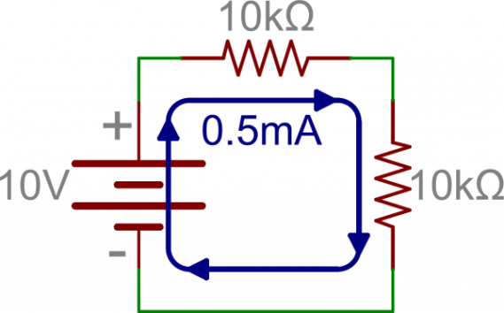
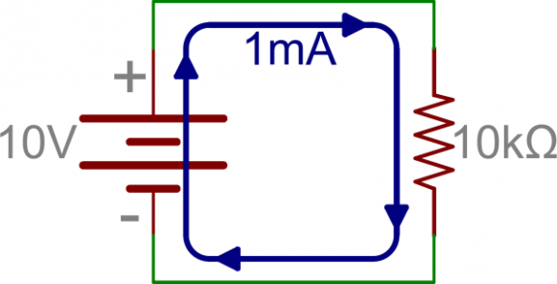
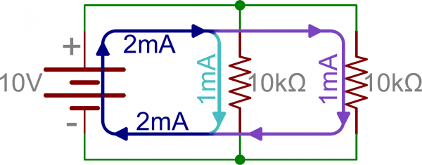
Equivalent Resistance
1. Original
2. Series
3. Parallel
I = V/R
I = 10 V / 10 kΩ
I = 1 mA
P = IV
P = 1 mA * 10 V
P = 10 mW
I = V / R
I = 10 V / ( 10 kΩ + 10 kΩ)
I = 0.5 mA
P = 0.5 mA * 10 V = 5 mW
I = V / R_{eq}
I = 10 V / (100/(10 + 10) kΩ)
I = 10 V / 5 kΩ
I = 2 mA
P = 2 mA * 10 V = 20 mW
For #2 , the added resistor increased the difficulty for current to flow through the circuit loop, thus increasing the resistance proportionally. Higher resistance means less current and lower power consumption.
For #3, notice the R_{eq} is less than the smallest R value. Thus, less resistance means more current flow and power consumption.
Weapon systems tend to connect payloads in parallel … why?

Slide 7
Current/Voltage Division
Voltage Division (series)
Current Division (parallel)
R₁
R₁
R₂
R₂
What is the current across R₂?
I₂ = 10 kΩ / 20 kΩ * 2 mA
I₂ = 1 mA
What is the voltage drop across R₂?
V₂ = 10 kΩ / 20 kΩ * 10 V
V₂ = 5 V
This equation is possible because all resistors in parallel see the same voltage drop, thus,
I₂*R₂ = I_{s}*R_{eq} -> I₂= R_{eq}/R₂*I_{s} = R₁/R_{sum}*I_{s}
Note: The R₂ cancel
This equation is possible because all resistors in series see the same current, thus, V₂/R₂ = V_{s}/R_{eq} = V_{s}/R_{sum}

Slide 8
KVL
Voltage rise and drops are 0 around a mesh
A
+
-
1
B
C
+
-
+
15V
-
D
+
2
E
+
3
F
5V
10V
+
-
-
-

Slide 9
Backups

