Slide 1
ECE231 Phasors Circuit Analysis and Design II
Maj Kevin Walchko
Don’t wait until the last minute to get a calculator that can do phasors

Slide 2
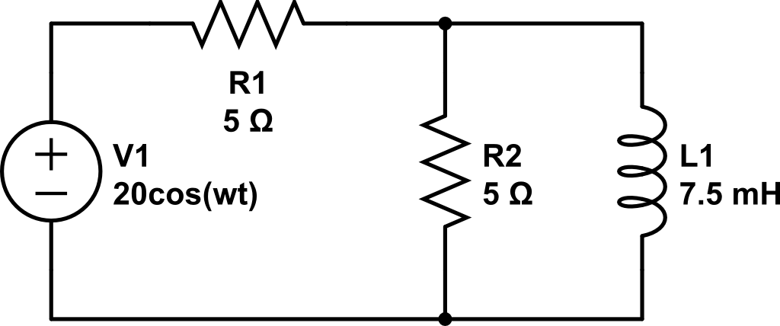

Find current through R1 and L1
$$w=2000$$
From Last time

Slide 3
Use Nodal to find i_{L}
Hint: it should be the same answer as the last slide!
$$w=2000$$
A
B
Ground
From Last time

Slide 4
Quiz Next Week
We have covered everything you need for the quiz next week
Hint: make sure you remember Thevenin

Slide 5
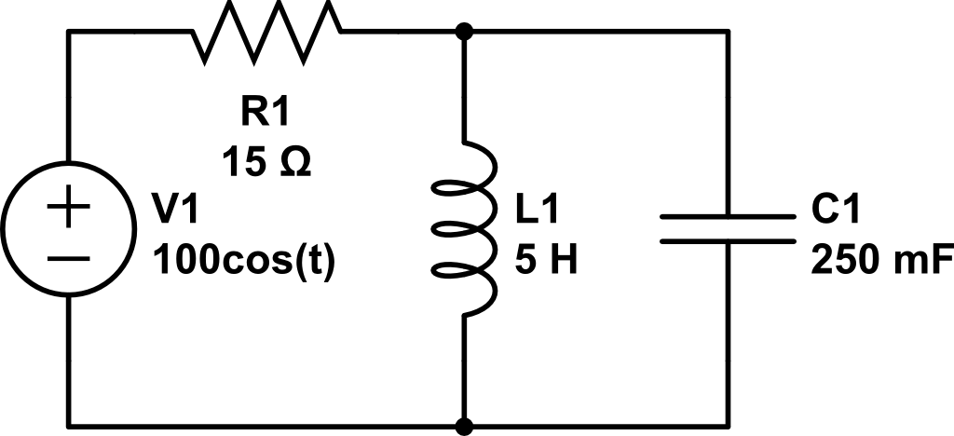
Use Current Div to find i_{L}(t)
Anything strange about this current divider solution???

Slide 6
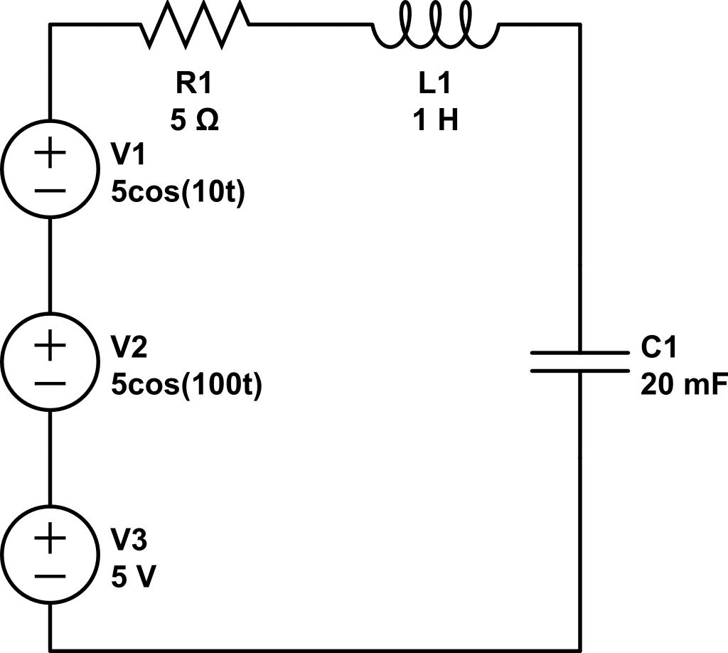
Find V_{out}(t)
+
w = 10
w = 100
V_{out}
Not AC
This is a mixture of AC/DC and frequencies!!!
-

Slide 7
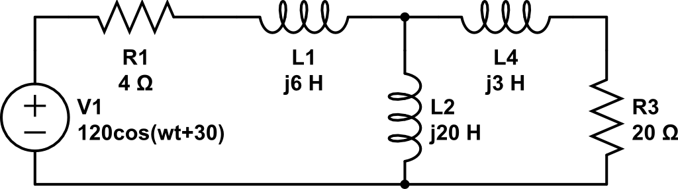
Find V_{out} using Nodal
A
Combine
B
C
+
V_{out}
-
Ground

Slide 8
Backups

Slide 9


Phasors
$$Vcos\left(ωt+α\right)=Re\left\{Ve^{j\left(ωt+α\right)}\right\}=Re\{Ve^{jα}e^{jωt}\}$$
$$\tilde{V_{s}}=Ve^{jα}=V<α$$
$$Vcos\left(ωt+α\right)=Re\{\tilde{V_{s}}e^{jωt}\}$$
projection
Complex number
Rotation, CCW

Slide 10
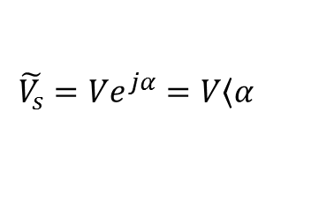
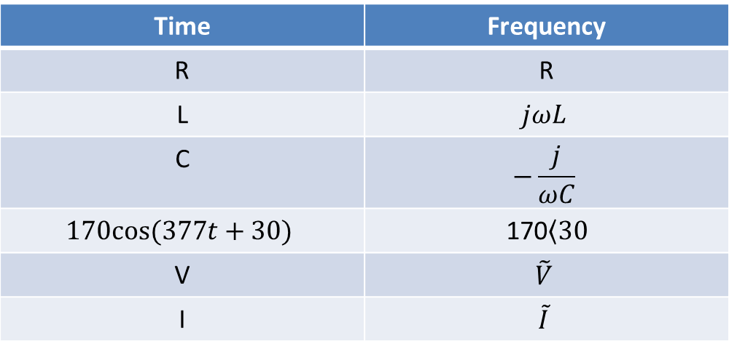
Time to Freq Domain
Time | Frequency
R | R
L | $$jωL$$
C | $$−\frac{j}{ωC}$$
$$170cos⁡(377t+30)$$ | 170$\left\langle 30\right.$
V | $$\tilde{V}$$
I | $$\tilde{I}$$
Where:
$$\tilde{V_{s}}=Ve^{jα}=V\left\langle α\right.$$

