Slide 1
ECE231 Instantaneous Power and Max Power
Maj Kevin Walchko
Don’t wait until the last minute to get a calculator that can do phasors

Slide 2
Quiz Next Week
We have covered everything you need for the quiz next week
Hint: make sure you remember Thevenin
Slide from lesson 30 last week … you will see this again!

Slide 3
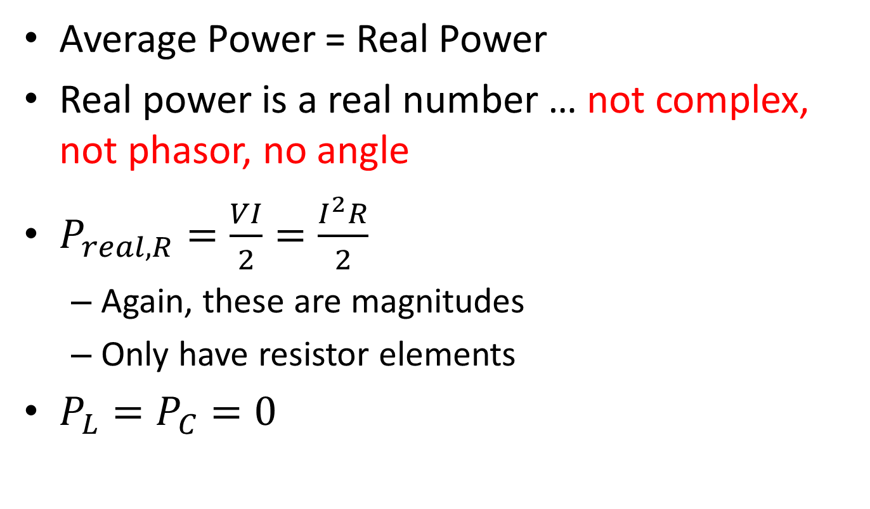
Summary
Average Power = Real Power
Real power is a real number … not complex, not phasor, no angle
$P_{real, R}=\frac{VI}{2}=\frac{I^{2}R}{2}$
Again, these are magnitudes
Only have resistor elements
$P_{L}=P_{C}=0$

Slide 4
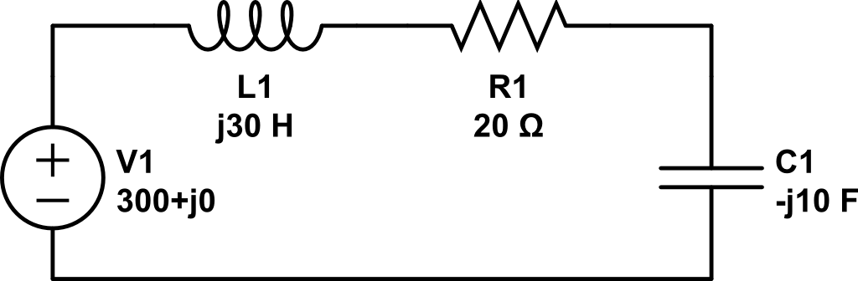

Find the real power
$$\tilde{I}$$

Slide 5
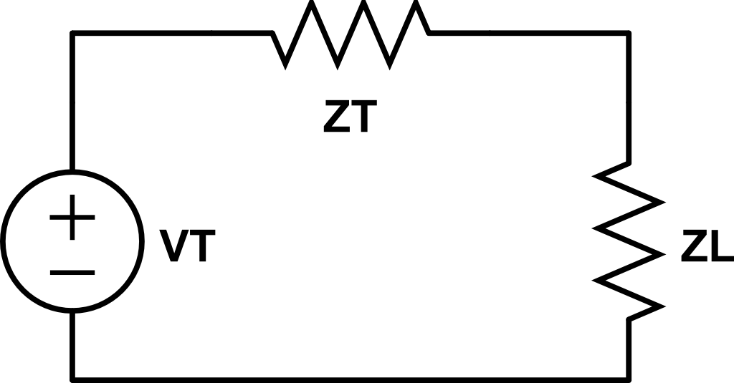
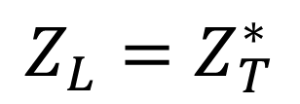
Max Power Transfer
Amp
source
load
What is a good process to find max power transfer?
How did we find max power transfer before?
$$Z_{L}=Z_{T}^{∗}$$

Slide 6
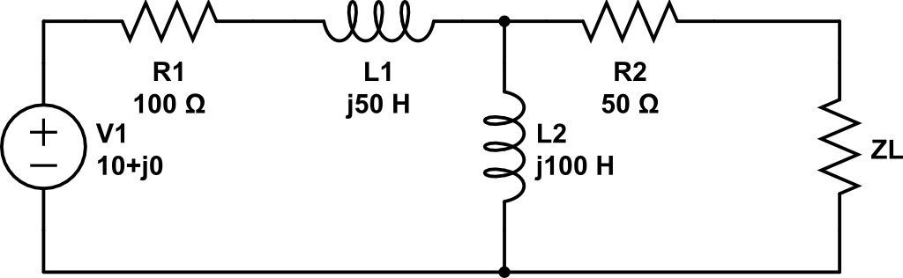
Find Z_{L} for max power transfer and real power of the load

Slide 7
Find Z_{L} for max power transfer and real power of the load
DMM
Z_{T}

Slide 8
Find Z_{L} for max power transfer and real power of the load
DMM
V_{T}

Slide 9
Find Z_{L} for max power transfer and real power of the load

Slide 10
Backups

Slide 11


Phasors
$$Vcos\left(ωt+α\right)=Re\left\{Ve^{j\left(ωt+α\right)}\right\}=Re\{Ve^{jα}e^{jωt}\}$$
$$\tilde{V_{s}}=Ve^{jα}=V<α$$
$$Vcos\left(ωt+α\right)=Re\{\tilde{V_{s}}e^{jωt}\}$$
projection
Complex number
Rotation, CCW

Slide 12
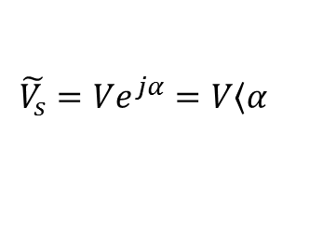
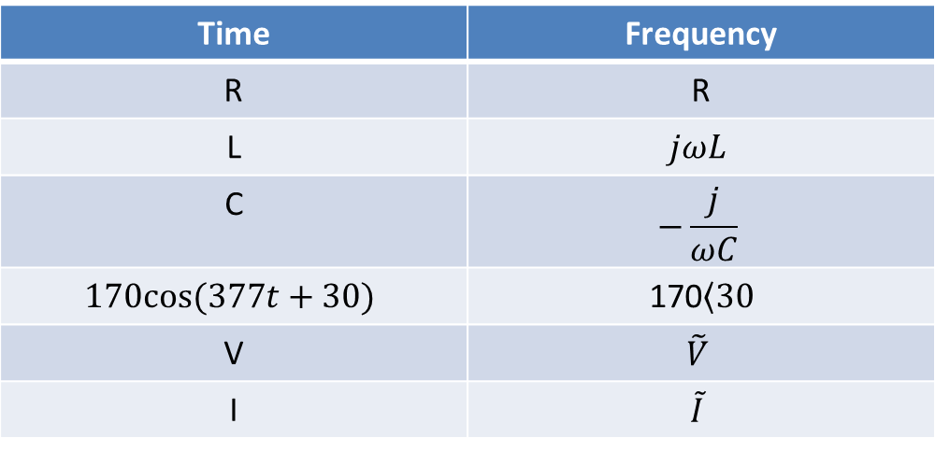
Time to Freq Domain
Time | Frequency
R | R
L | $$jωL$$
C | $$−\frac{j}{ωC}$$
$$170cos⁡(377t+30)$$ | 170$\left\langle 30\right.$
V | $$\tilde{V}$$
I | $$\tilde{I}$$
Where:
$$\tilde{V_{s}}=Ve^{jα}=V\left\langle α\right.$$

