Slide 1
ECE231 Filters II: Ideal Filters, LPF, HPF
Maj Kevin Walchko
Don’t wait until the last minute to get a calculator that can do phasors

Slide 2
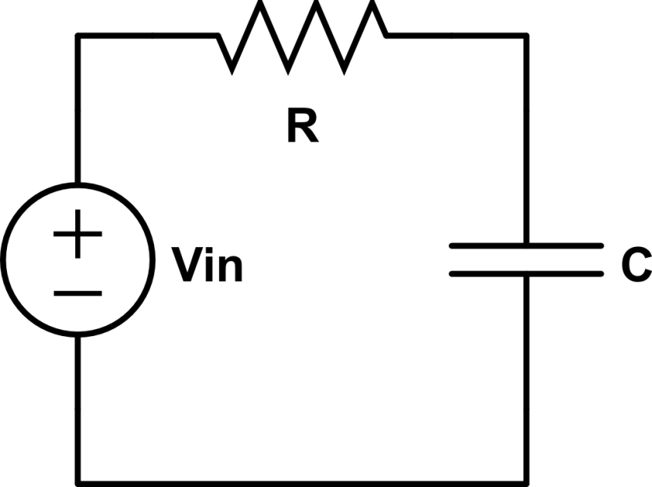
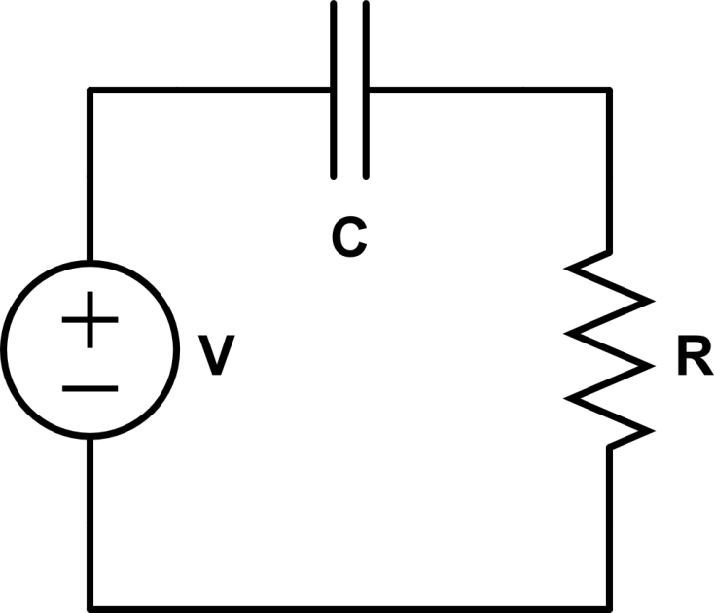
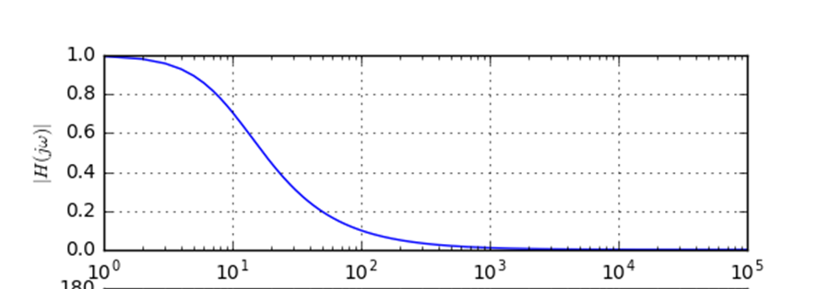




Intro/Review
We are going to focus on “single pole” active (op amp) filters and passive filters
ECE 332 will go into more advanced/higher order filters if you are interested
$$\frac{1}{jωC}$$
$$\frac{1}{jωC}$$
$$V_{out}$$
$$V_{out}$$
Low Pass Filter
High Pass Filter
Low Pass Filter
Are these Active or Passive filters?

Slide 3
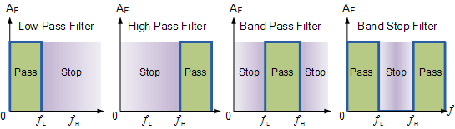
Ideal (ECE315) Filters
1. Low Pass Filter – only allows low frequency signals from 0Hz to its cut-off frequency (ƒc) point to pass while blocking those any higher.
2. High Pass Filter – only allows high frequency signals from its cut-off frequency (fc) point and higher to infinity to pass through while blocking those any lower.
3. Band Pass Filter – allows signals falling within a certain frequency band setup between two points to pass through while blocking both the lower and higher frequencies either side of this frequency band.
4. Band Stop Filter – allows signals outside of a band to pass will stopping signals within a band.

Slide 4

What is the output?
5
Pass Band
$$V_{in}=2\cos\left(2t\right)+4\cos\left(8t\right)+6\cos\left(15t\right)+8cos⁡(20t)$$
$$ω_{c}=10 Hz$$
$$V_{out}=5∗2\cos\left(2t\right)+5∗4\cos\left(8t\right)$$

Slide 5
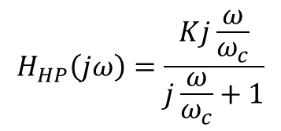
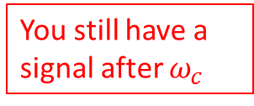
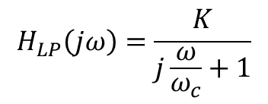


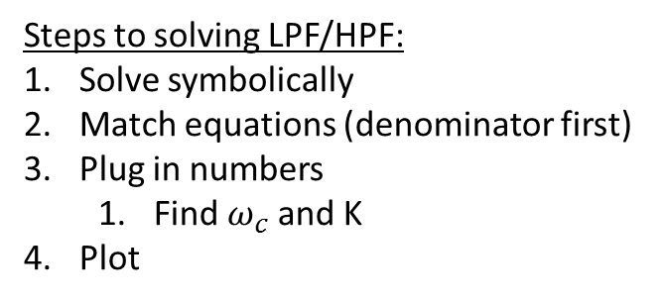
Real (ECE231) LPF & HPF TF
$$H_{LP}\left(jω\right)=\frac{K}{j\frac{ω}{ω_{c}}+1}$$
$$H_{HP}\left(jω\right)=\frac{Kj\frac{ω}{ω_{c}}}{j\frac{ω}{ω_{c}}+1}$$
K
K*0.707
Pass band
Pass band
$$ω_{c}$$
$$ω_{c}$$
You still have a signal after $ω_{c}$
Steps to solving LPF/HPF:
Solve symbolically
Match equations (denominator first)
Plug in numbers
Find $ω_{c}$ and K
Plot
Non-ideal

Slide 6
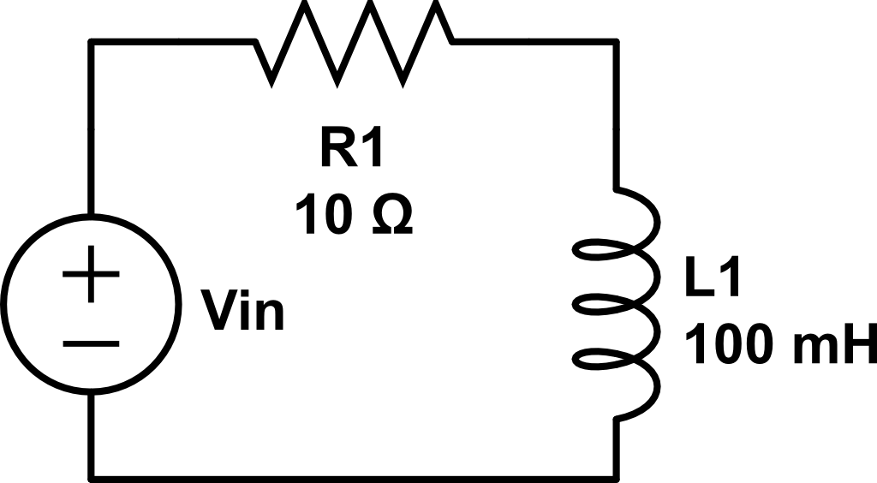

Determine Filter Type and Plot
Active or passive filter?
$$V_{out}$$

Slide 7
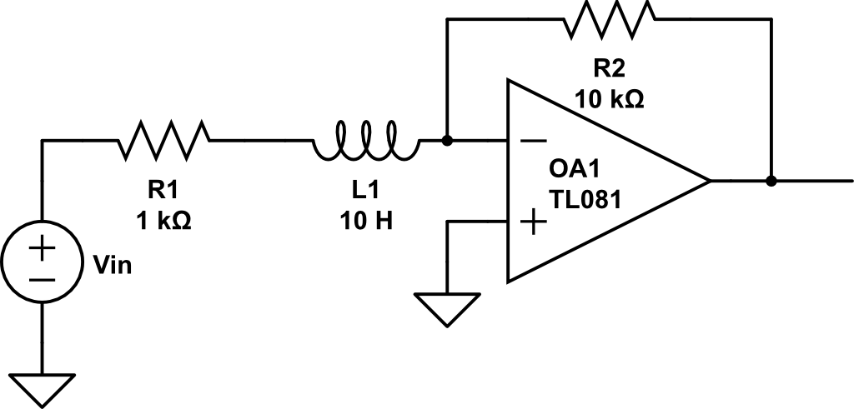

Determine Filter and Plot
$$V_{out}$$

Slide 8
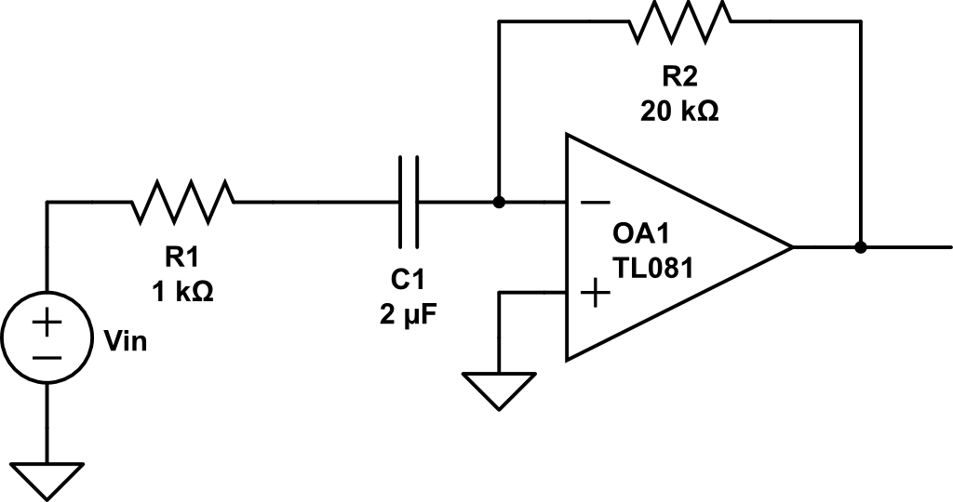

Determine Filter and Plot
$$V_{out}$$

Slide 9
Backups

Slide 10
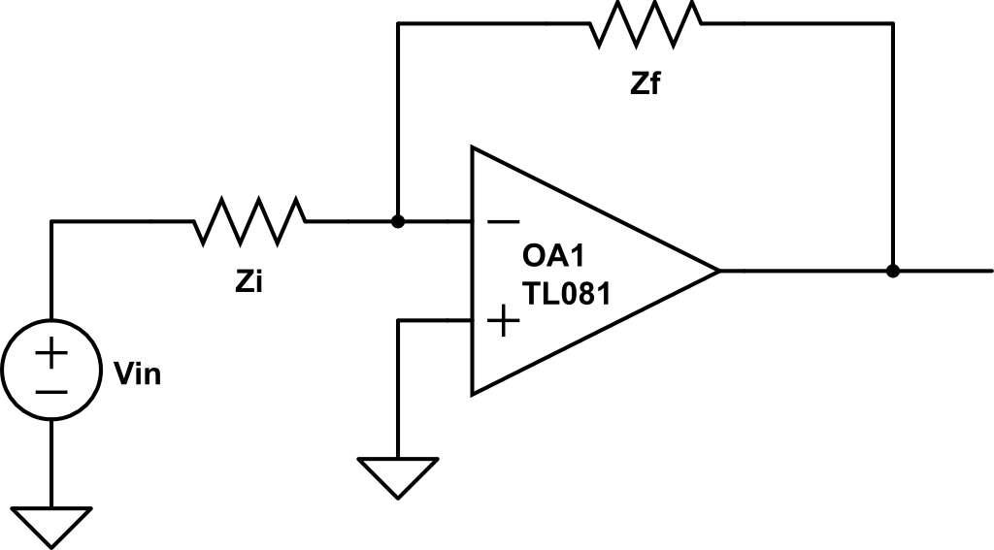


Active Filter
$$V_{out}$$
$${\tilde{V}}_{out}=−\frac{Z_{f}}{Z_{i}}{\tilde{V}}_{in}$$

Slide 11
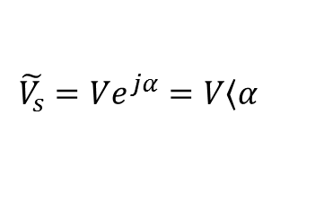
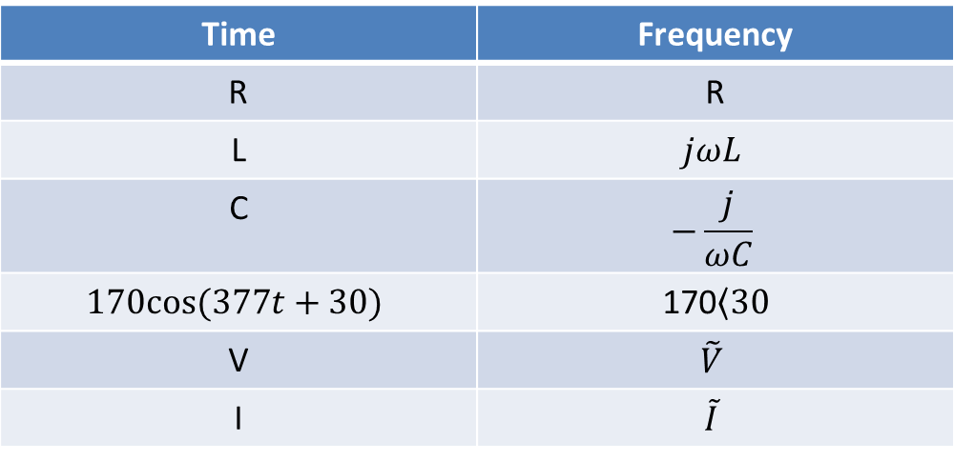
Time to Freq Domain
Time | Frequency
R | R
L | $$jωL$$
C | $$−\frac{j}{ωC}$$
$$170cos⁡(377t+30)$$ | 170$\left\langle 30\right.$
V | $$\tilde{V}$$
I | $$\tilde{I}$$
Where:
$$\tilde{V_{s}}=Ve^{jα}=V\left\langle α\right.$$

Slide 12
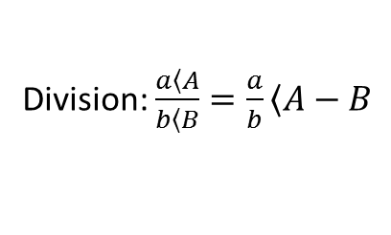
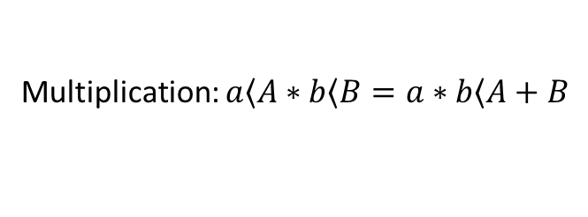
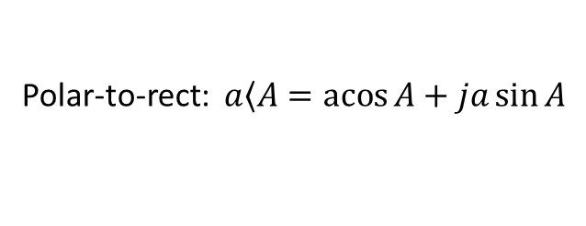
Review
Math:
Multiplication: $a\left\langle A\right.∗b\left\langle B\right.=a∗b\left\langle A+B\right.$
Division: $\frac{a\left\langle A\right.}{b\left\langle B\right.}=\frac{a}{b}\left\langle A−B\right.$
Add/subtract: polar -> rectangular -> polar
Conversions:
Polar-to-rect: $a\left\langle A\right.=\operatorname{acos}{A}+ja\sin{A}$
Rect-to-polar: $a+jb →mag=\sqrt{a^{2}+b^{2}} angle=\operatorname{atan}{\frac{b}{a}}$
Get a good calculator or know how to use Matlab

Slide 13
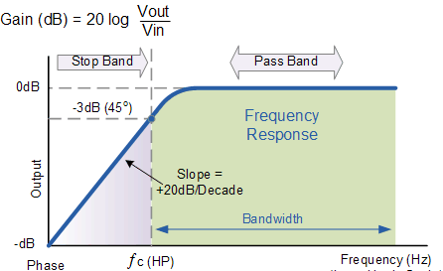
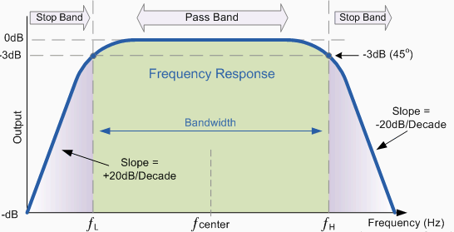
Other types
High Pass
Band Pass

Slide 14
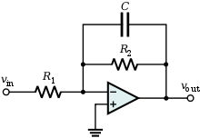
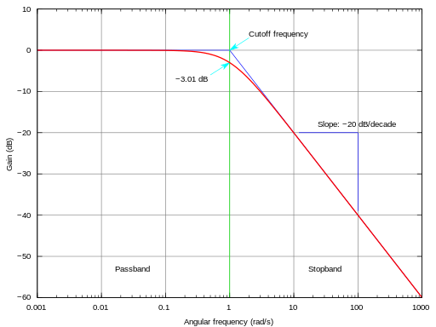
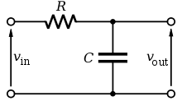
Can be done different ways
Active
Passive

