Slide 1
ECE231 Filters IV: Review and Filter Design
Maj Kevin Walchko
Don’t wait until the last minute to get a calculator that can do phasors

Slide 2
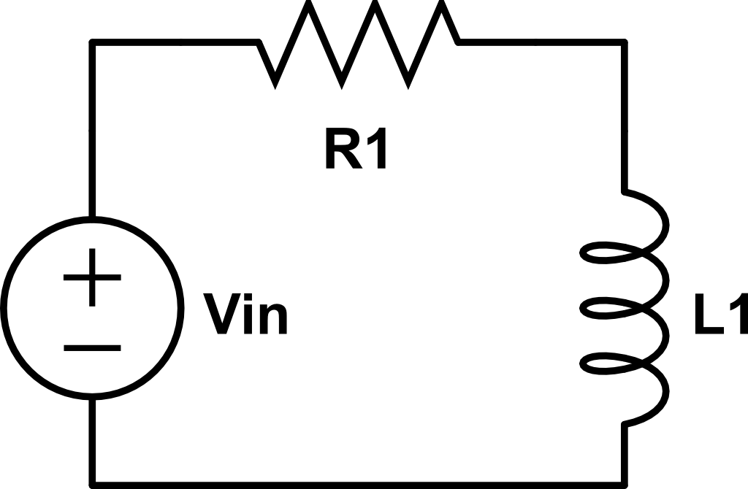
Example
Find the transfer function, determine the filter type, and sketch the magnitude response
V_{out}

Slide 3
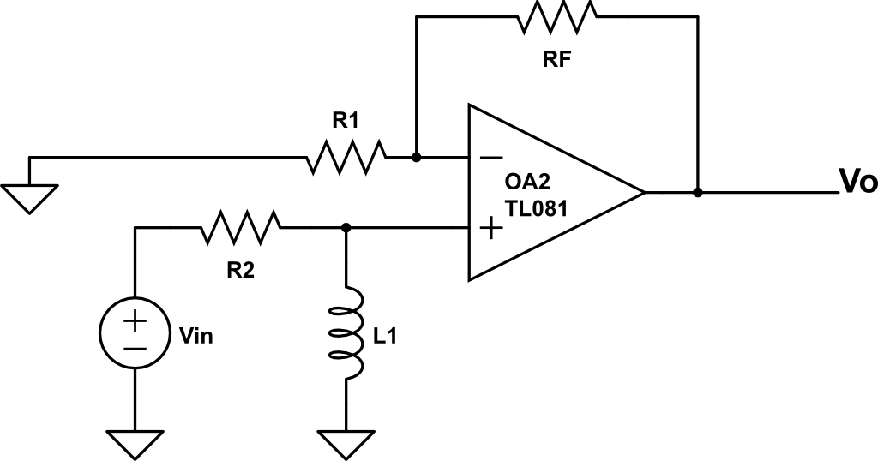
Example
Find the transfer function, determine the filter type, and sketch the magnitude response

Slide 4
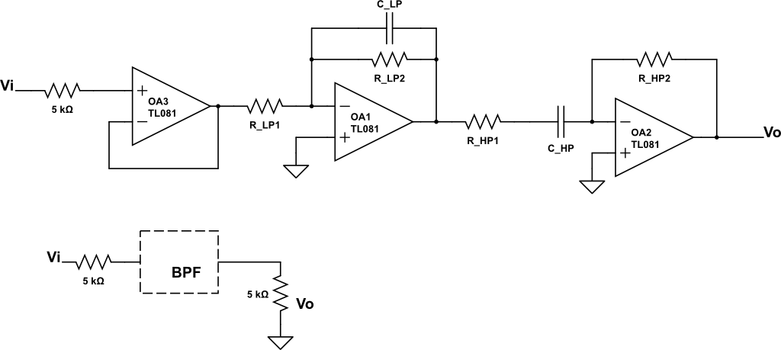

Example
Design a BPF with a pass band of $500≤ω≤200k\frac{rad}{s}$ and a gain of 5. Use active filters. Use $R≥1k Ω$ and $C≤1 μF$

Slide 5
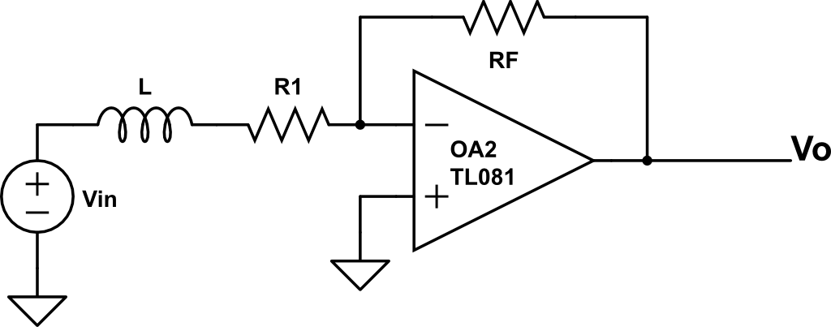
Board Problem
Find the transfer function, determine the filter type, and sketch the magnitude response

Slide 6
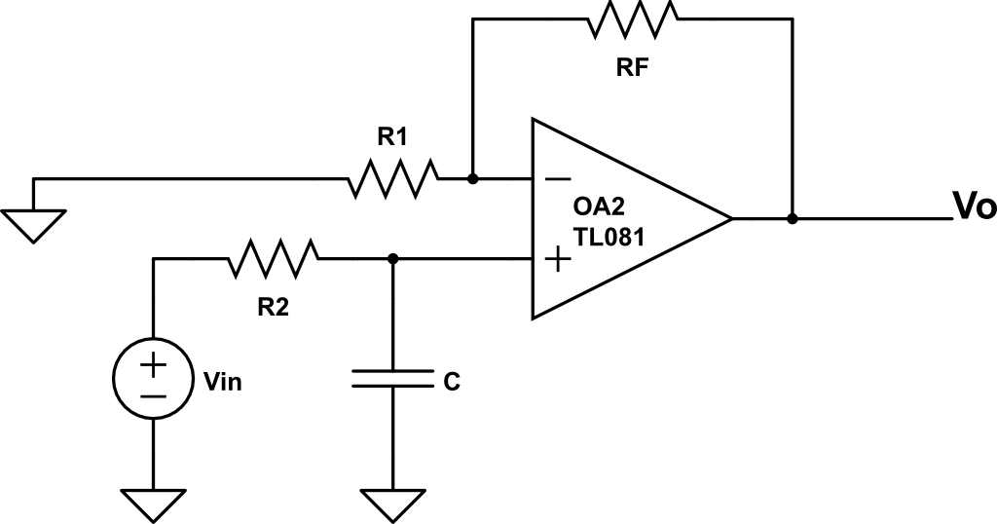
Board Problem
Find the transfer function, determine the filter type, and sketch the magnitude response

Slide 7
Backups

Slide 8
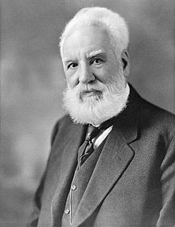
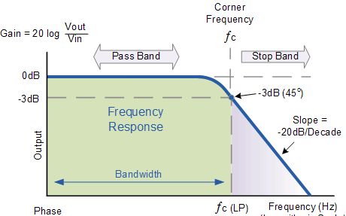
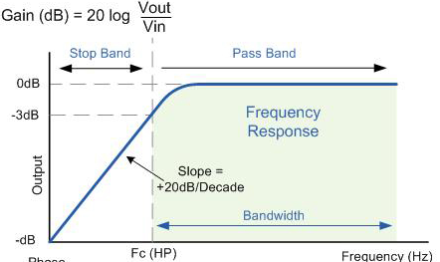

Decibel (dB)
In 1928, Bell Labs began using the decibel (1/10 of a bel) as the unit of power loss for telegraph/telephone circuits. Named in honor of Alexander Graham Bell, who was awarded the patent for the telephone in 1876.
$${|H}_{dB}|=20\log_{10}{|H\left(jω\right)|}$$
1847 - 1922

Slide 9
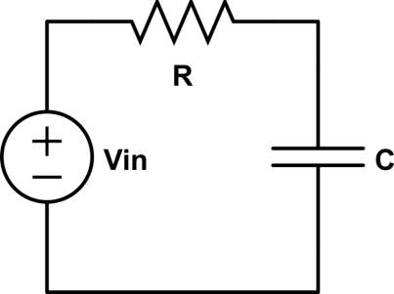
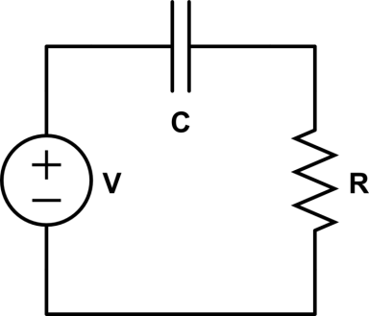
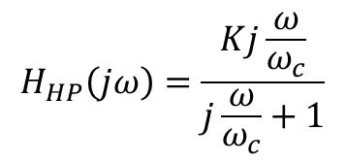
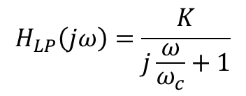
LPF/HPF Eqn Sheet Review
Low Pass Filter
High Pass Filter
$$H_{LP}\left(jω\right)=\frac{K}{j\frac{ω}{ω_{c}}+1}$$
$$H_{HP}\left(jω\right)=\frac{Kj\frac{ω}{ω_{c}}}{j\frac{ω}{ω_{c}}+1}$$

Slide 10






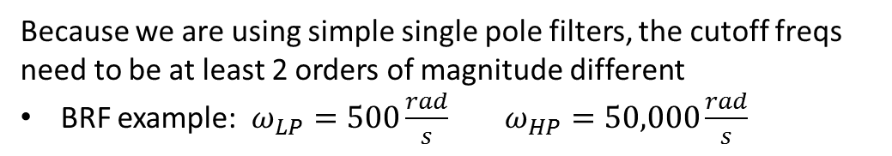


Ideal BPF & BRF
BPF
Vi
LPF
HPF
Vo
Pass band
Serial
$$ω_{HP}$$
$$ω_{LP}$$
$$ω_{HP}$$
$$ω_{LP}$$
BRF
LPF
Vo
Stop
band
Vi
HPF
$$ω_{LP}$$
$$ω_{HP}$$
$$ω_{LP}$$
$$ω_{HP}$$
Parallel
Because we are using simple single pole filters, the cutoff freqs need to be at least 2 orders of magnitude different
BRF example: $ω_{LP}=500\frac{rad}{s} ω_{HP}=50,000\frac{rad}{s}$
What do you think the real (231) filter diagrams look like?

Slide 11
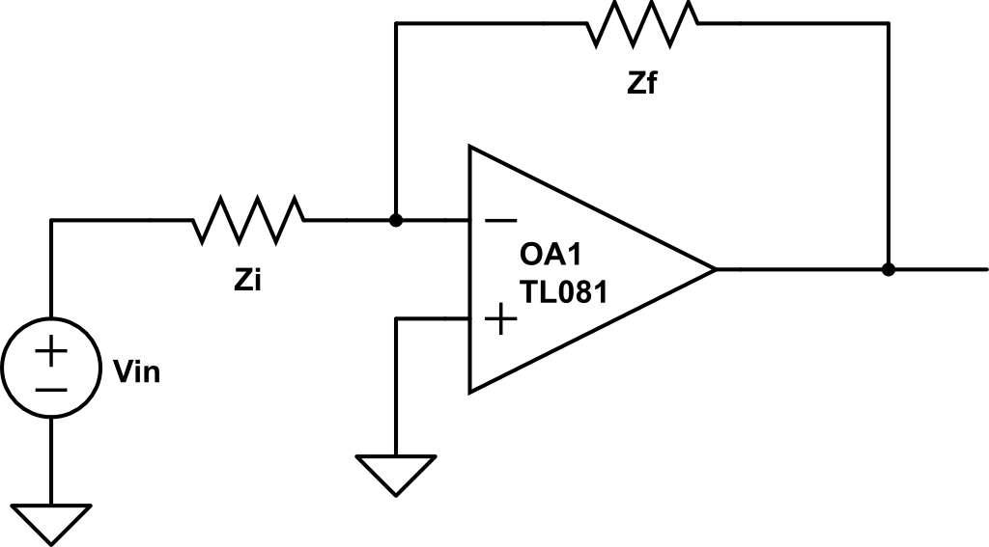


Active Filter
$$V_{out}$$
$${\tilde{V}}_{out}=−\frac{Z_{f}}{Z_{i}}{\tilde{V}}_{in}$$

Slide 12
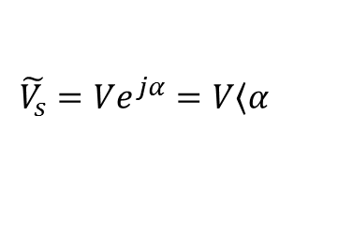
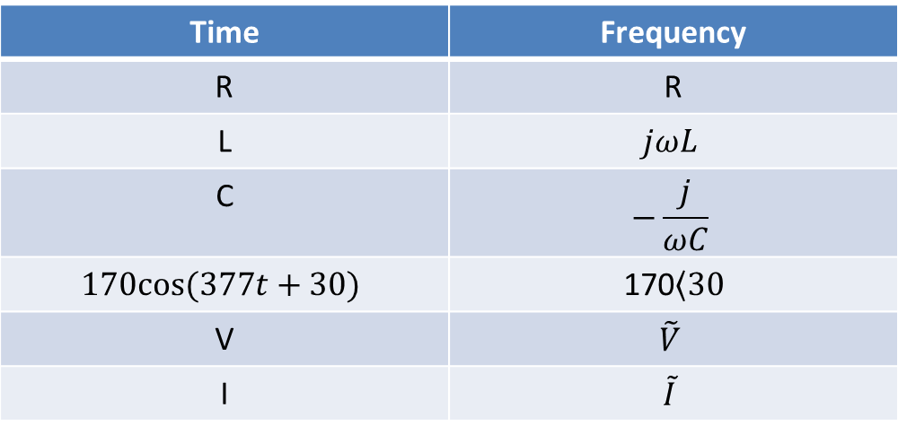
Time to Freq Domain
Time | Frequency
R | R
L | $$jωL$$
C | $$−\frac{j}{ωC}$$
$$170cos⁡(377t+30)$$ | 170$\left\langle 30\right.$
V | $$\tilde{V}$$
I | $$\tilde{I}$$
Where:
$$\tilde{V_{s}}=Ve^{jα}=V\left\langle α\right.$$

Slide 13
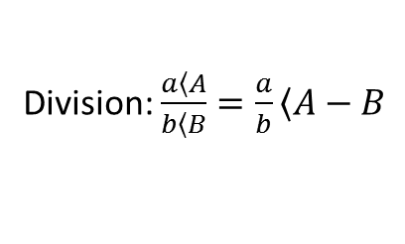
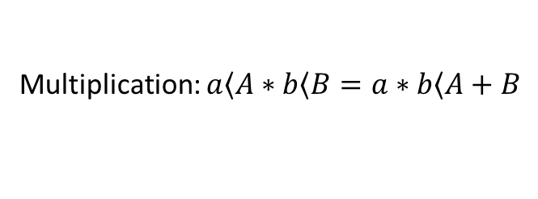
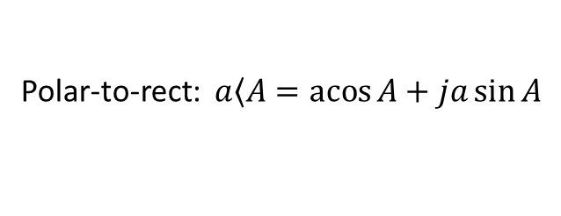
Review
Math:
Multiplication: $a\left\langle A\right.∗b\left\langle B\right.=a∗b\left\langle A+B\right.$
Division: $\frac{a\left\langle A\right.}{b\left\langle B\right.}=\frac{a}{b}\left\langle A−B\right.$
Add/subtract: polar -> rectangular -> polar
Conversions:
Polar-to-rect: $a\left\langle A\right.=\operatorname{acos}{A}+ja\sin{A}$
Rect-to-polar: $a+jb →mag=\sqrt{a^{2}+b^{2}} angle=\operatorname{atan}{\frac{b}{a}}$
Get a good calculator or know how to use Matlab

Slide 14
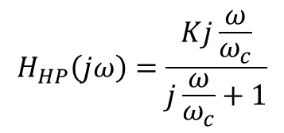
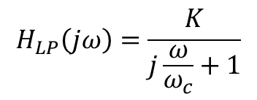


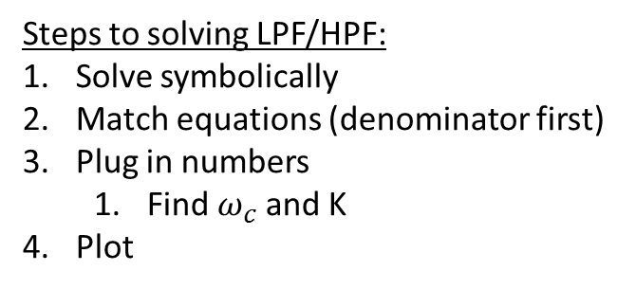
Real (ECE231) LPF & HPF TF
$$H_{LP}\left(jω\right)=\frac{K}{j\frac{ω}{ω_{c}}+1}$$
$$H_{HP}\left(jω\right)=\frac{Kj\frac{ω}{ω_{c}}}{j\frac{ω}{ω_{c}}+1}$$
K
K*0.707
Pass band
Pass band
$$ω_{c}$$
$$ω_{c}$$
Steps to solving LPF/HPF:
Solve symbolically
Match equations (denominator first)
Plug in numbers
Find $ω_{c}$ and K
Plot

Slide 15
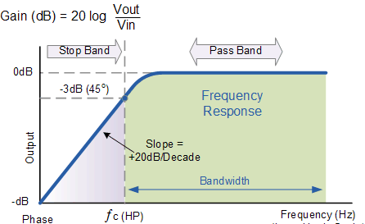
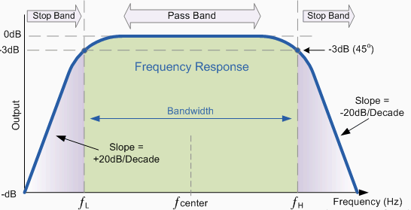
Other types
High Pass
Band Pass

Slide 16
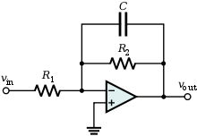
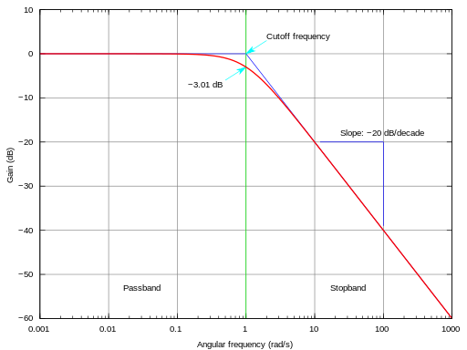
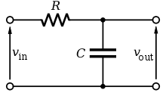
Can be done different ways
Active
Passive

