Slide 1
ECE231 Voltage/Current Division
Maj Kevin Walchko

Slide 2
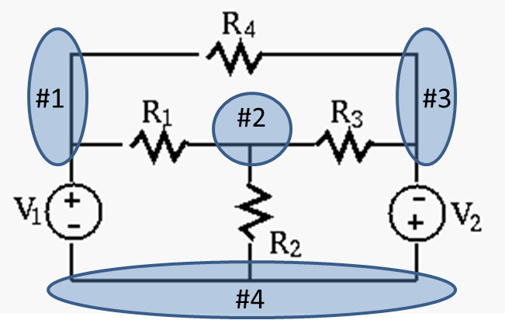
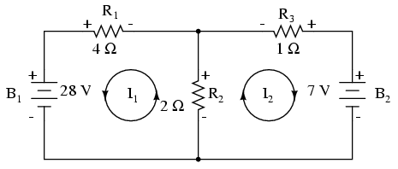
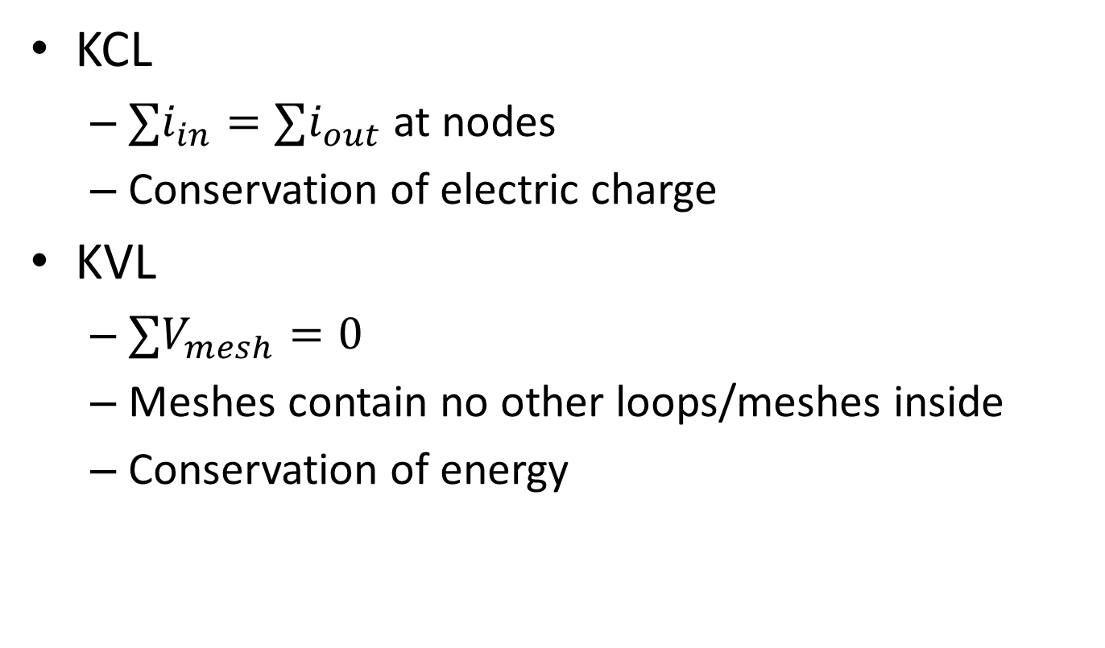
Review Kirchhoff's Laws
KCL
$∑i_{in}=∑i_{out}$ at nodes
Conservation of electric charge
KVL
$∑V_{mesh}=0$
Meshes contain no other loops/meshes inside
Conservation of energy

Slide 3
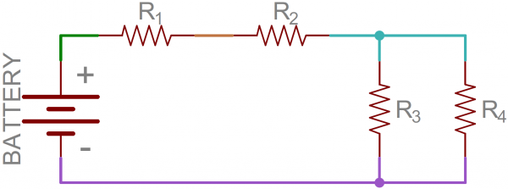
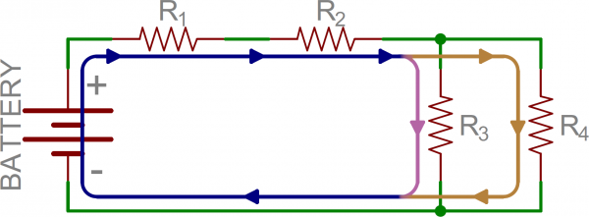
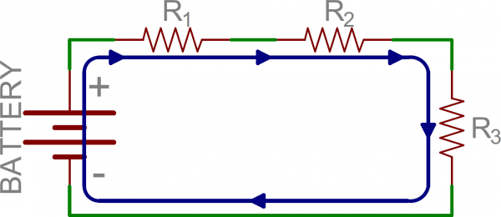
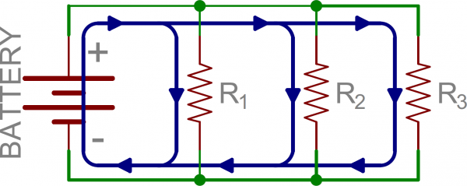


Review Equivalent Circuits
Given the following circuit, there are multiple nodes and loops which need to be calculated to determine the current flow through the circuit. However, we can simplify this with the idea of equivalent resistors.
Series (all see the same current)
Parallel (all see the same voltage drop)
(this only applies to 2 resistors)

Slide 4
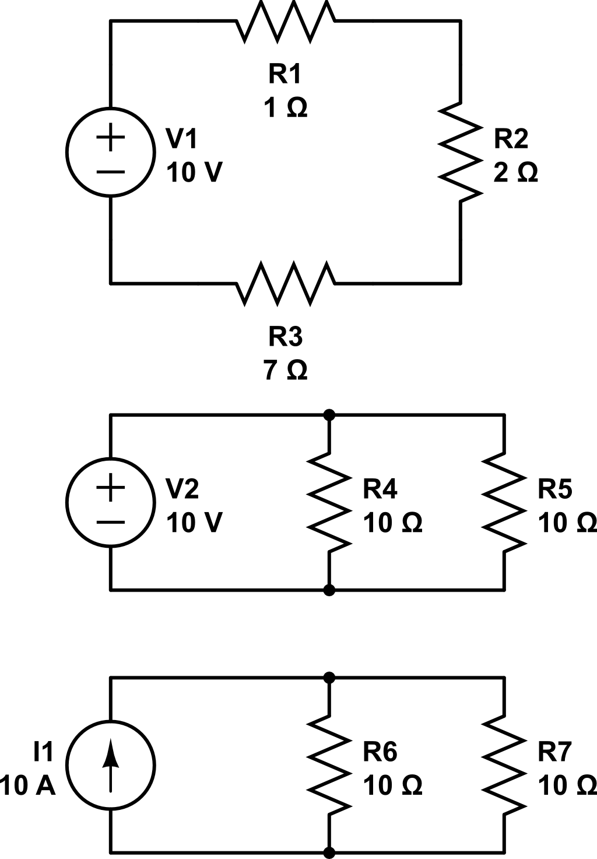
Problems
Power provide by source?
Voltage drop across 2Ω and 7Ω?
(a)
Power produced by source?
Current across 10Ω?
(b)
Voltage drop across resistors?
Current across one resistor?
(c)

Slide 5
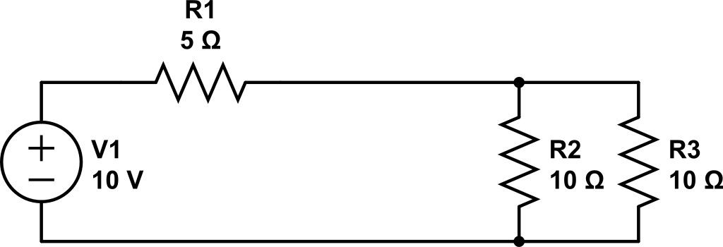
Mesh Example
Find V_{x} using KVL
+
V_{x}
-
You can also do this via voltage divider too

Slide 6
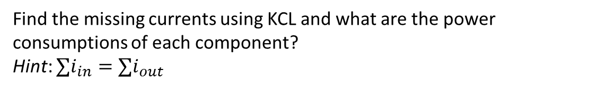
KCL
Find the missing currents using KCL and what are the power consumptions of each component?
Hint: $∑i_{in}=∑i_{out}$
A
B
P
What might this component be?
Q
10V
S
4V
+
R
-2A
1A
-
+Pwr – consume
-Pwr – provide
C

Slide 7

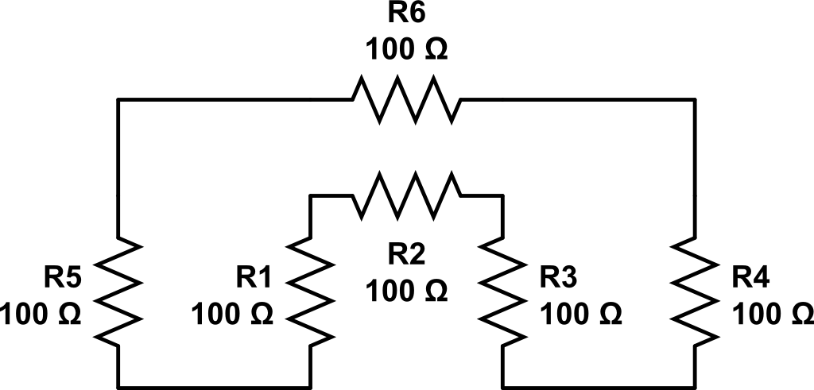
House
Find the resistance measured by the ohmmeter
Hint: find your nodes, what’s in serial or parallel?
R7
100
R8
100
Ω

Slide 8
Backups

Slide 9
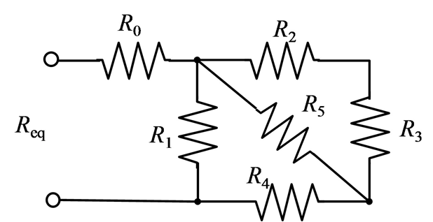
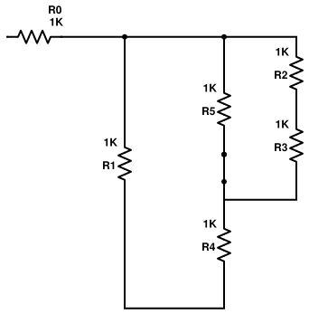
Example
Redraw
Series: Eq1 = R2 & R3
Parallel: Eq2 = R5 & Eq1
Series: Eq3 = R4 & Eq2
Parallel: Eq4 = R1 & Eq3
Series: R0 & Eq4

Slide 10
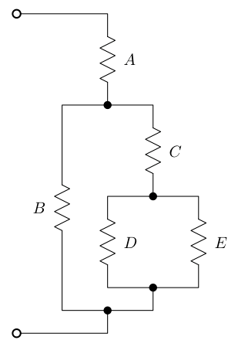
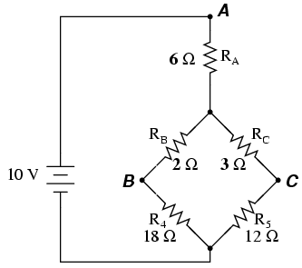
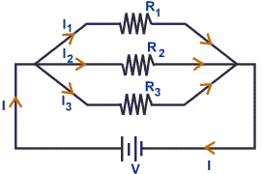
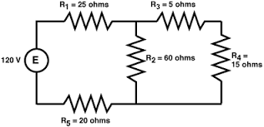
Parallel or Series?

Slide 11
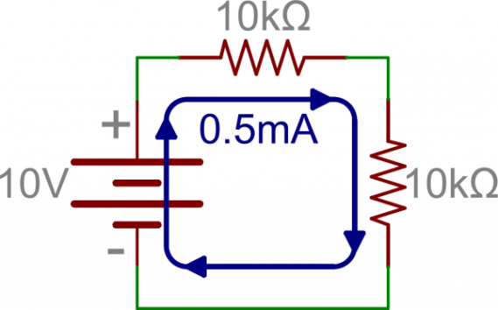
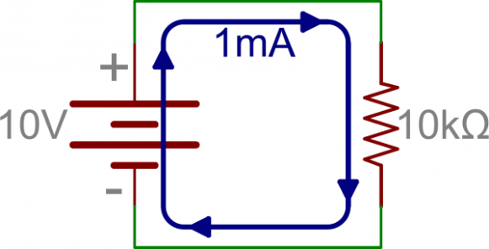
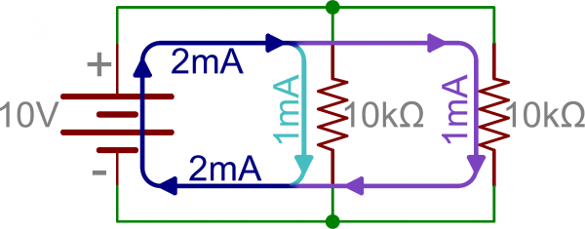
Equivalent Resistance
1. Original
2. Series
3. Parallel
I = V/R
I = 10 V / 10 kΩ
I = 1 mA
P = IV
P = 1 mA * 10 V
P = 10 mW
I = V / R
I = 10 V / ( 10 kΩ + 10 kΩ)
I = 0.5 mA
P = 0.5 mA * 10 V = 5 mW
I = V / R_{eq}
I = 10 V / (100/(10 + 10) kΩ)
I = 10 V / 5 kΩ
I = 2 mA
P = 2 mA * 10 V = 20 mW
For #2 , the added resistor increased the difficulty for current to flow through the circuit loop, thus increasing the resistance proportionally. Higher resistance means less current and lower power consumption.
For #3, notice the R_{eq} is less than the smallest R value. Thus, less resistance means more current flow and power consumption.

Slide 12
Current/Voltage Division
Voltage Division (series)
Current Division (parallel)
R₁
R₁
R₂
R₂
What is the current across R₂?
I₂ = 10 kΩ / 20 kΩ * 2 mA
I₂ = 1 mA
What is the voltage drop across R₂?
V₂ = 10 kΩ / 20 kΩ * 10 V
V₂ = 5 V
This equation is possible because all resistors in parallel see the same voltage drop, thus,
I₂*R₂ = I_{s}*R_{eq} -> I₂= R_{eq}/R₂*I_{s} = R₁/R_{sum}*I_{s}
Note: The R₂ cancel
This equation is possible because all resistors in series see the same current, thus, V₂/R₂ = V_{s}/R_{eq} = V_{s}/R_{sum}

Slide 13
KCL
Write the node equations for the circuit below and find the missing currents
Hint: sum current in = sum current out
A
B
P
Q
10V
R
S
4V
-2A
1A
C

