Slide 1
ECE231 Node Analysis
Maj Kevin Walchko

Slide 2
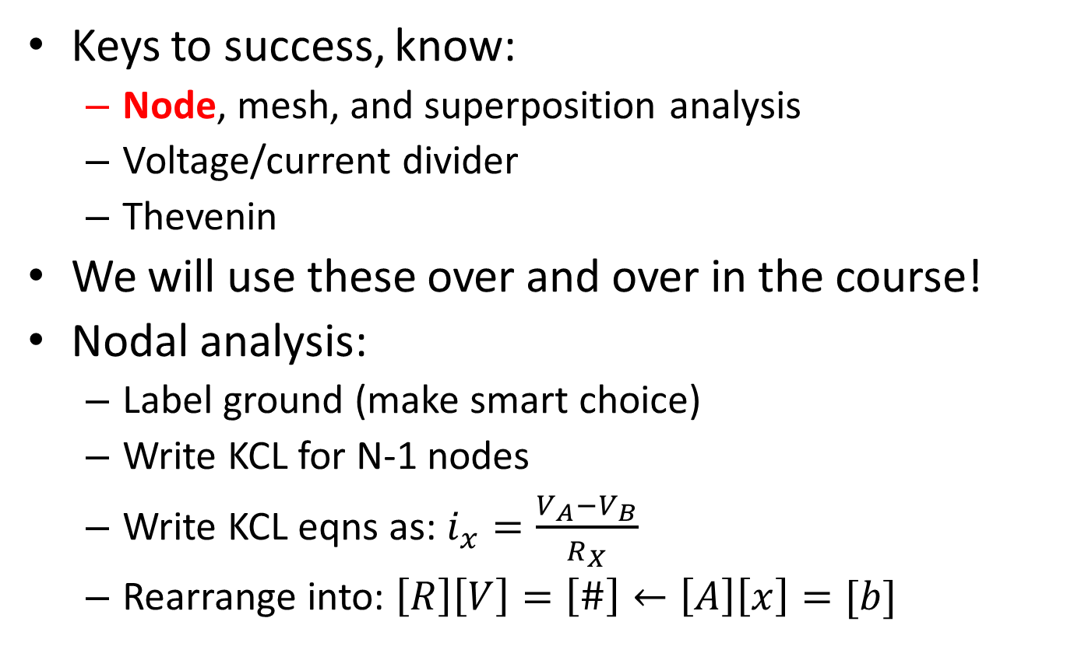
Node Analysis
Keys to success, know:
Node, mesh, and superposition analysis
Voltage/current divider
Thevenin
We will use these over and over in the course!
Nodal analysis:
Label ground (make smart choice)
Write KCL for N-1 nodes
Write KCL eqns as: $i_{x}=\frac{V_{A}−V_{B}}{R_{X}}$
Rearrange into: $\left[R\right]\left[V\right]=\left[\#\right]←\left[A\right]\left[x\right]=[b]$

Slide 3
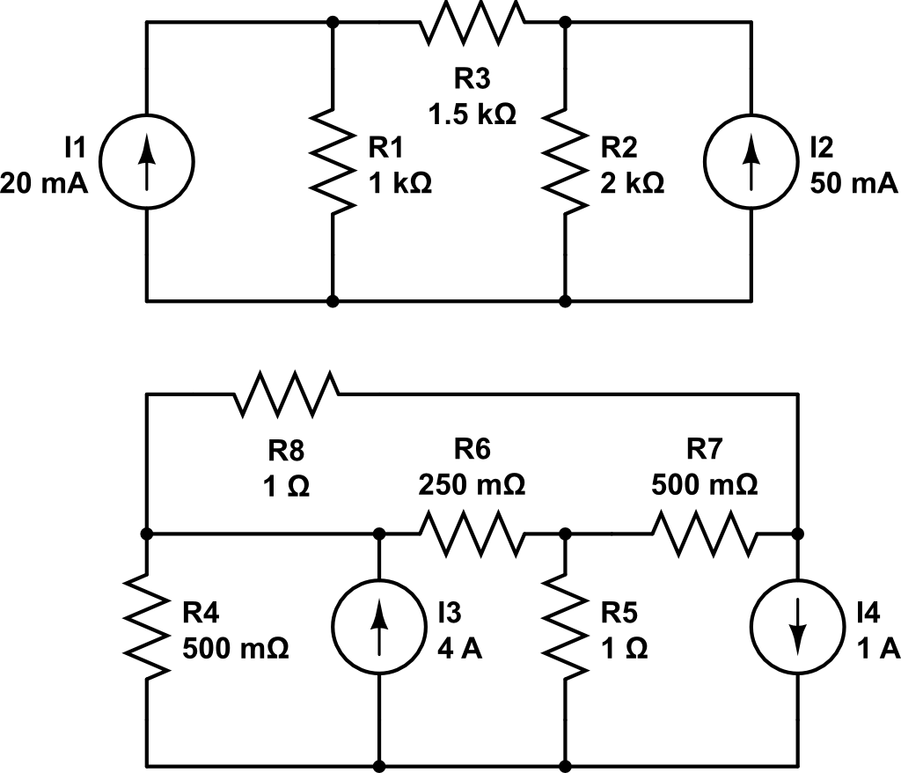
Nodal Analysis
A
B
What are the nodal voltages?
What is the current through R1?
C
C
What are the nodal voltages?
What is the current through R5?
A
B
D

Slide 4
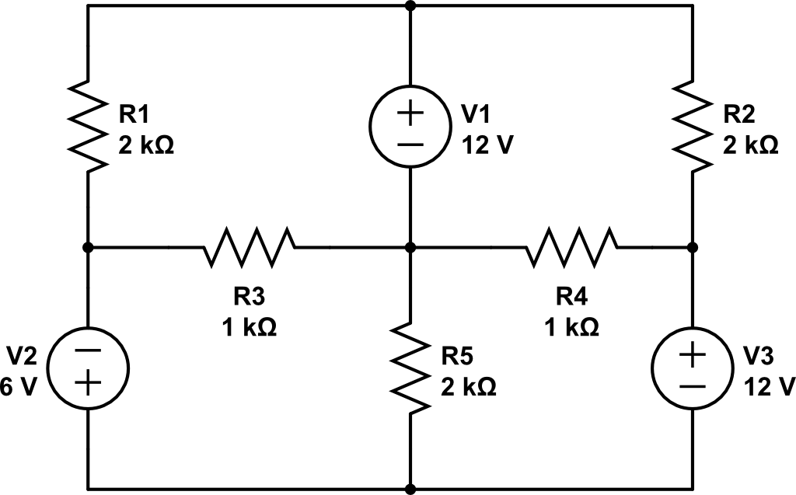
Super Node
Find I_{o}
A
Combine A and C
Super A
B
C
D
I_{o}
E

Slide 5
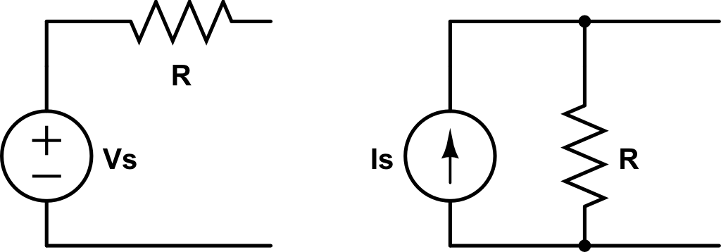
Source Transform
Across the same node, these are equivalent circuits
Don’t use this unless we tell you to do it or you are switching between Norton and Thevenin circuits!!!!!!!

Slide 6
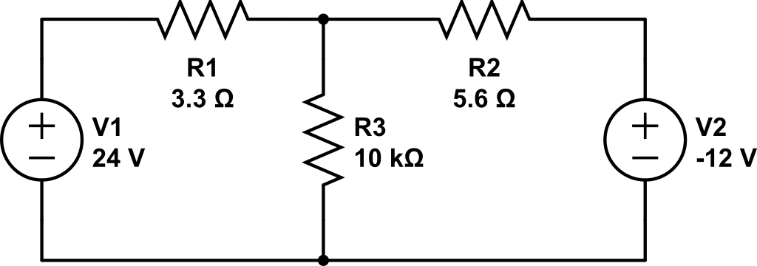
Source Transform

Slide 7
Backups

