Slide 1
ECE231 Mesh Analysis
Maj Kevin Walchko
Make sure you have Matlab installed by now!
Follow instructions on M:/Campus/Matlab/Cadet Instructions

Slide 2
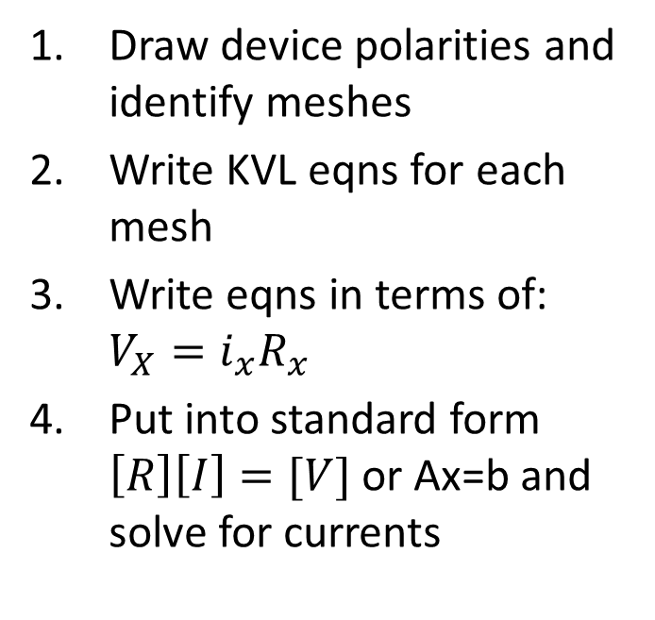
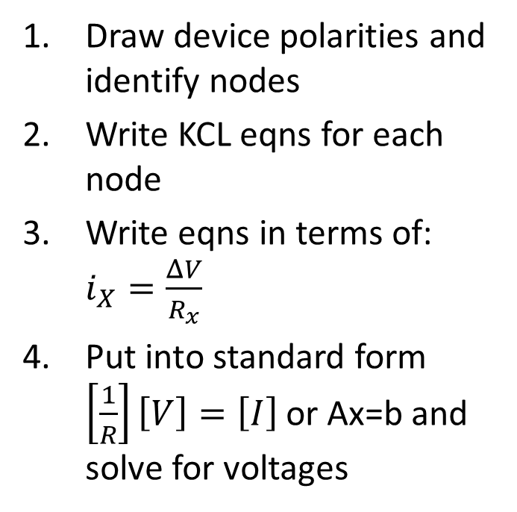
Node and Mesh
Nodal Analysis
Mesh Analysis
Draw device polarities and identify nodes
Write KCL eqns for each node
Write eqns in terms of: $i_{X}=\frac{ΔV}{R_{x}}$
Put into standard form $\left[\frac{1}{R}\right]\left[V\right]=\left[I\right]$ or Ax=b and solve for voltages
Draw device polarities and identify meshes
Write KVL eqns for each mesh
Write eqns in terms of: $V_{X}=i_{x}R_{x}$
Put into standard form $\left[R\right]\left[I\right]=[V]$ or Ax=b and solve for currents

Slide 3
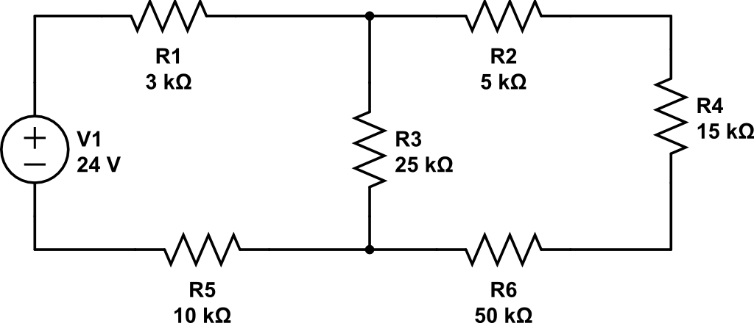
Simple Mesh, Find Currents
A
B

Slide 4
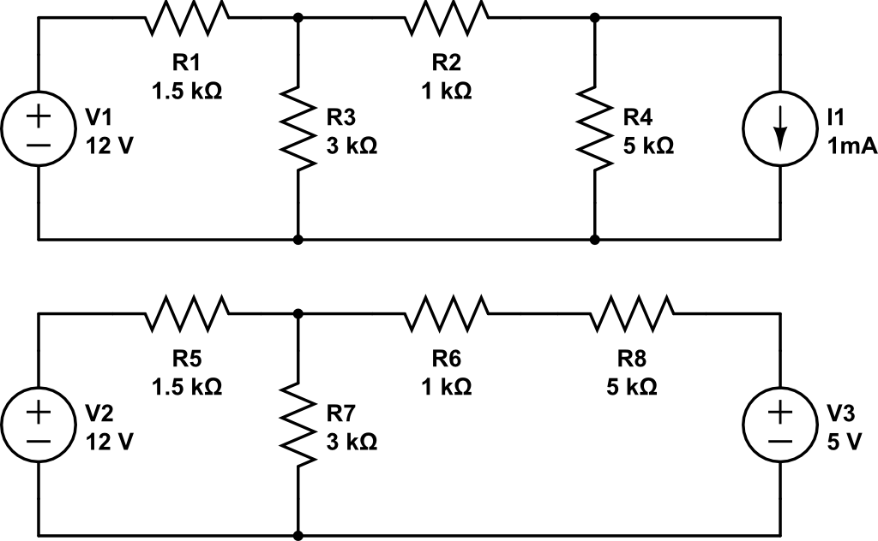
Current Src and Src Transform
A
B
C
A
B

Slide 5
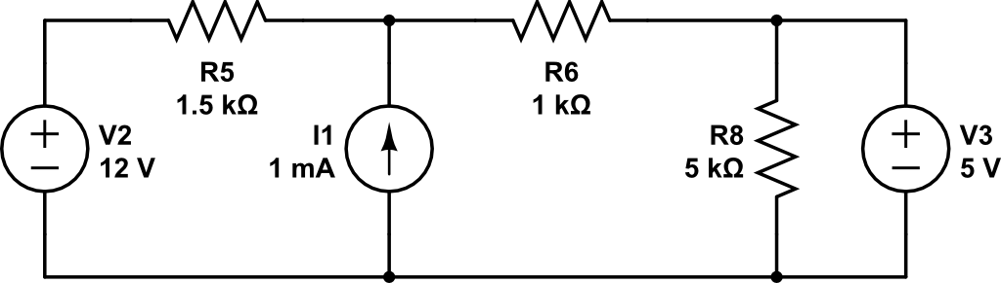
Super Mesh
B
A
C
This current source is embedded in 2 meshes, can’t transform it so we need to use supermesh

Slide 6
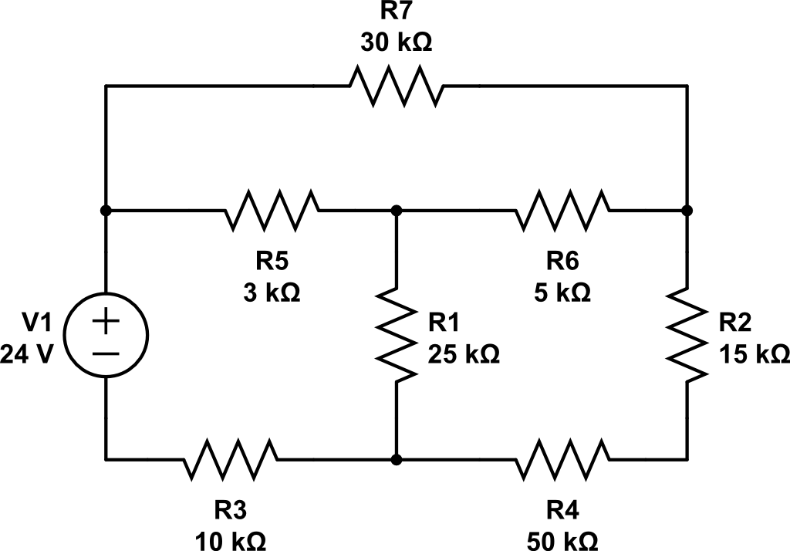
Find Mesh Currents
C
A
B

Slide 7
Backups

Slide 8
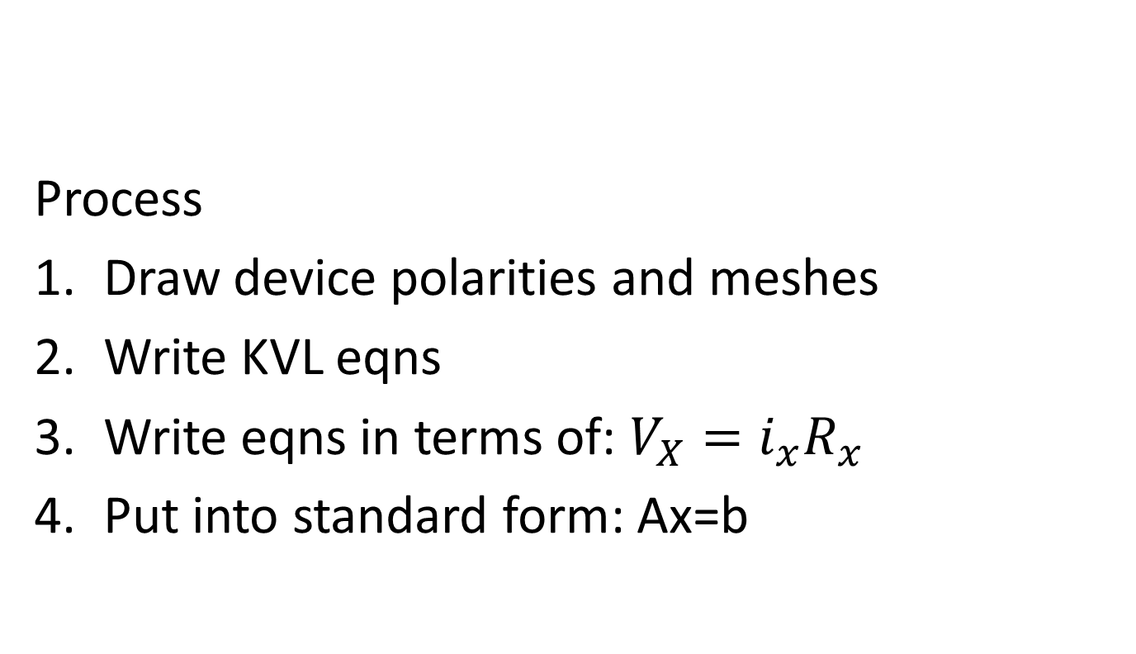
Mesh Analysis
Process
Draw device polarities and meshes
Write KVL eqns
Write eqns in terms of: $V_{X}=i_{x}R_{x}$
Put into standard form: Ax=b
Make sure you have Matlab installed by now!
Follow instructions on M:/Campus/Matlab/Cadet Instructions

