Slide 1
ECE231 Linearity and Super Position
Maj Kevin Walchko

Slide 2
Definitions
Linear system: use linear elements and independent sources, they also obey:
Proportionality (homogeneity): outputs are proportional to inputs
Super Position (additivity): outputs from multiple inputs to the same circuit can be summed together to find the total output
Linear
System
In some disciplines, this is a transfer function
x
y
2x
Linear
System
2y
x1
Linear
System
y1
x1+x2
Linear
System
y1+y2
x2
Linear
System
y2

Slide 3
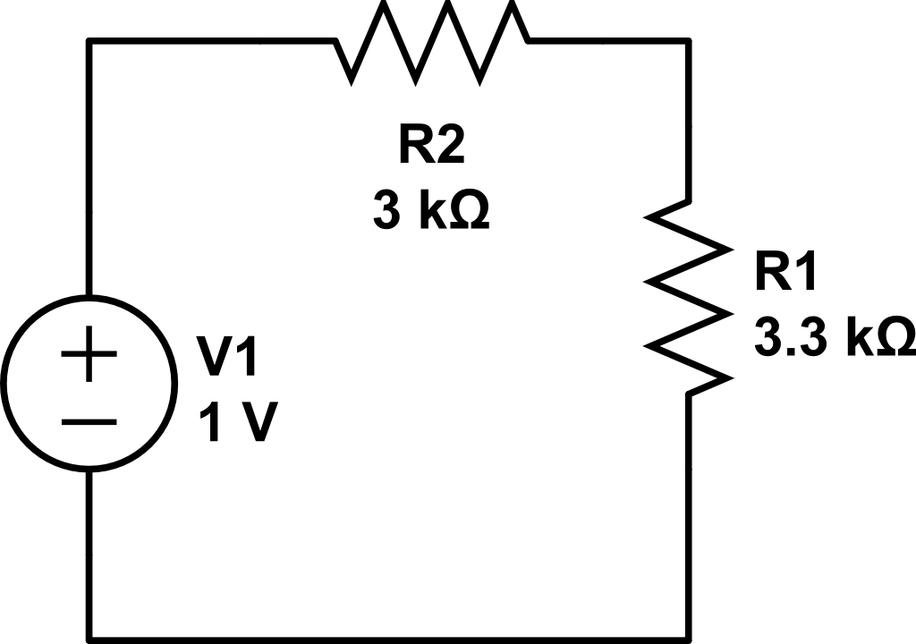
Proportionality
+
Vout
-
What is Vout?
If I change the source to 12V, what is Vout?

Slide 4
Super Position
Process:
Turn off all sources but 1
Short circuit voltage src (V=0)
Open circuit current src (I=0)
Solve for output of remaining src
Repeat for each source in circuit
Sum individual outputs
Hopefully you are replacing 1 complex mesh/node problem with several simple ohms law problems … if not, don’t use!

Slide 5
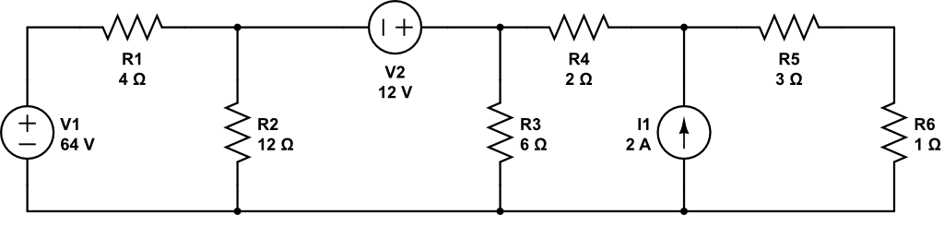
Super Position
+
V_{out}
-
Find V_{out}
You will need to do supernode/supermesh to do this … or superposition

Slide 6
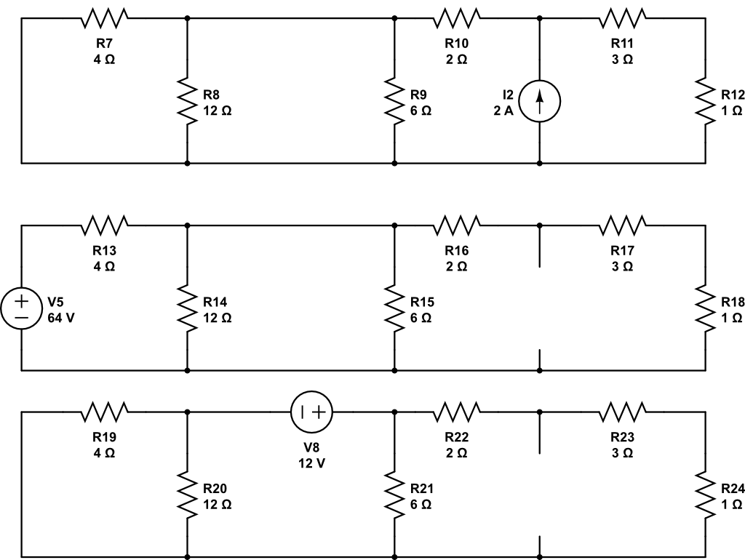
Super Position
A
B
C

Slide 7
Backups

Slide 8
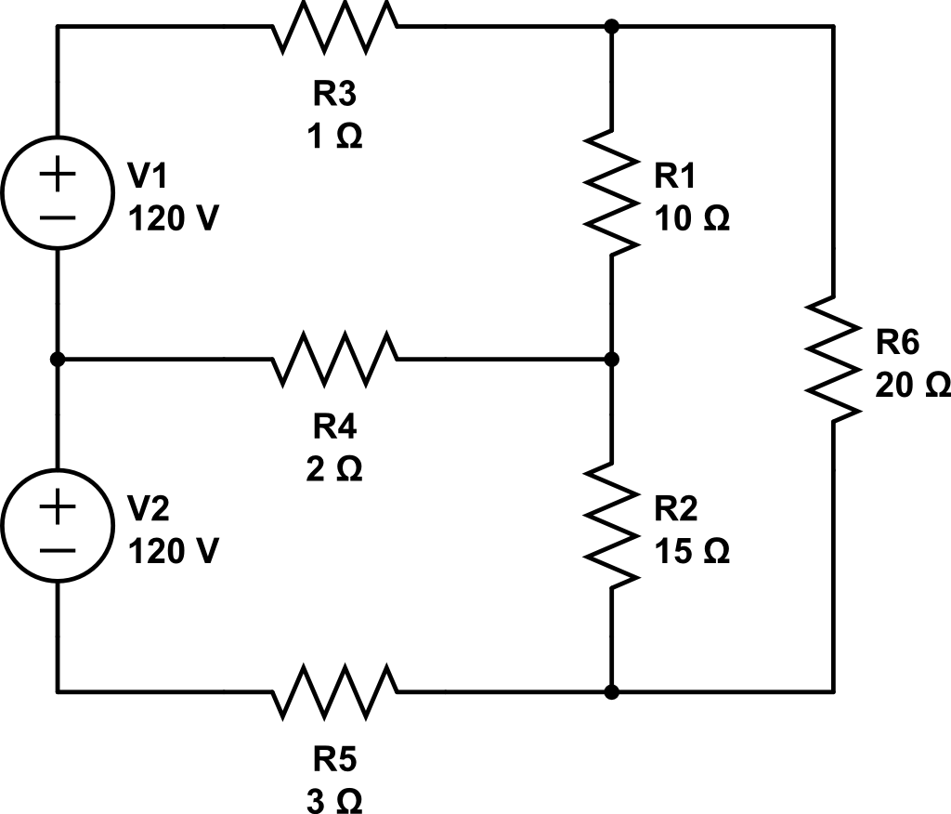
Node Analysis
1
2
Gnd
3
5
4

