Slide 1
ECE231 Thevenin and Norton Equiv
Maj Kevin Walchko

Slide 2
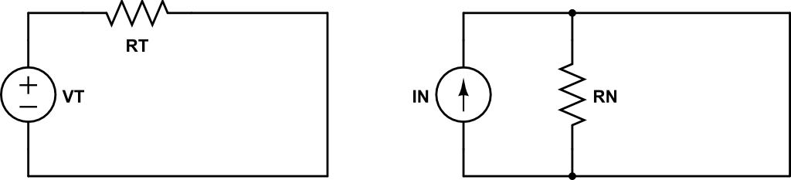
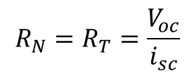
Definitions
Source Circuit: linear src that provides power
Load Circuit: remainder of circuit that consumes power
Thevenin: src circuit can be replaced with an independent voltage src (V_{T}) and resistor (R_{T}) at the interface, where the load is open circuit
Norton: src circuit can be replaced with an independent current src (i_{N}) and resistor (R_{N}) at the interface, where the load is short circuited
V_{oc}
i_{sc}
Load
Load
$$R_{N}=R_{T}=\frac{V_{oc}}{i_{sc}}$$

Slide 3
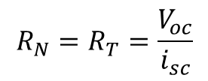
Thinking Another Way
Load
Load
V_{oc}
V
i_{sc}
A
Source
transform
A voltmeter has infinite resistance and measures voltage across, so it measures the V_{oc}
An ammeter has no resistance and measures the current i_{sc} through itself like a short circuit
$$R_{N}=R_{T}=\frac{V_{oc}}{i_{sc}}$$

Slide 4
Process
Disconnect src from load
Either make open circuit or short
Simplify circuit and calculate either:
Open circuit voltage (V_{oc})
Short circuit current (i_{sc})
Calculate src resistance (R_{T}), turn off independent srcs and find equivalent resistance
There is more than one way to do this!

Slide 5
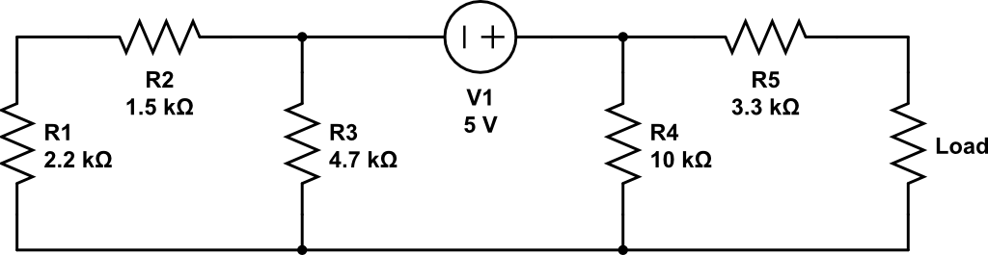
Find Norton Equiv
V_{oc}
Source circuit
Hint: going to find Thevenin first, since we have a voltage src

Slide 6
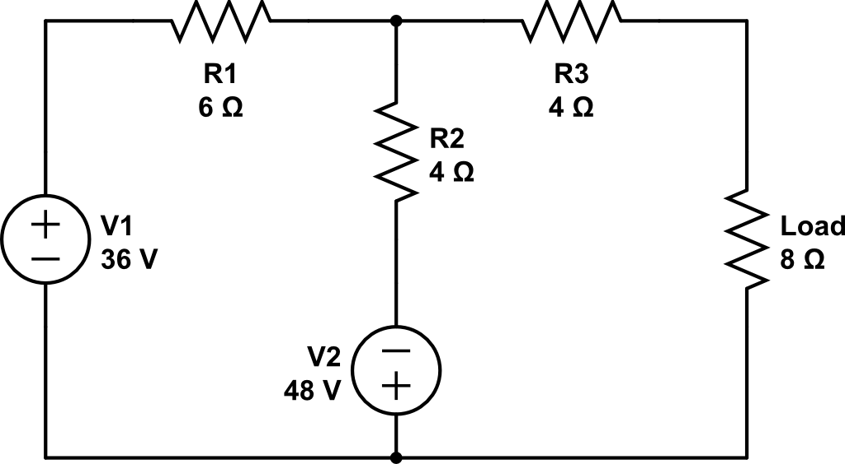
Find V_{out} across load using Thevenin
V_{oc}
+
V_{out}
-

Slide 7
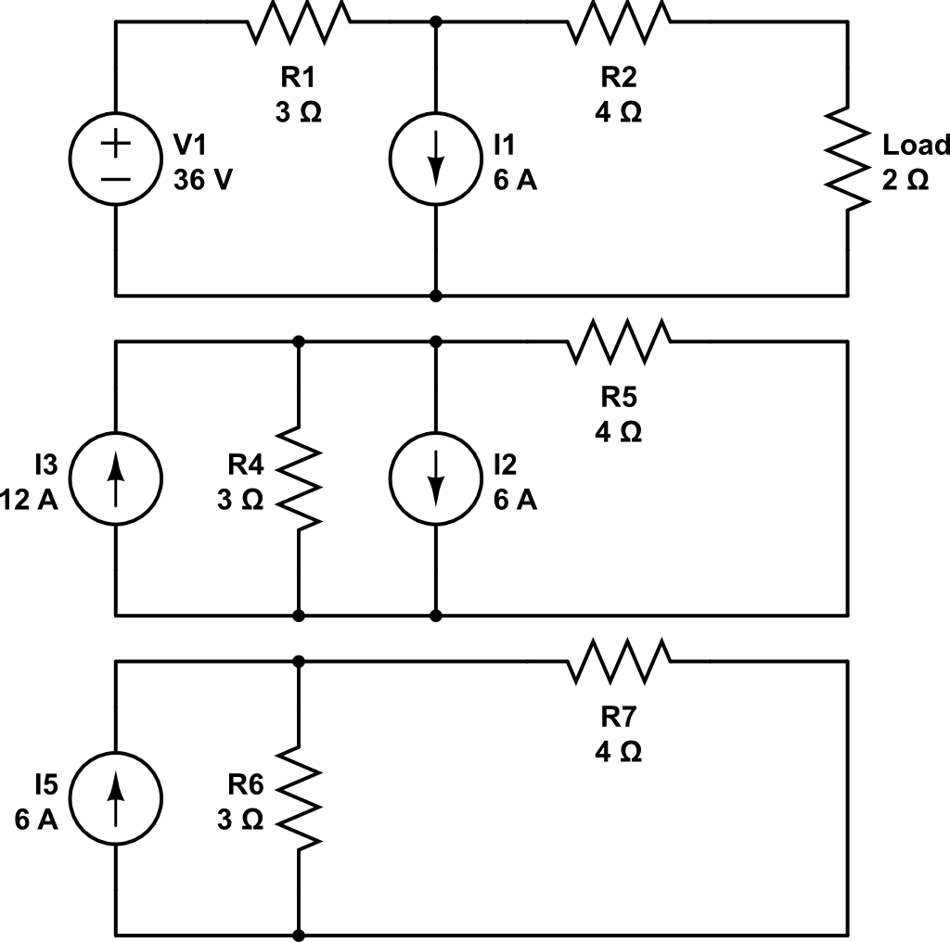
Find V_{out} using Norton
i_{sc}
i_{sc}

Slide 8
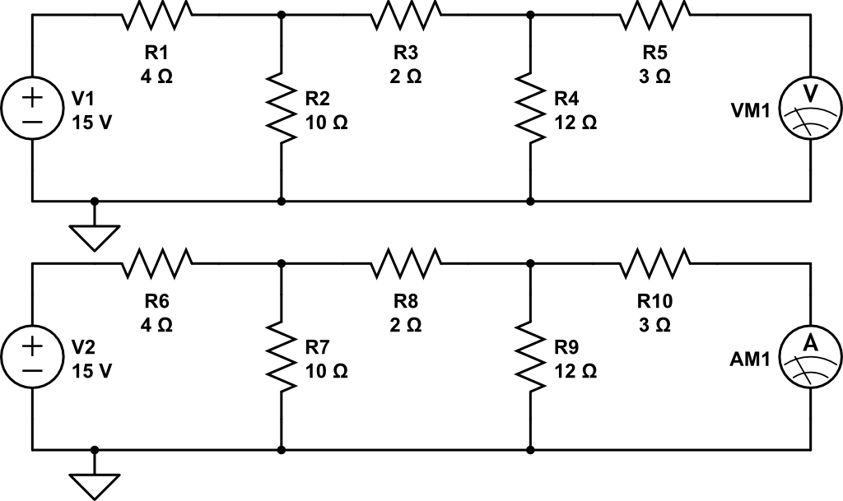
Find V_{oc}, i_{sc}, R_{T}
V_{oc}

Slide 9
Backups

Slide 10
Find V_{out} using Norton
i_{sc}
i_{sc}

Slide 11
Find V_{oc}, i_{sc}, R_{T}
V_{oc}

Slide 12
Super Position
Process:
Turn off all sources but 1
Short circuit voltage src (V=0)
Open circuit current src (I=0)
Solve for output of remaining src
Repeat for each source in circuit
Sum individual outputs
Hopefully you are replacing 1 complex mesh/node problem with several simple ohms law problems … if not, don’t use!

Slide 13
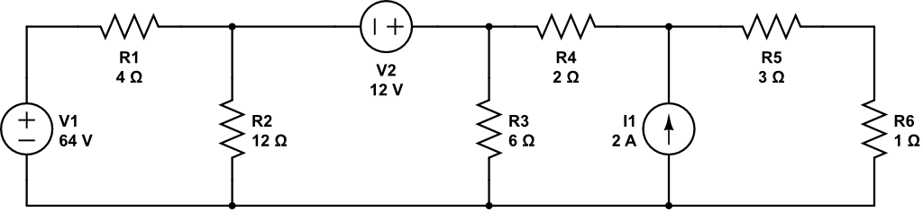
Super Position

Slide 14
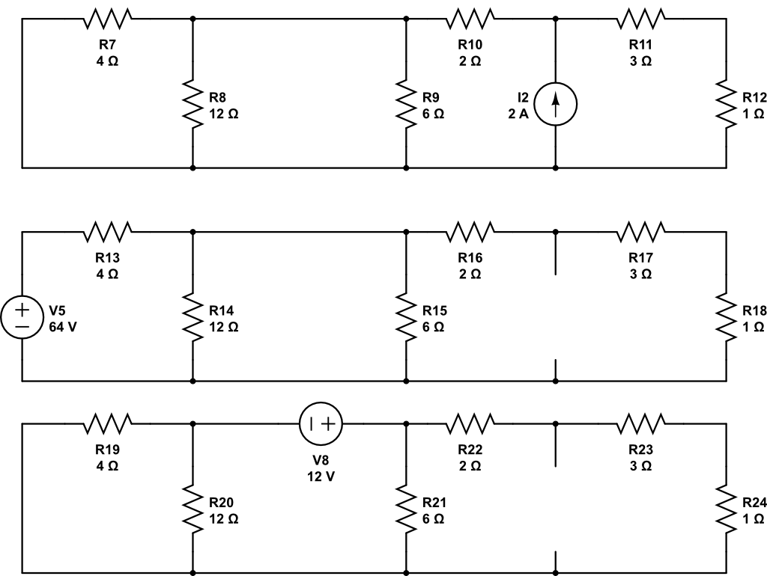
Super Position
A
B
C

Slide 15
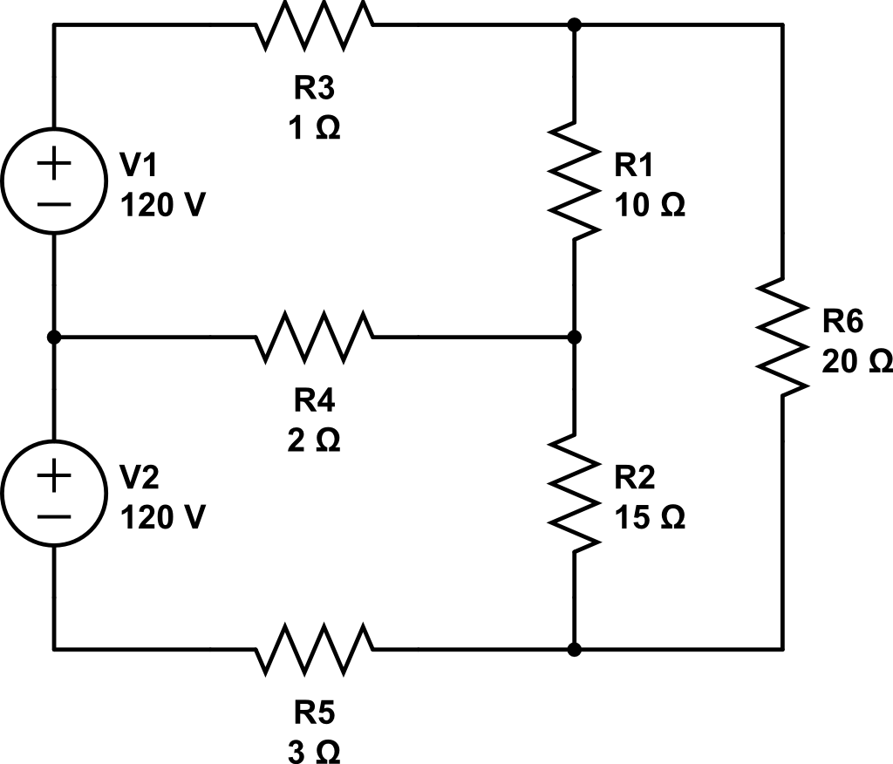
Node Analysis
1
2
Gnd
3
5
4

