Slide 1
ECE 382 Lab 3
Understanding the LCD Driver MCU interface

Slide 2
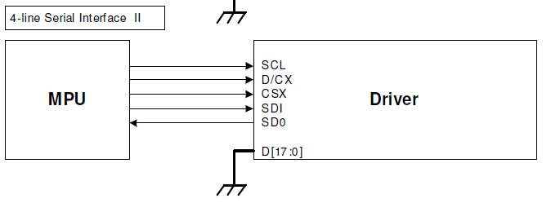
Overview
Primary resource: ILI9340 LCD Driver datasheet
We are using the 4-line Serial Interface II
SDI = MOSI
SDO = MISO
Pg 62 (7.6.2)

Slide 3
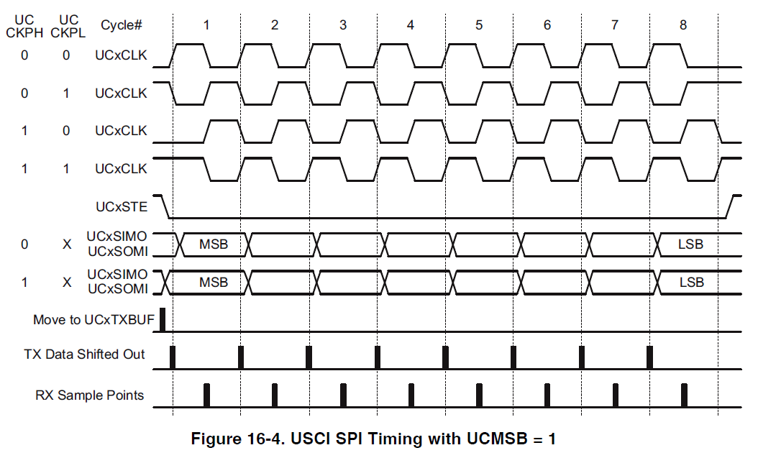
Timing Diagrams
Family Users Guide 16.3.6.1 (Pg. 442)
Inactive state = 0
Inactive state = 1
Data captures
Clock starts

Slide 4
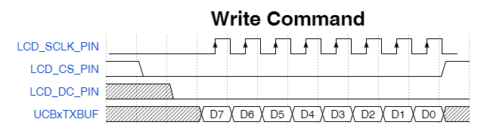

Diagram based on assembly code
UCB0MOSI
Logic Analyzer: What would you trigger on to catch this?
{signal: [
{name: 'LCD_SCLK_PIN', wave: '0...P.......', period: 1, phase: 0.4},
{name: 'LCD_CS_PIN', wave: '20.........1', },
{name: 'LCD_DC_PIN', wave: 'x.0.........', },
{name: ‘UCB0MOSI', wave: 'x..22222222x', data:['D7','D6', 'D5', 'D4', 'D3', 'D2', 'D1', 'D0']},
],
head: {text:
['tspan',
['tspan', {class:'h3'}, 'Write Command']
]
}
}
wavedrom.com

Slide 5
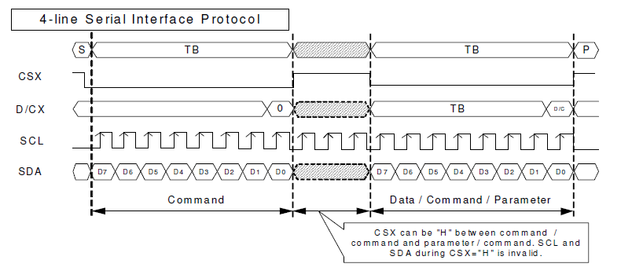

Write Cycle Sequence – Pg 35
From the above chart we can tell that the clock should have Polarity = 0, and Phase = 1
CS is the real driver for the process

Slide 6
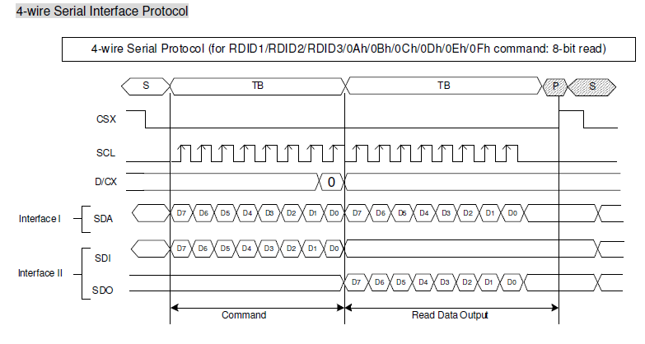
Reading data from LCD driver
Master (MCU) must send bytes (e.g., command) to slave (LCD driver) to receive anything

Slide 7
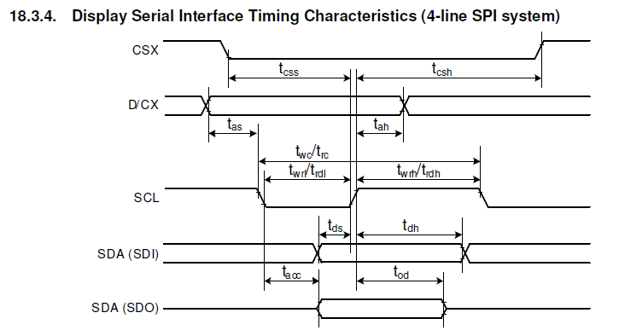
Timing Diagram with constraints
Pg. 231
See table of timing values for what required hold times, etc are

Slide 8
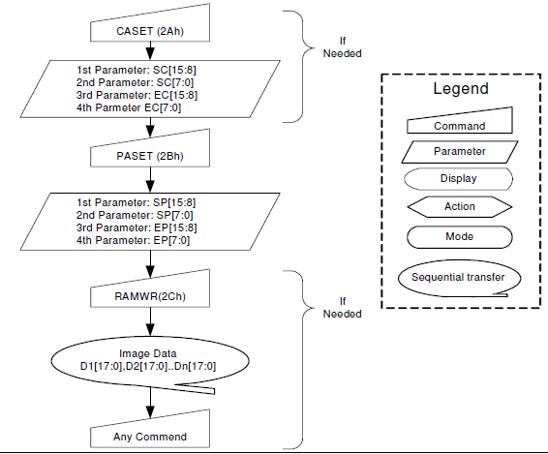
Painting pixels in the LCD
setArea
Pg. 111, 113
(CASET and PASET flowcharts)
R12 R13 R14 R15
setArea(xStart, yStart, xEnd, yEnd)

Slide 9
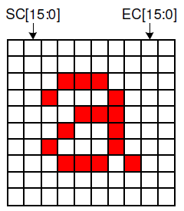
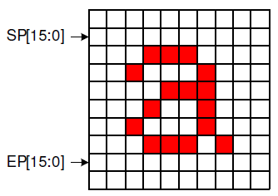
Picking col, row (CASET, PASET)
Start Column
End Column
Start Page
End Page

Slide 10
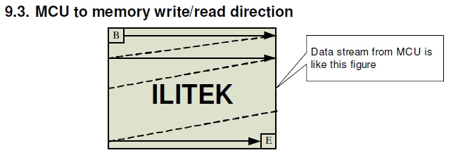

How painting pixels in an area works
Pg. 204
Here is how it works in words:

Slide 11
How painting pixels in an area works
What if?
SC = EC
SP = EP
SC = EC AND SP = EP
What could you draw?

Slide 12
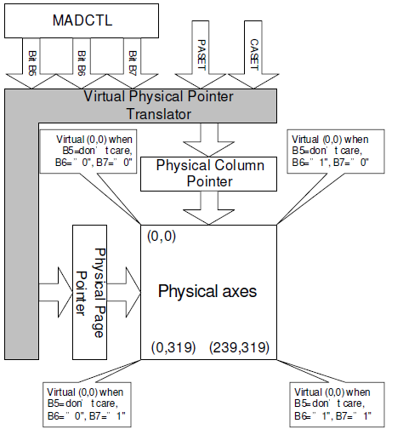
Various ways to fill area up
Can count columns and rows backwards!
Use Memory Data Access Control Command (MADCTL) – 0x36
Bits B5, B6, and B7
See pg. 127 Memory Access Control
Useful for easily mirroring an object across X and/or Y axes
Pg. 204

Slide 13
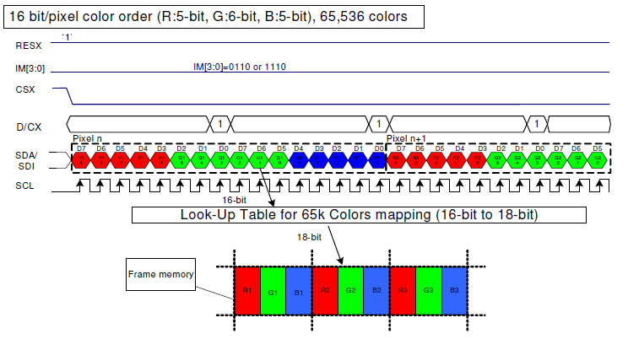
Painting Pixel Colors
How many bits do we send per pixel?
1 Byte at a time!

Slide 14
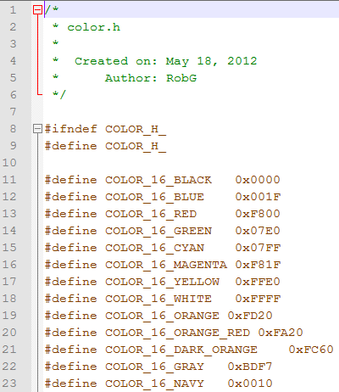
Using Other Predefined Colors
Do you have to define them individually in your assembly source?
- OR –
you could do something similar to …

Slide 15
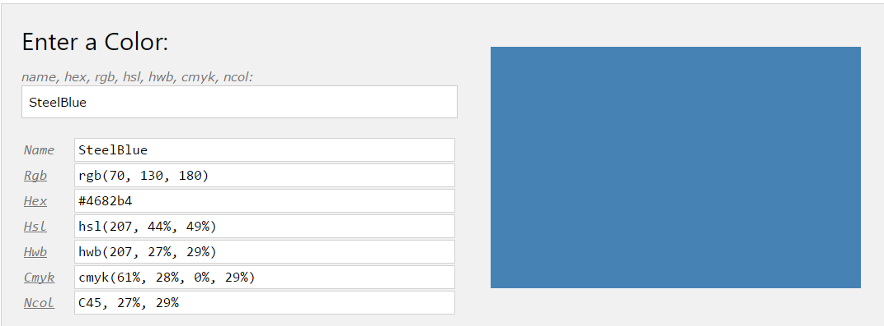
Custom Colors
Steel Blue for COLOR1 = 0x4416???
0x 4 4 1 6
0100 0100 0001 0110
RGB 5 6 5
0x 4 4 1 6
0100 0100 0001 0110
Value: 8 32 22
?!?
http://www.w3schools.com/colors/colors_converter.asp

Slide 16

Custom Colors
Scale range to 0-255:
0x 4 4 1 6
0100 0100 0001 0110
RGB 5 6 5
Value: 8 32 22
Scaled: 66 130 181
Pretty close to RGB(70, 130, 180)
Use color picker on W3 site to make your own

Slide 17
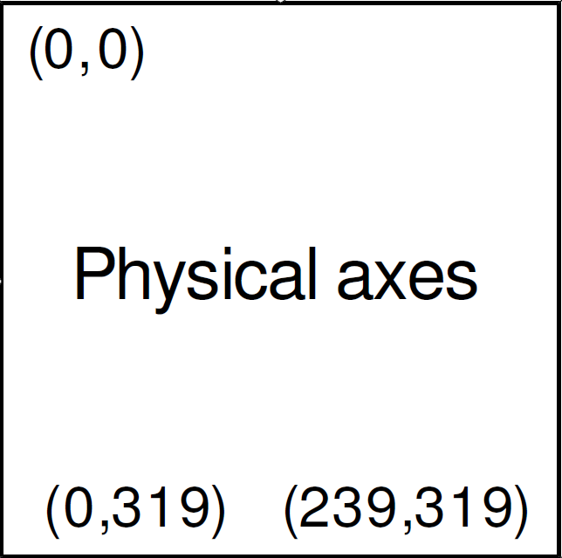
Your Goal: A moving 10x10 box
Your Goal
10
10
What does clearScreen() do???

