Slide 1

HQ U.S. Air Force Academy
ECE 382 Embedded Computer Systems I
Capt Phillip Warner
Office 2F46C
333-6556
1

Slide 2
Your first assignment…
Name Major
Hometown Desired AFSC/ Job
Interests Clubs/IC Sports
What you want me to do
What you want from this class
What you have heard about this class
Notes:
Fill out seating chart

Slide 3
Welcome to ECE 382 Embedded Computer Systems I
What have you heard about this course?
What are Embedded Computer Systems?
freescale_MCU_Video-Fullscreen.wmv
Swarm of Quadrotors
2015 Fall 382 Robot Maze Competition

Slide 4
Embedded Systems
Is a smart-phone an embedded system?
Embedded Systems
they're built to interact with the real-world and perform very specific functions, often with difficult constraints (timing, power, etc)
4

Slide 5
Embedded Processors
Every PC, iMac, engineering workstation, Cray supercomputer and all other general-purpose computers put together account for less than 1% of all microprocessors sold every year.
Your average car has about 15 microprocessors. (1999 BMW 7-series has 65)
There's one micro in each headlight of a new Lexus, BMW or Mercedes. Plus one in each rear-view mirror.
The average middle-class household has about 40 to 50 microprocessors in it (55 if you own a PC).
Where are they?
digital cellular telephone, pager, microwave oven, washer, dryer, dishwasher, coffee maker, refrigerator, VCR, television, video-game console, stereo receiver, CD player, DVD player, portable Discman, remote control for the TV, remote for the VCR, remote for the stereo, garage-door opener, automatic sprinkler timer, fax machine, PDA, answering machine, etc.
250 million 32-bit embedded microprocessors sold plus
>1 billion 16-bit plus
>1 billion 8-bit plus
>1 billion 4-bitters.
Source: May 1999 Embedded Systems Programming
5

Slide 6

Computer Systems Courses
EE 281:
Digital Design &
Comp Arch
EE 382:
Embedded Comp
Systems I
EE 383:
Embedded Comp
Systems II
EE 484:
Adv Digital
System Design
EE 485:
Adv Computer
Architecture
EE 387:
Introduction to
Robotics
SE 460:
UAV Systems
6

Slide 7
ECE 382
In this class, we'll be:
Writing programs in Assembly Language, then C
Learning about and using the functional units of a microcontroller
Using the microcontroller to interface with peripheral devices
In short – we want you to know how to use a microcontroller for your own purposes
7
Notes:
Application of an architecture and microarchitecture

Slide 8
Course Goals
Cadets shall develop the skills to design, implement, test, and debug microcontroller-based systems by developing operational assembly and C language programs that incorporate the built-in microcontroller functions, and by successfully interfacing the microcontroller to the external world.

Slide 9
Course Objectives
By the end of this course, cadets shall be able to:
Utilize the built-in functional units of a specified microcontroller.
Write, assemble, link, and run microcontroller code in assembly language.
Write, compile, assemble, link, and run microcontroller code in the C programming language.
Interpret and explain orally and in writing the functions of a given assembly language or C program as well as laboratory work
Evaluate, analyze, debug, and modify a given program to improve its execution of a specified task
Demonstrate a working knowledge of the on-board hardware components of a microcontroller and implement an interface between a specified microcontroller and other hardware.
Demonstrate the ability to solve well and ill-defined problems

Slide 10
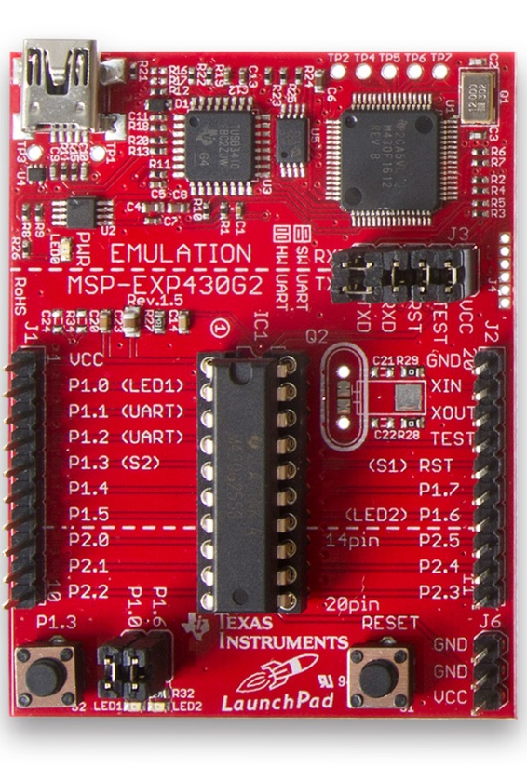
Course Labs Overview
Assembly
Simple calculator
Decrypt secret messages
Etch-a-sketch
C
Create interactive handheld games
Reverse engineer TV remote for wireless control
Create a robot and be the fastest to navigate a maze with sensors!
https://www.youtube.com/watch?v=58dCIdXB4lg&feature=youtu.be

Slide 11
ECE 382 – Labs
Lab | Language | Description/Goal
Lab 1 – "A Simple Calculator" | Assembly | Goal: Write a program that interprets a series of operands and operations and stores the results - an assembly language calculator!
Lab 2 – Subroutines - "Cryptography" | Assembly | Goal: Write a program that decrypts an encrypted message using a simple encryption technique (with and without key).
Lab 3 – SPI - "I/O" | Assembly | Goal: Write subroutines to interface with an LCD BoosterPack using the SPI subsystem.
Lab 4 – "An LCD Device Driver" | C Code / ASM mix | Goal: Write a program that creates an etch-a-sketch program that utilizes Lab 3 subroutines.

Slide 12
ECE 382 – Labs Continued
Lab | Language | Description/Goal
Lab 5 – Interrupts - "A Simple Game“ | C Code | Goal: Write a program that uses interrupts and the Timer_A subsytem to reverse engineer a remote control as a game controller.
Lab 6 – PWM - "Robot Motion" | C Code | Goal: Write program using the pulse-width modulationed waveforms to control the speed / direction of your robot's motors.
Lab 7 – A/D Conversion - "Robot Sensing" | C Code | Goal: Write a program to interface with an ultrasonic rangefinder on a servo to determine if the robot is approaching a wall on 3 sides.
Lab 8 – Robot Maze Competition | C Code | Goal: Combine what was learned in previous labs to program the robot to autonomously navigate through a maze.

Slide 13
Roll call & Who are you?
Name
“Go-by” name
What is your major?
Desired AFSC?
What fills your time (outside of academics)
- OR -
Random interesting fact about yourself
Notes:
Now that you know a little about the course, let’s get to know you a little
[Fill out seating chart]

Slide 14
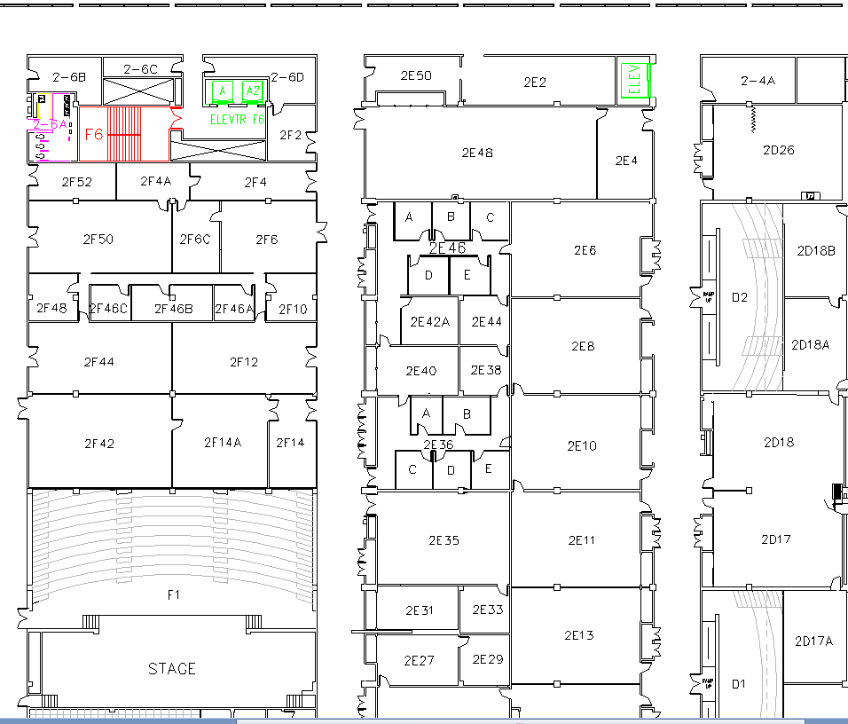
West (Terrazzo) Side
Lab
Maj Walchko
Capt Warner
Dr. York
Class

Slide 15
Fall 2017 General Availability
Capt Phillip Warner
Office: 2F46C
Ph: 333-6556
Phillip.Warner@USAFA.edu
Appointment via Outlook preferred
M1
T1
M2
T2
M3
T3
M4
T4
Available
M5
T5
Sometimes Available
M6
T6
Always Unavailable
M7
T7

Slide 16
Admin

Slide 17
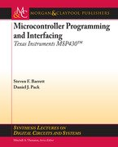

Course Text and Website
Textbook (Optional):
Microcontroller Programming and Interfacing: Texas Instruments MSP430 - Steven Barrett and Daniel Pack
Required References:
MSP430x2xx Family Users Guide
MSP430G2x53 MSP430G2x13 Mixed Signal MCU
Course URL - http://ece.ninja/382

Slide 18
Grade Distribution
 | Prog | Final
GRs | 40 % (1) | 30 % (2) |  | Grade | Grade
Labs | 35 % (2) | 35 % (8) |  | 90 ≤ A ≤ 100 | 74 ≤ C+ < 77
HW/Quizzes/CompEx | 25 % | 10 % |  | 87 ≤ A- < 90 | 70 ≤ C < 74
Final Exam |  | 25 % |  | 84 ≤ B+ < 87 | 67 ≤ C- < 70
 |  |  |  | 80 ≤ B < 84 | 60 ≤ D < 67
 |  |  |  | 77 ≤ B- < 80 | F < 60
TOTAL | 100 % | 100 %

Slide 19
Late Policy
How Late? |  | Penalty | Max Grade
1 calendar day | < 24 hrs | 25% | 75%
2 days | 24 to 48 hrs | 50% | 50%
3 days | 48 to 72 hrs | 75% | 25%
4 days or more | 72 + hrs | 100% | 0%
Note: Late time includes weekends and holidays. Make prior arrangements for weekend or holiday turn-in. All assigned labs must be turned in to pass the course—even if it’s too late to receive any credit.

Slide 20
Other Course Policies
Extra Instruction
Seek EI from me or another instructor
Send a meeting request to set up a time; be sure to let me know if you cancel
Attempt the work before you come
CAS
Pre-coordinate absences if at all possible
A CAS code doesn’t necessarily mean you’re excused from class (instructor “notification” vs “permission”)

Slide 21
Other Course Policies - Collaboration
Collaboration
Only instructors and current ECE 382 students
No using work from previous semesters
All graded work must be your own
Document any help/collaboration

Slide 22
Other Course Policies –Readings and Homework
Readings specified on each lesson page
Lesson notes
Datasheet pages
Provided links
Barrett and Pack readings optional
Homework due BOC next lesson unless otherwise stated
Skills Review Due Lesson 3

Slide 23
Other Course Policies - Labs
Bitbucket to turn in lab materials bitbucket.org
Class time is provided, but come prepared!
The labs will require debugging—53 minutes goes by quickly
Prelabs due NLT one full duty day prior to lab lesson (unless otherwise stated)
Early feedback critical
Bad plan → bad implementation

Slide 24
Bitbucket
Create Private Bitbucket Repository
https://bitbucket.org/
Name repo something like “ECE382_LastName_FirstName”
Give your instructor access to the repo
Usernames:
pwarner
walchko
GeorgeYork
Example/Template Lab Notebook:
https://github.com/pw4rn3r/ECE_382_Lab_Ex

Slide 25
Other Course Policies
Quizzes, GRs, and Final
Let me know at least one lesson ahead of time if you’re going to miss a graded evaluation
Food / Drink
No Food in classroom (Hallway OK)
Water in approved containers OK
Bring your laptop and board every lesson
Have fun!

Slide 26
?’s || /* */

Slide 27
Review

Slide 28
What are the main components of a computer?
CPU
Memory
Input/
Output
Outside
World
Control
Datapath
ALU
Control Bus
Data Bus
Address Bus
28

Slide 29
What are the main components of a PC?
Motherboard
CPU
RAM/ROM
Harddisk
Power Supply
I/O: ethernet, USB, …
PC
Single Board
Computer
System on
a Chip
Microcontroller
Small, 100kB of RAM
Low power, Low cost
29

Slide 30
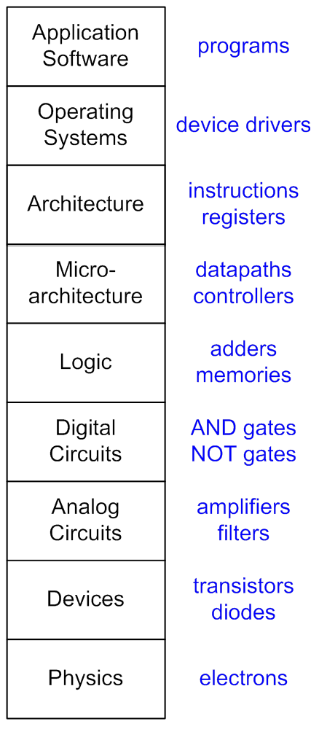
Hierarchy of ECE
Instruction Set Architecture (ISA)?
Microarchitecture?
30

Slide 31
ISA vs Microarchitecture
Instruction Set Architecture (ISA) The ISA is the programmer's view of the processor.
Processors with the same ISA share the same data types, assembly language instructions, registers, addressing modes, memory architecture, interrupts, IO, etc.
Are all processors that implement an ISA the same? Are the Intel and AMD chips that implement x86 the same (Pentium, Athlon)?
Microarchitecture The microarchitecture is the hardware implementation of a given ISA. An ISA can be implemented with different microarchitectures. This allows programmers to write software that functions on chips made by different manufacturers.
What ISA is your laptop?
Name some ISAs?
31

Slide 32
RISC vs CISC ?
Reduced Instruction Set Computer (RISC)
Complex Instruction Set Computer (CISC)
Tradeoffs RISC vs CISC
more instructions == more complex hardware
Complex
SW
Complex
HW
32

Slide 33
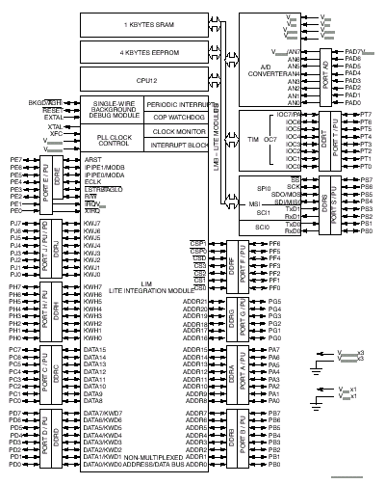
68HC12 vs MSP430G2553
http://ece.ninja/382/datasheets/msp430g2x53_2x13_mixed_sig_mcu.pdf
27 instructions
200 to 300 instructions
33

Slide 34
34

Slide 35
Backups
Bullets
35

