Slide 1
ECE 382 Lesson 4
Readings
Barrett 2.8-2.11 (pp47-54) MSP430 Family Users Guide pp47-55 MSP430 Addressing Modes
Lesson Outline
Addressing Modes
CompEx1 → due lesson 6
Admin
Assignment 1 due today
uCorrupt1 due today
Assignment 2 due next lesson

Slide 2
What does this program do? Where’s the BEEF?
; first thing's first - how do we create a comment?
mov.w #0x0200, r5
mov.w #0xbeef, r6
fill mov.w r6, 0(r5) ; anyone know what this syntax means?
incd r5
cmp.w #0x0400, r5 ; what does this instruction do?
jne fill
forever jmp forever

Slide 3
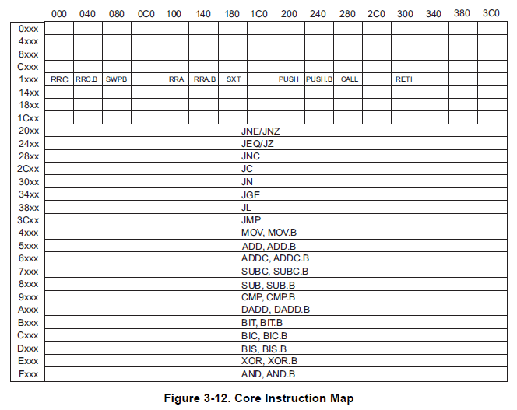
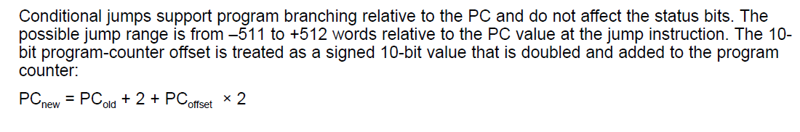
Relative Jump Instruction
Doesn’t use addressing mode.
forever JMP forever ; what does this do?
All instructions are 16 bits long. Their binary format looks like this:
15 | 14 | 13 | 12 | 11 | 10 | 9 | 8 | 7 | 6 | 5 | 4 | 3 | 2 | 1 | 0
0 | 0 | 1 | Condition |  |  | PC offset (10 bit)
Figure 3-12
Family User Guide 3.4.5 pp62
Blue Book pp19
:
:
_ _ _ _ _ _ _ _ _ _ _ _ _ _ _ _
Family User Guide 3.4.5 pp59
Blue Book pp18

Slide 4
MSP430 addressing modes
As/Ad | Addressing Mode | Description | Example
00/0 | Rn | Register direct | mov r8, r9
01/1 | offset(Rn) | Register Indexed | mov 2(r8), r9
10/- | @Rn | Register indirect | mov @r8, r9
11/- | @Rn+ | Register indirect with post-increment | mov @r8+, r9
01/1 | ADDR | Symbolic (PC relative) | mov LoopCtr, r6
01/1 | &ADDR | Absolute | mov r5, &0x0200
11/- | #N | Immediate | mov #0x2006, r6

Slide 5
Basic addressing modes
As/Ad | Addressing Mode | Description | Example
00/0 | Rn | Register direct | mov r8, r9
01/1 | offset(Rn) | Register Indexed | mov 2(r8), r9
10/- | @Rn | Register indirect | mov @r8, r9
11/- | @Rn+ | Register indirect with post-increment | mov @r8+, r9
memory
registers
203 | 56
202 | 78
201 | 12
200 | 34
r8 | 0200
r9 | 0000

Slide 6
Basic addressing modes
As/Ad | Addressing Mode | Description | Example
00/0 | Rn | Register direct | mov r8, r9
01/1 | offset(Rn) | Register Indexed | mov 2(r8), r9
10/- | @Rn | Register indirect | mov @r8, r9
11/- | @Rn+ | Register indirect with post-increment | mov @r8+, r9
memory
registers
203 | 56
202 | 78
201 | 12
200 | 34
r8 | 0200
r9 | 0200

Slide 7
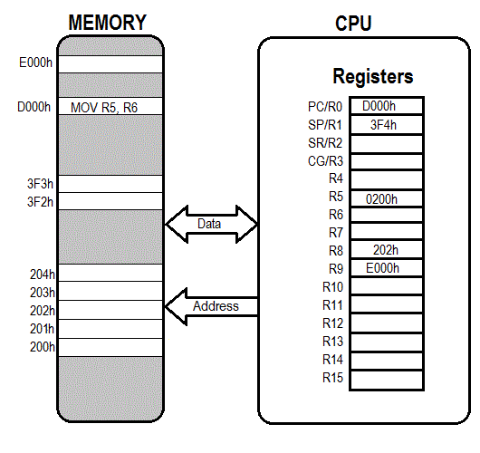
Register Direct

Slide 8
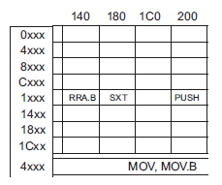
Hand assembly
no .b
register mode
mov r11, r10
 | 15 | 14 | 13 | 12 | 11 | 10 | 9 | 8 | 7 | 6 | 5 | 4 | 3 | 2 | 1 | 0
Two Operand | Opcode |  |  |  | Source reg |  |  |  | Ad | W=0/B=1 | As |  | Dest reg
register mode
_ _ _ _ _ _ _ _ _ _ _ _ _ _ _ _
Fig. 3-12

Slide 9
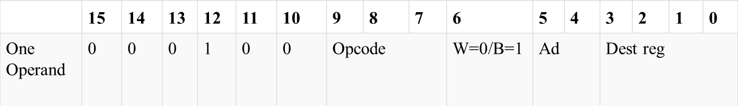
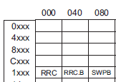
Hand assembly
no .b
register mode
swpb r10
_ _ _ _ _ _ _ _ _ _ _ _ _ _ _ _
Figure 3-12
Family User Guide 3.4.5 pp62
Blue Book pp19

Slide 10
Basic addressing modes
As/Ad | Addressing Mode | Description | Example
00/0 | Rn | Register direct | mov r8, r9
01/1 | offset(Rn) | Register Indexed | mov 2(r8), r9
10/- | @Rn | Register indirect | mov @r8, r9
11/- | @Rn+ | Register indirect with post-increment | mov @r8+, r9
memory
registers
203 | 56
202 | 78
201 | 12
200 | 34
r8 | 0200
r9 | 0000

Slide 11
Basic addressing modes
As/Ad | Addressing Mode | Description | Example
00/0 | Rn | Register direct | mov r8, r9
01/1 | offset(Rn) | Register Indexed | mov 2(r8), r9
10/- | @Rn | Register indirect | mov @r8, r9
11/- | @Rn+ | Register indirect with post-increment | mov @r8+, r9
memory
registers
0200
+ 2
0202
203 | 56
202 | 78
201 | 12
200 | 34
r8 | 0200
r9 | 5678
How about: mov.w 2(r6), 6(r5) ???

Slide 12
What is the last instruction doing
mov.w #0x200, r6
mov.w #0xbeef, 2(r6) ;places 0xbeef at address 0x0202
mov.w r6, r5
mov.w 2(r6), 6(r5)
Disassembled:
c01c: 36 40 00 02 mov #512, r6 ;#0x0200
c020: b6 40 ef be mov #-16657,2(r6) ;#0xbeef, 0x0002(r6)
c024: 02 00
c026: 05 46 mov r6, r5
c028: 95 46 02 00 mov 2(r6), 6(r5) ;0x0002(r6), 0x0006(r5)
c02c: 06 00

Slide 13
Hand assembly
no .b
indexed register mode
mov.w 2(r6), 6(r5)
 | 15 | 14 | 13 | 12 | 11 | 10 | 9 | 8 | 7 | 6 | 5 | 4 | 3 | 2 | 1 | 0
Two Operand | Opcode |  |  |  | Source reg |  |  |  | Ad | W=0/B=1 | As |  | Dest reg
Source or Destination 15:0
Destination 15:0
indexed register mode
Figure 3-12
Family User Guide 3.4.5 pp62
Blue Book pp19
_ _ _ _ _ _ _ _ _ _ _ _ _ _ _ _

Slide 14
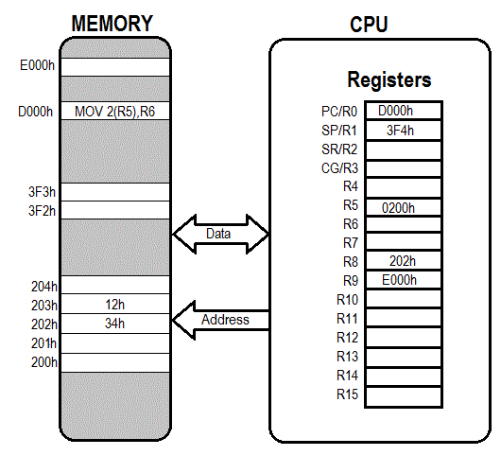
Indexed

Slide 15
Basic addressing modes
As/Ad | Addressing Mode | Description | Example
00/0 | Rn | Register direct | mov r8, r9
01/1 | offset(Rn) | Register indexed | mov 2(r8), r9
10/- | @Rn | Register indirect | mov @r8, r9
11/- | @Rn+ | Register indirect with post-increment | mov @r8+, r9
memory
registers
203 | 56
202 | 78
201 | 12
200 | 34
r8 | 0200
r9 | 0000

Slide 16
Basic addressing modes
As/Ad | Addressing Mode | Description | Example
00/0 | Rn | Register direct | mov r8, r9
01/1 | offset(Rn) | Register Indexed | mov 2(r8), r9
10/- | @Rn | Register indirect | mov @r8, r9
11/- | @Rn+ | Register indirect with post-increment | mov @r8+, r9
memory
registers
203 | 56
202 | 78
201 | 12
200 | 34
r8 | 0200
r9 | 1234
Like a pointer
Is this the same as: move 0(r8), r9 ???

Slide 17

Register Indirect

Slide 18
Hand assembly
no .b
register mode
mov @r7, r8
 | 15 | 14 | 13 | 12 | 11 | 10 | 9 | 8 | 7 | 6 | 5 | 4 | 3 | 2 | 1 | 0
Two Operand | Opcode |  |  |  | Source reg |  |  |  | Ad | W=0/B=1 | As |  | Dest reg
indirect register mode
Figure 3-12
Family User Guide 3.4.5 pp62
Blue Book pp19
_ _ _ _ _ _ _ _ _ _ _ _ _ _ _ _

Slide 19
Basic addressing modes
As/Ad | Addressing Mode | Description | Example
00/0 | Rn | Register direct | mov r8, r9
01/1 | offset(Rn) | Register Indexed | mov 2(r8), r9
10/- | @Rn | Register indirect | mov @r8, r9
11/- | @Rn+ | Register indirect with post-increment | mov @r8+, r9
memory
registers
203 | 56
202 | 78
201 | 12
200 | 34
r8 | 0200
r9 | 0000

Slide 20
Basic addressing modes
As/Ad | Addressing Mode | Description | Example
00/0 | Rn | Register direct | mov r8, r9
01/1 | offset(Rn) | Register Indexed | mov 2(r8), r9
10/- | @Rn | Register indirect | mov @r8, r9
11/- | @Rn+ | Register indirect with post-increment | mov @r8+, r9
memory
registers
203 | 56
202 | 78
201 | 12
200 | 34
r8 | 0202
r9 | 1234

Slide 21
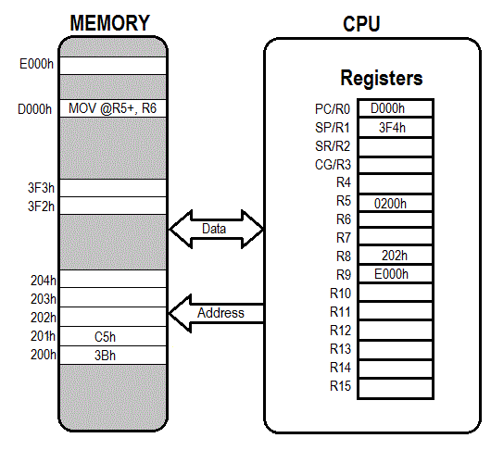

Slide 22
Other Addressing Modes
Immediate: mov.w #BEEF, r6
Symbolic/PC Relative: mov.w magic_number, r7
magic_number .word 0xafaf
becomes mov.w xxxx(PC), r7
Absolute: mov.w &0200, r6
mov.w #0xff, &P1OUT
mov.w #0xff, P1OUT ????

Slide 23

Immediate

Slide 24

Absolute

Slide 25
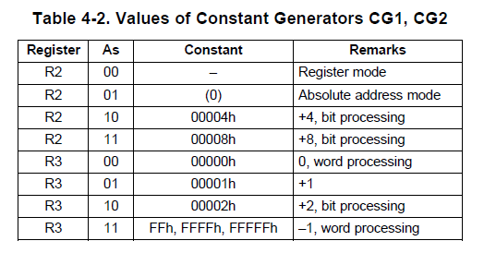
Values of Constant Generators CG1, CG2
Family User Guide 3.4.5 pp122

Slide 26
Hand assembly
no .b
register mode
rrc r6
_ _ _ _ _ _ _ _ _ _ _ _ _ _ _ _
Figure 3-12
Family User Guide 3.4.5 pp62
Blue Book pp19

Slide 27
Example Program Where’s the BEEF?
; example program to fill memory with BEEF -- what are the addressing modes used?
mov.w #0x200, r5
mov.w #0xBEEF,r6
fill: mov.w r6, 0(r5)
incd r5
cmp.w #0x0400, r5
jne fill
forever: jmp forever

Slide 28
In class programming exercise
; write an example program to add the numbers 0x06 through 0x15

Slide 29
In class programming exercise
; example program to add the numbers 10+9+8+...+1
mov.w #10, r6
mov.w #0, r5
summation: add.w r6, r5
dec r6
jnz summation
mov.w r5, &0x0200
forever: jmp forever

