Slide 1
ECE 382 Lesson 4
Readings
MSP430 Family Users Guide pp47-55 Davies 5.2 (pp125 - pp131) MSP430 Addressing Modes
Lesson Outline
Addressing Modes
CompEx1 → due lesson 6
Admin
Assignment 1 due today
Assignment 2 due next lesson

Slide 2
Relative Jump Instruction
Doesn’t use addressing mode.
forever JMP forever ; what does this do?
All instructions are 16 bits long. Their binary format looks like this:
15 | 14 | 13 | 12 | 11 | 10 | 9 | 8 | 7 | 6 | 5 | 4 | 3 | 2 | 1 | 0
0 | 0 | 1 | Condition |  |  | PC offset (10 bit)
:

Slide 3
MSP430 addressing modes
As/Ad | Addressing Mode | Description | Example
00/0 | Rn | Register direct | mov r8, r9
01/1 | offset(Rn) | Indexed | mov 2(r8), r9
10/- | @Rn | Register indirect | mov @r8, r9
11/- | @Rn+ | Register indirect with post-increment | mov @r8+, r9
01/1 | ADDR | Symbolic (PC relative) | mov LoopCtr, r6
01/1 | &ADDR | Absolute | mov r5, &0x0200
11/- | #N | Immediate | mov #0x2006, r6

Slide 4
Basic addressing modes
As/Ad | Addressing Mode | Description | Example
00/0 | Rn | Register direct | mov r8, r9
01/1 | offset(Rn) | Indexed | mov 2(r8), r9
10/- | @Rn | Register indirect | mov @r8, r9
11/- | @Rn+ | Register indirect with post-increment | mov @r8+, r9
memory
registers
203 | 56
202 | 78
201 | 12
200 | 34
r8 | 0200
r9 | 0000

Slide 5
Basic addressing modes
As/Ad | Addressing Mode | Description | Example
00/0 | Rn | Register direct | mov r8, r9
01/1 | offset(Rn) | Indexed | mov 2(r8), r9
10/- | @Rn | Register indirect | mov @r8, r9
11/- | @Rn+ | Register indirect with post-increment | mov @r8+, r9
memory
registers
203 | 56
202 | 78
201 | 12
200 | 34
r8 | 0200
r9 | 0200

Slide 6
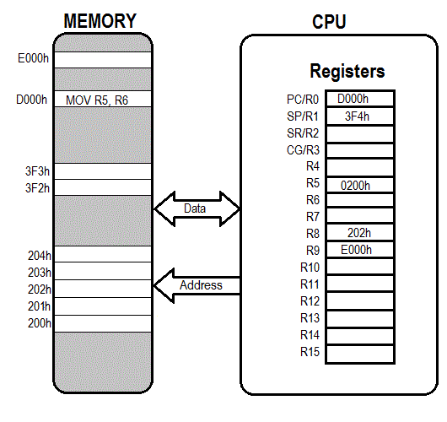
Register Direct

Slide 7
Basic addressing modes
As/Ad | Addressing Mode | Description | Example
00/0 | Rn | Register direct | mov r8, r9
01/1 | offset(Rn) | Indexed | mov 2(r8), r9
10/- | @Rn | Register indirect | mov @r8, r9
11/- | @Rn+ | Register indirect with post-increment | mov @r8+, r9
memory
registers
203 | 56
202 | 78
201 | 12
200 | 34
r8 | 0200
r9 | 0000

Slide 8
Basic addressing modes
As/Ad | Addressing Mode | Description | Example
00/0 | Rn | Register direct | mov r8, r9
01/1 | offset(Rn) | Indexed | mov 2(r8), r9
10/- | @Rn | Register indirect | mov @r8, r9
11/- | @Rn+ | Register indirect with post-increment | mov @r8+, r9
memory
registers
0200
+ 2
0202
203 | 56
202 | 78
201 | 12
200 | 34
r8 | 0200
r9 | 5678
How about: mov.w 2(r5), 6(r5) ???

Slide 9
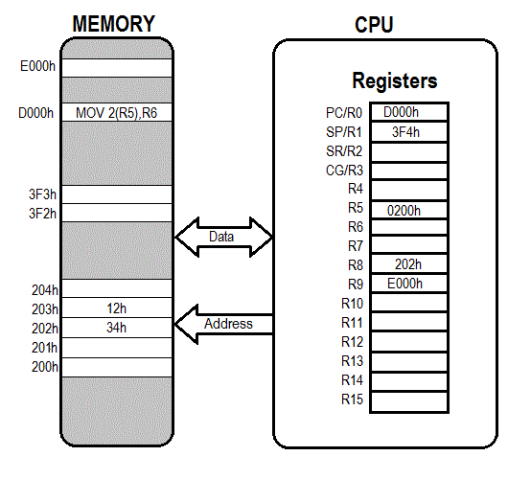
Indexed

Slide 10
Basic addressing modes
As/Ad | Addressing Mode | Description | Example
00/0 | Rn | Register direct | mov r8, r9
01/1 | offset(Rn) | Register indexed | mov 2(r8), r9
10/- | @Rn | Register indirect | mov @r8, r9
11/- | @Rn+ | Register indirect with post-increment | mov @r8+, r9
memory
registers
203 | 56
202 | 78
201 | 12
200 | 34
r8 | 0200
r9 | 0000

Slide 11
Basic addressing modes
As/Ad | Addressing Mode | Description | Example
00/0 | Rn | Register direct | mov r8, r9
01/1 | offset(Rn) | Indexed | mov 2(r8), r9
10/- | @Rn | Register indirect | mov @r8, r9
11/- | @Rn+ | Register indirect with post-increment | mov @r8+, r9
memory
registers
203 | 56
202 | 78
201 | 12
200 | 34
r8 | 0200
r9 | 1234
Like a pointer
Is this the same as: move 0(r5), r6 ???

Slide 12

Register Indirect

Slide 13
Basic addressing modes
As/Ad | Addressing Mode | Description | Example
00/0 | Rn | Register direct | mov r8, r9
01/1 | offset(Rn) | Indexed | mov 2(r8), r9
10/- | @Rn | Register indirect | mov @r8, r9
11/- | @Rn+ | Register indirect with post-increment | mov @r8+, r9
memory
registers
203 | 56
202 | 78
201 | 12
200 | 34
r8 | 0200
r9 | 0000

Slide 14
Basic addressing modes
As/Ad | Addressing Mode | Description | Example
00/0 | Rn | Register direct | mov r8, r9
01/1 | offset(Rn) | Indexed | mov 2(r8), r9
10/- | @Rn | Register indirect | mov @r8, r9
11/- | @Rn+ | Register indirect with post-increment | mov @r8+, r9
memory
registers
203 | 56
202 | 78
201 | 12
200 | 34
r8 | 0202
r9 | 1234

Slide 15
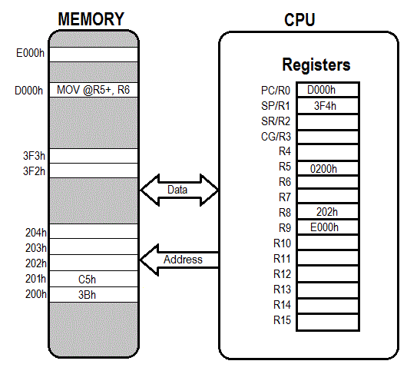

Slide 16
Other Addressing Modes
Immediate: mov.w #BEEF, r6
Symbolic/PC Relative: mov.w magic_number, r7
magic_number .word 0xafaf
becomes mov.w xxxx(PC), r7
Absolute: mov.w &0200, r6
mov.w #0xff, &P1OUT
mov.w #xff, P1OUT ????

Slide 17

Immediate

Slide 18

Absolute

Slide 19
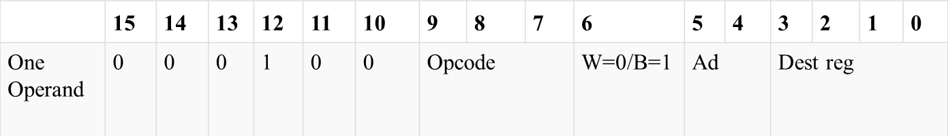
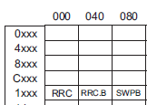
Hand assembly
no .b
register mode
rrc r6
_ _ _ _ _ _ _ _ _ _ _ _ _ _ _ _
Fig 3-12

Slide 20
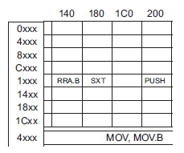
Hand assembly
no .b
register mode
mov @r7, r8
 | 15 | 14 | 13 | 12 | 11 | 10 | 9 | 8 | 7 | 6 | 5 | 4 | 3 | 2 | 1 | 0
Two Operand | Opcode |  |  |  | Source reg |  |  |  | Ad | W=0/B=1 | As |  | Dest reg
indirect register mode
_ _ _ _ _ _ _ _ _ _ _ _ _ _ _ _
Fig. 3-12

Slide 21
Let's write a MSP430 program
Our chip version: Msp430g2553 → open CCS
; This program sets all pins on Port 1 to output and high. Since LEDs 1 and 2 are connected to P1.0 and P1.6 respectively, they will light up. This program turns the LEDs on and off
.text
; turn off watchdog timer
main:
bis.b #0xFF, &P1DIR ; set port1 direction to output
Turn_on:
bis.b #0xFF, &P1OUT ; turn on leds at port1, bis?
; could of: move ____ , &P1OUT
Turn_off:
bic.b #0xFF, &P1OUT ; turn on leds at port1, bic?
; could of: move ____ , &P1OUT
jmp Turn_on ; loop forever
← what?
Stack pointer?

Slide 22
Example Program Where’s the BEEF?
; example program to fill memory with BEEF -- what are the addressing modes used?
mov.w #0x200, r5
mov.w #0xBEEF,r6
fill: mov.w r6, 0(r5)
incd r5
cmp.w #0x0400, r5
jne fill
forever: jmp forever

Slide 23
Sample Program – predict what happens
repeat:
mov.b #0x75, r10
add.b #0xC7, r10
;result should be 0x13c, so we should see 3c in r10 and carry bit set
adc r10
;since carry bit was set, this should increment r10 to 3d
inv.b r10
;invert, so r10 should be c2
mov.w #0x00aa, r10
sxt r10
;sign extend should clear upper 8 bits
inv r10
swpb r10
mov.w r10, r9
jmp repeat
c010: 7a 40 75 00 mov.b #117, r10 ;#0x0075
c014: 7a 50 c7 00 add.b #199, r10 ;#0x00c7
c018: 0a 63 adc r10
c01a: 7a e3 xor.b #-1, r10 ;r3 As==11
c01c: 3a 40 aa 00 mov #170, r10 ;#0x00aa
c020: 8a 11 sxt r10
c022: 3a e3 inv r10
c024: 8a 10 swpb r10
c026: 09 4a mov r10, r9
c028: f3 3f jmp $-24 ;abs 0xc010

Slide 24
In class programming exercise
; write an example program to add the numbers 0x06 through 0x15

Slide 25
In class programming exercise
; example program to add the numbers 10+9+8+...+1
mov.w #10, r6
mov.w #0, r5
summation: add.w r6, r5
dec r6
jnz summation
mov.w r5, &0x0200
forever: jmp forever

Slide 26
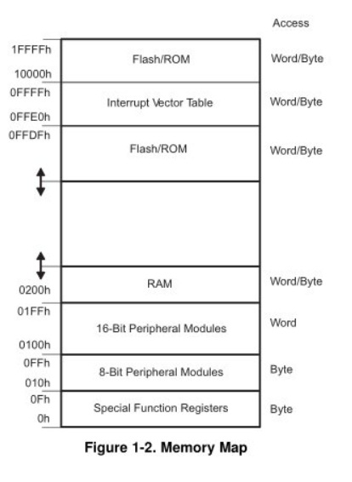
MSP430’s ISA
How many addr bits?
Msp430g2553 Memory Map
512b of RAM - 0x200-0x400 16kb of ROM - 0xc000-0xffdf
0x1100-0xc000 is empty!
- There is no memory backing it up!
- If you attempt to write to this area of memory, you'll trigger what's essentially a segmentation fault because that memory doesn't exist. It will cause the chip to do a Power-up Clear (PUC), resetting the state of your processor. This is a tough error to debug.

Slide 27
Assembly and Machine Languages
Instructions:
words in a computers language
Instruction Set:
the dictionary of the language
Assembly Language:
human-readable format of computer instructions
Machine Language:
computer-readable instructions - binary (1's and 0's)
Assembly Language Program
Assembler
Relocatable Object Code
Linker
Executable Code

Slide 28
MSP430 addressing modes
As/Ad | Addressing Mode | Description | Example
00/0 | Rn | Register direct | mov r8, r9
01/1 | offset(Rn) | Indexed | mov 2(r8), r9
10/- | @Rn | Register indirect | mov @r8, r9
11/- | @Rn+ | Register indirect with post-increment | mov @r8+, r9
01/1 | ADDR | Symbolic (PC relative) | mov LoopCtr, r6
01/1 | &ADDR | Absolute | mov r5, &0x0200
11/- | #N | Immediate | mov #0x2006, r6

Slide 29
Basic addressing modes
As/Ad | Addressing Mode | Description | Example
00/0 | Rn | Register direct | mov r8, r9
01/1 | offset(Rn) | Indexed | mov 2(r8), r9
10/- | @Rn | Register indirect | mov @r8, r9
11/- | @Rn+ | Register indirect with post-increment | mov @r8+, r9
memory
registers
203 | 56
202 | 78
201 | 12
200 | 34
r8 | 0200
r9 | 0000

Slide 30
Basic addressing modes
As/Ad | Addressing Mode | Description | Example
00/0 | Rn | Register direct | mov r8, r9
01/1 | offset(Rn) | Indexed | mov 2(r8), r9
10/- | @Rn | Register indirect | mov @r8, r9
11/- | @Rn+ | Register indirect with post-increment | mov @r8+, r9
memory
registers
203 | 56
202 | 78
201 | 12
200 | 34
r8 | 0200
r9 | 0200

Slide 31
Register Direct

Slide 32
Hand assembly
no .b
register mode
mov r11, r10
 | 15 | 14 | 13 | 12 | 11 | 10 | 9 | 8 | 7 | 6 | 5 | 4 | 3 | 2 | 1 | 0
Two Operand | Opcode |  |  |  | Source reg |  |  |  | Ad | W=0/B=1 | As |  | Dest reg
register mode
_ _ _ _ _ _ _ _ _ _ _ _ _ _ _ _
Fig. 3-12

Slide 33
Hand assembly
no .b
register mode
swpb r10
_ _ _ _ _ _ _ _ _ _ _ _ _ _ _ _
Fig 3-12

Slide 34
Basic addressing modes
As/Ad | Addressing Mode | Description | Example
00/0 | Rn | Register direct | mov r8, r9
01/1 | offset(Rn) | Indexed | mov 2(r8), r9
10/- | @Rn | Register indirect | mov @r8, r9
11/- | @Rn+ | Register indirect with post-increment | mov @r8+, r9
memory
registers
203 | 56
202 | 78
201 | 12
200 | 34
r8 | 0200
r9 | 0000

Slide 35
Basic addressing modes
As/Ad | Addressing Mode | Description | Example
00/0 | Rn | Register direct | mov r8, r9
01/1 | offset(Rn) | Indexed | mov 2(r8), r9
10/- | @Rn | Register indirect | mov @r8, r9
11/- | @Rn+ | Register indirect with post-increment | mov @r8+, r9
memory
registers
0200
+ 2
0202
203 | 56
202 | 78
201 | 12
200 | 34
r8 | 0200
r9 | 5678
How about: mov.w 2(r5), 6(r5) ???

Slide 36
Indexed

Slide 37
Hand assembly
.w word
Indexed register mode
mov.w 2(r5), 6(r5)
 | 15 | 14 | 13 | 12 | 11 | 10 | 9 | 8 | 7 | 6 | 5 | 4 | 3 | 2 | 1 | 0
Two Operand | Opcode |  |  |  | Source reg |  |  |  | Ad | W=0/B=1 | As |  | Dest reg
Source or Destination 15:0
Destination 15:0
Indexed register mode
_ _ _ _ _ _ _ _ _ _ _ _ _ _ _ _
Fig. 3-12

Slide 38
Basic addressing modes
As/Ad | Addressing Mode | Description | Example
00/0 | Rn | Register direct | mov r8, r9
01/1 | offset(Rn) | Register indexed | mov 2(r8), r9
10/- | @Rn | Register indirect | mov @r8, r9
11/- | @Rn+ | Register indirect with post-increment | mov @r8+, r9
memory
registers
203 | 56
202 | 78
201 | 12
200 | 34
r8 | 0200
r9 | 0000

Slide 39
Basic addressing modes
As/Ad | Addressing Mode | Description | Example
00/0 | Rn | Register direct | mov r8, r9
01/1 | offset(Rn) | Indexed | mov 2(r8), r9
10/- | @Rn | Register indirect | mov @r8, r9
11/- | @Rn+ | Register indirect with post-increment | mov @r8+, r9
memory
registers
203 | 56
202 | 78
201 | 12
200 | 34
r8 | 0200
r9 | 1234
Like a pointer
Is this the same as: move 0(r5), r6 ???

Slide 40
Register Indirect

Slide 41
Hand assembly
no .b
register mode
mov @r7, r8
 | 15 | 14 | 13 | 12 | 11 | 10 | 9 | 8 | 7 | 6 | 5 | 4 | 3 | 2 | 1 | 0
Two Operand | Opcode |  |  |  | Source reg |  |  |  | Ad | W=0/B=1 | As |  | Dest reg
indirect register mode
_ _ _ _ _ _ _ _ _ _ _ _ _ _ _ _
Fig. 3-12

Slide 42
Basic addressing modes
As/Ad | Addressing Mode | Description | Example
00/0 | Rn | Register direct | mov r8, r9
01/1 | offset(Rn) | Indexed | mov 2(r8), r9
10/- | @Rn | Register indirect | mov @r8, r9
11/- | @Rn+ | Register indirect with post-increment | mov @r8+, r9
memory
registers
203 | 56
202 | 78
201 | 12
200 | 34
r8 | 0200
r9 | 0000

Slide 43
Basic addressing modes
As/Ad | Addressing Mode | Description | Example
00/0 | Rn | Register direct | mov r8, r9
01/1 | offset(Rn) | Indexed | mov 2(r8), r9
10/- | @Rn | Register indirect | mov @r8, r9
11/- | @Rn+ | Register indirect with post-increment | mov @r8+, r9
memory
registers
203 | 56
202 | 78
201 | 12
200 | 34
r8 | 0202
r9 | 1234

Slide 45
Other Addressing Modes
Immediate: mov.w #BEEF, r6
Symbolic/PC Relative: mov.w magic_number, r7
magic_number .word 0xafaf
becomes mov.w xxxx(PC), r7
Absolute: mov.w &0200, r6
mov.w #0xff, &P1OUT
mov.w #xff, P1OUT ????

Slide 46
Immediate

Slide 47
Absolute

Slide 48
Hand assembly
no .b
register mode
rrc r6
_ _ _ _ _ _ _ _ _ _ _ _ _ _ _ _
Fig 3-12

Slide 49
Hand assembly
no .b
register mode
mov @r7, r8
 | 15 | 14 | 13 | 12 | 11 | 10 | 9 | 8 | 7 | 6 | 5 | 4 | 3 | 2 | 1 | 0
Two Operand | Opcode |  |  |  | Source reg |  |  |  | Ad | W=0/B=1 | As |  | Dest reg
indirect register mode
_ _ _ _ _ _ _ _ _ _ _ _ _ _ _ _
Fig. 3-12

Slide 50
Single-Operand Instruction
STX r10
All instructions are 16 bits long. Their binary format looks like this:
15 | 14 | 13 | 12 | 11 | 10 | 9 | 8 | 7 | 6 | 5 | 4 | 3 | 2 | 1 | 0
0 | 0 | 0 | 1 | 0 | 0 | Opcode |  |  | W=0/ B=1 | Ad |  | Dest reg
:

Slide 51
Relative Jump Instruction
JMP $-024
All instructions are 16 bits long. Their binary format looks like this:
15 | 14 | 13 | 12 | 11 | 10 | 9 | 8 | 7 | 6 | 5 | 4 | 3 | 2 | 1 | 0
0 | 0 | 1 | Condition |  |  | PC offset (10 bit)
:

Slide 52
Two-Operand Instruction
MOV r10, r9
All instructions are 16 bits long. Their binary format looks like this:
15 | 14 | 13 | 12 | 11 | 10 | 9 | 8 | 7 | 6 | 5 | 4 | 3 | 2 | 1 | 0
Opcode |  |  |  | Source reg |  |  |  | Ad | W=0/B=1 | As |  | Dest reg
:

Slide 53
Let's write a MSP430 program
Our chip version: Msp430g2553 → open CCS
; This program sets all pins on Port 1 to output and high. Since LEDs 1 and 2 are connected to P1.0 and P1.6 respectively, they will light up. This program turns the LEDs on and off
.text
; turn off watchdog timer
main:
bis.b #0xFF, &P1DIR ; set port1 direction to output
Turn_on:
bis.b #0xFF, &P1OUT ; turn on leds at port1, bis?
; could of: move ____ , &P1OUT
Turn_off:
bic.b #0xFF, &P1OUT ; turn on leds at port1, bic?
; could of: move ____ , &P1OUT
jmp Turn_on ; loop forever
← what?
Stack pointer?

Slide 54
Example Program Where’s the BEEF?
; example program to fill memory with BEEF -- what are the addressing modes used?
mov.w #0x200, r5
mov.w #0xBEEF,r6
fill: mov.w r6, 0(r5)
incd r5
cmp.w #0x0400, r5
jne fill
forever: jmp forever

Slide 55
Sample Program – predict what happens
repeat:
mov.b #0x75, r10
add.b #0xC7, r10
;result should be 0x13c, so we should see 3c in r10 and carry bit set
adc r10
;since carry bit was set, this should increment r10 to 3d
inv.b r10
;invert, so r10 should be c2
mov.w #0x00aa, r10
sxt r10
;sign extend should clear upper 8 bits
inv r10
swpb r10
mov.w r10, r9
jmp repeat
c010: 7a 40 75 00 mov.b #117, r10 ;#0x0075
c014: 7a 50 c7 00 add.b #199, r10 ;#0x00c7
c018: 0a 63 adc r10
c01a: 7a e3 xor.b #-1, r10 ;r3 As==11
c01c: 3a 40 aa 00 mov #170, r10 ;#0x00aa
c020: 8a 11 sxt r10
c022: 3a e3 inv r10
c024: 8a 10 swpb r10
c026: 09 4a mov r10, r9
c028: f3 3f jmp $-24 ;abs 0xc010

Slide 56
In class programming exercise
; write an example program to add the numbers 0x06 through 0x15

Slide 57
In class programming exercise
; example program to add the numbers 10+9+8+...+1
mov.w #10, r6
mov.w #0, r5
summation: add.w r6, r5
dec r6
jnz summation
mov.w r5, &0x0200
forever: jmp forever

Slide 58
MSP430’s ISA
How many addr bits?
Msp430g2553 Memory Map
512b of RAM - 0x200-0x400 16kb of ROM - 0xc000-0xffdf
0x1100-0xc000 is empty!
- There is no memory backing it up!
- If you attempt to write to this area of memory, you'll trigger what's essentially a segmentation fault because that memory doesn't exist. It will cause the chip to do a Power-up Clear (PUC), resetting the state of your processor. This is a tough error to debug.

Slide 59
Assembly and Machine Languages
Instructions:
words in a computers language
Instruction Set:
the dictionary of the language
Assembly Language:
human-readable format of computer instructions
Machine Language:
computer-readable instructions - binary (1's and 0's)
Assembly Language Program
Assembler
Relocatable Object Code
Linker
Executable Code

