Slide 1
ECE 382 Lesson 19
Lesson Outline
High-Level Programming Languages
Compilers
Intro to C
Admin
GR#1
Know for FINAL EXAM!
Lab 3 Functionality due COB Lesson 19 (Tuesday)
Lab 3 Notebook extended to COB Lesson 20 (Thursday)
Assignment 6 due BOC next Lesson

Slide 2
Lab 3 Cuts
Item | Grade | Points | Out of | Date | Due
Mega Prelab | On-Time: -------------------------------------------------------------------- Late: 1Day ---- 2Days |  | 20 |  | EOC L16
Required Logic Analyzer | On-Time: -------------------------------------------------------------------- Late: 1Day ---- 2Days ---- 3Days ---- 4+Days |  | 40 |  | COB L20
Required Functionality | On-Time: -------------------------------------------------------------------- Late: 1Day ---- 2Days ---- 3Days ---- 4+Days |  | 20 |  | COB L19
A Functionality | On-Time: -------------------------------------------------------------------- Late: 1Day ---- 2Days ---- 3Days ---- 4+Days |  | 10 |  | COB L19
Bonus Functionality | On-Time: -------------------------------------------------------------------- Late: 1Day ---- 2Days ---- 3Days ---- 4+Days |  | 5 |  | COB L19
Lab Notebook | On-Time: -------------------------------------------------------------------- Late: 1Day ---- 2Days ---- 3Days ---- 4+Days |  | 10 |  | COB L20
Total |  |  | 100

Slide 3
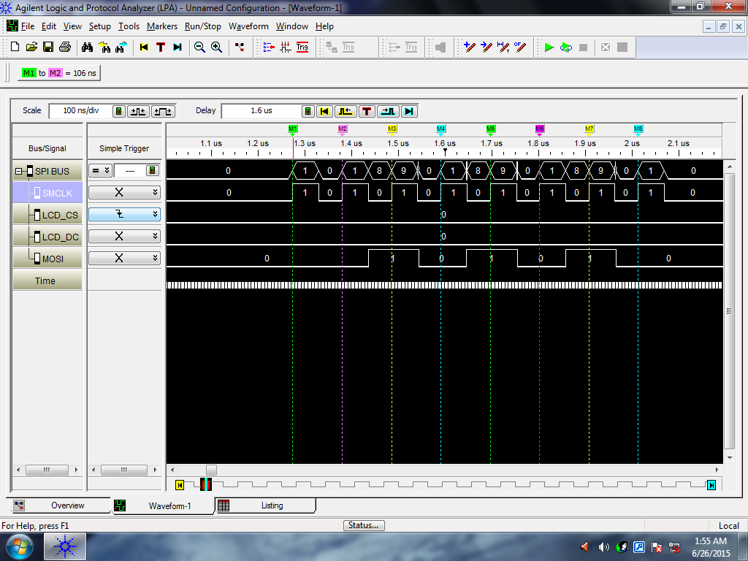
Logic Analyzer Good/Bad

Slide 4
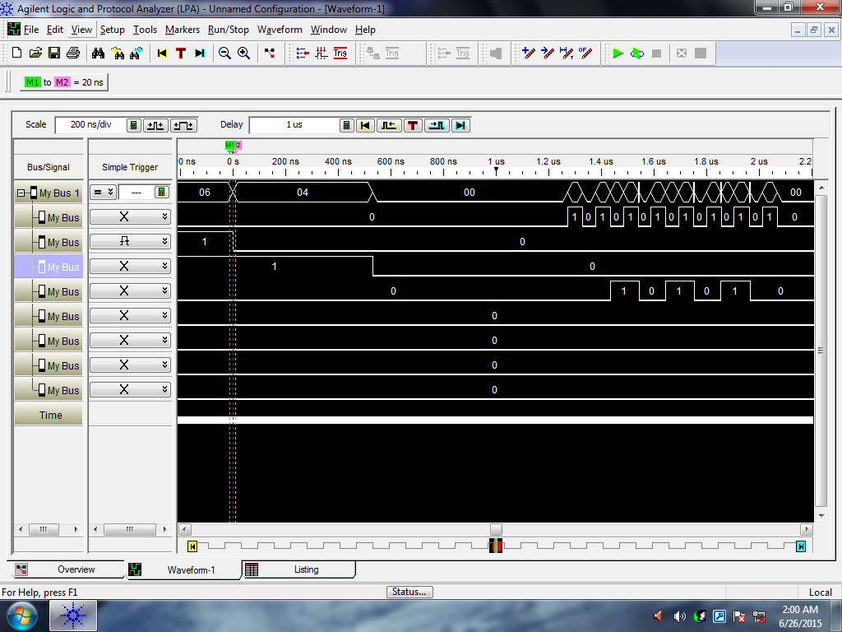
Logic Analyzer Good/Bad

Slide 5
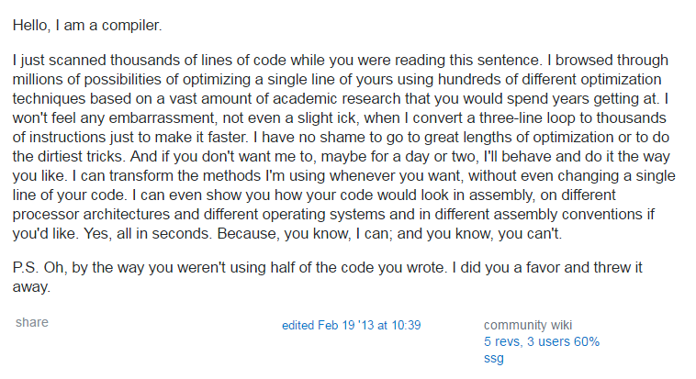
High Level Language versus Assembly
I'm a Compiler
List of Programming Languages
Benefits of using these over programming in assembly?

Slide 6
High Level Language versus Assembly
I'm a Compiler
List of Programming Languages
Benefits of using these over programming in assembly?
Ease of development
HLLs offer constructs that allow us to develop code faster
Loops
conditional statements (if/then)
Functions
memory management (for some)
Portability
HLL code can be made to run on many different machines, whereas assembly is architecture-specific
Readability
HLL code is generally easier to read / understand than assembly
Optimization
Humans typically aren't that great at writing assembly code
HLLs can offer optimization techniques / restrictions that can improve poorly-written code

Slide 7
High Level Language versus Assembly
Some perspective: everything that happens on a computer is machine code. What do we use to generate machine code? The assembler. So every program you write ultimately becomes assembly code, then machine code

Slide 8
Compiler
High Level Language Program
Compiler
Assembly Code
Assembler
Relocatable Object Code
Linker
Executable Code

Slide 9
Compiler
High Level Language Program
High Level Language Program
Compiler
Cross-Compiler
Assembly Code
Assembly Code
Assembler
Cross-Assembler
Relocatable Object Code
Relocatable Object Code
Linker
Linker
Executable Code
Executable Code

Slide 10
Compiler
Compiled Language versus Interpreted?
Examples:
Any Advantages of Assembly over HLL?

Slide 11
Compiler
Compiled Language versus Interpreted?
Examples:
Fast ←→ Portable
Any Advantages of Assembly over HLL?
Compiled | Both | Interpreted
C | Java | Python
C++ | C# | Prolog
Ada |  | Matlab
 |  | Scheme
 |  | Ruby

Slide 12
Compiler
Compiled Language versus Interpreted?
Examples:
Fast ←→ Portable
Any Advantages of Assembly over HLL?
HLL do not use all features of a chip
HLL has less control over generated code
HLL runs slower (usually)
Compiled | Both | Interpreted
C | Java | Python
C++ | C# | Prolog
Ada |  | Matlab
 |  | Scheme
 |  | Ruby

Slide 13
Why C?
One of the most widely used programming languages of all time
Examples of projects coded in C:
Kernel / OS: Linux, GNU
Version Control: git
Web Server: Apache, nginx
Interpreter: Ruby, Python
Databases: mysql, postgresql, redis
Virtualization: vmware
Almost anything embedded, device drivers
C is like a portable, higher-level assembly

Slide 14
C Language: Comments
// Single line comment
/* block comment that can span
multiple lines */
int i = 0; // a declaration
/*************************************
** The previous variable was
** declared just as an example.
*************************************/

Slide 15
C Language: Variables
Variable Types
Type | Size | Description
char | 1 byte | number or ASCII character
int | 2 bytes | larger number
float | 2 bytes | single-precision floating point number
double | 4 bytes | double-precision floating point number
•Note: These sizes are dependent on the compiler and target architecture - these are for the MSP430.
•Note: Do not use the float / double types on the MSP430 - since it doesn't have floating point hardware support, implementing software support will use almost all of your memory.

Slide 16
C Language: Variables
Variable Modifiers
Modifier | Description
short | remains a 2-byte integer
long | increases int size to 4 bytes
signed | two's complement numbers (default)
unsigned | allows unsigned arithmetic
static | directly allocates memory to remember a value between function calls. Variable is allocated to "permanent" memory, not the stack.
extern | actual storage and initial value of variable is defined elsewhere
const | assigns a constant (read-only) value to a variable
•Note: Once again, sizes are dependent on compiler / target architecture - these are for the MSP

Slide 17
C Language: Constants
Preferred Constant Declaration
The #define statement is a pre-processor directive.
pre-processor will “find-replace” each instant
similar to a .equ statement in assembly.
// #define MY_CONST some_value
#define SCREEN_WIDTH 640
#define SCREEN_HEIGHT 480
int numPixels = 0;
numPixels = SCREEN_WIDTH * SCREEN_HEIGHT;
•Note: There is no ';' or '=' in #define statements
•Note: Variables must be declared at the top of a block, and they are not initialized by default. A block is denoted by braces {}
•Note: A value can be binary (0b), octal (0), or hex (0x) by using prefixes

Slide 18
C Language: Operators
Assignment, Arithmetic Operators
char myVar, a, b; // variable declaration
myVar = a; // assignment - note, all vars have undefined values at this point
myVar = a + b; // addition
myVar = a - b; // subtraction
myVar = a * b; // multiplication
myVar = a / b; // division
myVar = a % b; // modulus (remainder)
myVar++; // increment
myVar--; // decrement
myVar += a; // myVar = myVar + a
myVar -= a; // myVar = myVar - a

Slide 19
C Language: Operators
Relational Operators
if ((a < 10) && (a > 5))
{
// literally: if a is greater than 5 and less than 10, do whatever is in here
// practically: if a is between 5 and 10, do whatever is in here
}
•Note: In C, "false" is 0, while any non-zero value is considered true.
Operator | Description | Example
< | less than
<= | less than or equal to
> | greater than
>= | greater than or equal to
== | equal to
!= | not equal to
&& | logical AND
| | | logical OR

Slide 20
C Language: Operators
Bit-wise Operators
// Example with SPI
UCA0CTL1 &= ~UCSWRST; // disable the subsystem (AND UCA0CTL1 with NOT UCSWRST)
UCA0CTL1 |= UCSWRST; // enable the subsystem (OR UCA0CTL1 with UCSWRST)
Operator | Description | Example
& | AND
| | OR
^ | XOR
~ | One's Complement
>> | Bit-shift right
<< | Bit-shift left

Slide 21
If Statement
if (logical expression)
{
statements;
} else if (logical expression)
{
statements;
}
...
else
{
statements;
}
Example:
if (temp < MIN_TEMP)
{
flag = TOO_LOW;
} else if (temp > MAX_TEMP)
{
flag = TOO_HIGH;
}
else
{
flag = JUST_RIGHT;
}

Slide 22
Switch Statement
switch (value)
{
case constant-expression1:
statements;
break;
case constant-expression2:
statements;
break;
default:
// gets executed if no other case hits
statements;
break;
}
Example:
switch (GAME_STATE)
{
case MENU:
displayMenu();
break;
case PLAYING:
updateState();
break;
case LOST:
displayLost();
break;
}

Slide 23
For Loop
for (initial; continue; increment)
{
statements;
}
initial - evaluated once, immediately before the first iteration of the loop. Usually used to initialize variable.
continue - condition checked to execute the next iteration. If false, then the loop terminates.
increment - single statement executed at the end of each loop. Usually used to increment / decrement a variable.
Example:
for (i = 1; i <= 20; i++)
{
sum += i;
}

Slide 24
While / Do While Loop
while (condition) {
statements;
}
do while is guaranteed to be executed once, while isn't.
do
{
statements;
} while (condition);
Example:
int i = 5;
while (i < 10)
{
i++;
}
do {
i++
} while (i < 10);
// final value of i is 11

Slide 25
Basic C Program Structure
// #include statements
// #define statements
// global variables
void main(void)
{
// Variable declarations
// Useful code
while (1) {} // trap the CPU
}
Example:
#include <stdio.h>
#include “math.h"
#define NUM_LOOPS 23
void main(void)
{
unsigned char i;
unsigned int summation = 0;
for (i = 1; i <= NUM_LOOPS; i++)
{
summation += i;
}
while (1) {} // trap the CPU
}

Slide 26
Headers !!!!
/*--------------------------------------------------------------------
Name:<Your Name>
Date:<The date you stated working on the file>
Course: <The course's name>
File:<This file's name>
HW: <HW# and name>
Purp:A brief description of what this program does and
the general solution strategy.
Doc: <list the names of the people who you helped>
<list the names of the people who assisted you>
Academic Integrity Statement: I certify that, while others may have
assisted me in brain storming, debugging and validating this program,
the program itself is my own work. I understand that submitting code
which is the work of other individuals is a violation of the honor
code. I also understand that if I knowingly give my original work to
another individual is also a violation of the honor code.
-------------------------------------------------------------------------*/
Want to edit your default empty C template??? Then modify:
C:\ti\ccsv6\eclipse\plugins\com.ti.ccstudio.project.templates_6.1.0.201502111100\resources\msp430\empty\main.c
Try Assignment 6:
http://ece.ninja/382/notes/L19/L19_C_basics.html

