Slide 1
ECE 382 Lesson 4
Readings
Barrett 2.8-2.11 (pp47-54) MSP430 Family Users Guide pp47-55 MSP430 Addressing Modes
Lesson Outline
Addressing Modes
CompEx1 → due lesson 6
Admin
Assignment 1 due today
uCorrupt1 due today
Assignment 2 due next lesson

Slide 2
What does this program do? Where’s the BEEF?
; first thing's first - how do we create a comment?
mov.w #0x0200, r5
mov.w #0xbeef, r6
fill mov.w r6, 0(r5) ; anyone know what this syntax means?
incd r5
cmp.w #0x0400, r5 ; what does this instruction do?
jne fill
forever jmp forever

Slide 3
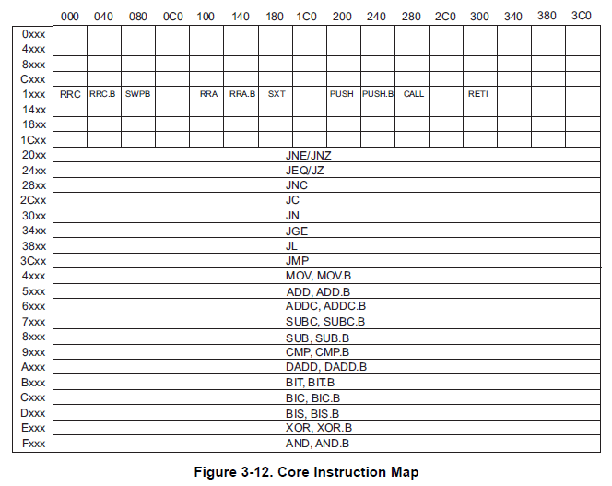
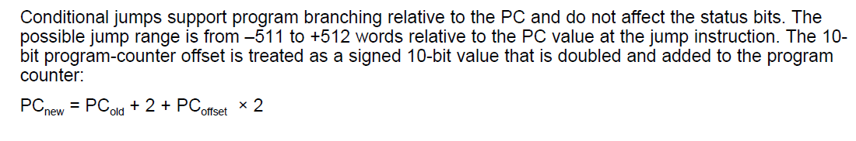
Relative Jump Instruction
Doesn’t use addressing mode.
forever JMP forever ; what does this do?
All instructions are 16 bits long. Their binary format looks like this:
15 | 14 | 13 | 12 | 11 | 10 | 9 | 8 | 7 | 6 | 5 | 4 | 3 | 2 | 1 | 0
0 | 0 | 1 | Condition |  |  | PC offset (10 bit)
Figure 3-12
Family User Guide 3.4.5 pp62
Blue Book pp19
:
:
_ _ _ _ _ _ _ _ _ _ _ _ _ _ _ _
Family User Guide 3.4.5 pp59
Blue Book pp18

Slide 4
MSP430 addressing modes
As/Ad | Addressing Mode | Description | Example
00/0 | Rn | Register direct | mov r8, r9
01/1 | offset(Rn) | Register Indexed | mov 2(r8), r9
10/- | @Rn | Register indirect | mov @r8, r9
11/- | @Rn+ | Register indirect with post-increment | mov @r8+, r9
01/1 | ADDR | Symbolic (PC relative) | mov LoopCtr, r6
01/1 | &ADDR | Absolute | mov r5, &0x0200
11/- | #N | Immediate | mov #0x2006, r6

Slide 5
Basic addressing modes
As/Ad | Addressing Mode | Description | Example
00/0 | Rn | Register direct | mov r8, r9
01/1 | offset(Rn) | Register Indexed | mov 2(r8), r9
10/- | @Rn | Register indirect | mov @r8, r9
11/- | @Rn+ | Register indirect with post-increment | mov @r8+, r9
memory
registers
203 | 56
202 | 78
201 | 12
200 | 34
r8 | 0200
r9 | 0000

Slide 6
Basic addressing modes
As/Ad | Addressing Mode | Description | Example
00/0 | Rn | Register direct | mov r8, r9
01/1 | offset(Rn) | Register Indexed | mov 2(r8), r9
10/- | @Rn | Register indirect | mov @r8, r9
11/- | @Rn+ | Register indirect with post-increment | mov @r8+, r9
memory
registers
203 | 56
202 | 78
201 | 12
200 | 34
r8 | 0200
r9 | 0200

Slide 7
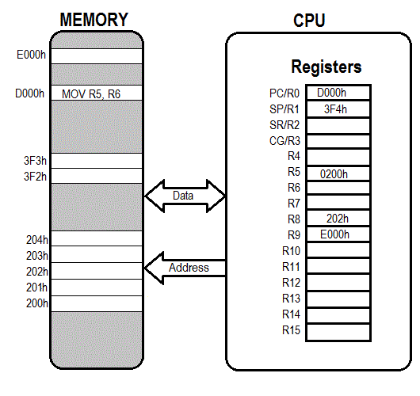
Register Direct

Slide 8
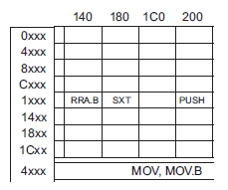
Hand assembly
no .b
register mode
mov r11, r10
 | 15 | 14 | 13 | 12 | 11 | 10 | 9 | 8 | 7 | 6 | 5 | 4 | 3 | 2 | 1 | 0
Two Operand | Opcode |  |  |  | Source reg |  |  |  | Ad | W=0/B=1 | As |  | Dest reg
register mode
_ _ _ _ _ _ _ _ _ _ _ _ _ _ _ _
Fig. 3-12

Slide 9
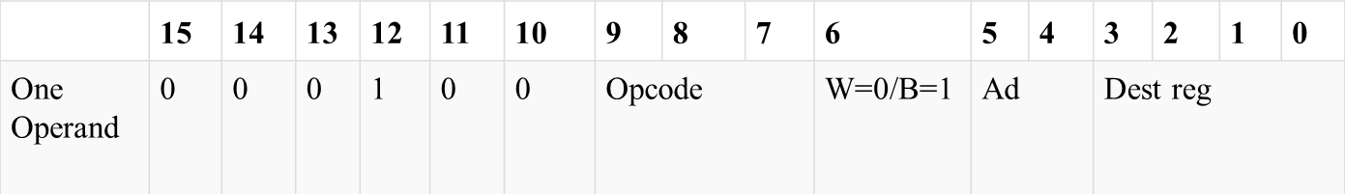
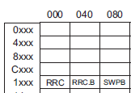
Hand assembly
no .b
register mode
swpb r10
_ _ _ _ _ _ _ _ _ _ _ _ _ _ _ _
Figure 3-12
Family User Guide 3.4.5 pp62
Blue Book pp19

Slide 10
Basic addressing modes
As/Ad | Addressing Mode | Description | Example
00/0 | Rn | Register direct | mov r8, r9
01/1 | offset(Rn) | Register Indexed | mov 2(r8), r9
10/- | @Rn | Register indirect | mov @r8, r9
11/- | @Rn+ | Register indirect with post-increment | mov @r8+, r9
memory
registers
203 | 56
202 | 78
201 | 12
200 | 34
r8 | 0200
r9 | 0000

Slide 11
Basic addressing modes
As/Ad | Addressing Mode | Description | Example
00/0 | Rn | Register direct | mov r8, r9
01/1 | offset(Rn) | Register Indexed | mov 2(r8), r9
10/- | @Rn | Register indirect | mov @r8, r9
11/- | @Rn+ | Register indirect with post-increment | mov @r8+, r9
memory
registers
0200
+ 2
0202
203 | 56
202 | 78
201 | 12
200 | 34
r8 | 0200
r9 | 5678
How about: mov.w 2(r5), 6(r5) ???

Slide 12
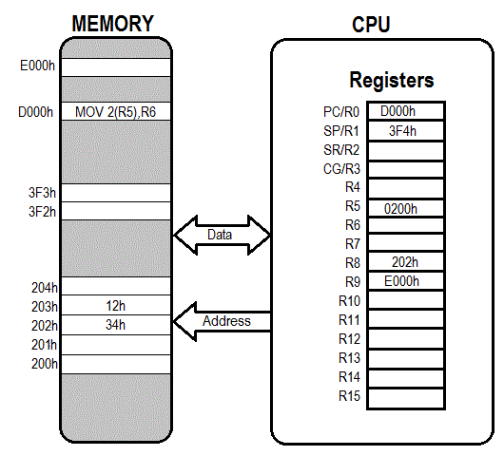
Indexed

Slide 13
What is the last instruction doing
mov.w #0x200, r6
mov.w #0xbeef, 2(r6) ;places 0xbeef at address 0x0202
mov.w r6, r5
mov.w 2(r6), 6(r5)
;this would move the word in the memory location at 2+r6 into the memory location at 6+r5 - so 0xbeef will be copied to 0x0206
Disassembled:
c01c: 36 40 00 02 mov #512, r6 ;#0x0200
c020: b6 40 ef be mov #-16657,2(r6) ;#0xbeef, 0x0002(r6)
c024: 02 00
c026: 05 46 mov r6, r5
c028: 95 46 02 00 mov 2(r6), 6(r5) ;0x0002(r6), 0x0006(r5)
c02c: 06 00

Slide 14
Hand assembly
no .b
indexed register mode
mov.w 2(r6), 6(r5)
 | 15 | 14 | 13 | 12 | 11 | 10 | 9 | 8 | 7 | 6 | 5 | 4 | 3 | 2 | 1 | 0
Two Operand | Opcode |  |  |  | Source reg |  |  |  | Ad | W=0/B=1 | As |  | Dest reg
Source or Destination 15:0
Destination 15:0
indexed register mode
Figure 3-12
Family User Guide 3.4.5 pp62
Blue Book pp19
_ _ _ _ _ _ _ _ _ _ _ _ _ _ _ _

Slide 15
Basic addressing modes
As/Ad | Addressing Mode | Description | Example
00/0 | Rn | Register direct | mov r8, r9
01/1 | offset(Rn) | Register indexed | mov 2(r8), r9
10/- | @Rn | Register indirect | mov @r8, r9
11/- | @Rn+ | Register indirect with post-increment | mov @r8+, r9
memory
registers
203 | 56
202 | 78
201 | 12
200 | 34
r8 | 0200
r9 | 0000

Slide 16
Basic addressing modes
As/Ad | Addressing Mode | Description | Example
00/0 | Rn | Register direct | mov r8, r9
01/1 | offset(Rn) | Register Indexed | mov 2(r8), r9
10/- | @Rn | Register indirect | mov @r8, r9
11/- | @Rn+ | Register indirect with post-increment | mov @r8+, r9
memory
registers
203 | 56
202 | 78
201 | 12
200 | 34
r8 | 0200
r9 | 1234
Like a pointer
Is this the same as: move 0(r5), r6 ???

Slide 17

Register Indirect

Slide 18
Hand assembly
no .b
register mode
mov @r7, r8
 | 15 | 14 | 13 | 12 | 11 | 10 | 9 | 8 | 7 | 6 | 5 | 4 | 3 | 2 | 1 | 0
Two Operand | Opcode |  |  |  | Source reg |  |  |  | Ad | W=0/B=1 | As |  | Dest reg
indirect register mode
Figure 3-12
Family User Guide 3.4.5 pp62
Blue Book pp19
_ _ _ _ _ _ _ _ _ _ _ _ _ _ _ _

Slide 19
Basic addressing modes
As/Ad | Addressing Mode | Description | Example
00/0 | Rn | Register direct | mov r8, r9
01/1 | offset(Rn) | Register Indexed | mov 2(r8), r9
10/- | @Rn | Register indirect | mov @r8, r9
11/- | @Rn+ | Register indirect with post-increment | mov @r8+, r9
memory
registers
203 | 56
202 | 78
201 | 12
200 | 34
r8 | 0200
r9 | 0000

Slide 20
Basic addressing modes
As/Ad | Addressing Mode | Description | Example
00/0 | Rn | Register direct | mov r8, r9
01/1 | offset(Rn) | Register Indexed | mov 2(r8), r9
10/- | @Rn | Register indirect | mov @r8, r9
11/- | @Rn+ | Register indirect with post-increment | mov @r8+, r9
memory
registers
203 | 56
202 | 78
201 | 12
200 | 34
r8 | 0202
r9 | 1234

Slide 21
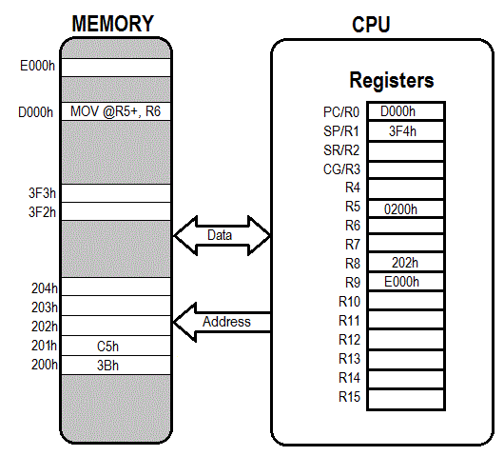

Slide 22
Other Addressing Modes
Immediate: mov.w #BEEF, r6
Symbolic/PC Relative: mov.w magic_number, r7
magic_number .word 0xafaf
becomes mov.w xxxx(PC), r7
Absolute: mov.w &0200, r6
mov.w #0xff, &P1OUT
mov.w #xff, P1OUT ????

Slide 23

Immediate

Slide 24

Absolute

Slide 25
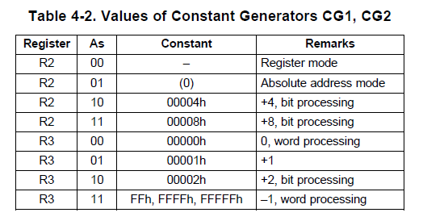
Values of Constant Generators CG1, CG2
Family User Guide 3.4.5 pp122

Slide 26
Hand assembly
no .b
register mode
rrc r6
_ _ _ _ _ _ _ _ _ _ _ _ _ _ _ _
Figure 3-12
Family User Guide 3.4.5 pp62
Blue Book pp19

Slide 27
Hand assembly
no .b
register mode
mov @r7, r8
 | 15 | 14 | 13 | 12 | 11 | 10 | 9 | 8 | 7 | 6 | 5 | 4 | 3 | 2 | 1 | 0
Two Operand | Opcode |  |  |  | Source reg |  |  |  | Ad | W=0/B=1 | As |  | Dest reg
indirect register mode
Figure 3-12
Family User Guide 3.4.5 pp62
Blue Book pp19
_ _ _ _ _ _ _ _ _ _ _ _ _ _ _ _

Slide 28
Single-Operand Instruction
STX r10
All instructions are 16 bits long. Their binary format looks like this:
15 | 14 | 13 | 12 | 11 | 10 | 9 | 8 | 7 | 6 | 5 | 4 | 3 | 2 | 1 | 0
0 | 0 | 0 | 1 | 0 | 0 | Opcode |  |  | W=0/ B=1 | Ad |  | Dest reg
:

Slide 29
Relative Jump Instruction
JMP $-024
All instructions are 16 bits long. Their binary format looks like this:
15 | 14 | 13 | 12 | 11 | 10 | 9 | 8 | 7 | 6 | 5 | 4 | 3 | 2 | 1 | 0
0 | 0 | 1 | Condition |  |  | PC offset (10 bit)
:

Slide 30
Two-Operand Instruction
MOV r10, r9
All instructions are 16 bits long. Their binary format looks like this:
15 | 14 | 13 | 12 | 11 | 10 | 9 | 8 | 7 | 6 | 5 | 4 | 3 | 2 | 1 | 0
Opcode |  |  |  | Source reg |  |  |  | Ad | W=0/B=1 | As |  | Dest reg
:

Slide 31
Let's write a MSP430 program
Our chip version: Msp430g2553 → open CCS
; This program sets all pins on Port 1 to output and high. Since LEDs 1 and 2 are connected to P1.0 and P1.6 respectively, they will light up. This program turns the LEDs on and off
.text
; turn off watchdog timer
main:
bis.b #0xFF, &P1DIR ; set port1 direction to output
Turn_on:
bis.b #0xFF, &P1OUT ; turn on leds at port1, bis?
; could of: move ____ , &P1OUT
Turn_off:
bic.b #0xFF, &P1OUT ; turn on leds at port1, bic?
; could of: move ____ , &P1OUT
jmp Turn_on ; loop forever
← what?
Stack pointer?

Slide 32
Example Program Where’s the BEEF?
; example program to fill memory with BEEF -- what are the addressing modes used?
mov.w #0x200, r5
mov.w #0xBEEF,r6
fill: mov.w r6, 0(r5)
incd r5
cmp.w #0x0400, r5
jne fill
forever: jmp forever

Slide 33
Sample Program – predict what happens
repeat:
mov.b #0x75, r10
add.b #0xC7, r10
;result should be 0x13c, so we should see 3c in r10 and carry bit set
adc r10
;since carry bit was set, this should increment r10 to 3d
inv.b r10
;invert, so r10 should be c2
mov.w #0x00aa, r10
sxt r10
;sign extend should clear upper 8 bits
inv r10
swpb r10
mov.w r10, r9
jmp repeat
c010: 7a 40 75 00 mov.b #117, r10 ;#0x0075
c014: 7a 50 c7 00 add.b #199, r10 ;#0x00c7
c018: 0a 63 adc r10
c01a: 7a e3 xor.b #-1, r10 ;r3 As==11
c01c: 3a 40 aa 00 mov #170, r10 ;#0x00aa
c020: 8a 11 sxt r10
c022: 3a e3 inv r10
c024: 8a 10 swpb r10
c026: 09 4a mov r10, r9
c028: f3 3f jmp $-24 ;abs 0xc010

Slide 34
In class programming exercise
; write an example program to add the numbers 0x06 through 0x15

Slide 35
In class programming exercise
; example program to add the numbers 10+9+8+...+1
mov.w #10, r6
mov.w #0, r5
summation: add.w r6, r5
dec r6
jnz summation
mov.w r5, &0x0200
forever: jmp forever

Slide 36
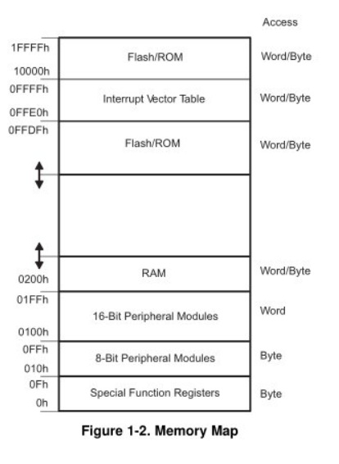
MSP430’s ISA
How many addr bits?
Msp430g2553 Memory Map
512b of RAM - 0x200-0x400 16kb of ROM - 0xc000-0xffdf
0x1100-0xc000 is empty!
- There is no memory backing it up!
- If you attempt to write to this area of memory, you'll trigger what's essentially a segmentation fault because that memory doesn't exist. It will cause the chip to do a Power-up Clear (PUC), resetting the state of your processor. This is a tough error to debug.

Slide 37
Assembly and Machine Languages
Instructions:
words in a computers language
Instruction Set:
the dictionary of the language
Assembly Language:
human-readable format of computer instructions
Machine Language:
computer-readable instructions - binary (1's and 0's)
Assembly Language Program
Assembler
Relocatable Object Code
Linker
Executable Code

