Slide 1
ECE 382 Lesson 26
Lesson Outline
Interrupts
Admin
Assignment #9 due next lesson

Slide 2
Interrupts
What is an interrupt?
Why is it better than polling?

Slide 3
Interrupts
What is an interrupt?
Why is it better than polling?
Polling is inefficient… wastes CPU resources
Interrupts can free the processor to do more useful work
Interrupts can save power
For example: In low-power mode, processor can go to sleep, until the time wakes it up to do something, and then go back to sleep
How do interrupts work?

Slide 4
Interrupts
How do interrupts work?
Initialize interrupt
Interrupt Vector
Interrupt Service Routine (ISR)
Interrupt Flag (clear before use)
Interrupt Enable (turn it on)
Run normal program
Interrupt Occurs !!!!
Processor saves its state
Jumps to ISR
Do ISR work
Clear Flag?
Restores the state
Return to normal program
Have you used an interrupt yet?

Slide 5
Interrupts
Have you used an interrupt yet?
Yes…. RESET
RESET mov.w #__STACK_END,SP ; Initialize stackpointer
StopWDT mov.w #WDTPW|WDTHOLD,&WDTCTL ; Stop watchdog timer
;
; YOUR CODE
;
;------------------------------------------------------------------
; Interrupt Vectors
;------------------------------------------------------------------
.sect ".reset" ; MSP430 RESET Vector
.short RESET
What if we didn’t define this interrupt vector?
Where are these interrupt vector’s located?

Slide 6
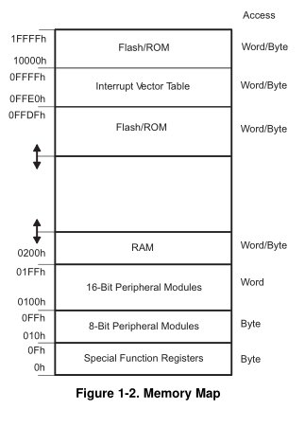
Interrupt Vector Table

Slide 7
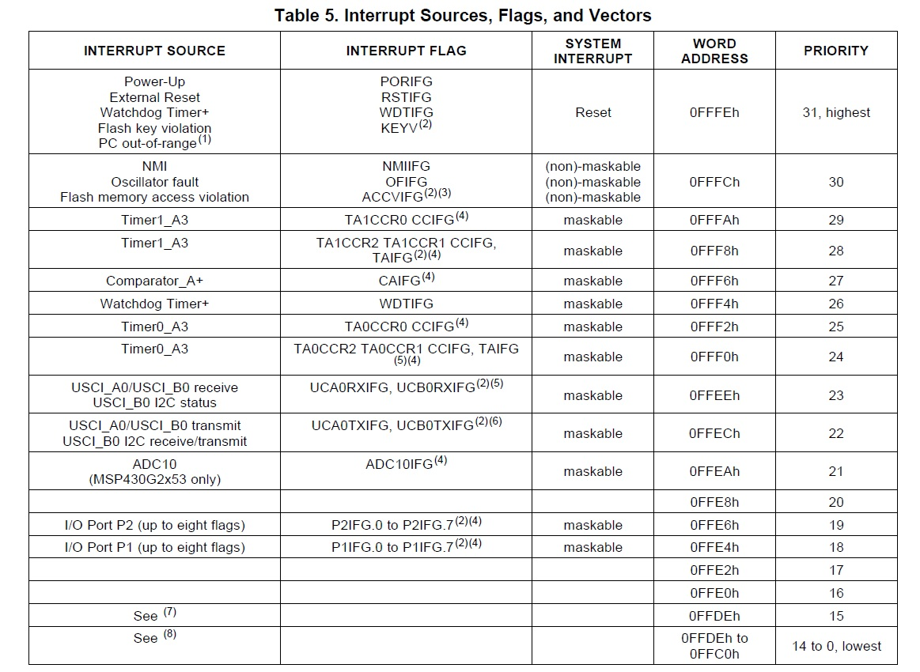

Slide 8
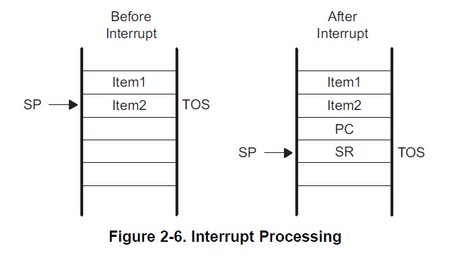
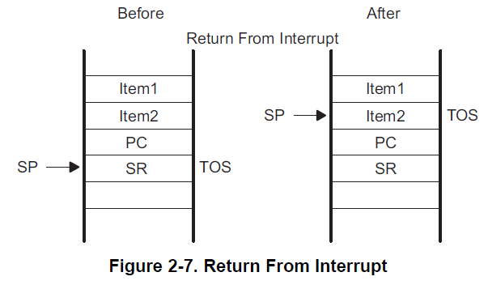
What happens on an Interrupt
On Interrupt:
Currently executing instruction is completed.
PC is pushed onto the stack.
SR is pushed onto the stack.
Selects highest priority interrupt.
If single interrupt, interrupt request flag reset.
Multiple interrupts, flag remains set.
SR is cleared - terminates low-power mode and disables maskable interrupts.
Interrupt vector content loaded into PC.
What about preserving other registers?
On ISR Completion:
Pop SR off stack - restoring previous settings.
Pop PC off stack - resume execution
at previous point.

Slide 9
Maskable vs Non-maskable Interrupts
Remember the Status Register?
GIE: General Interrupt Enable
Setting this bit Enables maskable interrupts
How to control in “C”?
__enable_interrupt()
__disable_interrupt()
15 | 14 | 13 | 12 | 11 | 10 | 9 | 8 | 7 | 6 | 5 | 4 | 3 | 2 | 1 | 0
Reserved |  |  |  |  |  |  | V | SCG1 | SCG0 | OSCOFF | CPUOFF | GIE | N | Z | C

Slide 10
Interrupt Service Routines (ISRs)
#pragma vector=XXXXX_VECTOR
__interrupt void XXXXX_ISR(void)
{
// do some stuff in response to an interrupt
}
#pragma vector=PORT1_VECTOR
__interrupt void Port_1(void)
{
P1IFG &= ~BIT3; // P1.3 IFG cleared
P1OUT ^= BIT0; // P1.0 = toggle
}
What if we didn’t clear P1IFG?
Caution: Spend as little time as possible inside an ISR!

Slide 11
Using Interrupts: Programmer's Job
Initialize
Configure subsystem
Set parameters to generate the interrupt you're interested in
Clear interrupt flag
Clear the flag for the interrupt you're interested in
Make sure an interrupt isn't generated immediately once you enable it
Turn on local switch
Set the interrupt enable bit for the interrupt you're interested in
Turn on global switch
Set the GIE bit in the SR
Write ISR
Include #pragma vector statement and subroutine itself
#pragma vector loads address into interrupt vector table
Clear interrupt flag
Accomplish task
Give interrupt opportunity to occur
It might take some time!

Slide 12
Example: P1 Interrupt
Go to pp 331 of Family Users Guide.
P1IFG
Contains flags for each pin specifying whether or not an interrupt has occurred
P1IES
Selects the edge to trigger on
0 - low-to-high transition
1 - high-to-low transition
P1IE
Enables / disables the associated interrupt
0 - disabled
1 - enabled

Slide 13
Example Push Button Interrupt
char interruptFlag = 0; // global variable? Bad or good?
int main(void) {
WDTCTL = WDTPW|WDTHOLD; // stop the watchdog timer
P1DIR |= BIT0|BIT6; // set LEDs to output
P1DIR &= ~BIT3; // set button to input
P1REN |= BIT3; // enable internal pull-up/pull-down network
P1OUT |= BIT3; // configure as pull-up
P1IES |= BIT3; // configure interrupt to sense falling edges
P1IFG &= ~BIT3; // clear P1.3 interrupt flag
P1IE |= BIT3; // enable the interrupt for P1.3
__enable_interrupt();
// main program loop
while (1) {
// if (interruptFlag) // respond
}
return 0;
}
#pragma vector=PORT1_VECTOR
__interrupt void Port_1_ISR(void) {
P1IFG &= ~BIT3; // clear P1.3 interrupt flag
P1OUT ^= BIT0|BIT6; // toggle LEDs
interruptFlag = 1;
}

Slide 14
Multiple Push Button Interrupts
int main(void) {
WDTCTL = WDTPW|WDTHOLD;
// stop the watchdog timer
P1DIR |= BIT0|BIT6;
// set LEDs to output
P1DIR &= ~(BIT1|BIT2|BIT3);
// set buttons to input
P1IE |= BIT1|BIT2|BIT3;
// enable the interrupts
P1IES |= BIT1|BIT2|BIT3;
// config interrupt for falling edges
P1REN |= BIT1|BIT2|BIT3;
// enable pull-up/pull-down network
P1OUT |= BIT1|BIT2|BIT3;
// configure as pull-up
P1IFG &= ~(BIT1|BIT2|BIT3);
// clear flags
__enable_interrupt();
while (1) {}
return 0;
}
#pragma vector=PORT1_VECTOR
__interrupt void Port_1_ISR(void) {
if (P1IFG & BIT1)
{
P1IFG &= ~BIT1; // clear flag
P1OUT ^= BIT6; // toggle LED 2
}
if (P1IFG & BIT2)
{
P1IFG &= ~BIT2; // clear flag
P1OUT ^= BIT0; // toggle LED 1
}
if (P1IFG & BIT3)
{
P1IFG &= ~BIT3; // clear P1.3
// interrupt flag
P1OUT ^= BIT0|BIT6;
// toggle both LEDs
}
}

Slide 15
Example Timer Interrupt (see coulston lec26.c)
int main(void) {
WDTCTL = WDTPW|WDTHOLD; // stop the watchdog timer
P1DIR = BIT6; // Set the green LED as an output
TA0CCR0 = 0xFFFF; // create a 16mS roll-over period
TACTL &= ~TAIFG; // clear flag before enabling interrupts = good practice
TACTL = ID_3 | TASSEL_2 | MC_1 | TAIE;
// Use 1:8 presclar off MCLK and enable interrupts
_enable_interrupt(); // main program loop
while (1) {
// if (interruptFlag) // respond
}
return 0;
}
#pragma vector = TIMER0_A1_VECTOR // This is from the MSP430G2553.h file
__interrupt void timerOverflow (void) {
P1OUT ^= BIT6; // This provides some evidence that we were in the ISR
TACTL &= ~TAIFG; // See what happens when you do not clear the flag
}

Slide 16
In class exercise
Try the Interrupt coding challenges at:
http://ecse.bd.psu.edu/cmpen352/lecture/lecture26.html

Slide 17
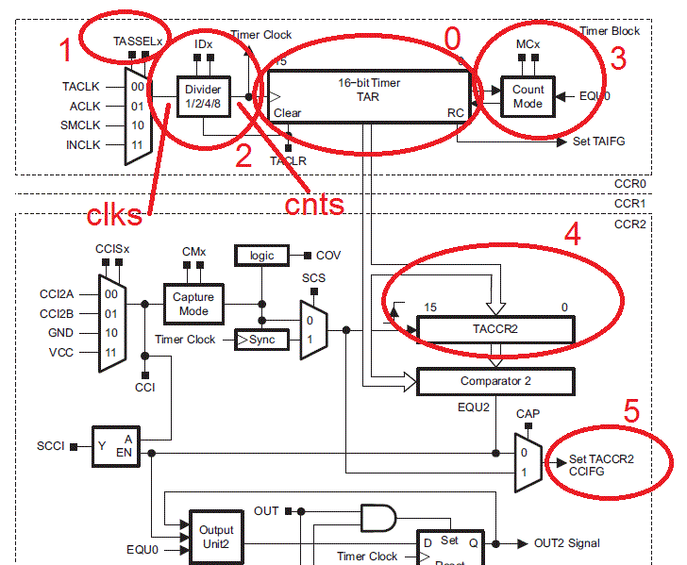
Timer Block Diagram

