Slide 1
ECE 382 Lesson 27
Lesson Outline
In-class coding exercise (push to Bitbucket)
Review Interrupts
Low Power Modes
Lab 5 Introduction
Admin
Assignment #9 due now
Lab 5 Prelab Due next time
- Read Lab!
- Fill in Blank Sections on test5.c
- Work to Characterize 10 buttons

Slide 2
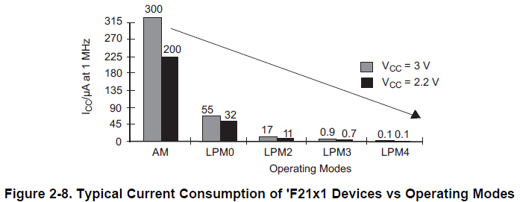
Low Power Modes

Slide 3
Low Power Modes
The following six operating modes can be configured by software:
• Active mode (AM)
All clocks are active
Low-power mode 0 (LPM0)
CPU is disabled
ACLK and SMCLK remain active, MCLK is disabled
Low-power mode 1 (LPM1)
CPU is disabled
ACLK and SMCLK remain active, MCLK is disabled
DCO's dc generator is disabled if DCO not used in active mode

Slide 4
Low Power Modes
The following six operating modes can be configured by software:
• Low-power mode 2 (LPM2)
CPU is disabled
MCLK and SMCLK are disabled
DCO's dc generator remains enabled
ACLK remains active
Low-power mode 3 (LPM3)
CPU is disabled
MCLK and SMCLK are disabled
DCO's dc generator is disabled
ACLK remains active

Slide 5
Low Power Modes
The following six operating modes can be configured by software:
Low-power mode 4 (LPM4)
CPU is disabled
ACLK is disabled
MCLK and SMCLK are disabled
DCO's dc generator is disabled
Crystal oscillator is stopped

Slide 6
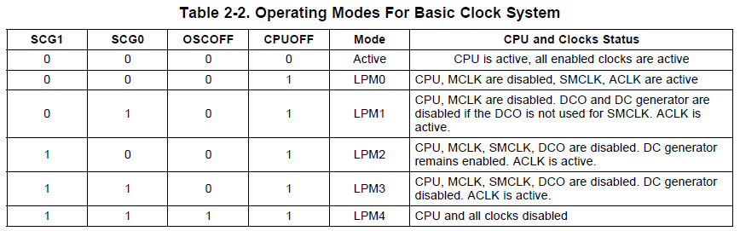
Low Power Modes
These modes are configured using bits in the Status Register (SR) - namely CPUOFF, OSCOFF, SCG0, and SCG1.
What happens to the bits of the SR once the ISR is triggered? They're cleared - so the MSP430 can 'wake up' from a low-power mode.
15 | 14 | 13 | 12 | 11 | 10 | 9 | 8 | 7 | 6 | 5 | 4 | 3 | 2 | 1 | 0
Reserved |  |  |  |  |  |  | V | SCG1 | SCG0 | OSCOFF | CPUOFF | GIE | N | Z | C

Slide 7
In-Class Programming Exercise
(see interruptTones.c)
Create a project around interruptTones.c. This C program utilizes interrupts to Blink the Green LED (P1.0 using Timer A at 440Hz Modify the program to do the following:
Put a speaker or headphones on P1.6 to listen to the 440Hz 'A' Tone using the following schematic.
Implement another interrupt from a button press (P1.3) to toggle the Red LED (P1.0) and then increment through each tone in the counts array.
Use the button interrupt to increment through the counts array to be output the different tones on a speaker.

Slide 8
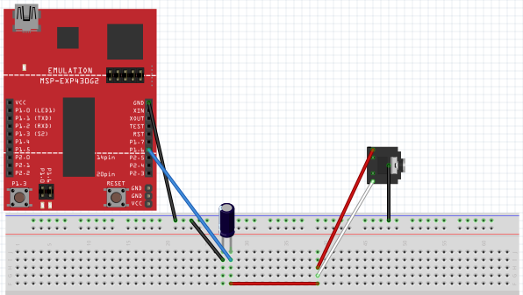
In-Class Programming Exercise
(see interruptTones.c)
Setup for the hooking up 3.5mm Audio Jack to the MSP430 Launchpad Board
without Volume Control

Slide 9
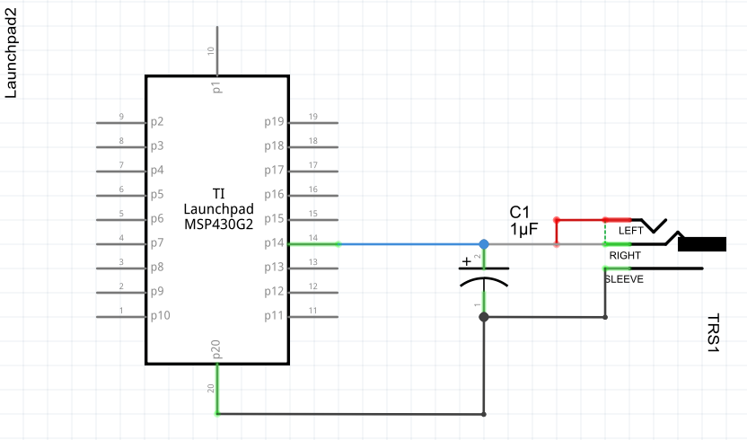
In-Class Programming Exercise
(see interruptTones.c)
Setup for the hooking up 3.5mm Audio Jack to the MSP430 Launchpad Board
without Volume Control

Slide 10
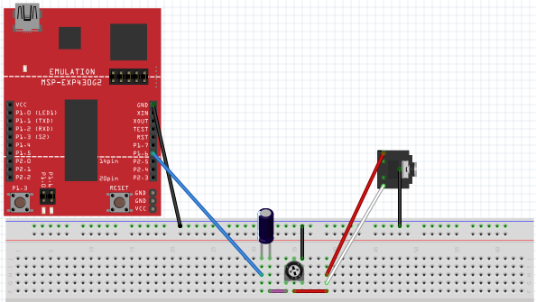
In-Class Programming Exercise
(see interruptTones.c)
Setup for the hooking up 3.5mm Audio Jack to the MSP430 Launchpad Board
with Volume Control

Slide 11
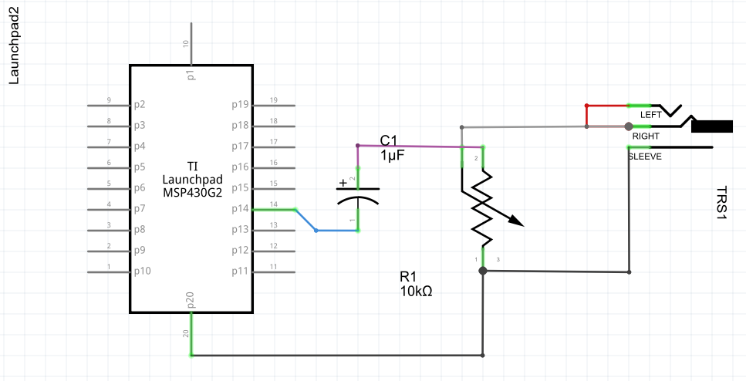
In-Class Programming Exercise
(see interruptTones.c)
Setup for the hooking up 3.5mm Audio Jack to the MSP430 Launchpad Board
with Volume Control

