Slide 1
ECE 382 Lesson 3
ECE 382Website:
http://ece.ninja/382/index.html
Readings
Debuggers MSP430 Instruction Set
Lesson Outline
MSP430 Execution Model
MSP430 Instruction Set
Converting Assembly to Machine Code
Admin
Skills Review due today!
Assignment 1 due next lesson
uCorrupt1 due next lesson

Slide 2
MSP430’s ISA
Types of Instructions
Single-operand
SWPB r12
Jump
JMP loop
Two-operand
add r5, r6
add src, dst
dst = dst + src
dst += src
Three-operand?
add r5, r6, r7

Slide 3
MSP430’s ISA
Specifying values
#10
What's the # mean?
What base is this number in?
#0x10
What base is this number in?
#0b10
What base is this number in?
Assembler does the work of base conversion for you.
What is the process is to convert an assembly language program to an executable that we can load onto our chip?

Slide 4
Assembly and Machine Languages
Instructions:
words in a computers language
Instruction Set:
the dictionary of the language
Assembly Language:
human-readable format of computer instructions
Machine Language:
computer-readable instructions - binary (1's and 0's)
Assembly Language Program
Assembler
Relocatable Object Code
Linker
Executable Code

Slide 5
Steps for Translating and starting a program
Higher Level Language (HLL)
Compiler
Assembly Language
Assembler
Object File (Machine Code)
Object Files
Library Files
Linker
Executable
Loader
Memory

Slide 6
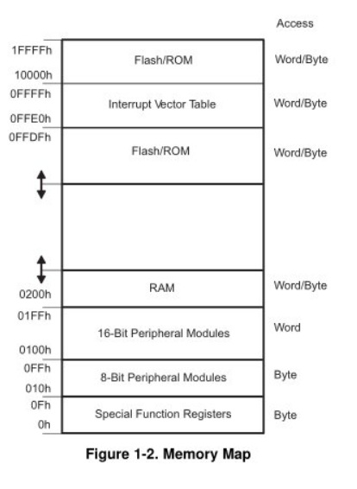
MSP430’s ISA
How many addr bits?
Msp430g2553 Memory Map
512b of RAM - 0x200-0x400 16kb of ROM - 0xc000-0xffdf
0x1100-0xc000 is empty!
- There is no memory backing it up!
- If you attempt to write to this area of memory, you'll trigger what's essentially a segmentation fault because that memory doesn't exist. It will cause the chip to do a Power-up Clear (PUC), resetting the state of your processor. This is a tough error to debug.

Slide 7
Let's write our first MSP430 program
; This program sets all pins on Port 1 to output and high. Since LEDs 1 and 2 are connected to P1.0 and P1.6 respectively, they will light up.
.include 'header.S'
.text
main:
mov.w #WDTPW, r15 ; turn off watchdog timer
xor.w #WDTHOLD, r15
mov.w r15, &WDTCTL
bis.b #0xFF, &P1DIR ; set port1 direction to output
bis.b #0xFF, &P1OUT ; turn on leds at port1
loop:
jmp loop ; loop forever

Slide 8
Example Relocatable Code
Notice the addresses - the code starts at 0x0.
Hex dump of section '.text':
0x00000000 3f40005a 3fe08000 824f2001 f2d32200
0x00000010 f2d32100 b0120000 ff3f
After Linking
Notice the addresses - the code starts at 0xC000.
Hex dump of section '.text':
0x0000c000 3f40005a 3fe08000 824f2001 f2d32200
0x0000c010 f2d32100 b0121ac0 ff3fc243 21003041

Slide 9
Example Dissassembled Code
Disassembly of section .text:
0000c000 <__ctors_end>:
c000: 3f 40 00 5a mov #23040, r15 ;#0x5a00
c004: 3f e0 80 00 xor #128, r15 ;#0x0080
c008: 82 4f 20 01 mov r15, &0x0120
c00c: f2 d3 22 00 bis.b #-1, &0x0022 ;r3 As==11
c010: f2 d3 21 00 bis.b #-1, &0x0021 ;r3 As==11
0000c014 <loop>:
c014: ff 3f jmp $+0 ;abs 0xc014

Slide 10
MSP430 Instruction Set
MSP430 Instruction Set
All instructions are 16 bits long. Their binary format looks like this:
15 | 14 | 13 | 12 | 11 | 10 | 9 | 8 | 7 | 6 | 5 | 4 | 3 | 2 | 1 | 0
0 | 0 | 0 | 1 | 0 | 0 | Opcode |  |  | W=0/ B=1 | Ad |  | Dest reg
0 | 0 | 1 | Condition |  |  | PC offset (10 bit)
Opcode |  |  |  | Source reg |  |  |  | Ad | W=0/B=1 | As |  | Dest reg
Which row corresponds to each format?
:
Double-Operand (Format I)
Single-Operand (Format II)
Jumps (Format III)

Slide 11
One Operand Instructions
Opcode | Assembly Instruction | Description
000 | RRC(.B) | 9-bit rotate right through carry. C->msbit->...->lsbit->C. Clear the carry bit beforehand to do a logical right shift.
001 | SWPB | Swap 8-bit register halves. No byte form.
010 | RRA(.B) | Badly named, this is an arithmetic right shift - meaning the most significant bit is preserved.
011 | SXT | Sign extend 8 bits to 16. No byte form.
100 | PUSH(.B) | Push operand on stack. Push byte decrements SP by 2. Most significant byte not overwritten. CPU BUG: PUSH #4 and PUSH #8 do not work when the short encoding using @r2 and @r2+ is used. The workaround, to use a 16-bit immediate, is trivial, so TI do not plan to fix this bug.
101 | CALL | Fetch operand, push PC, then assign operand value to PC. Note the immediate form is the most commonly used. There is no easy way to perform a PC-relative call; the PC-relative addressing mode fetches a word and uses it as an absolute address. This has no byte form.
110 | RETI | Pop SR, then pop PC. Note that because flags like CPUOFF are in the stored status register, the CPU will normally return to the low-power mode it was previously in. This can be changed by adjusting the SR value stored on the stack before invoking RETI (see below). The operand field is unused.
111 | Unused
:

Slide 12
Relative Jumps
Condition Code | Assembly Instruction | Description
000 | JNE/JNZ | Jump if Z==0 (if !=)
001 | JEQ/Z | Jump if Z==1 (if ==)
010 | JNC/JLO | Jump if C==0 (if unsigned <)
011 | JC/JHS | Jump if C==1 (if unsigned >)
100 | JN | Jump if N==1 - Note there is no jump if N==0
101 | JGE | Jump if N==V (if signed >=)
110 | JL | Jump if N!=V (if signed <)
111 | JMP | Jump unconditionally
:

Slide 13
Two Operand Instructions
Opcode | Assembly Instruction | Description | Notes
0100 | MOV src, dest | dest = src | The status flags are NOT set.
0101 | ADD src, dest | dest += src
0110 | ADDC src, dest | dest += src + C
0111 | SUBC src, dest | dest += ~src + C
1000 | SUB src, dest | dest -= src | Implemented as dest += ~src + 1
1001 | CMP src, dest | dest - src | Sets status only; the destination is not written.
1010 | DADD src, dest | dest += src + C, BCD (Binary Coded Decimal)
1011 | BIT src, dest | dest & src | Sets status only; the destination is not written.
1100 | BIC src, dest | dest &= ~src | The status flags are NOT set.
1101 | BIS src, dest | dest |=src | The status flags are NOT set.
1110 | XOR src, dest | dest ^= src
1111 | AND src, dest | dest &= src
:
These are generally of the form OP src, dst which actually means dest = src OP dest.

Slide 14
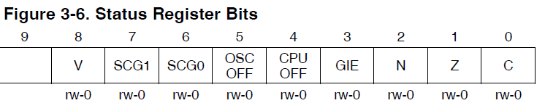
Emulated Instructions
Emulated Instruction | Assembly Instruction | Notes
NOP | MOV r3, r3
POP dst | MOV @SP+, dst
BR dst | MOV dst, PC | BR dst
RET | MOV @SP+, PC | RET
CLRC | BIC #1, SR
SETC | BIS #1, SR
CLRZ | BIC #2, SR
SETZ | BIS #2, SR
CLRN | BIC #4, SR
SETN | BIS #4, SR
DINT | BIC #8, SR
EINT | BIS #8, SR
:

Slide 15
More Emulated Instructions
Emulated Instruction | Assembly Instruction
RLA(.B) | ADD(.B) dst, dst
RLC(.B) | ADDC(.B) dst, dst
INV(.B) dst | XOR(.B) #-1, dst
CLR(.B) dst | MOV(.B) #0, dst
TST(.B) dst | CMP(.B) #0, dst
DEC(.B) dst | SUB(.B) #1, dst
DECD(.B) dst | SUB(.B) #2, dst
INC(.B) dst | ADD(.B) #1, dst
INCD(.B) dst | ADD(.B) #2, dst
ADC(.B) dst | ADDC(.B) #0, dst
DADC(.B) dst | DADD(.B) #0, dst
SBC(.B) dst | SUBC(.B) #0, dst
:

Slide 16
Let's write a MSP430 program
Our chip version: Msp430g2553 → open CCS
; This program sets all pins on Port 1 to output and high. Since LEDs 1 and 2 are connected to P1.0 and P1.6 respectively, they will light up. This program turns the LEDs on and off
.text
; turning off watchdog timer NOT shown
main:
bis.b #0xFF, &P1DIR ; set port1 direction to output
Turn_on:
bis.b #0xFF, &P1OUT ; turn on leds at port1, bis?
; alternatively: mov ____ , &P1OUT ???
Turn_off:
bic.b #0xFF, &P1OUT ; turn on leds at port1, bic?
; alternatively: mov ____ , &P1OUT ???
jmp Turn_on ; loop forever
← what?
Stack pointer?

Slide 17
Debugging Example Using breakpoints
; example program to add the numbers 10+9+8+...+1 and put result into 0x0200
mov.w #10, r6
mov.w #0, r5
summation: add.w r6, r5
dec r6
jnz summation
mov.w r5, &0x0200
forever: jmp forever

Slide 18
Sample Program
repeat:
mov.b #0x75, r10
add.b #0xC7, r10
;result should be 0x13c, so we should see 3c in r10 and carry bit set
adc r10 ;since carry bit was set, this should increment r10 to 3d
inv.b r10 ;invert, so r10 should be c2
mov.w #0x00aa, r10
sxt r10 ;sign extend should clear upper 8 bits
inv r10
swpb r10
mov.w r10, r9
jmp repeat
c010: 7a 40 75 00 mov.b #117, r10 ;#0x0075
c014: 7a 50 c7 00 add.b #199, r10 ;#0x00c7
c018: 0a 63 adc r10
c01a: 7a e3 xor.b #-1, r10 ;r3 As==11
c01c: 3a 40 aa 00 mov #170, r10 ;#0x00aa
c020: 8a 11 sxt r10
c022: 3a e3 inv r10
c024: 8a 10 swpb r10
c026: 09 4a mov r10, r9
c028: f3 3f jmp $-24 ;abs 0xc010
Hex
Decimal

Slide 19
Sample Program
c010: 7a 40 75 00 mov.b #117, r10 ;#0x0075
c014: 7a 50 c7 00 add.b #199, r10 ;#0x00c7
c018: 0a 63 adc r10
c01a: 7a e3 xor.b #-1, r10 ;r3 As==11
c01c: 3a 40 aa 00 mov #170, r10 ;#0x00aa
c020: 8a 11 sxt r10
c022: 3a e3 inv r10
c024: 8a 10 swpb r10
c026: 09 4a mov r10, r9
c028: f3 3f jmp $-24 ;abs 0xc010
4
1
3
2

Slide 20
MSP430 Instruction Set
MSP430 Instruction Set
All instructions are 16 bits long. Their binary format looks like this:
15 | 14 | 13 | 12 | 11 | 10 | 9 | 8 | 7 | 6 | 5 | 4 | 3 | 2 | 1 | 0
0 | 0 | 0 | 1 | 0 | 0 | Opcode |  |  | W=0/ B=1 | Ad |  | Dest reg
0 | 0 | 1 | Condition |  |  | PC offset (10 bit)
Opcode |  |  |  | Source reg |  |  |  | Ad | W=0/B=1 | As |  | Dest reg
:
Double-Operand (Format I)
Single-Operand (Format II)
Jumps (Format III)

Slide 21
Single-Operand Instruction
SXT r10
All instructions are 16 bits long. Their binary format looks like this:
15 | 14 | 13 | 12 | 11 | 10 | 9 | 8 | 7 | 6 | 5 | 4 | 3 | 2 | 1 | 0
0 | 0 | 0 | 1 | 0 | 0 | Opcode |  |  | W=0/ B=1 | Ad |  | Dest reg
:

Slide 22
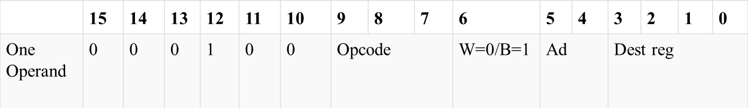
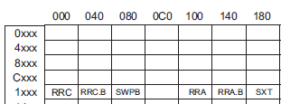
Single-Operand Instruction
no .b
register mode
Table 3-3 Blue Book Pg 12
All instructions are 16 bits long. Their binary format looks like this:
SXT r10
_ _ _ _ _ _ _ _ _ _ _ _ _ _ _ _
:
Figure 3-12
Family User Guide 3.4.5 pp62
Blue Book pp19

Slide 23
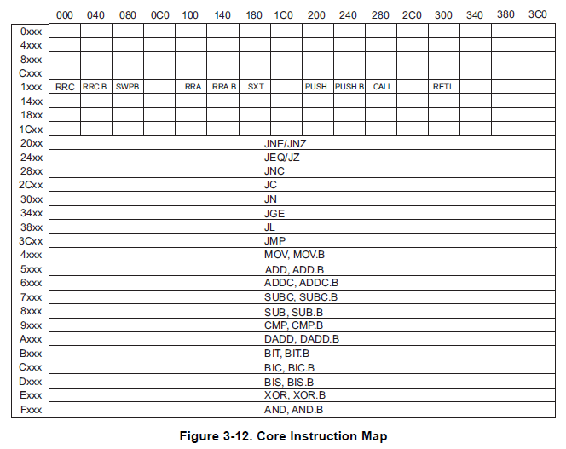
Core Instruction Map
Figure 3-12
Family User Guide 3.4.5 pp62
Blue Book pp19

Slide 24
Sample Program
repeat:
mov.b #0x75, r10
add.b #0xC7, r10
;result should be 0x13c, so we should see 3c in r10 and carry bit set
adc r10
;since carry bit was set, this should increment r10 to 3d
inv.b r10
;invert, so r10 should be c2
mov.w #0x00aa, r10
sxt r10
;sign extend should clear upper 8 bits
inv r10
swpb r10
mov.w r10, r9
jmp repeat
PC_{NEW}
c010: 7a 40 75 00 mov.b #117, r10 ;#0x0075
c014: 7a 50 c7 00 add.b #199, r10 ;#0x00c7
c018: 0a 63 adc r10
c01a: 7a e3 xor.b #-1, r10 ;r3 As==11
c01c: 3a 40 aa 00 mov #170, r10 ;#0x00aa
c020: 8a 11 sxt r10
c022: 3a e3 inv r10
c024: 8a 10 swpb r10
c026: 09 4a mov r10, r9
c028: f3 3f jmp $-24 ;abs 0xc010
PC_{NEW} - PC_{OLD}
PC_{OLD}

Slide 25
Relative Jumps
Condition Code | Assembly Instruction | Description
000 | JNE/JNZ | Jump if Z==0 (if !=)
001 | JEQ/Z | Jump if Z==1 (if ==)
010 | JNC/JLO | Jump if C==0 (if unsigned <)
011 | JC/JHS | Jump if C==1 (if unsigned >)
100 | JN | Jump if N==1 - Note there is no jump if N==0
101 | JGE | Jump if N==V (if signed >=)
110 | JL | Jump if N!=V (if signed <)
111 | JMP | Jump unconditionally
Not directly found in datasheets!
How many bits do we have for offset in a jump?
What is the range of signed numbers?
:

Slide 26
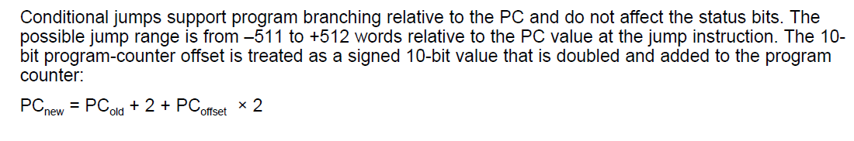
Relative Jump Instruction
JMP $-024
All instructions are 16 bits long. Their binary format looks like this:
15 | 14 | 13 | 12 | 11 | 10 | 9 | 8 | 7 | 6 | 5 | 4 | 3 | 2 | 1 | 0
0 | 0 | 1 | Condition |  |  | PC offset (10 bit)
Figure 3-12
Family User Guide 3.4.5 pp62
Blue Book pp19
:
_ _ _ _ _ _ _ _ _ _ _ _ _ _ _ _
Family User Guide 3.4.5 pp59
Blue Book pp18

Slide 27
Sample Program
repeat:
mov.b #0x75, r10
add.b #0xC7, r10
;result should be 0x13c, so we should see 3c in r10 and carry bit set
adc r10
;since carry bit was set, this should increment r10 to 3d
inv.b r10
;invert, so r10 should be c2
mov.w #0x00aa, r10
sxt r10
;sign extend should clear upper 8 bits
inv r10
swpb r10
mov.w r10, r9
jmp repeat
c010: 7a 40 75 00 mov.b #117, r10 ;#0x0075
c014: 7a 50 c7 00 add.b #199, r10 ;#0x00c7
c018: 0a 63 adc r10
c01a: 7a e3 xor.b #-1, r10 ;r3 As==11
c01c: 3a 40 aa 00 mov #170, r10 ;#0x00aa
c020: 8a 11 sxt r10
c022: 3a e3 inv r10
c024: 8a 10 swpb r10
c026: 09 4a mov r10, r9
c028: f3 3f jmp $-24 ;abs 0xc010

Slide 28
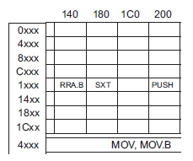
Two-Operand Instruction - Practice
All instructions are 16 bits long. Their binary format looks like this:
no .b
register mode
MOV r10, r9
 | 15 | 14 | 13 | 12 | 11 | 10 | 9 | 8 | 7 | 6 | 5 | 4 | 3 | 2 | 1 | 0
Two Operand | Opcode |  |  |  | Source reg |  |  |  | Ad | W=0/B=1 | As |  | Dest reg
register mode
:
_ _ _ _ _ _ _ _ _ _ _ _ _ _ _ _

Slide 29
Two-Operand Instruction with Immediate
yes .b
All instructions are 16 bits long. Their binary format looks like this:
Register mode = Immediate
As/Ad →11/-
add.b #0xC7, r10
15 | 14 | 13 | 12 |  | 11 | 10 | 9 | 8 | 7 | 6 | 5 | 4 | 3 | 2 | 1 | 0
Opcode |  |  |  |  | Source reg |  |  |  | Ad | W=0/B=1 | As |  | Dest reg
Source or Destination 15:0
Destination 15:0
????
***Immediate mode so Source is the PC (i.e. 0000)
:
Figure 3-12
Family User Guide 3.4.5 pp62
Blue Book pp19
_ _ _ _ _ _ _ _ _ _ _ _ _ _ _ _
Notes:
The source and destination of an instruction are defined by the following fields:
src The source operand defined by As and S-reg
dst The destination operand defined by Ad and D-reg
As The addressing bits responsible for the addressing mode used for the source (src)
S-reg The working register used for the source (src)
Ad The addressing bits responsible for the addressing mode used for the destination (dst)
D-reg The working register used for the destination (dst)
B/W Byte or word operation:
0: word operation
1: byte operation

Slide 30
MSP430 addressing modes
As/Ad | Addressing Mode | Description | Example
00/0 | Rn | Register direct | mov r8, r9
01/1 | offset(Rn) | Indexed | mov 2(r8), r9
10/- | @Rn | Register indirect | mov @r8, r9
11/- | @Rn+ | Register indirect with post-increment | mov @r8+, r9
01/1 | ADDR | Symbolic (PC relative) | mov LoopCtr, r6
01/1 | &ADDR | Absolute | mov r5, &0x0200
11/- | #N | Immediate | mov #0x2006, r6
Table 3-3 Blue Book Pg 12

Slide 31
Next Lesson: addressing modes
Code | Addressing Mode | Description
00 | Rn | Register direct
01 | offset(Rn) | Register indexed
10 | @Rn | Register indirect
11 | @Rn+ | Register indirect with post-increment

Slide 32
MSP430’s ISA
How many addr bits?
Msp430g2553 Memory Map
512b of RAM - 0x200-0x400 16kb of ROM - 0xc000-0xffdf
0x1100-0xc000 is empty!
- There is no memory backing it up!
- If you attempt to write to this area of memory, you'll trigger what's essentially a segmentation fault because that memory doesn't exist. It will cause the chip to do a Power-up Clear (PUC), resetting the state of your processor. This is a tough error to debug.

