Slide 1
ECE 382 Lesson 2
Readings
Assembler Linker
Lesson Outline
Intro to the MSP430
MSP430 Architecture
Assembly and Machine Languages
Admin
Skills Review due next time!

Slide 2
Intro to the MSP430
The MSP430 is an industry leader in low-cost, low-power consumption embedded applications
RISC architecture with just 27 instructions.
Products in the Wild Using MSP430
Only $5
Our version: MSP430G2553
What is an ISA?

Slide 3
Instruction Set Architecture
Consists of
set of operations (instructions)
registers
data units (byte/word/etc)
addressing modes
memory organization / memory map

Slide 4
MSP430’s ISA
RISC architecture
fewer instructions (27)
emulates higher-level instructions (24)
for instance, NOP → ___________
16-bit datapath
What is a datapath?

Slide 5
MSP430’s ISA
16-bit datapath
word size is 16 bits
word is the natural unit of info for the processor
16 bit addresses
16 bit registers
all instructions are 16 bits long
this consistency isn't necessarily true of all processors, but it's convenient - allows us to load addresses into registers, perform ops on them, etc.
What is a register?

Slide 6
MSP430’s ISA
Registers - 16 bits wide
Fast memory that holds values in-use by the CPU
Four special purpose registers
r0 - Program Counter - holds address of instruction currently being executed
r1 - Stack Pointer - address of top of stack
r2 - Status Register - holds flags related to various conditions
r3 - Constant Generator - 0, but can assume other values for different addressing modes (L4)
12 general purpose registers
r4 to r15: can be used to hold anything you want

Slide 7
MSP430’s ISA
Set of Operations
27 Instructions in 3 families - we'll talk about these next time
Single-operand
for instance, SWPB r12
Conditional jump
for instance, JMP jump_label
Two-operand
for instance, MOV r12, r10

Slide 8
MSP430’s ISA
Data Units
byte-addressable memory
instructions for byte and word actions
MOV.B r12, r10
MOV.W r12, r10
remember, word size is 16 bits
words must lie on even addresses

Slide 9
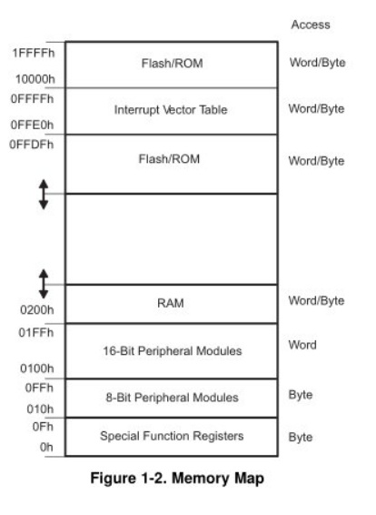
MSP430’s ISA
How many addr bits?
MSP430G2553 Memory Map
512B of RAM - 0x200-0x400 16kB of ROM - 0xc000-0xffdf
0x1100-0xbfff is empty!
- There is no memory backing it up!
- If you attempt to write to this area of memory, you'll trigger what's essentially a segmentation fault because that memory doesn't exist. It will cause the chip to do a Power-up Clear (PUC), resetting the state of your processor. This is a tough error to debug.
 |  | MSP430G2553
Memory Main: interrupt vector Main: code memory | Size Flash Flash | 16kB 0xFFFF to 0xFFC0 0xFFFF to 0xC000
Information memory | Size Flash | 256 Byte 010FFh to 01000h
RAM | Size | 512 Byte 0x03FF to 0x0200
Peripherals | 16-bit 8-bit 8-bit SFR | 01FFh to 0100h 0FFh to 010h 0Fh to 00h
Excerpt from Table 8: Memory Organization from MSP430G2x53 Device Specific User Guide (pp13)

Slide 10
Big/Little Endian Byte Storage
There are two storage conventions: big endian and little endian
The value ABCD1234H would be stored as shown below for the different storage conventions
The name big/little endian answers the question: “What is stored in Byte #0?”
Byte zero holds Little Endian of the word
0
0
1
1
0
1
0
0
0
0
0
1
0
0
1
0
1
1
0
0
1
1
0
1
1
0
1
0
1
0
1
1
(34)
(12)
(CD)
(AB)
Low Order Byte
(Byte #0)
Byte #1
Byte #2
High Order Byte
(Byte #3)
Byte zero holds Big Endian of the word
1
0
1
0
1
0
1
1
1
1
0
0
1
1
0
1
0
0
0
1
0
0
1
0
0
0
1
1
0
1
0
0
(AB)
(CD)
(12)
(34)
Low Order Byte
(Byte #0)
Byte #1
Byte #2
High Order Byte
(Byte #3)

Slide 11
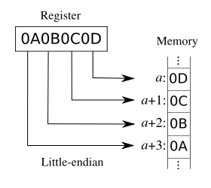
MSP430Architecture Uses Little Endian
Values stored in little-endian byte order
Least significant byte is stored first
5000
5001
5002
5003

Slide 12
MSP430’s ISA
Endianness
concerned with the ordering of bytes on a computer.
Little Endian means the least significant byte of a chunk of data is stored at the lowest memory address.
MSP430 and your x86_64 are little endian
Big Endian means the most significant byte of a chunk of data is stored at the lowest memory address.
The 68S12 used in previous classes used this
If we executed MOV.W #0xdfec, &0x0200, how would that word be stored in memory?
addr | value
200
201
202
203
Debugger: 200

Slide 13
Assembly and Machine Languages
Instructions:
words in a computers language
Instruction Set:
the dictionary of the language
Assembly Language:
human-readable format of computer instructions
Machine Language:
computer-readable instructions - binary (1's and 0's)
Assembly Language Program
Assembler
Relocatable Object Code
Linker
Executable Code

Slide 14
Steps for Translating and starting a program
Higher Level Language (HLL)
Compiler
Assembly Language
Assembler
Object File (Machine Code)
Object Files
Library Files
Linker
Executable
Loader
Memory

Slide 15
Let's write our first MSP430 program
; This program sets all pins on Port 1 to output and high. Since LEDs 1 and 2 are connected to P1.0 and P1.6 respectively, they will light up.
.include 'header.S'
.text
main:
mov.w #WDTPW, r15 ; turn off watchdog timer
xor.w #WDTHOLD, r15
mov.w r15, &WDTCTL
bis.b #0xFF, &P1DIR ; set port1 direction to output
bis.b #0xFF, &P1OUT ; turn on leds at port1
loop:
jmp loop ; loop forever

Slide 16
Example Relocatable Code
Notice the addresses - the code starts at 0x0.
Hex dump of section '.text':
0x00000000 3f40005a 3fe08000 824f2001 f2d32200
0x00000010 f2d32100 b0120000 ff3f
After Linking
Notice the addresses - the code starts at 0xC000.
Hex dump of section '.text':
0x0000c000 3f40005a 3fe08000 824f2001 f2d32200
0x0000c010 f2d32100 b0121ac0 ff3fc243 21003041

Slide 17
Example Dissassembled Code
Disassembly of section .text:
0000c000 <__ctors_end>:
c000: 3f 40 00 5a mov #23040, r15 ;#0x5a00
c004: 3f e0 80 00 xor #128, r15 ;#0x0080
c008: 82 4f 20 01 mov r15, &0x0120
c00c: f2 d3 22 00 bis.b #-1, &0x0022 ;r3 As==11
c010: f2 d3 21 00 bis.b #-1, &0x0021 ;r3 As==11
0000c014 <loop>:
c014: ff 3f jmp $+0 ;abs 0xc014

Slide 18
Code Composer Studio demo…

