Slide 1
Lesson 10
Stack Example in CCS

Slide 2
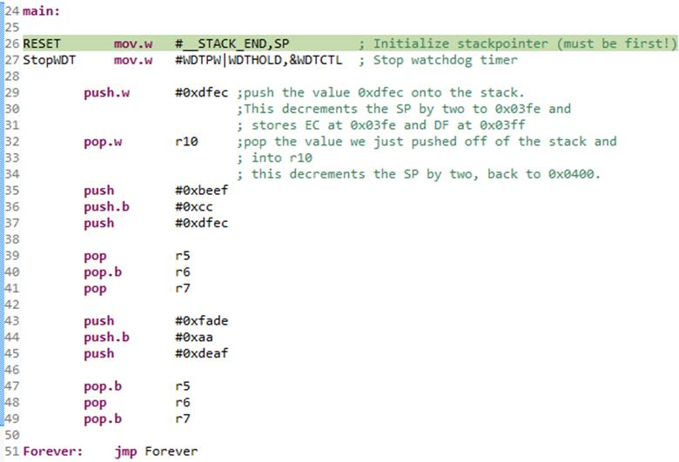
The example code

Slide 3
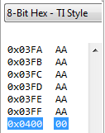
Initial State
Next instruction to run
SP 0x0400
R5 0x0000
R6 0x0000
R7 0x0000
R10 0x0000
Stack
SP location highlighted

Slide 4
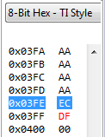
push.w #0xdfec
SP 0x03FE
R5 0x0000
R6 0x0000
R7 0x0000
R10 0x0000
PUSH
SP – 2 → SP
src → @SP

Slide 5
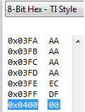
pop.w r10
SP 0x0400
R5 0x0000
R6 0x0000
R7 0x0000
R10 0xDFEC
POP
@SP → dest
SP + 2 → SP

Slide 6
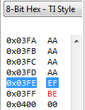
push #0xbeef
SP 0x03FE
R5 0x0000
R6 0x0000
R7 0x0000
R10 0xDFEC

Slide 7
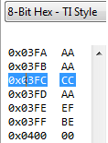
push.b #0xcc
SP 0x03FC
R5 0x0000
R6 0x0000
R7 0x0000
R10 0xDFEC
This byte left AS IS

Slide 8
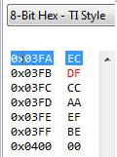
push #0xdfec
SP 0x03FA
R5 0x0000
R6 0x0000
R7 0x0000
R10 0xDFEC

Slide 9
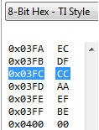
pop R5
SP 0x03FC
R5 0xDFEC
R6 0x0000
R7 0x0000
R10 0xDFEC

Slide 10
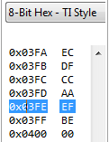
pop.b R6
SP 0x03FE
R5 0xDFEC
R6 0x00CC
R7 0x0000
R10 0xDFEC

Slide 11
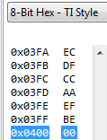
pop R7
SP 0x0400
R5 0xDFEC
R6 0x00CC
R7 0xBEEF
R10 0xDFEC

Slide 12
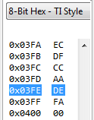
push #0xfade
SP 0x03FE
R5 0xDFEC
R6 0x00CC
R7 0xBEEF
R10 0xDFEC

Slide 13
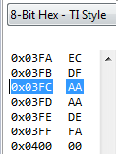
push.b #0xaa
SP 0x03FC
R5 0xDFEC
R6 0x00CC
R7 0xBEEF
R10 0xDFEC
This byte left AS IS

Slide 14
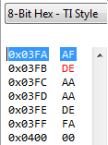
push #0xdeaf
SP 0x03FA
R5 0xDFEC
R6 0x00CC
R7 0xBEEF
R10 0xDFEC

Slide 15
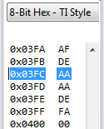
pop.b R5
SP 0x03FC
R5 0x00AF
R6 0x00CC
R7 0xBEEF
R10 0xDFEC
Byte Op cleared UPPER nibble

Slide 16
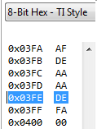
pop R6
SP 0x03FE
R5 0x00AF
R6 0xAAAA
R7 0xBEEF
R10 0xDFEC
Mystery byte here
This byte was never changed

Slide 17
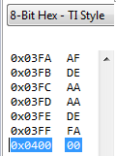
pop.b R7
SP 0x0400
R5 0x00AF
R6 0xAAAA
R7 0x00DE
R10 0xDFEC
Byte Op cleared UPPER nibble

