Slide 1
ECE 382 Lesson 8
Lesson Outline
Miniquiz
Assignment 3
Assembler Directives
Structured Design and Test
Assembly Code Style
Testing
Lab Guidance
Lab 1 Introduction
Admin
Assignment 3 (due today)
Lab#1 Prelab due BOC next lesson
***Meet in 2E48 for Lesson 9 / all Labs***

Slide 2
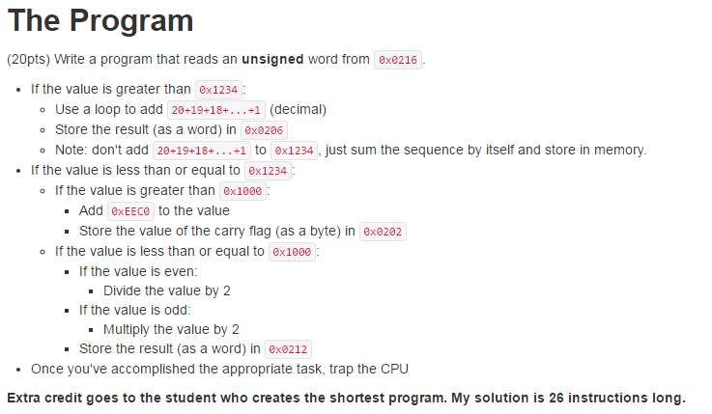
Assignment 3
Assignment 3

Slide 3
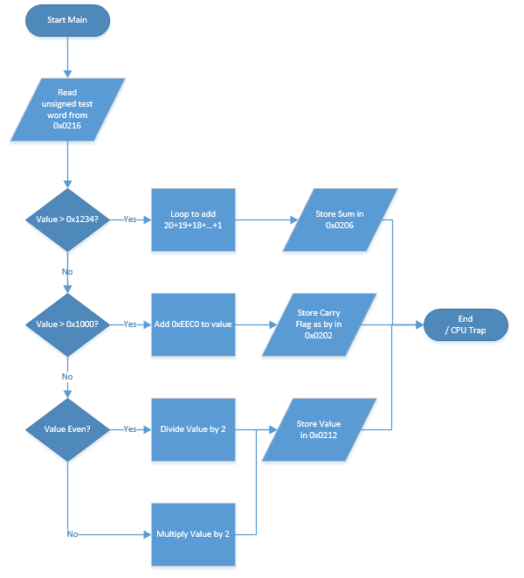
Software Flow Chart / Algorithm Ex: Assignment 3

Slide 4
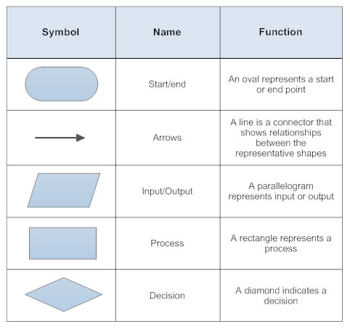
Basic Flow Chart Symbols
https://www.smartdraw.com/flowchart/flowchart-symbols.htm

Slide 5
Status register and Jumps
15 | 14 | 13 | 12 | 11 | 10 | 9 | 8 | 7 | 6 | 5 | 4 | 3 | 2 | 1 | 0
Reserved |  |  |  |  |  |  | V | SCG1 | SCG0 | OSCOFF | CPUOFF | GIE | N | Z | C
Condition Code | Assembly Instruction | Description
000 | JNE/JNZ | Jump if Z==0 (if !=)
001 | JEQ/JZ | Jump if Z==1 (if ==)
010 | JNC/JLO | Jump if C==0 (if unsigned <)
011 | JC/JHS | Jump if C==1 (if unsigned >)
100 | JN | Jump if N==1 - Note there is no jump if N==0
101 | JGE | Jump if N==V (if signed >=)
110 | JL | Jump if N!=V (if signed <)
111 | JMP | Jump unconditionally

Slide 6
Assembler Directives
.cdecls C,LIST,"msp430.h"
.text ;put code in the text section - maps to FLASH (ROM)
StopWDT mov.w #WDTPW|WDTHOLD
.data ;put code into the data section - maps to RAM
.sect ".reset" ;put this at the reset vector
.sect .stack ;make this the location of the stack
MY_RESULTS: .space 20 ; reserves 20 bytes
-----------------
To use:
mov #MY_RESULTS, r5 ; pointer address into r5
mov #0xfefe, &MY_RESULT ; put fefe into 1st two bytes

Slide 7
Assembler Directives
; Can initialize ROM; cannot initialize RAM
;initialize sequence of bytes
bytes: .byte 9,8,7,6,5,4,3,2,1
;initialize sequence of words
words: .word 0x1111,0x2222,0x3333,0x4444
;initialize strings
myStr: .string "hello, world!"
;initialize characters
Chars: .char 'a','b','c','d‘
; see in CCS

Slide 8
Assembler Directives
; .equ ← assign a label to a particular value
SEVENTEEN: .equ 0x11
;align a variable with a particular multiple of bytes (useful to ensure word on even address)
.align 2
;probably won't use these often, but they're available
.float ;floating point value
.int ;16-bit int
.short ;16-bit int
.long ;32-bit int

Slide 9
Structured Design and Test
Guiding Principle: Get one small thing working
Don't write the entire program in one go, then press go, and hope it works. When the entire program is the space you're looking for a bug, it makes debugging really hard.
Modularity
Modularity is the practice of breaking down a larger program into smaller tasks.
Makes code more reusable
Makes code more readable
Make individual taks more manageable
Focus on simpler tasks
Tough to hold a big problem in your brain

Slide 10
Example Design
Concurrent Processes
Init
Process#1
Process#2
Process#3
Process#4
Init
Init
Init
Init
Got msg?
No
Write
Image
New = 1
image
Memory
Send Msg
Msg#1
No
New = 1
New image?
Yes
Do math
No
Got Ack?
Ack#1
image
Yes
Send Ack
FIFO
count
New data?
No
New = 0
Read Image
Yes
count++
Data#2
No
Do math
Write data
Data#2
Yes
Process image
Memory
Yes
locked?
Locked?
Locked?
locked?
Yes
count--
Read data
Done?
No
No
No
Do math
Lock
Lock
Lock
Lock
Yes
Done?
No
Write Data
Write D
Read D
Read Data
unlock
unlock
Yes
Done?
Done?
No
Yes
Yes

Slide 11
Testing
How do we know when we're done with a task? Testing!
You should specify the tests you'll run on the code you're going to write in advance of writing the code. It's a little more work up front, but will save you time debugging down the road.
Write tests that cover all cases - particularly edge cases.

Slide 12
Assembly Code Style Guidelines
Comments
Assume the reader is a competent assembly language programmer
Comment above blocks of code to convey purpose
Only comment individual lines when purpose is unclear
Labels
Descriptive!
loop or loop1 or l1 or blah - not acceptable!
Constants
Use .equ syntax for all constants!
SEVENTEEN: .equ 0x11
Don't want to see naked values

Slide 13
Assembly Code Style Guidelines
Instruction Choice
Use the instruction that makes your code readable!
JHS rather than JC
INCD rather than ADD #2
Well-written code requires few comments
Spacing
Align your code to make it readable
Put whitespace between logical blocks of code

Slide 14
Example Code
What is good and bad about this code?
http://ece.ninja/382/notes/L8/hw_sample.html

Slide 15
Programming Exercise 1
Write a program that will write your name in memory 6 times:
Can use:
myname: .string "Jeff Falkinburg!"
numNames: .equ 0x0006

Slide 16
Programming Exercise 2
Write a program that counts the number of 1s in a 16-Bit Binary number and stores it at &0x0300

Slide 17
Lab Notebook Expectations
Lab Noteboook Standards
https://github.com/jfalkinburg/ECE_382_Lab_Ex

Slide 18
Lab 1 Introduction
The goal of this lab is to implement a simple calculator using assembly language.
Lab 1
How This Lesson Applies
Use assembler directives:
.byte to put your test program into memory
.space to reserve space for your results
Where is this going to go?
Labels for your program / results
.equ for key constants
Modularity
Section to store results of ops
Section for each op
Testing
Specify multiple testing sequences at the beginning!
I'll test your code with a few of my own

Slide 19
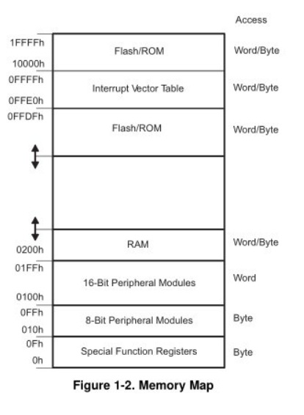
MSP430’s ISA
How many addr bits?
Msp430g2553 Memory Map
512b of RAM - 0x200-0x400 16kb of ROM - 0xc000-0xffdf
0x1100-0xc000 is empty!
- There is no memory backing it up!
- If you attempt to write to this area of memory, you'll trigger what's essentially a segmentation fault because that memory doesn't exist. It will cause the chip to do a Power-up Clear (PUC), resetting the state of your processor. This is a tough error to debug.

Slide 20
Assembly and Machine Languages
Instructions:
words in a computers language
Instruction Set:
the dictionary of the language
Assembly Language:
human-readable format of computer instructions
Machine Language:
computer-readable instructions - binary (1's and 0's)
Assembly Language Program
Assembler
Relocatable Object Code
Linker
Executable Code

Slide 21
Let's write a MSP430 program
Our chip version: Msp430g2553 → open CCS
; This program sets all pins on Port 1 to output and high. Since LEDs 1 and 2 are connected to P1.0 and P1.6 respectively, they will light up. This program turns the LEDs on and off
.text
; turn off watchdog timer
main:
bis.b #0xFF, &P1DIR ; set port1 direction to output
Turn_on:
bis.b #0xFF, &P1OUT ; turn on leds at port1, bis?
; could of: move ____ , &P1OUT
Turn_off:
bic.b #0xFF, &P1OUT ; turn on leds at port1, bic?
; could of: move ____ , &P1OUT
jmp Turn_on ; loop forever
← what?
Stack pointer?

Slide 22
Status register and Jumps
15 | 14 | 13 | 12 | 11 | 10 | 9 | 8 | 7 | 6 | 5 | 4 | 3 | 2 | 1 | 0
Reserved |  |  |  |  |  |  | V | SCG1 | SCG0 | OSCOFF | CPUOFF | GIE | N | Z | C
Condition Code | Assembly Instruction | Description
000 | JNE/JNZ | Jump if Z==0 (if !=)
001 | JEQ/JZ | Jump if Z==1 (if ==)
010 | JNC/JLO | Jump if C==0 (if unsigned <)
011 | JC/JHS | Jump if C==1 (if unsigned >)
100 | JN | Jump if N==1 - Note there is no jump if N==0
101 | JGE | Jump if N==V (if signed >=)
110 | JL | Jump if N!=V (if signed <)
111 | JMP | Jump unconditionally

