Slide 1
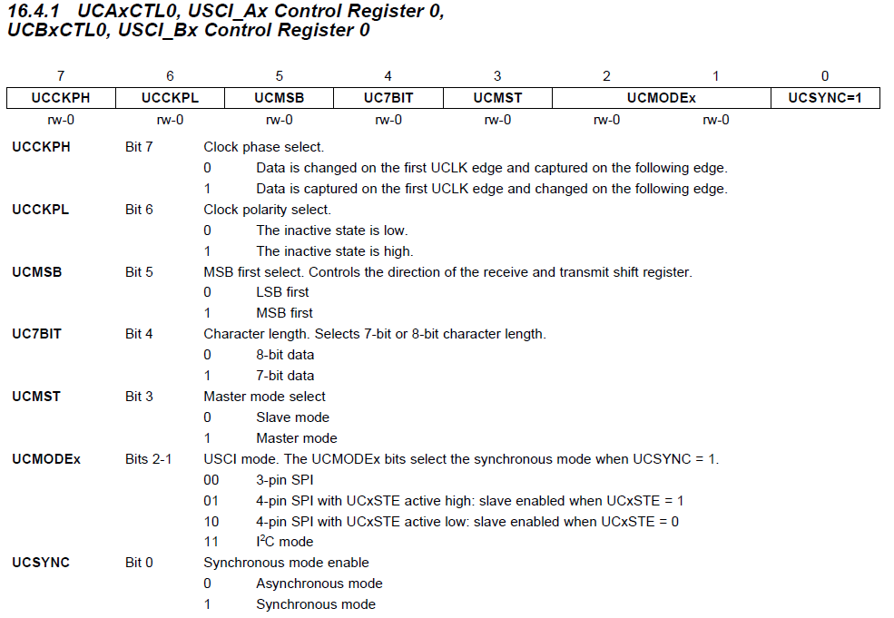
UCA/B Control Register 0
Control Register: Page 445 of the Family User Guide (Blue book pp 73)

Slide 2
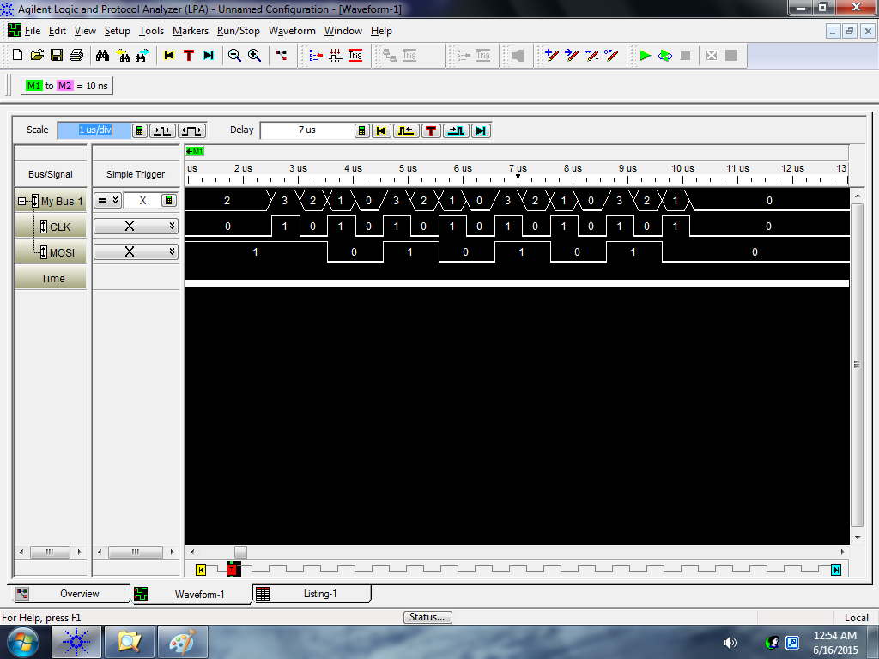
Phase = 0 and Polarity = 0
Change
Capture
Input = 0xAA
bis.b #UCMSB|UCMST|UCSYNC, &UCA0CTL0 ; UCCKPH = 0, UCCKPL = 0

Slide 3
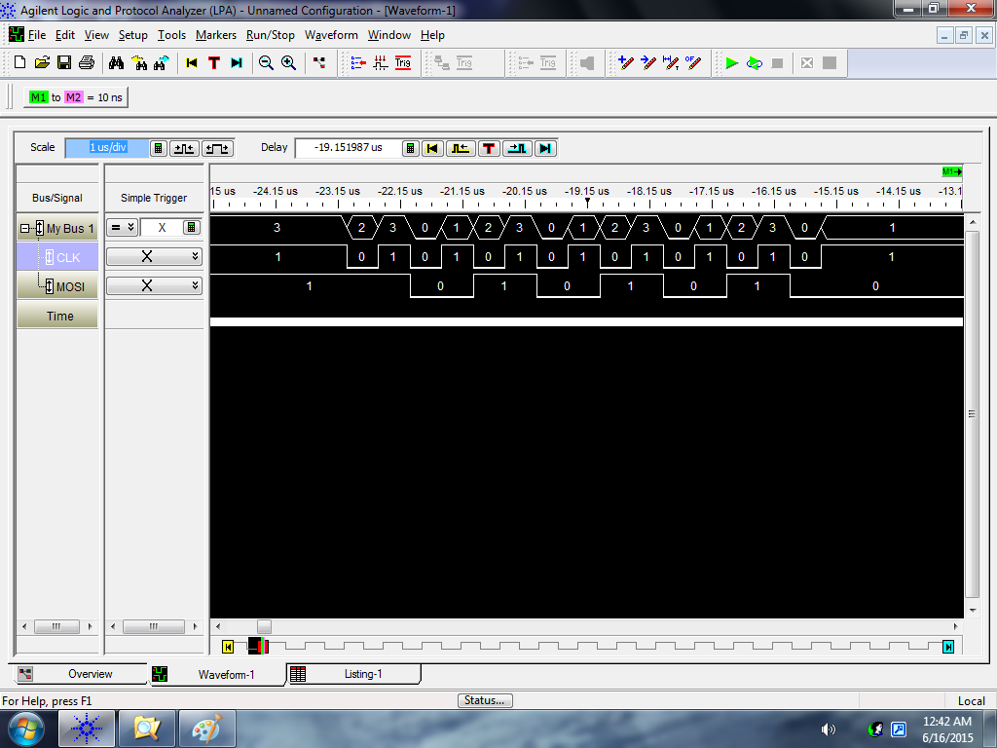
Phase = 0 and Polarity = 1
Change
Capture
Input = 0xAA
bis.b #UCCKPL|UCMSB|UCMST|UCSYNC, &UCA0CTL0 ; UCCKPH = 0, UCCKPL = 1

Slide 4

Phase = 1 and Polarity = 0
Change
Capture
Input = 0xAA
bis.b #UCCKPH|UCMSB|UCMST|UCSYNC, &UCA0CTL0 ; UCCKPH = 1, UCCKPL = 0

Slide 5
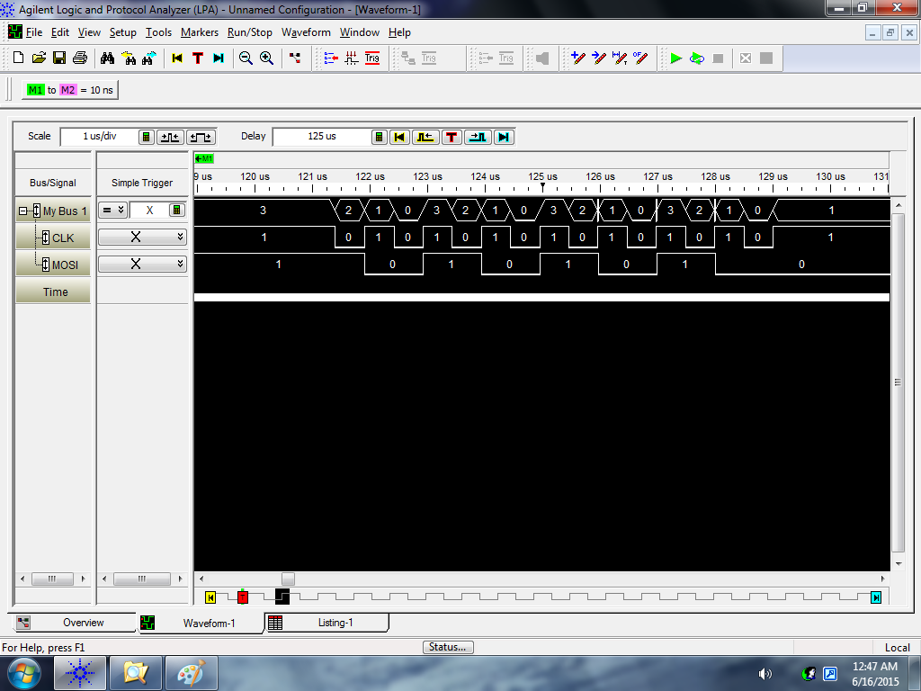
Phase = 1 and Polarity = 1
Change
Capture
Input = 0xAA
bis.b #UCCKPH|UCCKPL|UCMSB|UCMST|UCSYNC, &UCA0CTL0 ; UCCKPH = 1, UCCKPL = 1

Slide 6
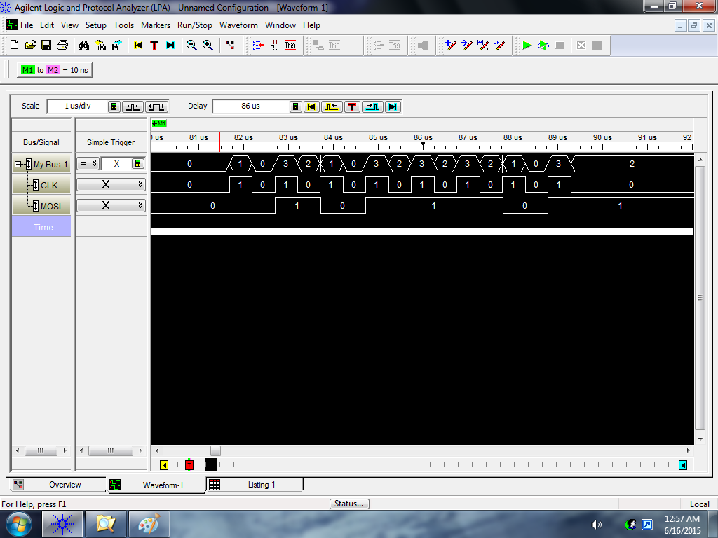
Phase = 0 and Polarity = 0
Change
Capture
Input = 0x5D
bis.b #UCMSB|UCMST|UCSYNC, &UCA0CTL0 ; UCCKPH = 0, UCCKPL = 0

Slide 7
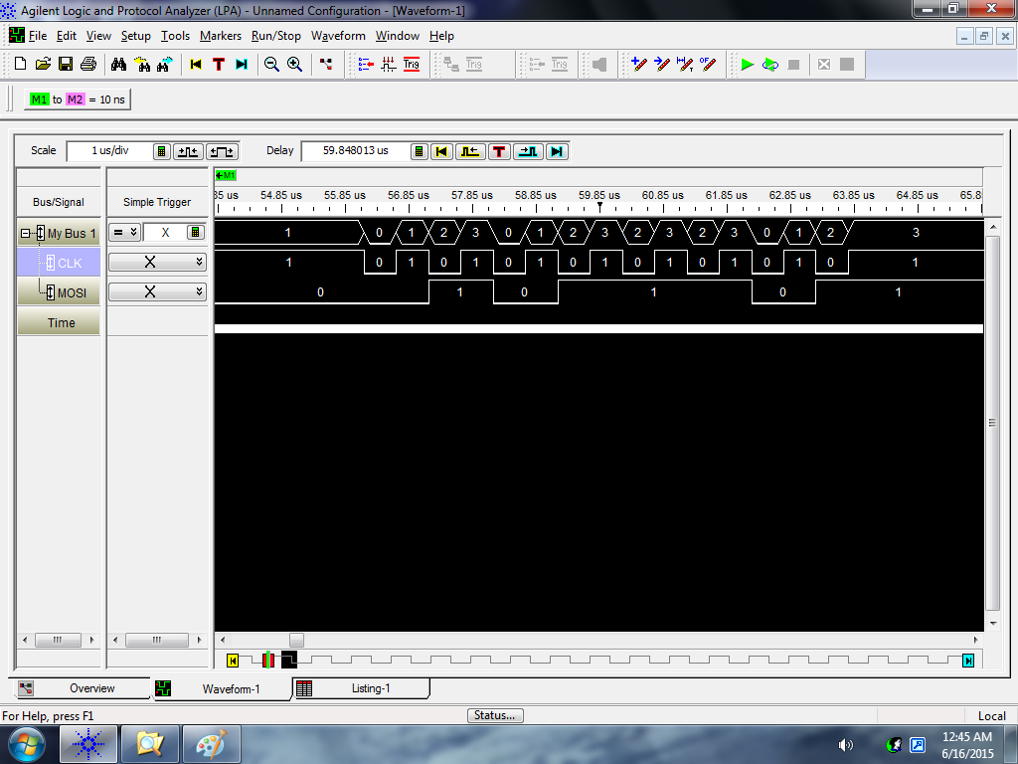
Phase = 0 and Polarity = 1
Change
Capture
Input = 0x5D
bis.b #UCCKPL|UCMSB|UCMST|UCSYNC, &UCA0CTL0 ; UCCKPH = 0, UCCKPL = 1

Slide 8
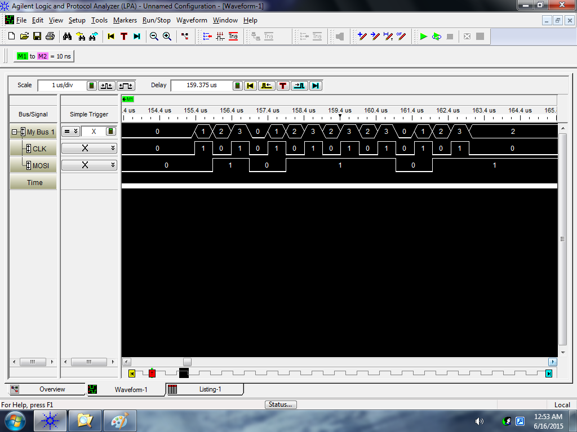
Phase = 1 and Polarity = 0
Change
Capture
Input = 0x5D
bis.b #UCCKPH|UCMSB|UCMST|UCSYNC, &UCA0CTL0 ; UCCKPH = 1, UCCKPL = 0

Slide 9

Phase = 1 and Polarity = 1
Change
Capture
Input = 0x5D
bis.b #UCCKPH|UCCKPL|UCMSB|UCMST|UCSYNC, &UCA0CTL0 ; UCCKPH = 1, UCCKPL = 1

