Slide 1
ECE 382 Lesson 15
Lesson Outline
Lab#2 Feedback
Serial Comm Fundamentals
Serial Peripheral Interface (SPI)
SPI on the MSP430
Logic Analyzer Demo
Lab 3 Introduction
BB-8 in action, Cracking open BB-8
STM32F3
Admin
Assignment 5 due BOC
Lab 3 prelab? (a bit different this time…must be typed, pushed, and printed by EOC)

Slide 2
Lab#2 feedback
What is wrong with this subroutine?
Other Issues: pass-by-reference and pass-by-value; using labels to refer to location of the encrypted and decrypted messsages and the key; committing early and often.
Subroutine Header: Which is the best?
Choice A
; Inputs:
; Outputs:
Choice B
; Inputs: r10, r11, r6, r8
; Outputs: r8
decryptMessage:
tst r5
jz forever
mov.b @r7+, r10
call #decryptCharacter
mov.b r10, 0(r9)
inc.w r9
dec.b r5
jmp decryptMessage
ret
Choice C
;Inputs:
r10 length of message
r11 length of key
r6 address location of encrypted message
r8 address location for decrypted message
;Outputs:
RAM [@r8 to @(r8+r11)] decrypted results

Slide 3
What does this disassembled code do?
0000c0a2 <mystery_routine>:
c0a2: 0d 4f mov r15, r13
c0a4: 0f 43 clr r15
c0a6: 0e 93 tst r14
c0a8: 07 24 jz $+16 ;abs 0xc0b8
c0aa: 12 c3 clrc
c0ac: 0d 10 rrc r13
c0ae: 01 28 jnc $+4 ;abs 0xc0b2
c0b0: 0f 5e add r14, r15
c0b2: 0e 5e rla r14
c0b4: 0d 93 tst r13
c0b6: f7 23 jnz $-16 ;abs 0xc0a6
c0b8: 30 41 ret

Slide 4
Serial Communication
Lab#3: Using Serial port to control LCD Display
Parallel versus Serial?
Serial Advantages?
Serial Disadvantages?

Slide 5
Serial Communication
Lab#3: Using Serial port to control LCD Display
Parallel versus Serial?
Serial Advantages?
Simple interface – less hardware, less pins, less cost
Faster clock speed per wire (no “cross-talk”)
Longer Distance (no “cross-talk”)
Serial Disadvantages?
Slower
On-chip hardware to encode/decode serial signal

Slide 6
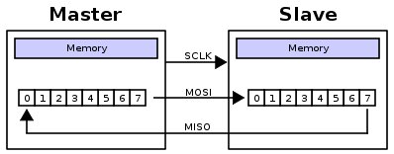
Serial Peripheral Interface (SPI)
Simple: with each clock cycle, a single bit is transferred from the MSB of one shift register to the other
Is this a half-duplex or full-duplex protocol?
Synchronous or Asynchronous protocol?
How many clocks to transfer a byte?
Signals
MOSI: Master Out Slave In
MISO: Master In Slave Out
SCLK: Clock
SS: Slave Select
TI renamed these:
MOSI = SIMO
MISO = SOMI

Slide 7
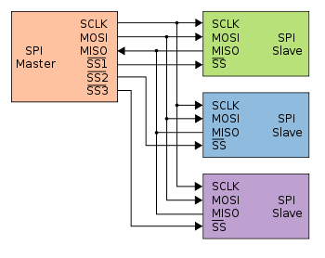

Serial Peripheral Interface (SPI)
Slave Select signal allows the master to potentially use the same interface to potentially interact with multiple slaves. It's usually active low

Slide 8
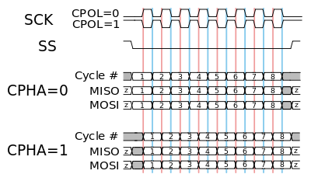
Serial Peripheral Interface (SPI)
Page 35 of LCD Driver
Can we just tie SS low?
Configurable Elements:
Clock frequency
Clock polarity
Clock phase
On the MSP430:
MSB first or LSB first
you'll pretty much always want MSB first, which isn't the default
8-bits or 7-bits per transmission
7-bits is justified toward the LSB
3-pin or 4-pin modes
Control Register: Page 445 of the Family User Guide (Blue book pp 73)
SPI: Page 436 of the Family User Guide (Blue book pp 69)

Slide 9
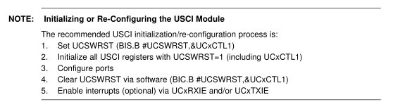
Universal Serial Communication Interface (USCI)
On the MSP430:
Two Universal Serial Communication Interfaces (USCI), A and B
Can do multiple protocols (one is SPI), defined by configuration registers
UCA0 and UCB0
datasheet - control registers (pp 435-448)
Page 436 or 452 of the Family User Guide (Blue book pp 69 or 76)

Slide 10
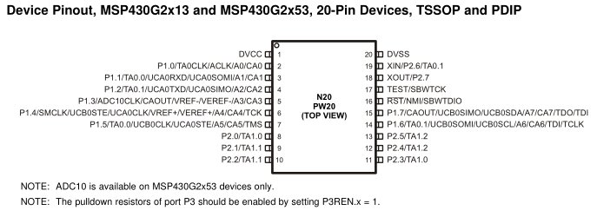
Universal Serial Communication Interface (USCI)
i.e (SW reset)
Step 1
Setting the UCSWRST bit in the CTL1 register [16.4.2] resets the subsystem into a known state until it is cleared. All the registers will hold their default values.
Step 2
Set the appropriate bits in the control registers to configure our signal the way we want.
Remember, you've got to set UCSYNC for the system to function!
CTL0 [bit 7 phase; bit 6 polarity; bit 3 master/slave; bit 0 UCSYNC = 1 ] [16.4.1]
CTL1 [bit 7&6 clock; bit 0 UCSWRST][16.4.2]
UCBRx [clock speed] [16.4.3 & 16.4.4]
STAT [16.4.5]
Step 3
All the ports on our MSP430 are multiplexed! We need to set the PxSEL and PxSEL2
Step 4
Clear the UCSWRST bit in the CTL1 register - releases the system to operate.
pp 437 for Block Diagram

Slide 11
Example SPI Setup for Lab 3
1) bis.b #UCSWRST, &UCB0CTL1
2) mov #UCCKPH|UCMSB|UCMST|UCSYNC, &UCB0CTL0
bis #UCSSEL_2, &UCB0CTL1
bis #BIT0, &UCB0BR0
clr &UCB0BR1
3) bis #LCD_SCLK_PIN|LCD_MOSI_PIN|LCD_MISO_PIN, &P1SEL
bis #LCD_SCLK_PIN|LCD_MOSI_PIN|LCD_MISO_PIN, &P1SEL2
4) bic.b #UCSWRST, &UCB0CTL1

Slide 12
Universal Serial Communication Interface (USCI)
Step 5
Use the subsystem!
To send a byte, just write to the TXBUF register. [16.4.6]
To read a received byte, read from the RXBUF register. [16.4.7]
How do you know “you’ve got mail” or last transmission is done?
You've got to monitor the flags in the IFG2 register [16.4.9] to know when it's safe the send
TXIFG
Set when TXBUF is ready for a byte
Cleared on write
Just because the TXBUF is ready for another byte doesn't mean that the transmission is complete! It's double-buffered!
RXIFG
Set when RXBUF has received a complete character
Cleared on read
This is what you should monitor to determine a transmission has completed!

Slide 13
Example (loopback)
bis.b #UCSWRST, &UCA0CTL1
bis.b #UCCKPL|UCMSB|UCMST|UCSYNC, &UCA0CTL0 ; don't forget UCSYNC!
bis.b #UCSSEL1, &UCA0CTL1 ; select a clock to use!
bis.b #UCLISTEN, &UCA0STAT ; enables internal loopback
bis.b #BIT4, &P1SEL ; make UCA0CLK available on P1.4
bis.b #BIT4, &P1SEL2
bis.b #BIT2, &P1SEL ; make UCA0SSIMO available on P1.2
bis.b #BIT2, &P1SEL2
bis.b #BIT1, &P1SEL ; make UCA0SSOMI available on P1.1
bis.b #BIT1, &P1SEL2
bic.b #UCSWRST, &UCA0CTL1 ; enable subsystem
send mov.b #0xBB, &UCA0TXBUF ; place a byte in the TX buffer
wait bit.b #UCA0RXIFG, &IFG2 ; wait for receive flag to be set (operation complete)
jz wait
mov.b &UCA0RXBUF, r4 ; read RX buffer to clear flag
jmp send ; send another byte

Slide 14
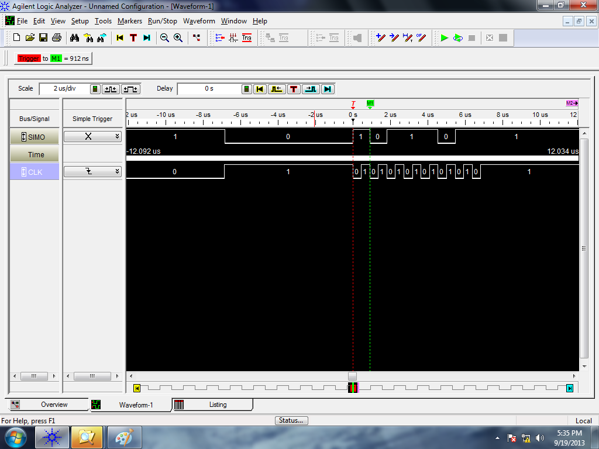
Logic Analyzer
Sending 0xBB once (0x1011 1011) [MSB first!]
Note how the clock default state is high and data is read on the second clock edge - consistent with our settings.

Slide 15
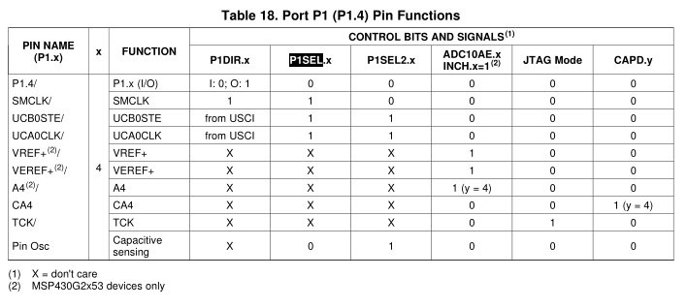
Logic Analyzer Demo
Logic Analyzer is tutorial available here.
Let’s Measure SMCLK (P1.4)
Multiplexed? P1SEL1 & P1SEL2?

Slide 16
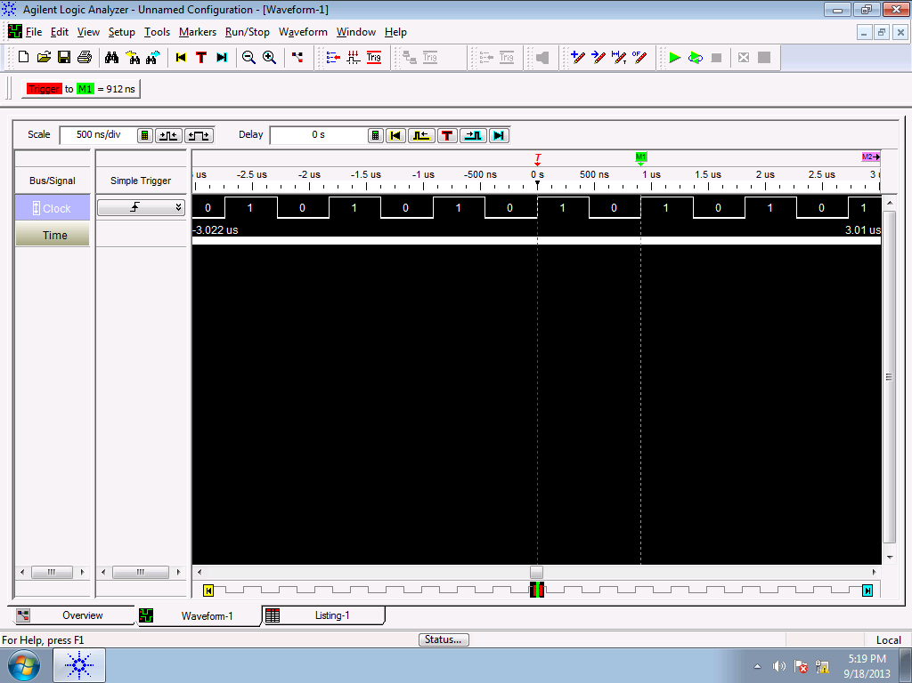
Measure SMCLK
Hook up the black Ground wire on Pod 1 to ground on the MSP430
Hook up Pod 1 Wire 0 to P1.4 (SMCLK)
Sampling setup screen: set the sampling speed to be the fastest possible (once every 2ns)
Waveform screen and set the trigger on my signal to be falling edge
Run Single button
Drag markers to measure falling edge to falling edge of SMCLK
bis.b #BIT4, &P1DIR
bis.b #BIT4, &P1SEL
forever jmp forever

Slide 17
Lab3
http://ece.ninja/382/labs/lab3/index.html

