Slide 1
ECE 382 Lesson 13
Lesson Outline
Peripherals
Memory-Mapped IO
Ports
GPIO
Multiplexing
Admin
Lab 2 BitBucket report due COB Today (no penalty if turned in by Midnight Sunday)
- Commit Message “Lab 2 notebook is ready to grade”
BadLec5.asm Extra Credit Due Next Lesson

Slide 2
Common Mistakes on Lab 1
Use of multiple .asm files (all functionalities should be in final .asm)
Lack detail on flowgraph (i.e. values and data outputs)
Didn’t include documentation in code header or didn’t have a header
Didn’t show Proof of Functionality (i.e. “Show me the memory!”)
Used Magic numbers instead of constants
Constants should be in all CAPs
Not using the Example repo (missing sections or details)
https://github.com/jfalkinburg/ECE_382_Lab_Ex
Don’t copy entire code into readme
Code built in RAM (i.e. the .data section)
Missing 2 Additional Test Cases, didn’t test them, or didn’t account for edge cases, or didn’t explain the results
Effective use of BitBucket (need at least 3 commits with detailed comments for code)
Didn’t show me the Multiply algorithm or document the source
Poor Conclusion (i.e. Telling me what you did and what you learned)

Slide 3
What do I want to see on the Lab 2 Notebook?
Use one .asm file for all functionalities and commit often
Each Functionality should have a commit
Effective use of BitBucket should be at least 3 commits with detailed comments
Don’t forget code headers and comments and update subroutine headers
Show Proof of Functionality (i.e. “Show me the memory!”)
Don’t include an image without explaining what it is and how it is important
For A-Funct you should also tell me what the key in addition to the message
Update your flowgraph! Show me what registers you used to pass data
If you did A or B-Funct you need to show me how you did it (i.e. Flowgraph)
Discuss any issues had in the debugging section
Conclusion – Paragraph that restates the purpose, discusses whether you achieved that goal, and tell me what you learned and how you can use this in the future.

Slide 4
Peripherals
What are Peripherals?
MSP430G2xx Peripherals?
MSP430 wikipedia:
Watchdog Timer
Universal Serial Communication Interface (USCI)
Implements SPI and I2C protocols
We'll use SPI to interface with the LCD in your black box
Pulse Width Modulation (PWM)
We'll use this later to drive the robot
Temperature Sensor
Multipliers
Capacitive Touch I/O
For working with touch screens, etc

Slide 5
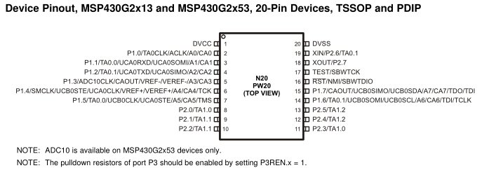
Ports
What are Ports? Examples?
Your LaunchPad Board has…
Port 1, Pin 0 to Pin 7
Port 2, Pin 0 to Pin 5 (where are pin 6 and 7?)

Slide 6
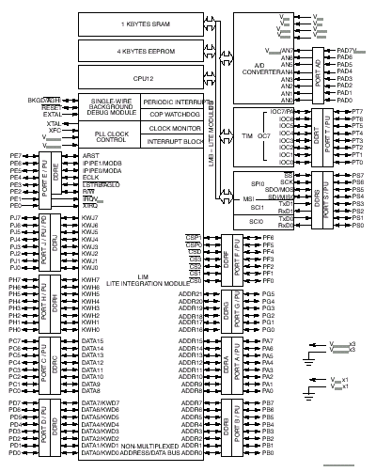
68HC12

Slide 7
Multiplexing
Only 20 Pins !!! But want access to many more signals
Therefore, each pin shares several signals → multiplexing
Use PxSEL1 and PxSEL2 to select signal for each pin
The details are in the MSP430G2x53 2x13 Mixed Signal MCU Datasheet.

Slide 8
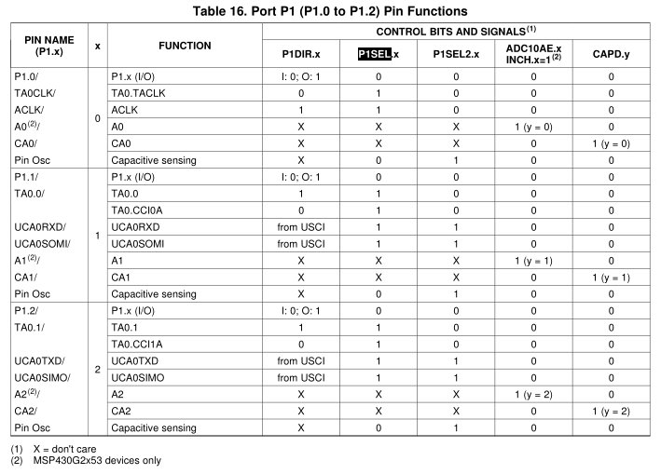
Pitfall !!!
Let's say I wanted to make the UCA0SOMI function available on P1.1:
; 'from USCI' means this bit is set automatically by the USCI when enabled
bis.b #BIT1, P1SEL
bis.b #BIT1, P1SEL2

Slide 9
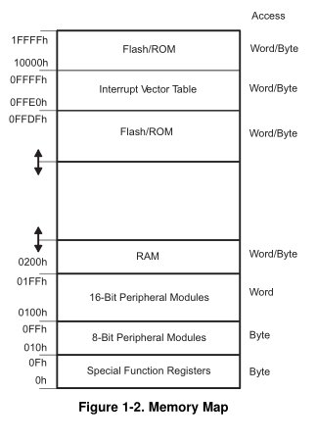
How do we talk to Ports? Do I/O?
Two classic methods
Memory-Mapped I/O (Motorola)
Port-Mapped I/O [or Isolated IO] (Intel)
Memory-Mapped I/O
I/O and memory SHARE the same address space
Advantage
Fewer instructions
Can use all addressing modes
Disadvantage
Lose memory to IO
Programmer mistakes
How to use
Mov #0x55, &P1OUT
Mov #0x55, &0x0021
User’s Guide p 333, Table 8-2 (BB pp 41)
Watchdog Timer, page 341 (BB pp 42)

Slide 10
How do we talk to Ports? Do I/O?
Port-Mapped I/O (Intel)
I/O and memory have their own separate address space
Advantage
Don't lose memory for IO.
Protects coder from mistakes.
Disadvantage
Need More Instructions (like In/Out)
More restrictive addressing modes
How to use
Out #0x55, &PORT1
Does Port-Mapped cheat?

Slide 11
General Purpose Input Output (GPIO)
The registers used to configure GPIO are PxDIR, PxREN, PxOUT, and PxIN
PxDIR configures which pins are input and which pins are output
1 corresponds to output, 0 to input
PxREN controls pull up / pull down resistors to avoid floating inputs.
Writing to PxOUT controls the output of each pin
PxIN allows you to read the values on these pins
Let's write a program that controls the onboard LEDs with the onboard push button
bis.b #BIT0|BIT6, &P1DIR
bic.b #BIT3, &P1DIR
check_btn: bit.b #BIT3, &P1IN ;push button is LOW on push
jz set_lights
bic.b #BIT0|BIT6, &P1OUT
jmp check_btn
set_lights: bis.b #BIT0|BIT6, &P1OUT
jmp check_btn
Any problem with this code?
Family Users Guide p 328
Blue Book pp 38

Slide 12
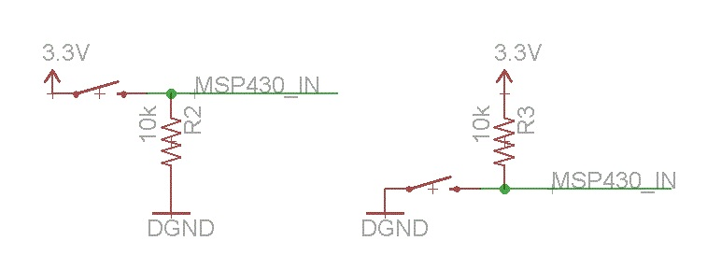
Example Program
Input was FLOATING! Low is ground, High is floating, so use a pull- _________?
bis.b #BIT0|BIT6, &P1DIR ; output pin direction
bic.b #BIT3, &P1DIR ; input pin direction
bis.b #BIT3, &P1REN ; enable pin 3’s resistor
bis.b #BIT3, &P1OUT ; make it a pull-up? (trick)
check_btn: bit.b #BIT3, &P1IN
jz set_lights
bic.b #BIT0|BIT6, &P1OUT
jmp check_btn
set_lights: bis.b #BIT0|BIT6, &P1OUT
jmp check_btn
Modify code to toggle the LEDs when button is pressed (i.e. one LED on and one off)

Slide 13
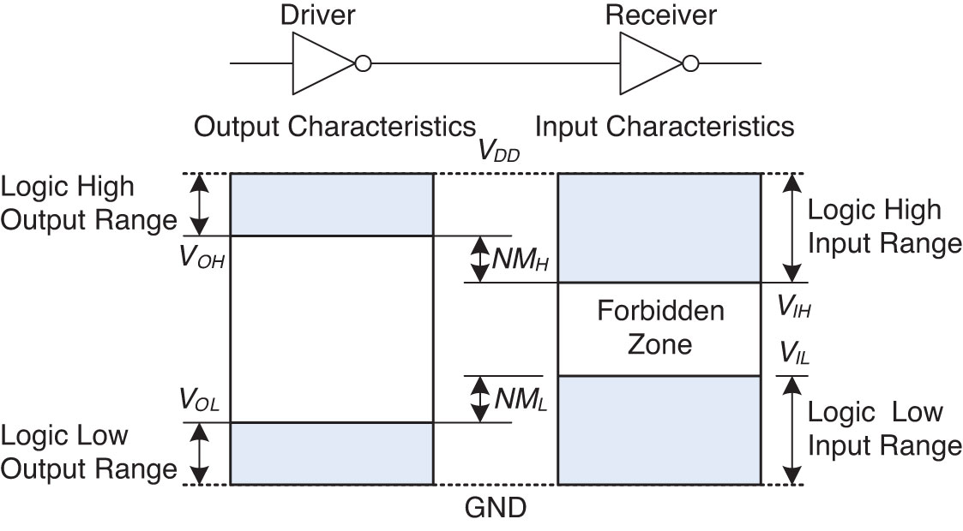
Why Pullup and Pulldown Resistors are needed
Voltage Levels and Noise Margins
Figure 1.23 Logic levels and noise margins

Slide 14
Pitfall !!!
Anything wrong with this?
mov.b #0xff, P1DIR
What do these commands do?
mov.b #0b00001111, &P1DIR
bis.b #0b00001111, &P1OUT
mov.b #0xff, &P1OUT
mov.b &P1IN, r5

Slide 15
Inclass Exercise
Modify this program so the two LEDs always have the opposite value
bis.b #BIT0|BIT6, &P1DIR ; output pin direction
bic.b #BIT3, &P1DIR ; input pin direction
bis.b #BIT3, &P1REN ; enable pin 3’s resistor
bis.b #BIT3, &P1OUT ; make it a pull-up? (trick)
check_btn: bit.b #BIT3, &P1IN
jz set_lights
bic.b #BIT0|BIT6, &P1OUT
jmp check_btn
set_lights: bis.b #BIT0|BIT6, &P1OUT
jmp check_btn

