Slide 1
Welcome to ECE 382 Embedded Computer Systems I
What have you heard about this course?
What are Embedded Computer Systems?
freescale_MCU_Video-Fullscreen.wmv
Swarm of Quadrotors

Slide 2

Computer Systems Courses
EE 281:
Digital Design &
Comp Arch
EE 382:
Embedded Comp
Systems I
EE 383:
Embedded Comp
Systems II
EE 484:
Adv Digital
System Design
EE 485:
Adv Computer
Architecture
EE 387:
Introduction to
Robotics
SE 460:
UAV Systems

Slide 3
Embedded Processors
Every PC, iMac, engineering workstation, Cray supercomputer and all other general-purpose computers put together account for less than 1% of all microprocessors sold every year.
Your average car has about 15 microprocessors. (1999 BMW 7-series has 65)
There's one micro in each headlight of a new Lexus, BMW or Mercedes. Plus one in each rear-view mirror.
The average middle-class household has about 40 to 50 microprocessors in it (55 if you own a PC).
Where are they?
digital cellular telephone, pager, microwave oven, washer, dryer, dishwasher, coffee maker, refrigerator, VCR, television, video-game console, stereo receiver, CD player, DVD player, portable Discman, remote control for the TV, remote for the VCR, remote for the stereo, garage-door opener, automatic sprinkler timer, fax machine, PDA, answering machine, etc.
250 million 32-bit embedded microprocessors sold plus
>1 billion 16-bit plus
>1 billion 8-bit plus
>1 billion 4-bitters.
Source: May 1999 Embedded Systems Programming

Slide 4
ECE 382
In this class, we'll be:
Writing programs in Assembly Language, then C
Learning about and using the functional units of a microcontroller
Using the microcontroller to interface with peripheral devices
In short – we want you to know how to use a microcontroller for your own purposes

Slide 5
Embedded Systems
Is a smart-phone an embedded system?
Embedded Systems
they're built to interact with the real-world and perform very specific functions, often with difficult constraints (timing, power, etc)

Slide 6
Who am I?
Education
BSCE, University of Nebraska Lincoln – Omaha Campus
MSCE, Air Force Institute of Technology (AFIT)
USAF Career (62E3C, T62E3E, 62E3A, 3CO31, 2E231)
Prior Enlisted 9.5 yrs
3rd Combat Communication Group – Tinker AFB, OK
Operation Southern Watch – Eskan Village, Saudi Arabia
55th Communications Group – Offutt AFB, NE
School/AFROTC/AECP – University of Nebraska
Air Force Research Labs (AFRL) – Munitions Directorate – Eglin AFB, FL
Operation Iraqi Freedom – Al Asad, Iraq
School – AFIT
711 Human Performance Wing (HPW) – Wright Patterson AFB, OH
Interests
Spending time with my Family, computers, watching movies, woodworking, getting outside

Slide 7

Why I do what I do

Slide 8
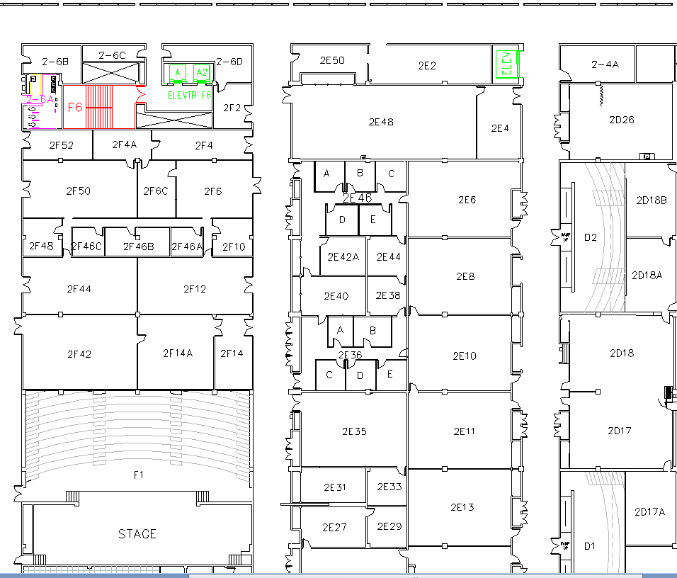
West (Terrazzo) Side
Lab
Class

Slide 9
Extra Instruction (EI)
Capt Jeffrey Falkinburg
2E46E
Office: 333-9193
M1
T1
ECE 210 – 2E6
M2
ECE 382 – 2F44
T2
M3
ECE 463 – 2G2
T3
M4
ECE 463 – 2G2
T4
Available
M5
T5
Sometimes Available
M6
ECE 382 – 2F44
T6
Always Unavailable
M7
T7

Slide 10
Admin
Course Website: http://ece.ninja/382/
Schedule
Lesson Notes & Reading (do before class)
Admin → Course Letter
What are the 2 ways to fail ece382?
Bring laptop to class
Skills Review → due BOC lesson 3
Lab Notebooks?
Using Bitbucket.org

Slide 11
What are the main components of a computer?
CPU
Memory
Input/
Output
Outside
World
Control
Datapath
ALU
Control Bus
Data Bus
Address Bus

Slide 12
What are the main components of a PC?
Motherboard
CPU
RAM/ROM
Harddisk
Power Supply
I/O: ethernet, USB, …
PC
Single Board
Computer
System on
a Chip
Microcontroller
Small, 100kB of RAM
Low power, Low cost

Slide 13
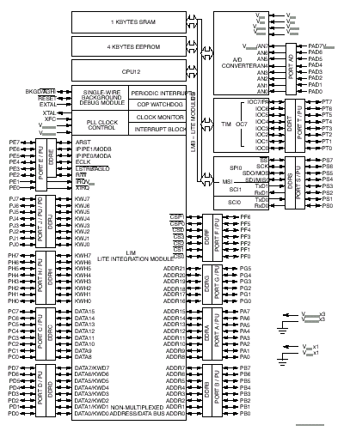
68HC12 vs MSP430G2553
http://ece.ninja/382/datasheets/msp430g2x53_2x13_mixed_sig_mcu.pdf
27 instructions
200 to 300 instructions

Slide 14
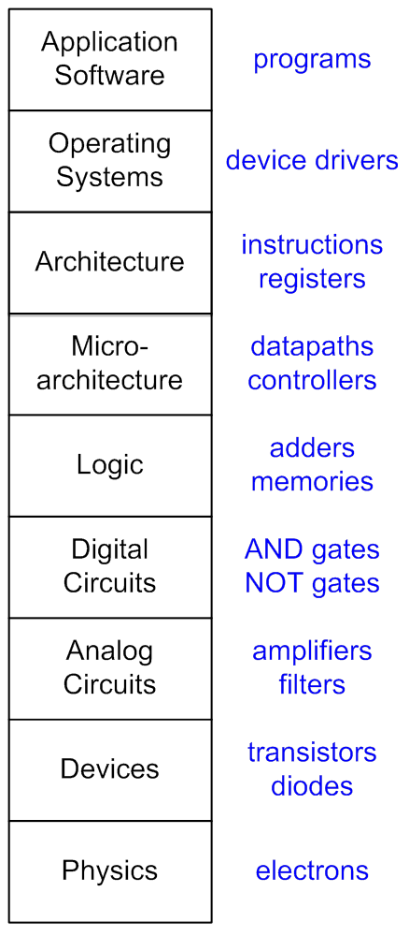
Hierarchy of ECE
Instruction Set Architecture (ISA)?
Microarchitecture?

Slide 15
ISA vs Microarchitecture
Instruction Set Architecture (ISA) The ISA is the programmer's view of the processor.
Processors with the same ISA share the same data types, assembly language instructions, registers, addressing modes, memory architecture, interrupts, IO, etc.
Are all processors that implement an ISA the same? Are the Intel and AMD chips that implement x86 the same (Pentium, Athlon)?
Microarchitecture The microarchitecture is the hardware implementation of a given ISA. An ISA can be implemented with different microarchitectures. This allows programmers to write software that functions on chips made by different manufacturers.
What ISA is your laptop?
Name some ISAs?

Slide 16
RISC vs CISC ?
Reduced Instruction Set Computer (RISC)
Complex Instruction Set Computer (CISC)
Tradeoffs RISC vs CISC
more instructions == more complex hardware
Complex
SW
Complex
HW

Slide 17
Notecards
Name
Hometown
Hobbies / Interests
Course Goals?
Issues / Concerns about this course?
Anything else I should know?

