Slide 1
In-Class Programming Exercise
(see interruptTones.c)
Create a project around interruptTones.c. This C program utilizes interrupts to Blink the Green LED (P1.0 using Timer A at 440Hz Modify the program to do the following:
Put a speaker or headphones on P1.6 to listen to the 440Hz 'A' Tone using the following schematic.
Implement another interrupt from a button press (P1.3) to toggle the Red LED (P1.0) and then increment through each tone in the counts array.
Use the button interrupt to increment through the counts array to be output the different tones on a speaker.

Slide 2
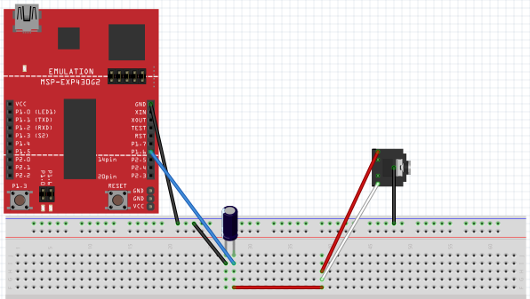
In-Class Programming Exercise
(see interruptTones.c)
Setup for the hooking up 3.5mm Audio Jack to the MSP430 Launchpad Board
without Volume Control

Slide 3
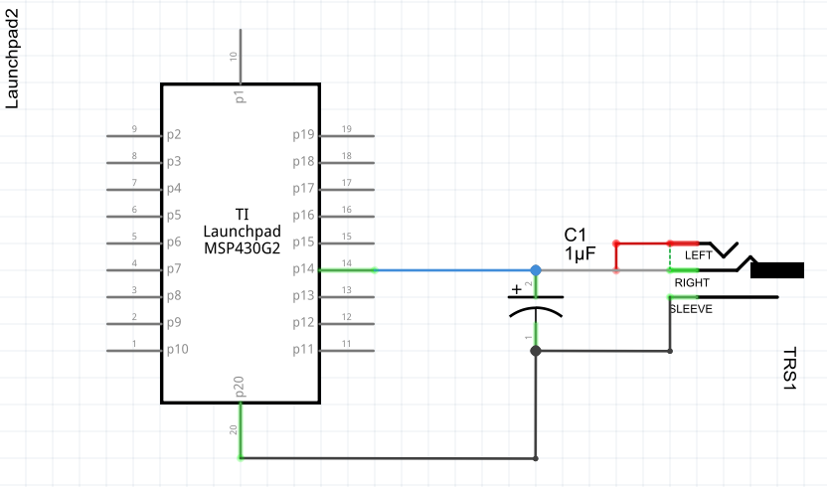
In-Class Programming Exercise
(see interruptTones.c)
Setup for the hooking up 3.5mm Audio Jack to the MSP430 Launchpad Board
without Volume Control

Slide 4
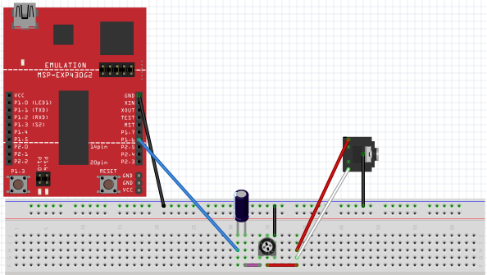
In-Class Programming Exercise
(see interruptTones.c)
Setup for the hooking up 3.5mm Audio Jack to the MSP430 Launchpad Board
with Volume Control

Slide 5
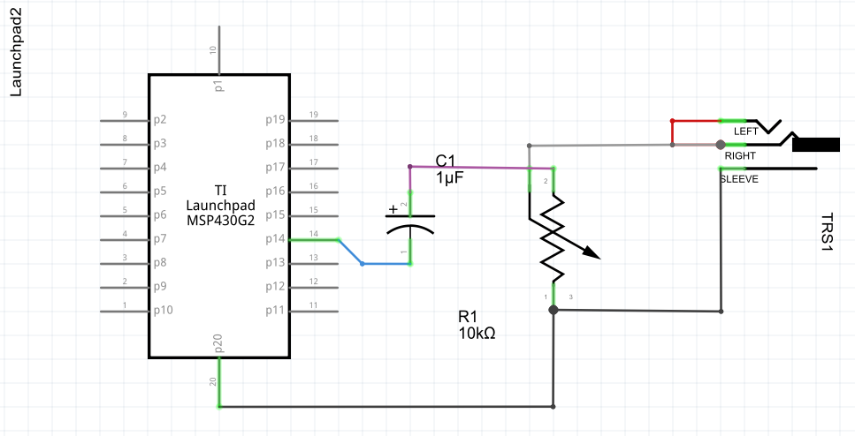
In-Class Programming Exercise
(see interruptTones.c)
Setup for the hooking up 3.5mm Audio Jack to the MSP430 Launchpad Board
with Volume Control

Slide 6
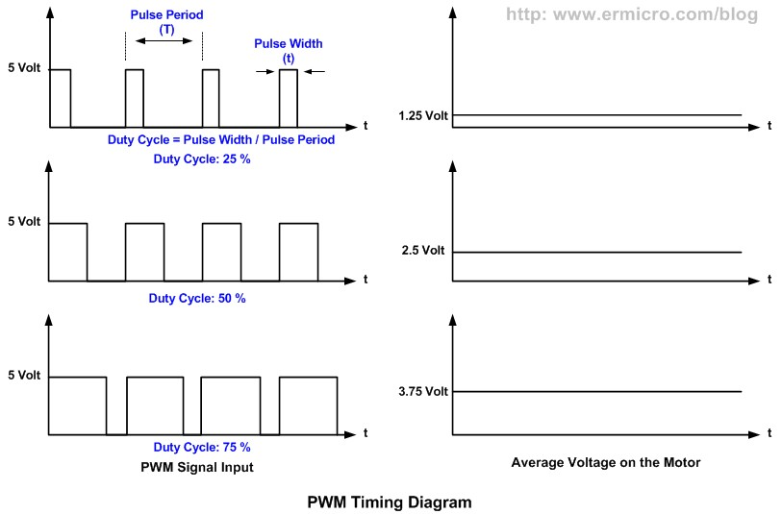
Mimic DC Values

Slide 7
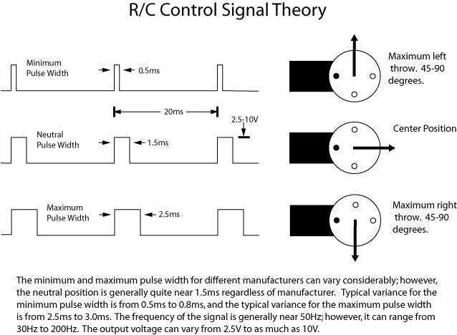
Servos

