Slide 1

HQ U.S. Air Force Academy
ECE 382 Embedded Computer Systems I
Maj Walchko
Office 2F48
1

Slide 2
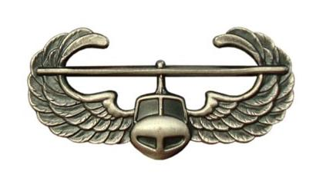



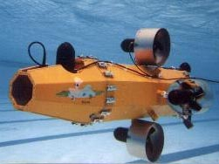



Background – Pre-AF

Slide 3
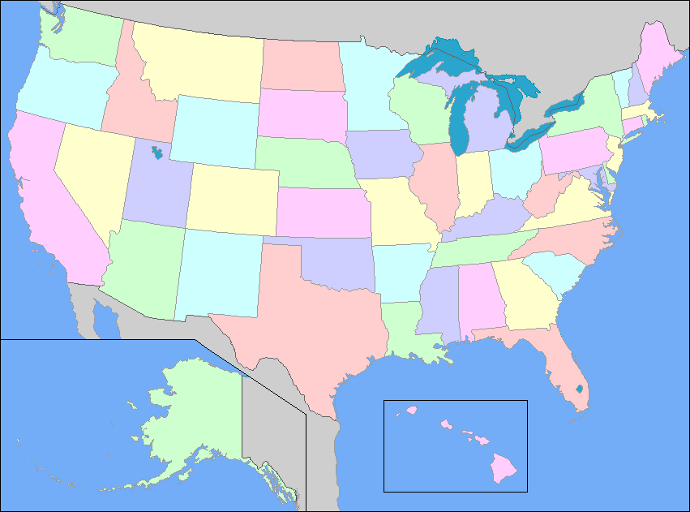
AF Carrier
NRO
Chantilly, VA
CW/DF
USAFA
Space Superiority
LAAFB
NGA
Springfield, VA
AFRL Space Vehicles
Kirtland AFB

Slide 4
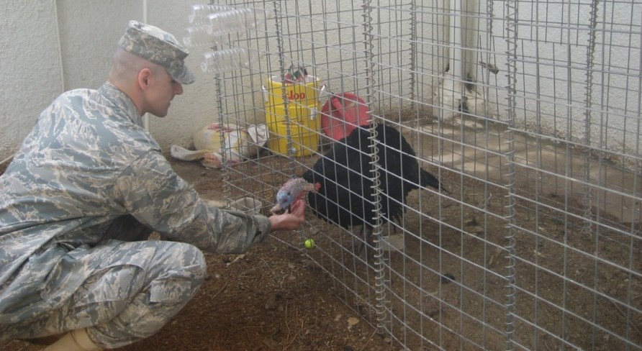
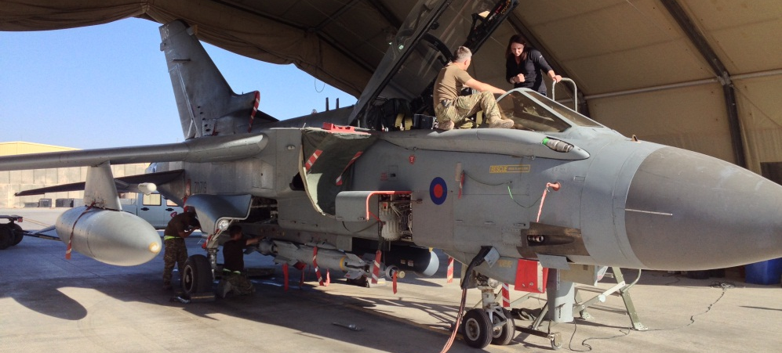
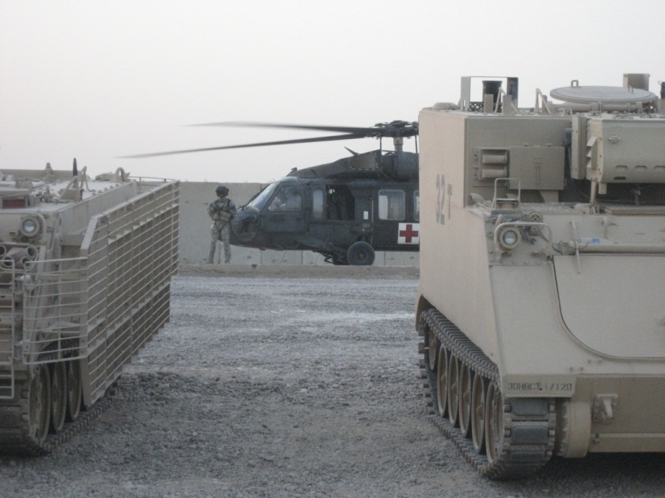
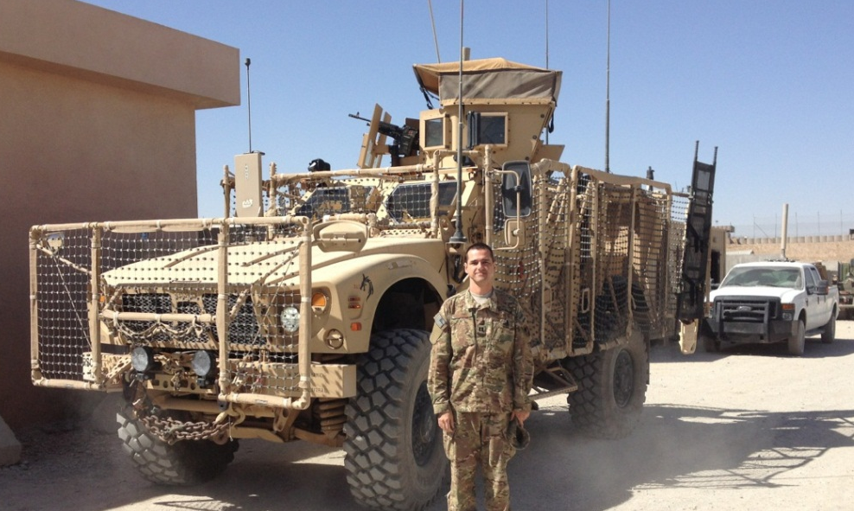



Deployments
Iraq Feb – Aug 09
Afghanistan Sept 13 – Feb 14
DCMA Southern Iraq: LOGCAP
ISAF IJC CJ2: NRO LNO
Sgt Russel, Camp Liberty

Slide 5
Roll call & Who are you?
Name
Where are you from?
What is your major?
Desired AFSC?
Why did you join the military?
What fills your time (outside of academics)?
Notes:
Fill out seating chart

Slide 6
ECE 382
In this class, we'll be:
Writing programs in Assembly Language, then C
Learning about and using the functional units of a microcontroller
Using the microcontroller to interface with peripheral devices
In short – this is a hardware class, NOT a software class
Although we will learn assembly and some C, those are just the means to use the HW
This class is very different from previous offerings
6
Notes:
Application of an architecture and microarchitecture

Slide 7
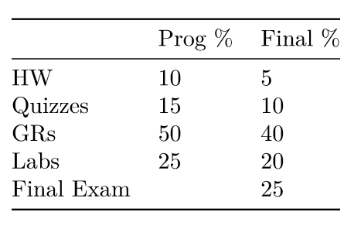
Grades

Slide 8
Course Policies
Lesson pages (linked from syllabus on-line)
Readings
Lesson ppts
Datasheet pages
Homework
Every lesson has homework (10-20 mins)
Questions come from ppts and readings
Due BOC next lesson unless otherwise stated
I will not grade every homework
Quizzes
Based off of homework and in-class exercises
GRs
Based off quizzes and Labs

Slide 9
What Has Changed?
Hardware
We will actually cover more of the uC
Labs
7 to 4
They are shorter/simpler
No lab write-ups, all demo
You still have to push code to bitbucket
Make sure you can log into your account
They exercise what we learn in class
Homework
Added them, we really never had but 3 homework before
Every lesson a homework is due
Quizzes (6)
More quizzes and actually listed on the syllabus
GRs (2 + Final)
You cannot keep GRs anymore

Slide 10
Course Text and Website
Required Books (pdfs available on class Webpage):
MSP430x2xx Family Users Guide
MSP430G2x53 MSP430G2x13 Mixed Signal MCU
Course URL - https://marsuniversity.github.io/ece382/
Can you guess which TV show my github Organizations are based off of?
With hardware, you need to read the datasheet, so that is our book for the class
It is your responsibility to read/follow the syllabus and know when things are due

Slide 11
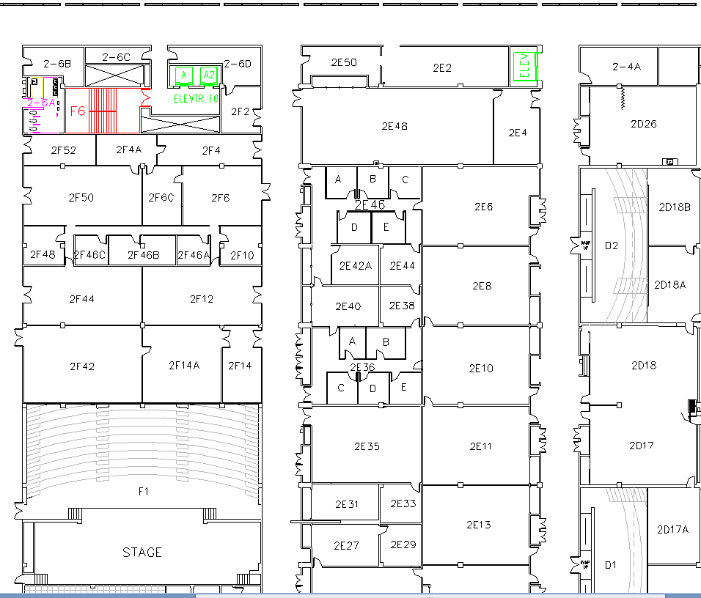
West (Terrazzo) Side
Lab
Capt Johnson
Maj Walchko
Class

Slide 12
Extra Instruction (EI)
M1
T1
Office: 2F48
kevin.walchko@usafa.edu
My schedule is dynamic, so feel free to send me a meeting invite or email for EI
M2
T2
M3
T3
M4
T4
Available
M5
T5
Sometimes Available
M6
T6
Always Unavailable
M7
T7
For the first part of the course I will be covering for Capt Johnson (T3) while he is at SOS

Slide 13
?’s || /* */
(if you are a REAL programmer, this is FUNNY!!!!)

Slide 14
14

Slide 15
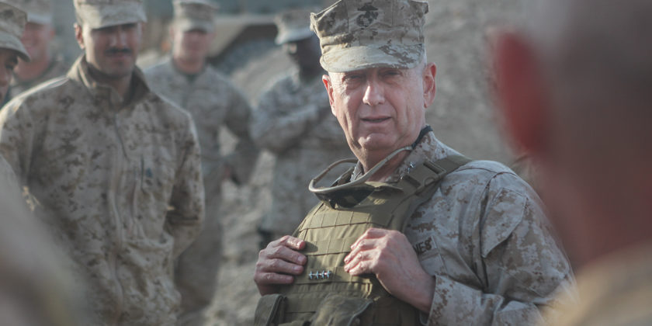
Green on Blue
Be polite, be professional, but have a plan to kill everybody you meet.

