Slide 1

ECE382
Lesson 14+15
1

Slide 2
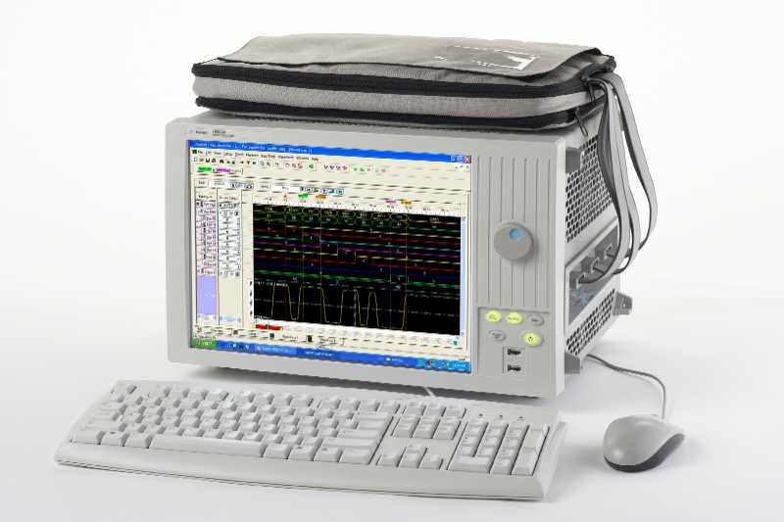
Overview
Lesson Outline
Polling
Debouncing
Intro to Logic Analyzer
Being able to “see” what is coming into and out of our microcontroller is very useful (debugging)
Go To Lab for ICE3

Slide 3
Talking with HW
What is Polling?
What are Interrupts?

Slide 4
Polling vs Interrupts
Polled I/O requires CPU to ask a device if the device state has changed, say from HIGH to LOW
Consumes lots of CPU cycles
Can provide a quick response (guaranteed response delay)
Interrupts allow a CPU to do other things until the device has changed in some way
Device gets the CPUs attention
CPU doesn’t have to waist time checking if the device is ready
Interrupts can happen at any time, so the programmer has to write code to account for that
Response delay is not guaranteed
In reality, if your CPU has a OS, you already live in an interrupt driven world, you just may not know it

Slide 5
Polling
Polling Example
bic.b #BIT3, &P1DIR
bis.b #BIT3, &P1REN
bis.b #BIT3, &P1OUT
poll_button: bit.b #BIT3, &P1IN
jnz poll_button
; Do useful stuff after button press
forever jmp forever
So basically we sit around and wait for something to happen … boring and a waist of CPU time!
When we get to interrupts, we will fix this waste of time

Slide 6
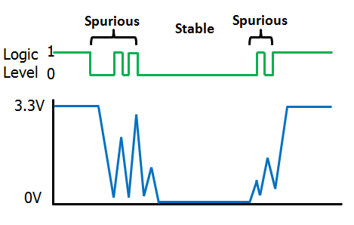
Debouncing
Lot of inputs have a mechanical component to them
Most buttons, switches, relays, etc are mechanical devices and experience bouncing
As the metal switch starts to close, arcing will occur on and off between the contacts until the switch is closed
In software, we can wait (sleep) between input reads to negate the effects of this. Is this good or bad way to handle?

Slide 7
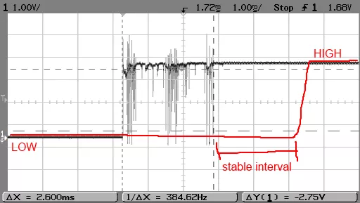
Debouncing
Notice how this looks like high frequency noise. How do we remove high frequency noise …. think ECE231 or ECE315

Slide 8
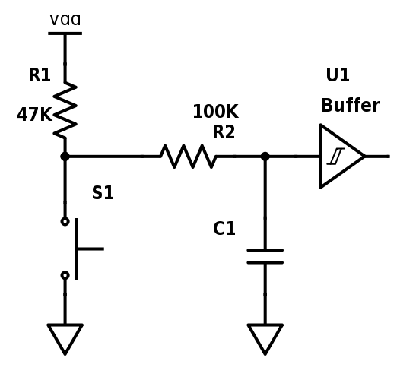
Debouncing in HW
RC Filter
(low pass)
Pull-up
uC
When the button is pressed, what value does the uC see?
When the button is open, what value does the uC see?
Input pins generally go through buffers
ECE231 Material

Slide 9
Debouncing and Polling
bis.b #BIT3, &P1OUT
bis.b #BIT3, &P1REN
bic.b #BIT3, &P1DIR
clr r4 ; counter for pushes
check_btn: bit.b #BIT3, &P1IN
jz btn_pushed
jmp check_btn
btn_pushed: inc r4
wait: bit.b #BIT3, &P1IN
jz wait
jmp check_btn
When pressed, our buttons give a 0 (False). Said another way, they are active low.
Polling for button press
Subroutine to handle button press
So how does bouncing effect this software?

Slide 10
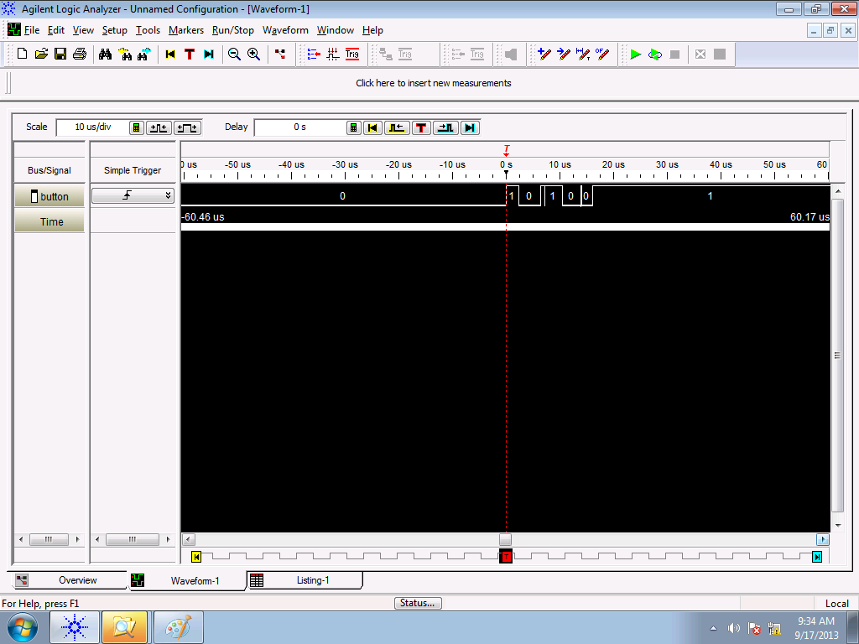
Logic Analyzer

Slide 11
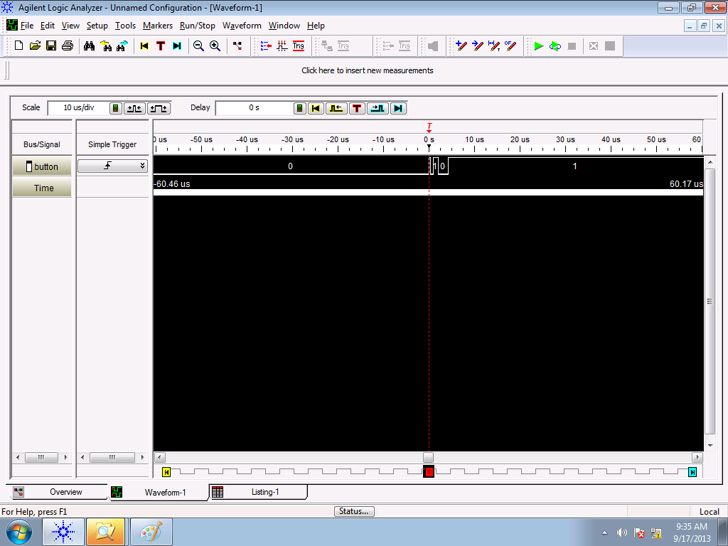
Logic Analyzer
Debouncing: random bounces each time…
Let’s zoom in and see this better!

Slide 12
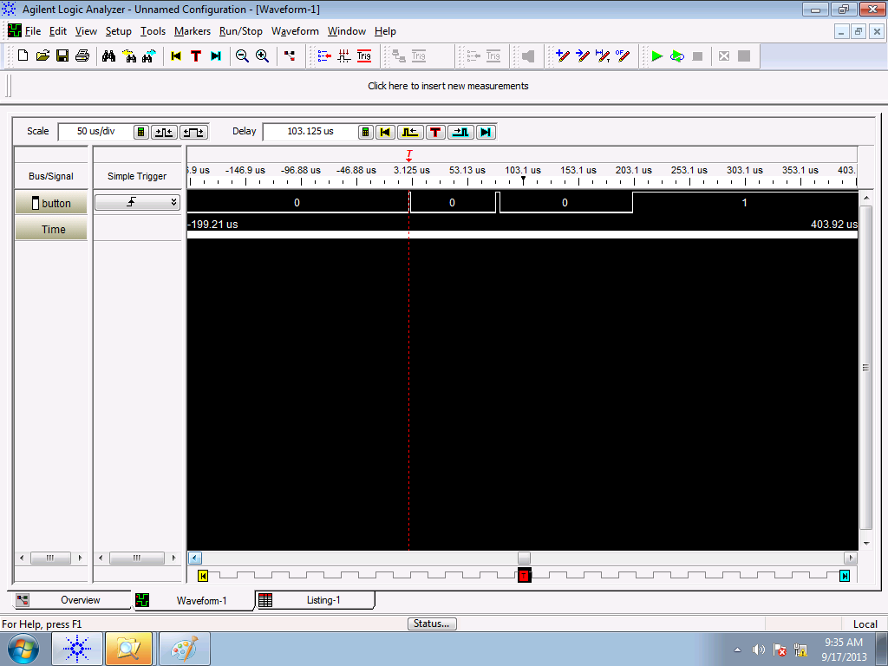
Logic Analyzer
We need to figure out how long, on average, the button bouncers for … the logic analyzer helps us do that!

Slide 13
Example Software Delay Routine
If we know how long we need to delay for, we can write a subroutine to “sleep” for that amount of time before we try to read the button again.
call #software_delay
software_delay:
push r5
mov.w #0xaaaa, r5
delay: dec r5
jnz delay
pop r5
ret
How long is this software delay?
MSP430 Family Users Guide Section 3.4.4, p 60 for cycles per instruction
Remember when we talked about clock cycles?

Slide 14
Example Software Delay Routine
How long is this software delay?
call #software_delay ; 5 cycles
software_delay:
push r5 ; 3 cycles
mov.w #0xaaaa, r5 ; 2 cycles
delay: dec r5 ; 2 cycles?
; no 1, emulated sub rm, rm
jnz delay ; 2 cycles
pop r5 ; 2 cycles
ret ; 2 cycles?
; no 3, emulated mov @SP+, PC
5 + 3 + 2 + (0xaaaa * (1 + 2)) + 2 + 3 = 131085 total clock cycles
Only variable is r5… if I change r5 by “one”, how many cycles is this?
So, How long in time is this?
… well, hold on before you answer this, we need more info … how fast is our clock???

Slide 15
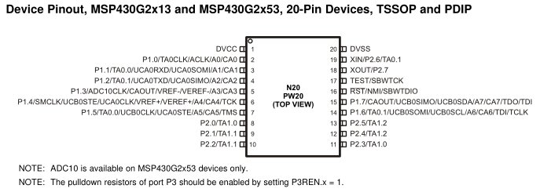
MSP430’s Digitally Controlled Oscillator
MSP430’s Clock = Digitally Controlled Oscillator (DCO)
Advantage: It is tunable. Can run at many different frequencies
Disadvantage: It is an RC oscillator, so can be inaccurate
Default: 1 MHz, with significant variance (0.8MHz - 1.5MHz)
Fix: At the factory, each chip is calibrating with a more accurate quartz crystal resonator. TI stores the proper calibrated values for DCOCTL and BCSCTL1 for 1MHz, 8MHz, 12MHz, and 16MHz in protected memory.
We can measure clock speed (SMCLK) on P1.4

Slide 16
Calibrate DCO
Use clock.asm to send the SMCLK to pin P1.4 and measure it with the logic analyzer
;-------------------------------------------------------------------------------
; Main loop here
;-------------------------------------------------------------------------------
bis.b #BIT4, &P1DIR ; show SMCLK on P1.4
bis.b #BIT4, &P1SEL
forever jmp forever
All this does is routes the SMCLK signal out Port 1, Pin 4

Slide 17
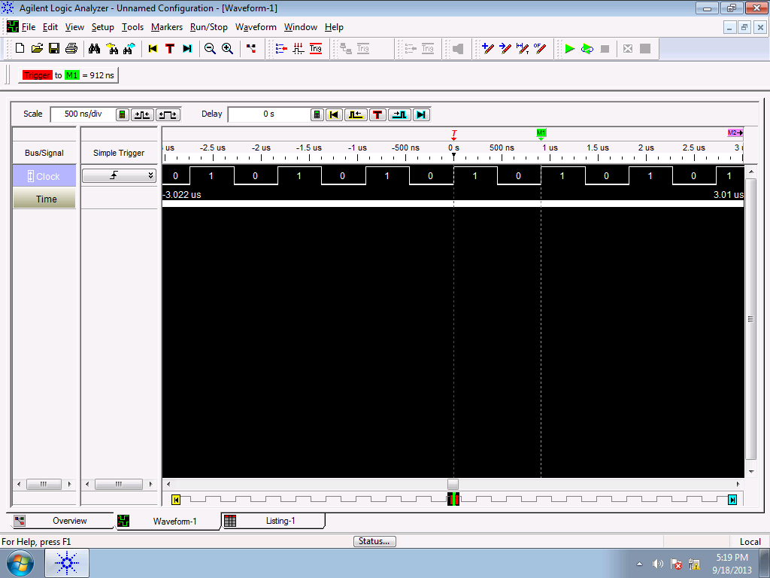
SMCLK
bis.b #BIT4, &P1DIR
bis.b #BIT4, &P1SEL
forever jmp forever
If Clock period is 912ns, how long is
131085 clock cycles?

Slide 18
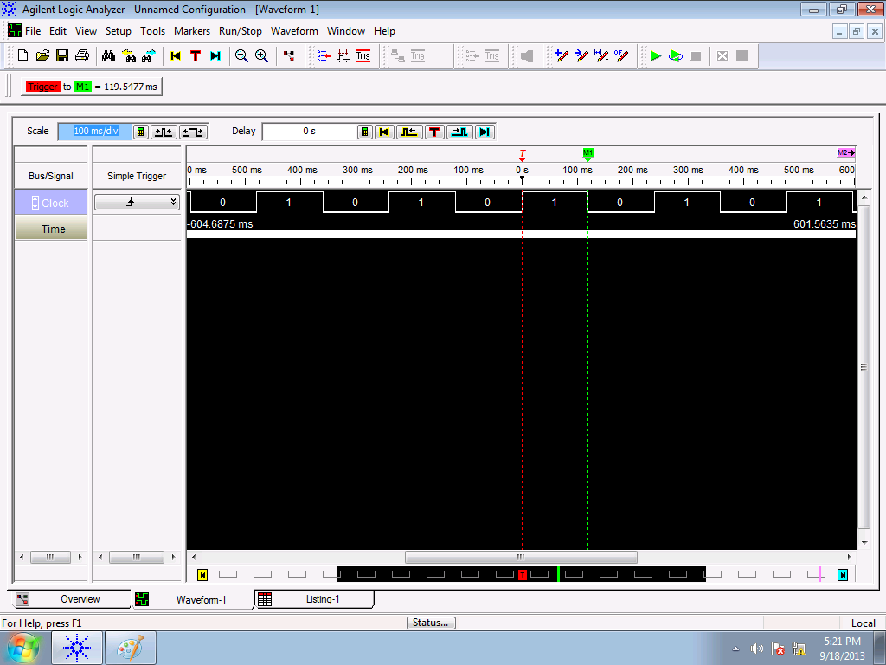
Measure SW delay routine
bis.b #BIT4, &P1DIR
bis.b #BIT4, &P1SEL
forever jmp forever
If Clock period is 912ns, how long is
131085 clock cycles?
Once you have your SW delay done, you can use it to toggle a pin high and low. Here we are measuring how long the delay is to verify we calculated everything correctly

Slide 19
Debounced code with SW delay
; Setup P1.3 for button input
bis.b #BIT3, &P1OUT
bis.b #BIT3, &P1REN
bic.b #BIT3, &P1DIR
clr R4 ; Variable to hold the number of button pushes
; Increment Btn Counter on Btn press
; A delay is used immediately after the press and release
check_btn: bit.b #BIT3, &P1IN
jnz check_btn
inc R4
call #software_delay
btn_pushed: bit.b #BIT3, &P1IN ; is button still pressed?
jz btn_pushed ; if yes, jmp back to btn_pushed
; Button is finally released
call #software_delay
jmp check_btn
Button is push counted
Call a delay (sleep) to wait for bouncing to settle down before reading again

Slide 20
Debounced code with SW delay
; -------------------------------------------
; Software delay
; Purpose: Delays code based on value of R5
; R5 is currently hard coded as 0xAAAA
; Destroyed: None
; Returned: None
; -------------------------------------------
software_delay:
push r5
mov.w #0xaaaa, r5
delay: dec r5
jnz delay
pop r5
ret
; End Software delay ---------------------------
For your uC, you need to determine how fast your oscillator is and set #0xaaaa to a value you want for debouncing

Slide 21
ICE 3
This is needed for Lab 2 to work correctly
You are basically getting a head start on the lab
Do the ICE from the website for this lesson
Measure how long your button bounces for
Measure the SMCLK on pin 1.4 to figure out how long a clock cycle is for your MSP430
Mine came in round 912nsec (0.912 E-6 sec) for 1MHz clock
It should be 1usec (1E-6 sec) for a 1 MHz clock

Slide 22
BACKUPS

Slide 23
Review
What do these commands do?
mov.b #0b00001111, &P1DIR
bis.b #0b00001111, &P1OUT
mov.b #0xff, &P1OUT
mov.b &P1IN, r5

Slide 24
Measure Software Delay Routine
bis.b #BIT0, &P1DIR
blinkLED: bic.b #BIT0, &P1OUT
call #software_delay
bis.b #BIT0, &P1OUT
call #software_delay
jmp blinkLED
software_delay:
push r5
mov.w #0xaaaa, r5
delay: dec r5
jnz delay
pop r5
ret

