Slide 1

ECE382
Lesson 20
1

Slide 2

Overview
Lesson Outline
Intro to C
Program flow control
Christ, people. Learn C, instead of just stringing random characters together until it compiles (with warnings).
https://en.wikiquote.org/wiki/Linus_Torvalds

Slide 3

There be monsters ahead

Slide 4
C Language: Comments
// Single line comment
/* block comment that can span
multiple lines */
int i = 0; // a declaration
/*************************************
** The previous variable was
** declared just as an example.
*************************************/

Slide 5
C Language: Variables
Variable Types: int a;
Type | Size | Description
char | 1 byte | number or ASCII character
int | 2 bytes | larger number
float | 2 bytes | single-precision floating point number
double | 4 bytes | double-precision floating point number
bool | 1 byte | True or false, need to include stdbool.h
•Note: These sizes are dependent on the compiler and target architecture - these are for the MSP430.
•Note: Do not use the float / double types on the MSP430 - since it doesn't have floating point hardware support, implementing software support will use almost all of your memory.

Slide 6
C Language: Variables
Variable Modifiers: unsigned int a;
Modifier | Description
short | remains a 2-byte integer
long | increases int size to 4 bytes
signed | two's complement numbers (default)
unsigned | allows unsigned arithmetic
static | directly allocates memory to remember a value between function calls. Variable is allocated to "permanent" memory, not the stack.
extern | actual storage and initial value of variable is defined elsewhere
const | assigns a constant (read-only) value to a variable
•Note: Once again, sizes are dependent on compiler / target architecture - these are for the MSP430

Slide 7

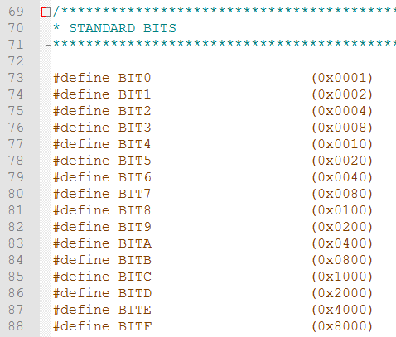
#include <msp430.h>
From assembly template:
c:\ti\ccsv6\ccs_base\msp430\include\msp430.h
c:\ti\ccsv6\ccs_base\msp430\include\msp430g2553.h

Slide 8
#include <stdint.h>
In: C:\ti\ccsv6\tools\compiler\msp430_15.12.3.LTS\include
Take a look, this defines a bunch of data types to help you:
Long Declaration | Clear Shorthand
signed char | int8_t
unsigned char | uint8_t
int | int16_t
unsigned int | uint16_t
long | int32_t
unsigned long | uint32_t
These data types will cleanly compile on x86, MSP430, ARM (32b/64b), etc
Why is this useful? Portability … an int isn’t always 16 bits on every architecture. It is useful to use these, makes your code more readable (and portable)

Slide 9
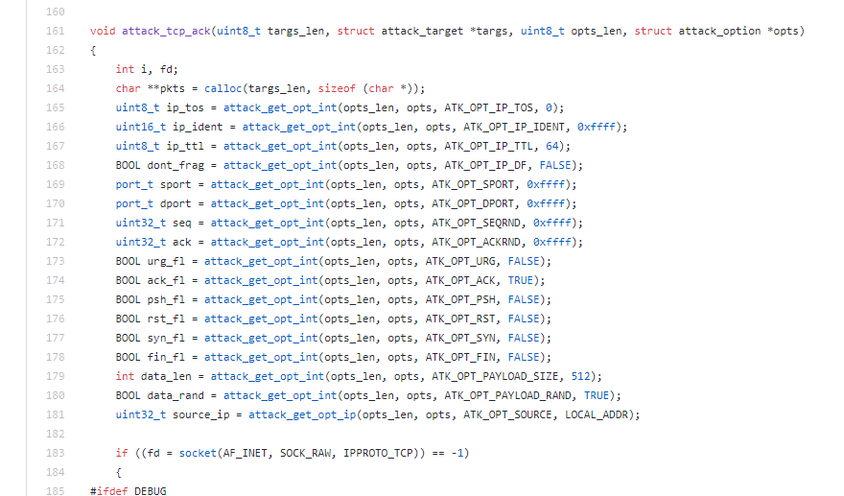
Mirai Source Code
Don’t be stupid and download this, compile this, and infect the .EDU
https://github.com/AllGloryToTheHypnotoad/Mirai-Source-Code/blob/master/mirai/bot/attack_tcp.c

Slide 10
Others
#include <stdbool.h> defines booleans
true = 1
false = 0
bool is a valid data type
#include <math.h> defines things like:
#define M_PI 3.14159265358979323846 /* pi */
#define M_PI_2 1.57079632679489661923 /* pi/2 */
sqrtf() square root float
sqrt() square root double (default)
cosf() cosine float
cos() cosine double (default)
etc

Slide 11
So now you can write this
#include <msp430.h>
#include <stdint.h>
#include <stdbool.h>
/*
* main.c
*/
void main(void) {
WDTCTL = WDTPW | WDTHOLD; // Stop watchdog timer
uint8_t bob = 0;
bool run = true;
while(run){
bob += 1;
}
while(true){;} // CPU trap
}

Slide 12
Volatile
Volatile is an important key word in embedded applications talking to memory mapped IO
static int foo;
void bar(void) {
foo = 0;
while (foo != 255)
;
}
void bar_optimized(void) {
foo = 0;
while (true)
;
}
static volatile int foo;
void bar (void) {
foo = 0;
while (foo != 255)
;
}
If you program this, where foo is tied to a pin and polled for change
A good compiler will optimize to this. Nothing changes foo, or so the compiler thinks.
In order to tell the compiler, “hey, don’t change foo!”, declare it volatile.

Slide 13
C Language: Constants
Preferred Constant Declaration
The #define statement is a pre-processor directive.
pre-processor will “find-replace” each instant … think copy/paste
This is the source of a lot of errors!
similar to a .equ statement in assembly.
// #define MY_CONST some_value
#define SCREEN_WIDTH 640
#define SCREEN_HEIGHT 480
int numPixels = 0;
numPixels = SCREEN_WIDTH * SCREEN_HEIGHT;
•Note: There is no ';' or '=' in #define statements
•Note: Variables must be declared at the top of a block, and they are not initialized by default. A block is denoted by braces {}
•Note: A value can be binary (0b), octal (0), or hex (0x) by using prefixes
Generally poor form, unless you are writing compilers or SW tools

Slide 14
Constants vs Macros (#define)
const
Tells the compiler the variable (or pointer) can not be modified
Properly scoped / identifier clash issues handled nicely
Depending on how it is used may not consume RAM
The compiler can check you are using it correctly (i.e. data type) and throw a warning or error if you are not
#define
It acts like a global copy/paste and can produce very difficult bugs to find
Is this a problem? uint8_t == int16_t
"global" scope / more prone to conflicting usages, which can produce hard-to-resolve compilation issues and unexpected run-time results rather than sane error messages
Compiler assumes it is untyped and some compilers will allow comparisons between defines and unsigned ints (which you may not want)

Slide 15
C Language: Operators
Assignment, Arithmetic Operators
char myVar, a, b; // variable declaration, gcc sets their value to 0
myVar = a; // assignment
myVar = a + b; // addition
myVar = a - b; // subtraction
myVar = a * b; // multiplication
myVar = a / b; // division
myVar = a % b; // modulus (remainder)
myVar++; // increment
myVar--; // decrement
myVar += a; // myVar = myVar + a
myVar -= a; // myVar = myVar - a

Slide 16
C Language: Operators
Relational Operators
if ((a < 10) && (a > 5)) {
// literally: if a is greater than 5 and less than 10, do whatever is in here
// practically: if a is between 5 and 10, do whatever is in here
}
•Note: In C, "false" is 0, while any non-zero value is considered true.
Operator | Description
< | less than
<= | less than or equal to
> | greater than
>= | greater than or equal to
== | equal to
!= | not equal to
&& | logical AND
| | | logical OR

Slide 17
C Language: Operators
Bit-wise Operators
uint8_t a = 5;
uint8_t b = 5;
a &= ~BIT2; // a = a && ~BIT2
b |= BIT2; // b = b || BIT2
Operator | Description
& | AND
| | OR
^ | XOR
~ | One's Complement
>> | Bit-shift right
<< | Bit-shift left
Remember:
BIT2: 00000100
~BIT2: 11111011

Slide 18
BIS and BIC in C
uint8_t a = 5;
uint8_t b = 5;
a &= ~BIT2; // clear bit 2
b |= BIT1; // set bit 1
Instead of number, these could be ports or registers that we are setting/clearing bits on
BIC in C
BIT2: 00000100
~BIT2: 11111011
a & ~BIT2: 00000101
AND 11111011
00000001
BIS in C
b | BIT1: 00000101
OR 00000010
00000111

Slide 19
If Statement
if (logical expression){
statements;
}
else if (logical expression){
statements;
}
...
else{
statements;
}
Example:
if (temp < MIN_TEMP) {
flag = TOO_LOW;
}
else if (temp > MAX_TEMP){
flag = TOO_HIGH;
}
else{
flag = JUST_RIGHT;
}

Slide 20
Switch Statement
switch (value){
case constant-expression1:
statements;
break;
case constant-expression2:
statements;
break;
default:
// gets executed if no other case hits
statements;
break;
}
Example:
switch (GAME_STATE){
case MENU:
displayMenu();
break;
case PLAYING:
updateState();
break;
case LOST:
displayLost();
break;
}

Slide 21
For Loop
for (initial; continue; increment){
statements;
}
initial – initializes variable to the starting value
continue – continues looping while condition is true
increment - usually used to increment / decrement a variable
Example:
int sum = 0; // good form to ALWAYS initialize your variables
for (int i = 1; i <= 20; i++){
sum += i;
}

Slide 22
While / Do While Loop
while (condition) {
statements;
}
do while is guaranteed to be executed once, while isn't.
do
{
statements;
} while (condition);
Example:
int i = 5;
while (i < 10){i++;}
do {
i++;
} while (i < 10);
// final value of i is 11
Is this valid? … yes! You could write your entire program on one line … but please don’t!!
Will execute at least once!

Slide 23
Basic C Program Structure
// #include statements
// #define statements
// global variables <- NOOOOOO!
void main(void)
{
// Variable declarations
// Useful code
while (1) {;} // trap the CPU
}
Example:
#include <stdio.h>
#include <stdint.h>
const unint8_t NUM_LOOPS = 23;
void main(void)
{
unsigned char i;
unsigned int summation = 0;
for (i = 1; i <= NUM_LOOPS; i++)
{
summation += i;
}
while (1) {;} // trap the CPU
}

Slide 24
main.c Documentation
/*--------------------------------------------------------------------
Name:<Your Name>
<Lab# and name>
Purp:A brief description of what this program does and
the general solution strategy.
Doc: <list the names of the people who you helped>
<list the names of the people who assisted you>
Academic Integrity Statement: I certify that, while others may have
assisted me in brain storming, debugging and validating this program,
the program itself is my own work. I understand that submitting code
which is the work of other individuals is a violation of the honor
code. I also understand that if I knowingly give my original work to
another individual is also a violation of the honor code.
-------------------------------------------------------------------------*/
Remember to put the correct header on your code!

Slide 25
BACKUPS

