Slide 1

ECE382
Lesson 24+25
1

Slide 2
Overview
Lesson Outline
Interrupts

Slide 3
Interrupts
What is an interrupt?
Why is an interrupt worse than polling?

Slide 4
Interrupts
What is an interrupt?
Why is an interrupt worse than polling?
Polling guarantees a set delay response to a change
Why is it better than polling?
Polling is inefficient… wastes CPU resources
Interrupts can free the processor to do more useful work
Interrupts can save power
For example: In low-power mode, processor can go to sleep, until the time wakes it up to do something, and then go back to sleep
How do interrupts work?

Slide 5
Interrupts
How do interrupts work?
Initialize interrupt
Interrupt Vector
Interrupt Service Routine (ISR) – function that runs
Interrupt Flag (clear before use)
Interrupt Enable (turn it on)
Run normal program
Interrupt Occurs !!!!
Processor saves its state
Jumps to ISR
Do ISR work
Clear Flag
Restores the state
Return to normal program

Slide 6
Interrupts
Have you used an interrupt yet?
Yes…. RESET
RESET mov.w #__STACK_END,SP ; Initialize stackpointer
StopWDT mov.w #WDTPW|WDTHOLD,&WDTCTL ; Stop watchdog timer
;
; YOUR CODE
;
;------------------------------------------------------------------
; Interrupt Vectors
;------------------------------------------------------------------
.sect ".reset" ; MSP430 RESET Vector
.short RESET
What if we didn’t define this interrupt vector?
Where are these interrupt vectors located?

Slide 7
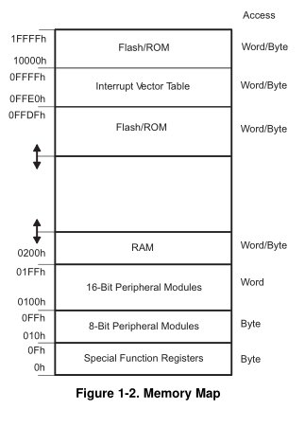
Interrupt Vector Table
Interrupts live here in memory
They are prioritized

Slide 8
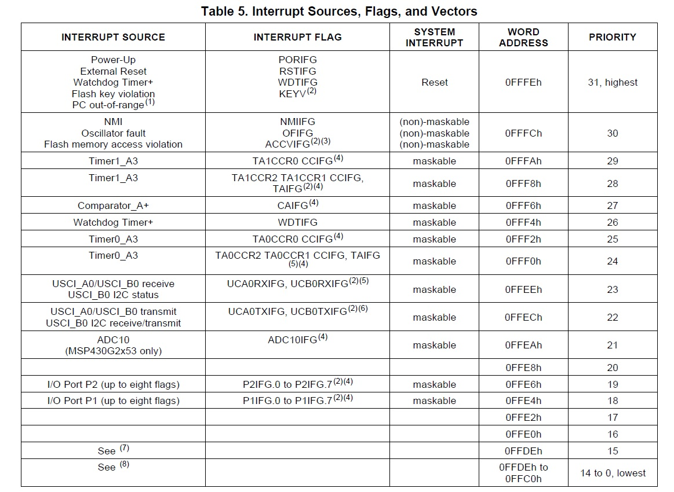
pp 11 of Device Specific
Maskable: turn on/off
Non-Maskable: always on

Slide 9
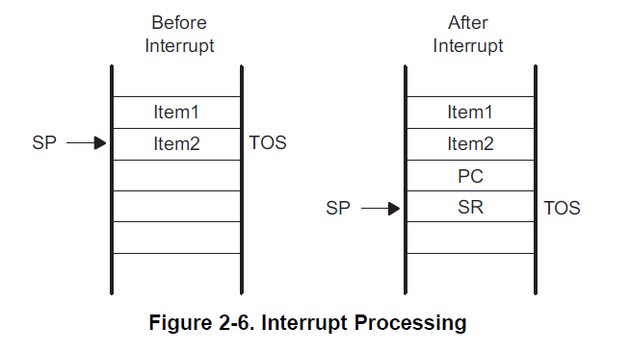
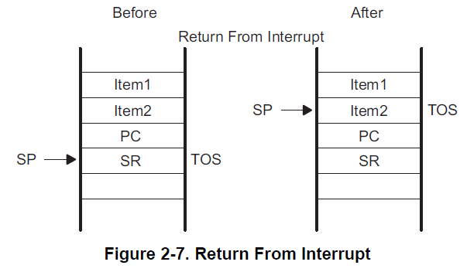
What happens on an Interrupt
On Interrupt:
Currently executing instruction is completed.
PC is pushed onto the stack.
SR is pushed onto the stack.
Selects highest priority interrupt.
If single interrupt, interrupt request flag reset.
Multiple interrupts, flag remains set.
SR is cleared - terminates low-power mode and disables maskable interrupts.
Interrupt vector content loaded into PC.
What about preserving other registers?
On ISR Completion:
Pop SR off stack - restoring previous settings.
Pop PC off stack - resume execution
at previous point.

Slide 10
Maskable vs Non-maskable Interrupts
Remember the Status Register?
GIE: General Interrupt Enable
Setting this bit Enables maskable interrupts
How to control in “C”?
__enable_interrupt()
__disable_interrupt()
15 | 14 | 13 | 12 | 11 | 10 | 9 | 8 | 7 | 6 | 5 | 4 | 3 | 2 | 1 | 0
Reserved |  |  |  |  |  |  | V | SCG1 | SCG0 | OSCOFF | CPUOFF | GIE | N | Z | C

Slide 11
Interrupt Service Routines (ISRs)
#pragma vector=XXXXX_VECTOR
__interrupt void XXXXX_ISR(void)
{
// do some stuff in response to an interrupt
}
#pragma vector=PORT1_VECTOR
__interrupt void Port_1_ISR(void)
{
P1IFG &= ~BIT3; // P1.3 IFG cleared
P1OUT ^= BIT0; // P1.0 = toggle
}
What if we didn’t clear P1IFG?
Caution: Spend as little time as possible inside an ISR! Why do you think I say this?
This name doesn’t have to match the interrupt vector name, but we generally make it similar

Slide 12
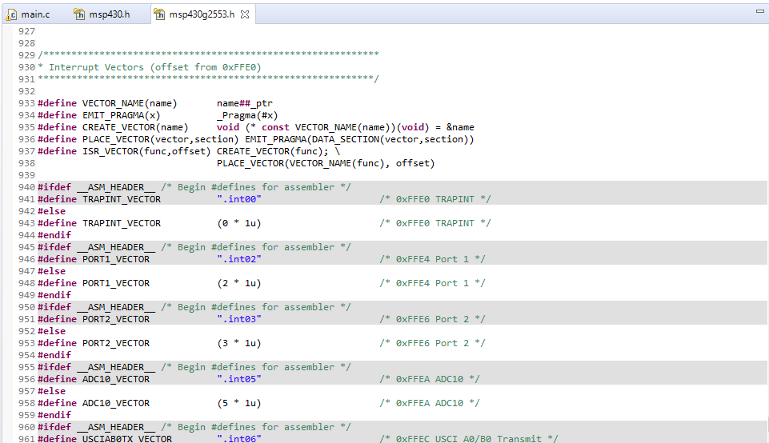
Interrupt Vector Names
Since the user guides are written in assembly, they don’t seem to show the C defines in them. The only way I know to find all of the interrupt vector names is to look at the header

Slide 13
Interrupts: Programmer's Job
Initialize
Configure subsystem
Set parameters to generate the interrupt you're interested in
Clear interrupt flag
Clear the flag for the interrupt you're interested in
Make sure an interrupt isn't generated immediately once you enable it
Turn on local switch
Set the interrupt enable bit for the interrupt you're interested in
Turn on global switch
Set the GIE bit in the SR
Write ISR
Include #pragma vector statement and subroutine itself
#pragma vector loads address into interrupt vector table
Clear interrupt flag
Accomplish task
Give interrupt opportunity to occur
It might take some time!

Slide 14
Example: P1 Interrupt
Go to pp 331 of Family Users Guide.
P1IFG
Contains flags for each pin specifying whether or not an interrupt has occurred
P1IES
Selects the edge to trigger on
0 - low-to-high transition (0 is where you start)
1 - high-to-low transition
P1IE
Enables / disables the associated interrupt
0 - disabled
1 - enabled
This should make you think of the logic analyzer and when you select the triggering mode
Lab 3

Slide 15
Example Push Button Interrupt
char interruptFlag = 0; // global variable? Bad or good?
void main(void) {
WDTCTL = WDTPW|WDTHOLD; // stop the watchdog timer
P1DIR |= BIT0|BIT6; // set LEDs to output
P1DIR &= ~BIT3; // set button to input
P1REN |= BIT3; // enable internal pull-up/pull-down network
P1OUT |= BIT3; // configure as pull-up
P1IES |= BIT3; // configure interrupt to sense falling edges
P1IFG &= ~BIT3; // clear P1.3 interrupt flag
P1IE |= BIT3; // enable the interrupt for P1.3
__enable_interrupt();
// main program loop
while (1) {}
}
#pragma vector=PORT1_VECTOR
__interrupt void Port_1_ISR(void) {
P1IFG &= ~BIT3; // clear P1.3 interrupt flag
P1OUT ^= BIT0|BIT6; // toggle LEDs
interruptFlag = 1; // you could use this tell the main() something
}

Slide 16
Multiple Push Button Interrupts
void main(void) {
WDTCTL = WDTPW|WDTHOLD;
// stop the watchdog timer
P1DIR |= BIT0|BIT6;
// set LEDs to output
P1DIR &= ~(BIT1|BIT2|BIT3);
// set buttons to input
P1IE |= BIT1|BIT2|BIT3;
// enable the interrupts
P1IES |= BIT1|BIT2|BIT3;
// config interrupt for falling edges
P1REN |= BIT1|BIT2|BIT3;
// enable pull-up/pull-down network
P1OUT |= BIT1|BIT2|BIT3;
// configure as pull-up
P1IFG &= ~(BIT1|BIT2|BIT3);
// clear flags
__enable_interrupt();
while (1) {}
}
#pragma vector=PORT1_VECTOR
__interrupt void Port_1_ISR(void) {
if (P1IFG & BIT1) // is bit 1 set?
{
P1IFG &= ~BIT1; // clear flag
P1OUT ^= BIT6; // toggle LED 2
}
if (P1IFG & BIT2)
{
P1IFG &= ~BIT2; // clear flag
P1OUT ^= BIT0; // toggle LED 1
}
if (P1IFG & BIT3)
{
P1IFG &= ~BIT3; // clear P1.3
// interrupt flag
P1OUT ^= BIT0|BIT6; // toggle LEDs
}
}

Slide 17
In Class Exercise
Create a new C project
Setup the interrupts to read a button presses
When you press the button on the Launchpad, the red LED is toggled on/off
Meanwhile, the green LED turns itself on/off about every second
You can use: __delay_cycles(cycles);
Show your instructor when you are done

Slide 18
BACKUPS

