Slide 1

ECE382
Lesson 8
1

Slide 2
Outline
Lesson Outline
Status Register
Flow of Control (review of CS110)
If, else
While
For
Why
The status register keeps track of the uC’s state. We will use that to determine how the code executes (flows)

Slide 3
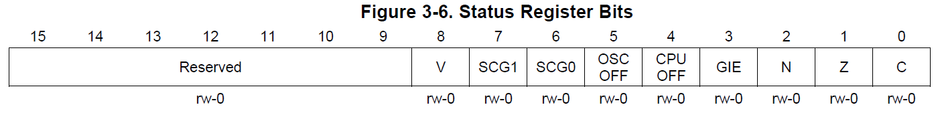
Status Register
Upper 7 bits are unused
Figure 3-6
Family User Guide 3.2.3 pp46

Slide 4
Overflow Bit
The V bit is the overflow bit.
What is an Overflow?
This indicates that the signed two's-complement result of an operation cannot fit in the available space.
For instance, 0x7fff + 0x01 would result in 0x8000

Slide 5
Overflow Bit
mov.w #0x7fff, r5
add.w #1, r5 ; sets N, V
mov.b #0x80, r5 ; note how MOV doesn't impact flags. BIC, BIS don't either.
add.b #0x80, r5 ; sets C, V, Z - resets N
mov.b #0x7f, r5
sub.b #0x80, r5 ; sets N - resets Z, C

Slide 6
Negative Bit
The N bit is the negative bit.
This is the same as the first bit of the result of the previous operation.
This only works for signed numbers - where the MSB of the result indicates the sign. 1 indicates a negative number, 0 a positive.

Slide 7
Negative Bit
mov.w #0x8001, r5
cmp.w #0x1, r5 ; sets N, C
cmp.w #0x1000, r5 ; sets C, V - resets N
add.w #00001111b, r5 ; sets N - resets C, V

Slide 8
Zero Bit
The Z bit is the zero bit.
This is set if the result of the previous operation is 0. If not, it is cleared.
This functions the same way for both signed and unsigned numbers.
This is commonly used to test for equality.
You'd subtract two numbers - if the result is 0, they are equal.

Slide 9
Zero Bit
mov.w #10, r5
cmp.w #10, r5 ; sets C, Z
; note how CMP only sets flags, along with BIT, TST
sub.w #10, r5 ; sets C, Z
tst r5 ; sets C, Z
; talk about how tst emulated CMP #0, dst

Slide 10
Carry Bit
The C bit is the carry bit.
The carry bit is used to indicate that the result of an operation is too large to fit in the space allocated.
For instance, say the register r7 had the value 1. The operation add.w #0xffff, r7 would result in 0000 in r7 and the C bit being set. In that situation, we'd say a carry occurred.
Logical instructions set C to the opposite of Z - i.e. C is set if the result is NOT 0.

Slide 11
Carry Bit
mov.w #1, r7
add.w #0xffff, r7 ; sets C, Z
mov.w #1, r7
add.w #0x7fff, r7 ; sets N, V - resest C, Z
mov.w #0xffff, r7
add.w #0xffff, r7 ; sets N, C - resets V
xor.w #10101010b, r7 ; logical ops set C to the opposite of Z

Slide 12
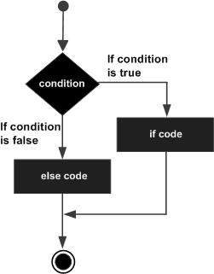
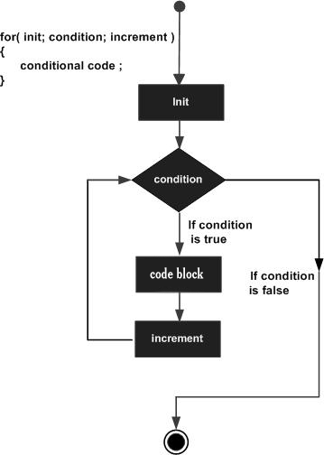
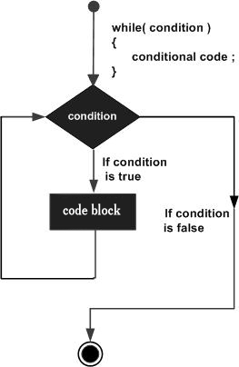
Flow of Control
When we want to use certain pieces of code based off of certain conditions
In computer science, control flow refers to the order in which instructions in a program are executed.
Let’s look at if/else, for loop, and while loop

Slide 13
Flow of Control
Remember, all higher level code eventually becomes assembly, then is assembled into machine code.
In assembly, we use conditional jumping instructions that jump based on the status of certain flags in the Status Register to achieve this.

Slide 14
Jump Instructions
Condition Code | Assembly Instruction | Description
000 | JNE/JNZ | Jump if Z==0 (if !=)
001 | JEQ/JZ | Jump if Z==1 (if ==)
010 | JNC/JLO | Jump if C==0 (if unsigned <)
011 | JC/JHS | Jump if C==1 (if unsigned >=)
100 | JN | Jump if N==1 - Note there is no jump if N==0
101 | JGE | Jump if N==V (if signed >=)
110 | JL | Jump if N!=V (if signed <)
111 | JMP | Jump unconditionally

Slide 15
Decision Making
The code has the “if” and “else” in it, but it also has one more check, “else if”.
; start of “if” block of code
if:
mov #10, r7 ; setup condition chk
cmp #5, r7 ; if Z == 0, run code
jnz elseif ; jmp to next chk
mov r7, r8 ; here is the code!
jmp done ; always jmp, to end
elseif:
cmp #20, r7 ; if Z == 0, run code
jnz else ; jmp to final code
mov r7, r9 ; here is the code!
else:
mov r7, r10 ; all else fails, do this
done:
These labels (if, else if, else, done) do thing, they are just labels for the jump commands

Slide 16
For Loop
; start of “for” block of code
mov #10, r7 ; do this 10x
for:
cmp #0, r7 ; r7 - #0: Z = ?
jz done ; if Z == 1, done
; else, do code block
dec r7 ; r7 = r7 - 1
mov r7, r8 ; do something useful!
… ; maybe more stuff
jmp for ; back to start
done:

Slide 17
While Loop
; start of “while” block of code
mov #10, r7 ; do this 10x
while:
cmp #0, r7 ; r7 - #0: Z = ?
jz done ; if Z == 1, done
; do code block
mov #0, r7 ; r7 = 0
mov r9, r8 ; do something useful!
… ; maybe more stuff
jmp while ; back to start
done:
This is actually very similar to the for loop, when you look at the assembly … we just changed the labels

Slide 18
What the Frak?
; A student wrote this code, but didn’t comment it.
; What is going on here?
; What type of loops?
; How many times will they run?
mov #0, r6
mov #10, r7
loop:
add #2, r6
dec r7
jnz loop
forever:
jmp forever ; why????
What is frak?

Slide 19
BACKUPS

Slide 20
In class programming exercise
; write an example program to add the numbers 10+9+8+...+1

Slide 21
Examples of a Conditional
; example of a conditional
mov #10, r7
cmp #5, r7 ; set C - why is the carry flag set here? think about how CMP is SUB and how the SUB operation is implemented
jge greater ; if N == V, jump
mov #0xbeef, r7
jmp done ; always jump
greater:
mov #0xdfec, r7
done:
forever: ; trap CPU
jmp forever

Slide 22
In class programming exercise
; example program to add the numbers 10+9+8+...+1
mov.w #10, r6
mov.w #0, r5
summation: add.w r6, r5
dec r6
jnz summation
mov.w r5, &0x0200
forever: jmp forever

Slide 23
Branch Instructions
Due to Relative Jump range limitations:
The BR instruction is an emulated instruction for a MOV to the PC - this allows us to move anywhere in the map we choose.
This instruction is simply a MOV to the PC.
So, with BR we have access to the full range of addressing modes if PC-relative is not acceptable.
Emulated Instruction | Assembly Instruction
BR dst | MOV dst, PC

Slide 24
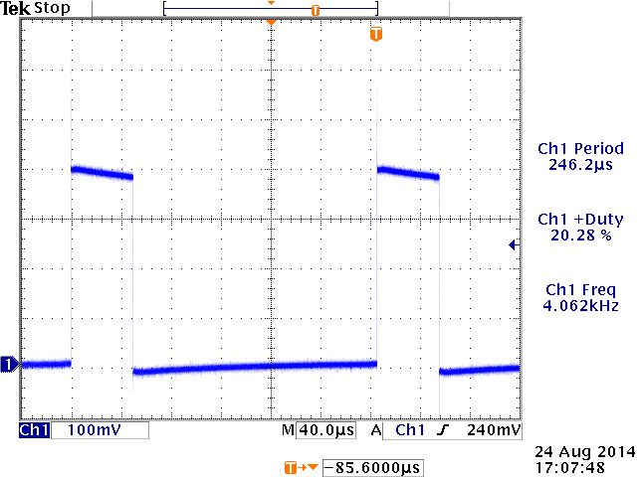
Find the errors in this program
http://ecse.bd.psu.edu/cmpen352/lecture/lecture05.html
http://ece.ninja/382/notes/L6/code/badlec5.asm
; intention was to have it generate a PWM waveform on the P1.0 pin attached
duty = 0x20;
while(1) {
cnt = 0x40;
P1.0 = 1;
while (cnt>duty)
cnt-=1;
P1.0 = 0;
while (cnt>0)
cnt-=1;
if (P1.3 == 0) {
while (P1.3 == 0);
duty += 0x08;
duty &= 0x3F;
} }

Slide 25
Sample Program – predict what happens
repeat:
mov.b #0x75, r10
add.b #0xC7, r10
adc r10
inv.b r10
mov.w #0x00aa, r10
sxt r10
inv r10
swpb r10
mov.w r10, r9
jmp repeat
c010: 7a 40 75 00 mov.b #117, r10 ;#0x0075
c014: 7a 50 c7 00 add.b #199, r10 ;#0x00c7
c018: 0a 63 adc r10
c01a: 7a e3 xor.b #-1, r10 ;r3 As==11
c01c: 3a 40 aa 00 mov #170, r10 ;#0x00aa
c020: 8a 11 sxt r10
c022: 3a e3 inv r10
c024: 8a 10 swpb r10
c026: 09 4a mov r10, r9
c028: f3 3f jmp $-24 ;abs 0xc010

Slide 26
Sample Program – predict what happens
repeat:
mov.b #0x75, r10
add.b #0xC7, r10
;result should be 0x13c, so we should see 3c in r10 and carry bit set
adc r10
;since carry bit was set, this should increment r10 to 3d
inv.b r10
;invert, so r10 should be c2
mov.w #0x00aa, r10
sxt r10
;sign extend should clear upper 8 bits
inv r10
swpb r10
mov.w r10, r9
jmp repeat
c010: 7a 40 75 00 mov.b #117, r10 ;#0x0075
c014: 7a 50 c7 00 add.b #199, r10 ;#0x00c7
c018: 0a 63 adc r10
c01a: 7a e3 xor.b #-1, r10 ;r3 As==11
c01c: 3a 40 aa 00 mov #170, r10 ;#0x00aa
c020: 8a 11 sxt r10
c022: 3a e3 inv r10
c024: 8a 10 swpb r10
c026: 09 4a mov r10, r9
c028: f3 3f jmp $-24 ;abs 0xc010

Slide 27
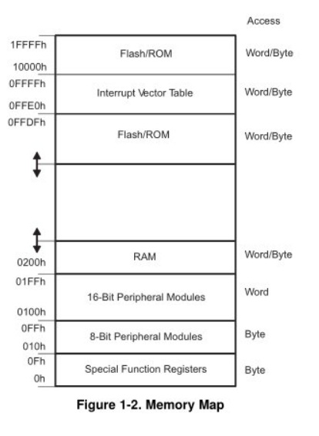
MSP430’s ISA
How many addr bits?
Msp430g2553 Memory Map
512b of RAM - 0x200-0x400 16kb of ROM - 0xc000-0xffdf
0x1100-0xc000 is empty!
- There is no memory backing it up!
- If you attempt to write to this area of memory, you'll trigger what's essentially a segmentation fault because that memory doesn't exist. It will cause the chip to do a Power-up Clear (PUC), resetting the state of your processor. This is a tough error to debug.

Slide 28
Assembly and Machine Languages
Instructions:
words in a computers language
Instruction Set:
the dictionary of the language
Assembly Language:
human-readable format of computer instructions
Machine Language:
computer-readable instructions - binary (1's and 0's)
Assembly Language Program
Assembler
Relocatable Object Code
Linker
Executable Code

Slide 29
Let's write a MSP430 program
Our chip version: Msp430g2553 → open CCS
; This program sets all pins on Port 1 to output and high. Since LEDs 1 and 2 are connected to P1.0 and P1.6 respectively, they will light up. This program turns the LEDs on and off
.text
; turn off watchdog timer
main:
bis.b #0xFF, &P1DIR ; set port1 direction to output
Turn_on:
bis.b #0xFF, &P1OUT ; turn on leds at port1, bis?
; could of: move ____ , &P1OUT
Turn_off:
bic.b #0xFF, &P1OUT ; turn on leds at port1, bic?
; could of: move ____ , &P1OUT
jmp Turn_on ; loop forever
← what?
Stack pointer?

Slide 30
Status register and Jumps
15 | 14 | 13 | 12 | 11 | 10 | 9 | 8 | 7 | 6 | 5 | 4 | 3 | 2 | 1 | 0
Reserved |  |  |  |  |  |  | V | SCG1 | SCG0 | OSCOFF | CPUOFF | GIE | N | Z | C
Condition Code | Assembly Instruction | Description
000 | JNE/JNZ | Jump if Z==0 (if !=)
001 | JEQ/JZ | Jump if Z==1 (if ==)
010 | JNC/JLO | Jump if C==0 (if unsigned <)
011 | JC/JHS | Jump if C==1 (if unsigned >)
100 | JN | Jump if N==1 - Note there is no jump if N==0
101 | JGE | Jump if N==V (if signed >=)
110 | JL | Jump if N!=V (if signed <)
111 | JMP | Jump unconditionally

Slide 31
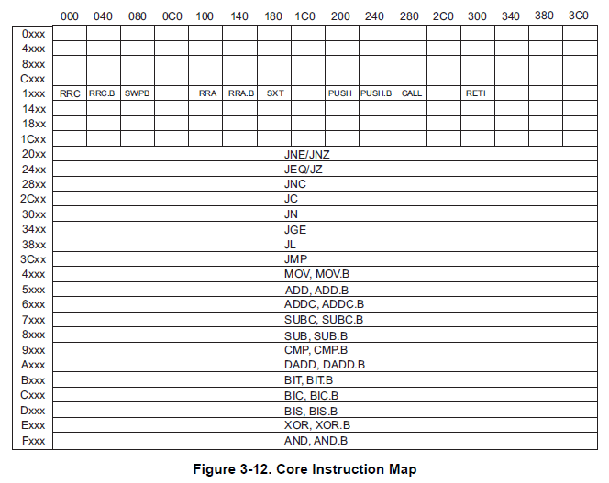
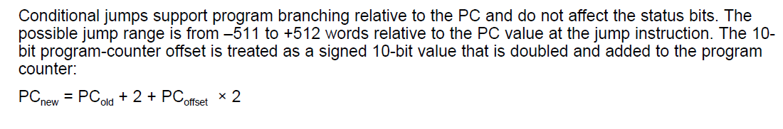
Relative Jump Instruction
Doesn’t use addressing mode.
forever JMP forever ; CPU Trap
All instructions are 16 bits long. Their binary format looks like this:
15 | 14 | 13 | 12 | 11 | 10 | 9 | 8 | 7 | 6 | 5 | 4 | 3 | 2 | 1 | 0
0 | 0 | 1 | Condition |  |  | PC offset (10 bit)
Figure 3-12
Family User Guide 3.4.5 pp62
Blue Book pp19
:
:
_ _ _ _ _ _ _ _ _ _ _ _ _ _ _ _
Family User Guide 3.4.5 pp59
Blue Book pp18

