Slide 1

ECE382
Lesson 9+10
1

Slide 2
Overview
Lesson Outline
The Stack
Subroutines (like functions)
Application (ABI)
Why?
Modular code: we want to break things up into small, testable pieces of code that we can reuse … subroutines help us do this
ABI helps ensure binary compatibility of modular code
Subroutines use the stack to do their job
But understanding how the stack works also allows you to do “stack manipulation” and maybe write a virus or patch broken code

Slide 3
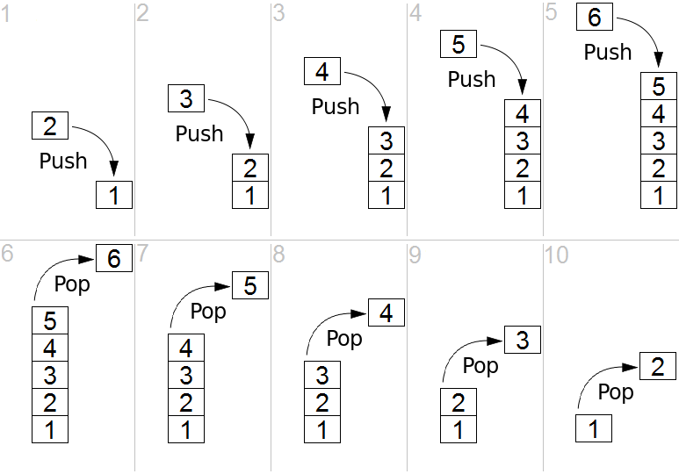
Stack
What is a Stack?
Last In First Out (LIFO) queue
Push and Pop are our two operations for dealing with the stack
The last item you pushed onto the stack is the first item you'll pop off of it.
Why use a Stack?
Temporary Storage
Subroutine calls/returns use the Stack
Stack Pointer
Holds the address of the top of the stack
Stack Pointer (SP), also known as r1

Slide 4
Stack
Stack Instructions
Where is the Stack located in memory?
Assembly Instruction | Description
PUSH(.B) | Push operand on stack. Push byte decrements SP by 2.
Emulated Instruction | Assembly Instruction
POP dst | MOV @SP+, dst
Be careful you are not thinking backwards:
Push: dec
Pop: inc
The stack is upside down!

Slide 5
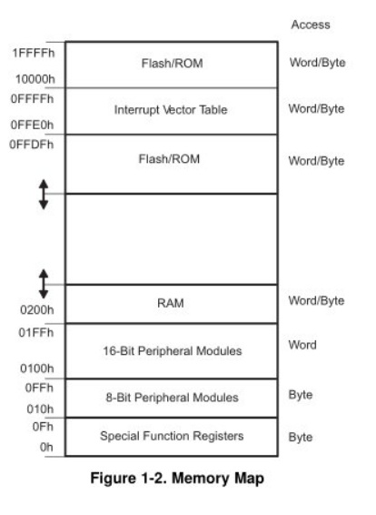
Stack
Where is the Stack located in memory?
In RAM
need to read and write to it
RAM is from 0x200 to 0x400
Where in RAM should you initialize the Stack Pointer to point to?
Hint: remember it works backwards!
0x400
0x200 would be bad!

Slide 6
Stack
mov.w #0x0400, r1 ;initialize stack pointer
push.w #0xdfec ; push the value 0xdfec onto the stack.
; This decrements the SP by two to 0x03fe and
; stores EC at 0x03fe and DF at 0x03ff
pop.w r10 ; pop the value we just pushed off of the stack and
; into r10
; this decrements the SP by two, back to 0x0400.
push #0xbeef
push.b #0xcc
push #0xdfec
pop r5
pop.b r6
pop r7
push #0xfade
push.b #0xaa
push #0xdeaf
pop.b r5
pop r6
pop.b r7
Address | Value
0x3FA
0x3FB
0x3FC
0x3FD
0x3FE
0x3FF
0x400
Backwards
SP
Let’s load stack_example.asm and watch this work

Slide 7
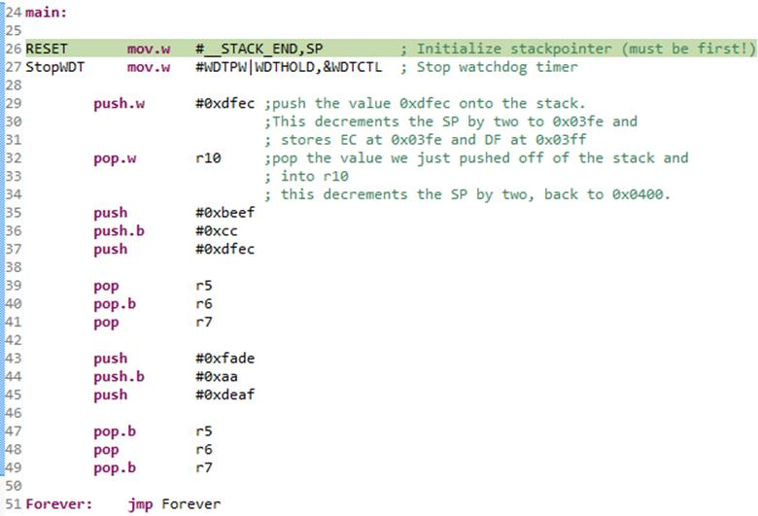
The example code

Slide 8
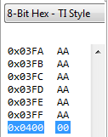
Initial State
Next instruction to run
SP 0x0400
R5 0x0000
R6 0x0000
R7 0x0000
R10 0x0000
Stack
SP location highlighted

Slide 9
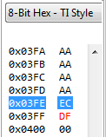
push.w #0xdfec
SP 0x03FE
R5 0x0000
R6 0x0000
R7 0x0000
R10 0x0000
PUSH
SP – 2 → SP
src → @SP
Notice what happened? Decrement SP, then write the data!

Slide 10
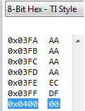
pop.w r10
SP 0x0400
R5 0x0000
R6 0x0000
R7 0x0000
R10 0xDFEC
POP
@SP → dest
SP + 2 → SP

Slide 11
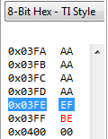
push #0xbeef
SP 0x03FE
R5 0x0000
R6 0x0000
R7 0x0000
R10 0xDFEC

Slide 12
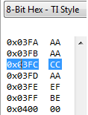
push.b #0xcc
SP 0x03FC
R5 0x0000
R6 0x0000
R7 0x0000
R10 0xDFEC
This byte left AS IS

Slide 13
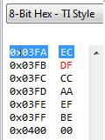
push #0xdfec
SP 0x03FA
R5 0x0000
R6 0x0000
R7 0x0000
R10 0xDFEC

Slide 14
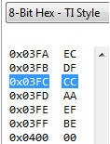
pop R5
SP 0x03FC
R5 0xDFEC
R6 0x0000
R7 0x0000
R10 0xDFEC

Slide 15
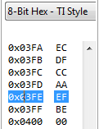
pop.b R6
SP 0x03FE
R5 0xDFEC
R6 0x00CC
R7 0x0000
R10 0xDFEC

Slide 16
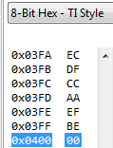
pop R7
SP 0x0400
R5 0xDFEC
R6 0x00CC
R7 0xBEEF
R10 0xDFEC

Slide 17
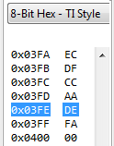
push #0xfade
SP 0x03FE
R5 0xDFEC
R6 0x00CC
R7 0xBEEF
R10 0xDFEC

Slide 18
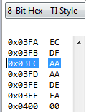
push.b #0xaa
SP 0x03FC
R5 0xDFEC
R6 0x00CC
R7 0xBEEF
R10 0xDFEC
This byte left AS IS

Slide 19
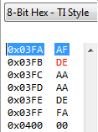
push #0xdeaf
SP 0x03FA
R5 0xDFEC
R6 0x00CC
R7 0xBEEF
R10 0xDFEC

Slide 20
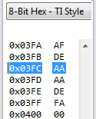
pop.b R5
SP 0x03FC
R5 0x00AF
R6 0x00CC
R7 0xBEEF
R10 0xDFEC
Byte Op cleared UPPER nibble

Slide 21
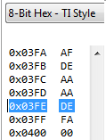
pop R6
SP 0x03FE
R5 0x00AF
R6 0xAAAA
R7 0xBEEF
R10 0xDFEC
Mystery byte here
This byte was never changed

Slide 22
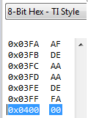
pop.b R7
SP 0x0400
R5 0x00AF
R6 0xAAAA
R7 0x00DE
R10 0xDFEC
Byte Op cleared UPPER nibble

Slide 23
Stack Summary
Students have trouble with the stack at first
It is a FILO
ALWAYS make sure your program has the same number of pushes and pops
If you don’t bad things could happen!
The stack always decrements by 2 BEFORE it writes
Remember the difference between word and byte ops
I strongly suggest you play with CCS and do push(.b)/pop(.b) like we did in class. A lot of student fail to understand this straight forward topic until they play with the code

Slide 24
Subroutines
Subroutines are a way to break up large code into smaller, reusable chunks of code
They also make it easier to debug
Once debugged, if you don’t modify them, you should never introduce new bugs from them
In higher level languages (C, C++, python, etc) we would call these functions
We’ll talk about this later when we cover C after prog

Slide 25
Example Subroutine
main:
mov.w #2, r10
mov.w #4, r11
call #addition
…
;---------------------------------------------------
; Function: Adds two numbers
; Inputs: Op1 (r10), Op2 (r11)
; Outputs: result (r11)
; Registers destroyed: r11
;---------------------------------------------------
addition:
add.w r10, r11
ret
subtraction:
… ; code here
multiplication:
… ; code here
Here we are only using the addition subroutine right now.
Why is this comment (documentation) important about r11?
You could write an entire library of functions and use them in different projects (once they are tested)

Slide 26
Subroutines
How do subroutines work?
Call #addition
…
0xC010 call #addition
0xC012 nop
…
0xC01A addition: …
…
…
RET
The stack!!
Assembly Instruction | Description
CALL | Fetch operand, push PC, then assign operand value to PC.
Top of Stack
Emulated Instruction | Assembly Instruction
RET | MOV @SP+, PC
This address pushed

Slide 27
Arguments
Arguments are the parameters (or data) passed to and from a subroutine
;---------------------------------------------------
; Function: Adds two numbers
; Inputs: Op1 (r10), Op2 (r11)
; Outputs: result (r11)
; Registers destroyed: r11
;---------------------------------------------------
addition:
add.w r10, r11
ret
Load up ex_subroutine.asm in CCS and let’s watch this execute
Watch what address gets pushed to the stack when CALL is used

Slide 28
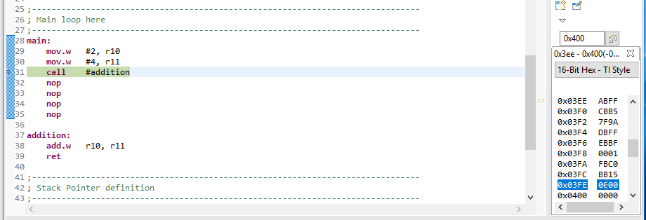
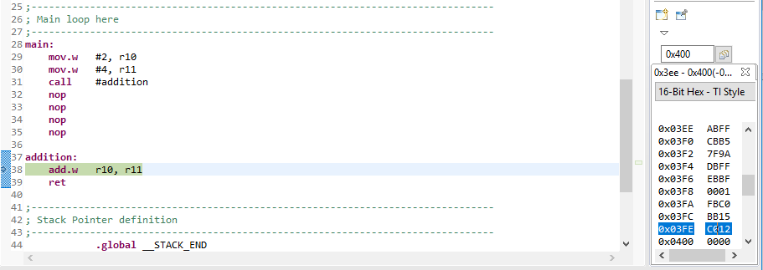
ex_subroutine.asm
Stack before CALL, it is 0x0000
Stack after CALL, it is now 0xC012 which points to the nop

Slide 29
Arguments
Use a stack to avoid destroying registers
mySubroutine:
push.w r5 ; let’s save these registers
push.w r6
push.w r7
;... Do subroutine work here ....
pop.w r7 ; all done, let’s restore them
pop.w r6
pop.w r5
ret
What is Pass-by-Value and Pass-by-Reference?
3 pushes
3 pops

Slide 30
Arguments
Pass-by-Value
pass the actual values of the arguments to a subroutine
This creates a copy of the data
Imagine we are passing an1600 x 1400 color image … is this an issue?
Pass-by-Reference
Pass the address of the argument to a subroutine
This also is referred to as a pointer
Which method can modify the original source data, and which can only modify a copy of the source data?
Which is best if you are passing an array of 1000 values?

Slide 31
Key Subroutine Rules
Always return from a subroutine!
should only return from one place in your subroutine.
Subroutines only receive information via registers!
reusable for many different programs
should not rely on specific label names for arguments (what about ports?)
Can we use the Stack to pass arguments?
Subroutines should be reusable!

Slide 32
Very Simple Explanation
Application Programming Interface
Ensure subroutines/functions have the same interface to make writing programs easier and introduce less bugs
Deals with source code
Application SW
Your code
Libraries
API
OS (not present in a uC)
Application Binary Interface
Ensure subroutines/functions after compiling, operate the same on similar HW (say all x86) the same
Deals with a binary program
ABI
Hardware
ISA
This is super simple and gets more complex when working with an OS

Slide 33
Application Binary Interface (ABI)
Convention of specifying which registers are used for arguments passed in to a subroutine and which are used to pass back results.
For subroutines in the MSP430 use r12, r13, r14, and r15 to pass arguments to your subroutine.
Use the stack if you have more than four arguments
Subroutine results are returned in r12
If you follow the ABI and then link to a 3rd party library (meaning someone else developed it and you have probably never seen the source code), it should work correctly!!

Slide 34
BACKUPS

