Slide 1

ECE382
Lesson 32+33+34
1

Slide 2
Overview
Lesson Outline
Serial vs Parallel
Types of serial communication
Serial Communications
UART
SPI
I2C

Slide 3
Serial Communication
Parallel versus Serial?
Serial Advantages?
Serial Disadvantages?

Slide 4
Serial Communication
Parallel versus Serial?
Serial Advantages?
Simple interface – less hardware, less pins, less cost
Faster clock speed per wire (no “cross-talk”)
Longer Distance (no “cross-talk”)
Serial Disadvantages?
Slower
Overhead
On-chip hardware to encode/decode serial signal

Slide 5
Common Types of Serial Comm
CANBus: common in cars
RS-485: single master, multiple slave
MIL-STD-1553: common in aircraft and spacecraft
UART: Similar to RS232, but uses TTL, one-to-one
SPI: common in embedded systems (e.g., cellphones)
I2C: common in embedded systems (e.g., cellphones)

Slide 6
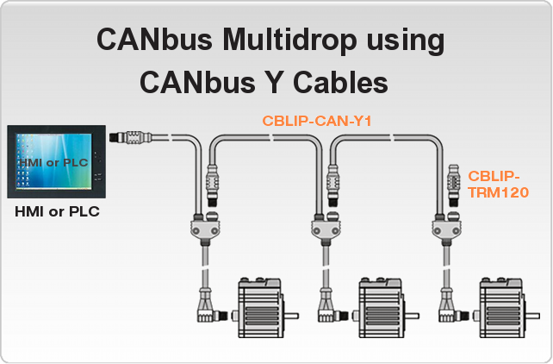
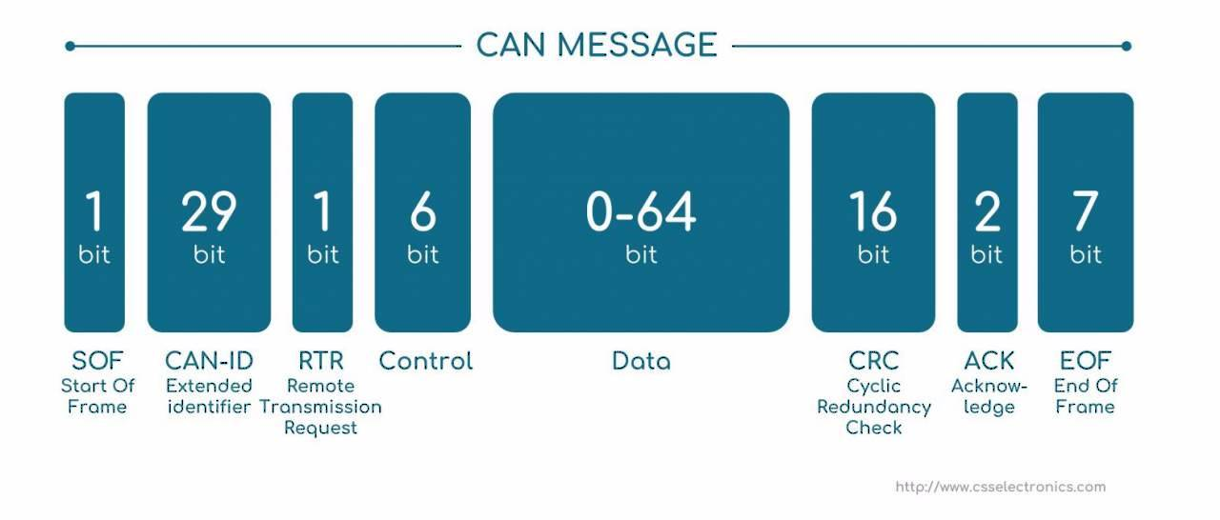
CAN Bus
A Controller Area Network (CAN bus) is a robust vehicle bus standard designed to allow microcontrollers and devices to communicate with each other in applications without a host computer. It is a message-based protocol, designed originally for multiplex electrical wiring within automobiles to save on copper, but is also used in many other contexts.
USAFA is doing research on the CAN bus and a Tesla car

Slide 7
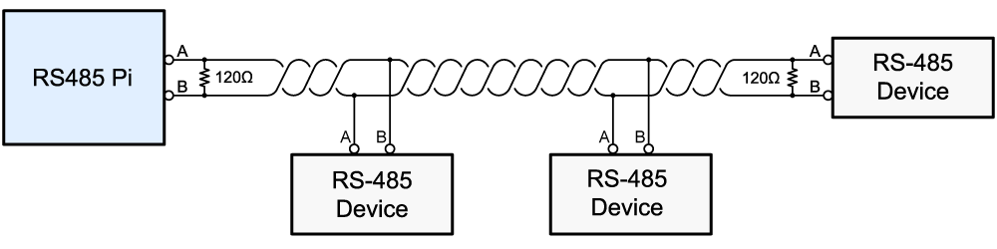
RS-485
RS-485 supports inexpensive local networks and multidrop communications links, using the same differential signaling over twisted pair
Slave
Master
Slave
Slave
This is actually diagram for how to hook up a Raspberry Pi to a 485 network

Slide 8
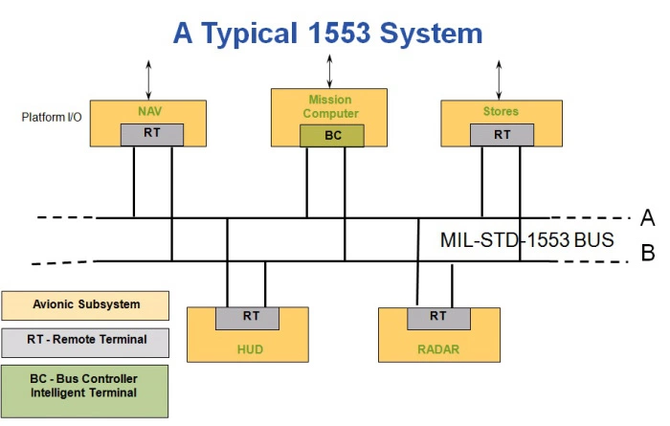
MIL-STD-1553
MIL-STD-1553 is a military standard that defines the mechanical, electrical, and functional characteristics of a serial data bus. It is used in aircraft and spacecraft on-board data handling (OBDH) subsystems. It features multiple (commonly dual) redundant balanced line physical layers, a (differential) network interface, time division multiplexing, half-duplex command/response protocol, and can handle up to 30 Remote Terminals (devices).

Slide 9
MSP430
For this class we will focus on these 3:
SPI
Synchronous, full duplex (2-way comm)
Datarates: 10Mbps
Number of slaves depends on how many available pins you have
UART
Asynchronous, full duplex
Data rates: 2.3M-9600 bps
Point to point (only 2 devices talking)
I2C
Synchronous, half duplex (1-way comm)
Data rates: 5M, 3.4M, 1M, 400K, and 100K bps
127 slaves possible
Note, these numbers are HW dependent. Not every I2C sensor can achieve 5Mbps for example … check the datasheet

Slide 10
SPI

Slide 11
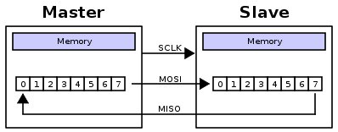
Serial Peripheral Interface (SPI)
Simple: with each clock cycle, a single bit is transferred from the MSB of one shift register to the other
Is this a half-duplex or full-duplex protocol?
Synchronous or Asynchronous protocol?
How many clocks cycles to transfer a byte?
Signals
MOSI: Master Out Slave In
MISO: Master In Slave Out
SCLK: Clock
SS: Slave Select
We actually did this in code for Lab 2! You could have used the SPI interface to do it.
TI renamed these:
MOSI = SIMO
MISO = SOMI

Slide 12

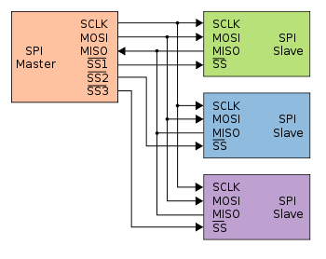
Serial Peripheral Interface (SPI)
Slave Select signal allows the master to use the same interface to interact with multiple slaves. It's usually active low
Often, if you only have one slave, you will just tie SS low
Look at all the SS wires, typically you would use a MUX to help reduce the number of uC pins you need

Slide 13
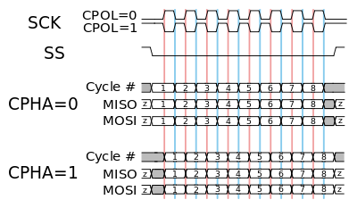
Serial Peripheral Interface (SPI)
Configurable Elements:
Clock frequency
Clock polarity
Clock phase
On the MSP430:
MSB first or LSB first
Depends on the external HW you are talking to
8-bits or 7-bits per transmission
7-bits is justified toward the LSB
3-pin or 4-pin modes
Control Register: Page 445 of the Family User Guide
SPI: Page 436 of the Family User Guide

Slide 14
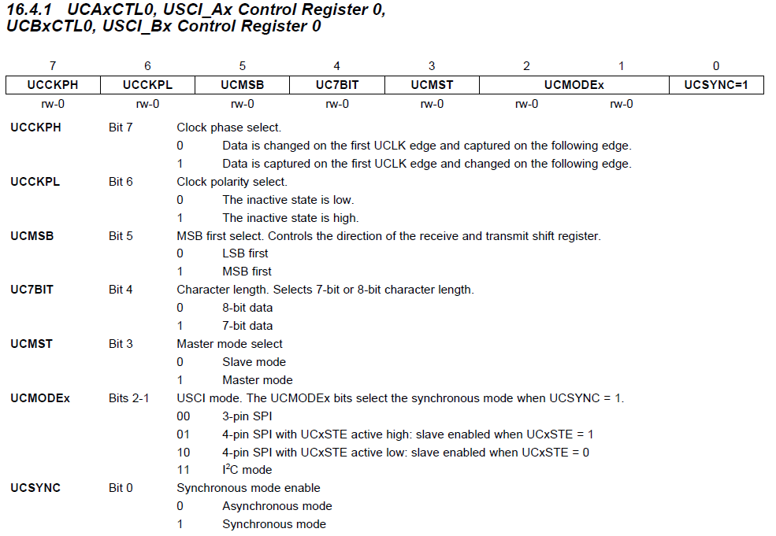
UCA/B Control Register 0
Control Register: Page 445 of the Family User Guide

Slide 15
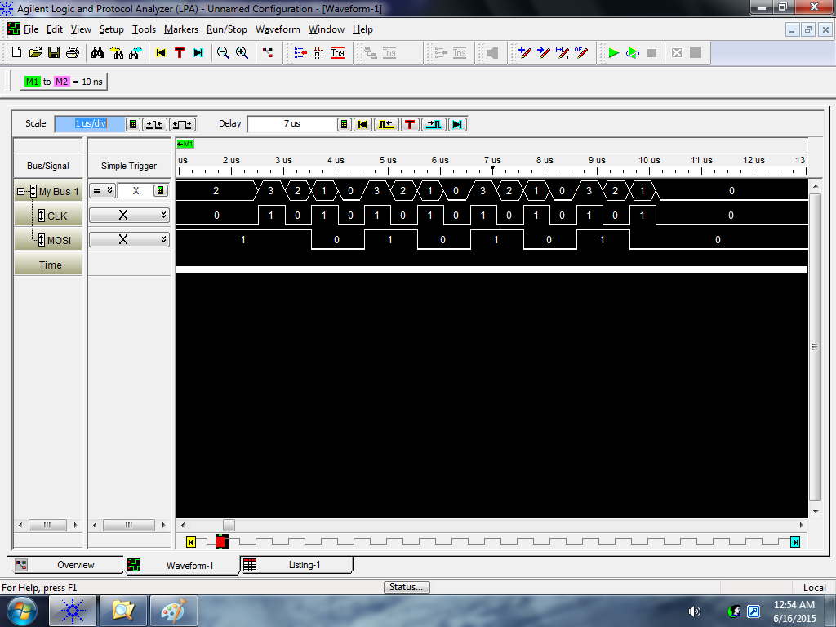
Phase = 0 and Polarity = 0
Change
Capture
10101010
AA
Input = 0xAA
Read on down clock
bis.b #UCMSB|UCMST|UCSYNC, &UCA0CTL0 ; UCCKPH = 0, UCCKPL = 0

Slide 16
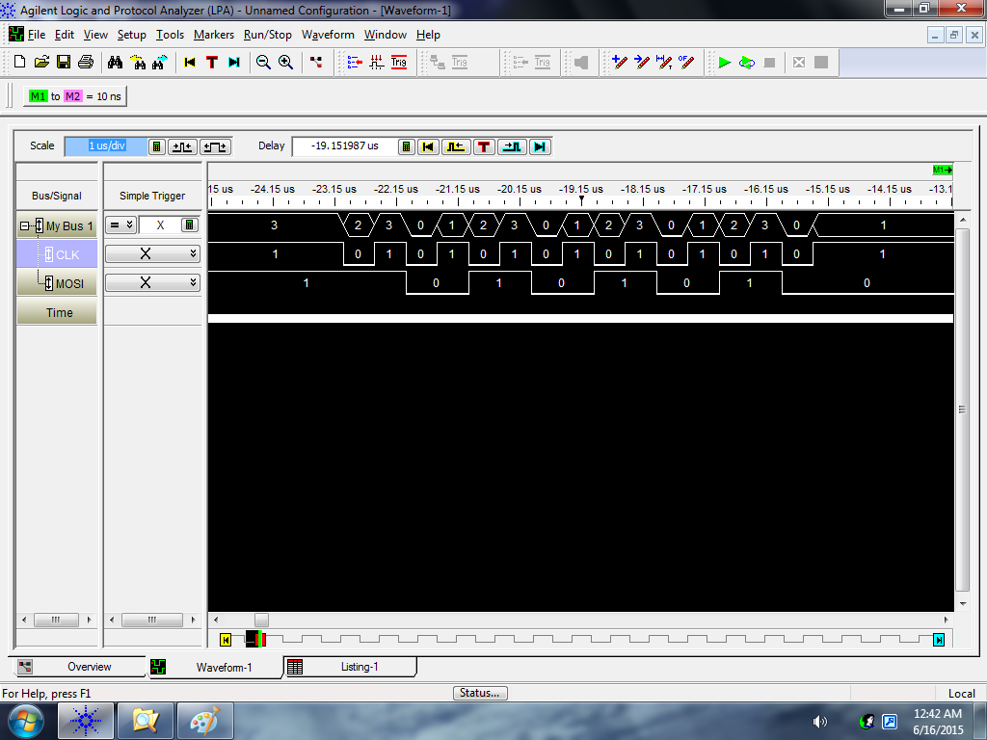
Phase = 0 and Polarity = 1
Change
Capture
10101010
AA
Input = 0xAA
Read on up clock
bis.b #UCCKPL|UCMSB|UCMST|UCSYNC, &UCA0CTL0 ; UCCKPH = 0, UCCKPL = 1

Slide 17

Phase = 1 and Polarity = 0
Change
Capture
10101010
AA
Input = 0xAA
bis.b #UCCKPH|UCMSB|UCMST|UCSYNC, &UCA0CTL0 ; UCCKPH = 1, UCCKPL = 0

Slide 18
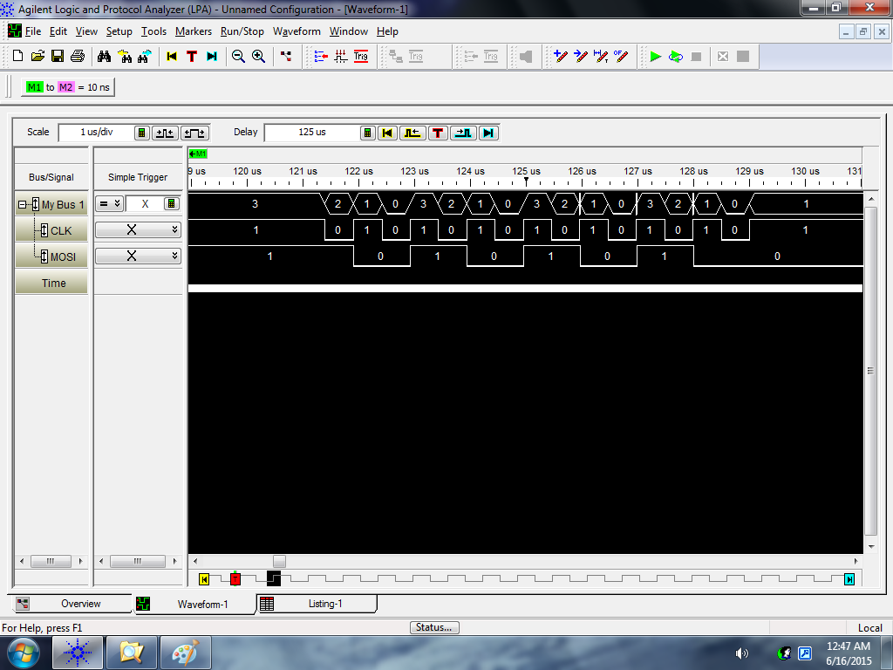
Phase = 1 and Polarity = 1
Change
Capture
Input = 0xAA
bis.b #UCCKPH|UCCKPL|UCMSB|UCMST|UCSYNC, &UCA0CTL0 ; UCCKPH = 1, UCCKPL = 1

Slide 19
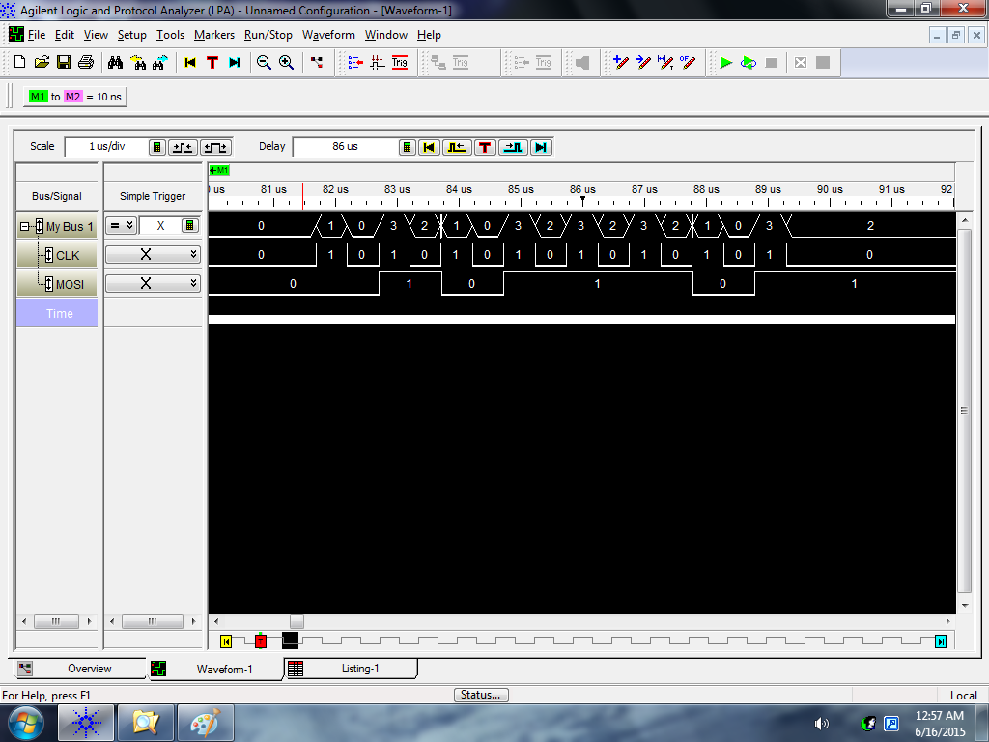
Phase = 0 and Polarity = 0
Change
Capture
01011101
5D
Input = 0x5D
Read on down clock
bis.b #UCMSB|UCMST|UCSYNC, &UCA0CTL0 ; UCCKPH = 0, UCCKPL = 0

Slide 20
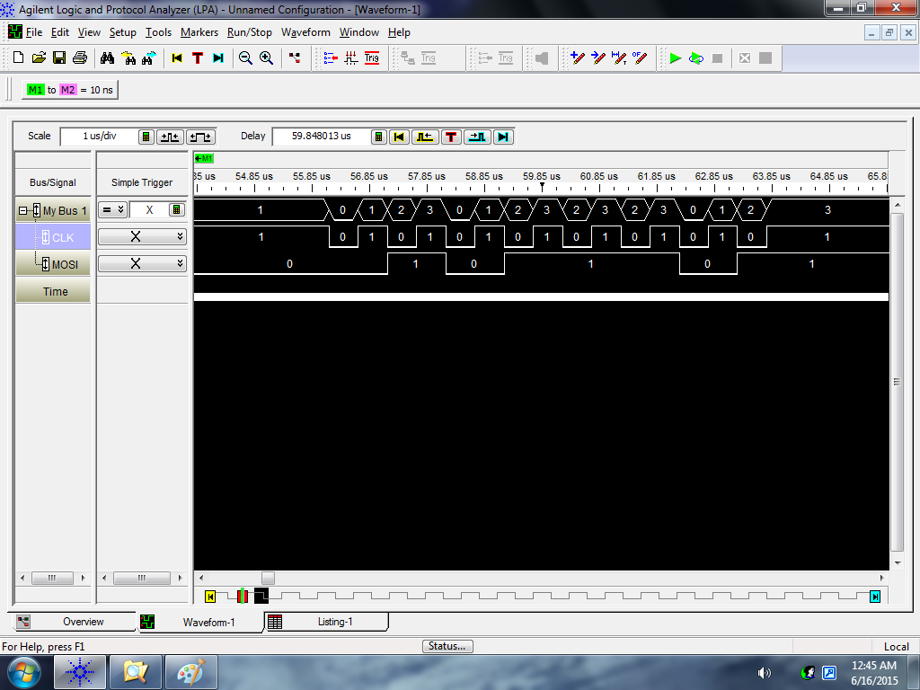
Phase = 0 and Polarity = 1
Change
Capture
Input = 0x5D
bis.b #UCCKPL|UCMSB|UCMST|UCSYNC, &UCA0CTL0 ; UCCKPH = 0, UCCKPL = 1

Slide 21
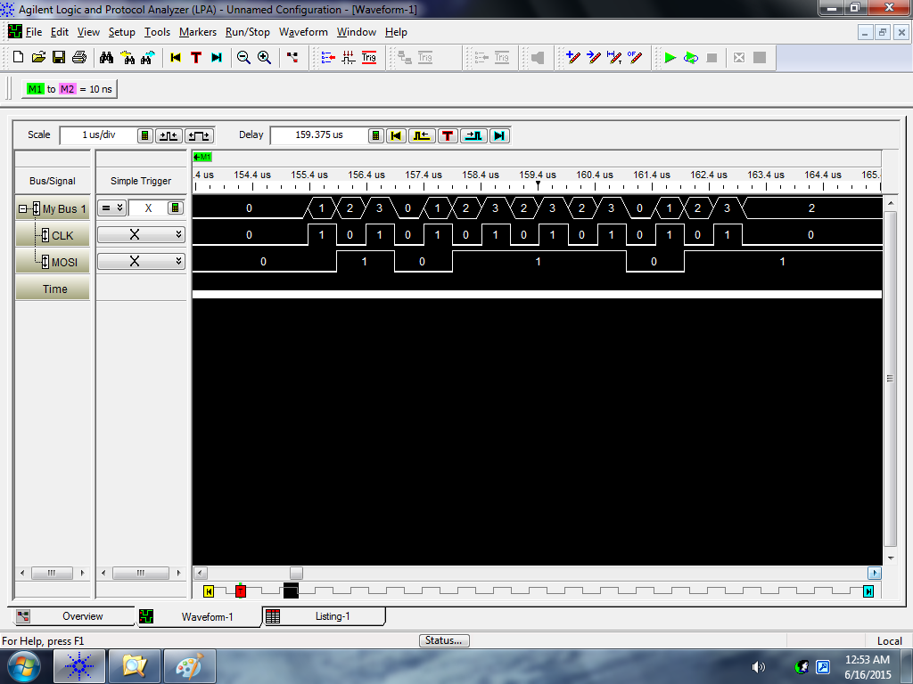
Phase = 1 and Polarity = 0
Change
Capture
Input = 0x5D
bis.b #UCCKPH|UCMSB|UCMST|UCSYNC, &UCA0CTL0 ; UCCKPH = 1, UCCKPL = 0

Slide 22

Phase = 1 and Polarity = 1
Change
Capture
Input = 0x5D
bis.b #UCCKPH|UCCKPL|UCMSB|UCMST|UCSYNC, &UCA0CTL0 ; UCCKPH = 1, UCCKPL = 1

Slide 23
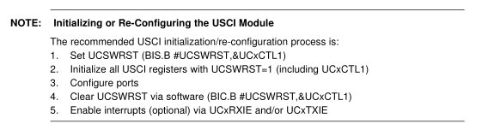
Universal Serial Communication Interface (USCI)
On the MSP430:
Two Universal Serial Communication Interfaces (USCI), A and B
Can do multiple protocols (one is SPI), defined by configuration registers
UCA0 and UCB0
datasheet - control registers (pp 435-448)
Page 436 or 452 of the Family User Guide

Slide 24
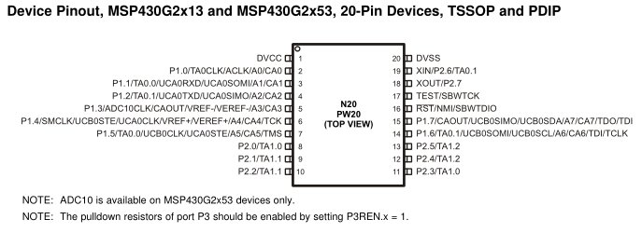
Universal Serial Communication Interface (USCI)
i.e (SW reset)
Step 1
Setting the UCSWRST bit in the CTL1 register [16.4.2] resets the subsystem into a known state until it is cleared. All the registers will hold their default values.
Step 2
Set the appropriate bits in the control registers to configure our signal the way we want.
Remember, you've got to set UCSYNC for the system to function!
CTL0 [bit 7 phase; bit 6 polarity; bit 3 master/slave; bit 0 UCSYNC = 1 ] [16.4.1]
CTL1 [bit 7&6 clock; bit 0 UCSWRST][16.4.2]
UCBRx [clock speed] [16.4.3 & 16.4.4]
STAT [16.4.5]
Step 3
All the ports on our MSP430 are multiplexed! We need to set the PxSEL and PxSEL2
Step 4
Clear the UCSWRST bit in the CTL1 register - releases the system to operate.
pp 437 for Block Diagram

Slide 25
Example SPI Setup
1) bis.b #UCSWRST, &UCB0CTL1
2) mov #UCCKPH|UCMSB|UCMST|UCSYNC, &UCB0CTL0
bis #UCSSEL_2, &UCB0CTL1
bis #BIT0, &UCB0BR0
clr &UCB0BR1
3) bis #LCD_SCLK_PIN|LCD_MOSI_PIN|LCD_MISO_PIN, &P1SEL
bis #LCD_SCLK_PIN|LCD_MOSI_PIN|LCD_MISO_PIN, &P1SEL2
4) bic.b #UCSWRST, &UCB0CTL1

Slide 26
Universal Serial Communication Interface (USCI)
Step 5
Use the subsystem!
To send a byte, just write to the TXBUF register. [16.4.6]
To read a received byte, read from the RXBUF register. [16.4.7]
How do you know “you’ve got mail” or last transmission is done?
You've got to monitor the flags in the IFG2 register [16.4.9] to know when it's safe the send
TXIFG
Set when TXBUF is ready for a byte
Cleared on write
Just because the TXBUF is ready for another byte doesn't mean that the transmission is complete! It's double-buffered!
RXIFG
Set when RXBUF has received a complete character
Cleared on read
This is what you should monitor to determine a transmission has completed!

Slide 27
Example (loopback)
bis.b #UCSWRST, &UCA0CTL1
bis.b #UCCKPL|UCMSB|UCMST|UCSYNC, &UCA0CTL0 ; don't forget UCSYNC!
bis.b #UCSSEL1, &UCA0CTL1 ; select a clock to use!
bis.b #UCLISTEN, &UCA0STAT ; enables internal loopback
bis.b #BIT4, &P1SEL ; make UCA0CLK available on P1.4
bis.b #BIT4, &P1SEL2
bis.b #BIT2, &P1SEL ; make UCA0SSIMO available on P1.2
bis.b #BIT2, &P1SEL2
bis.b #BIT1, &P1SEL ; make UCA0SSOMI available on P1.1
bis.b #BIT1, &P1SEL2
bic.b #UCSWRST, &UCA0CTL1 ; enable subsystem
send mov.b #0xBB, &UCA0TXBUF ; place a byte in the TX buffer
wait bit.b #UCA0RXIFG, &IFG2 ; wait for receive flag to be set (operation complete)
jz wait
mov.b &UCA0RXBUF, r4 ; read RX buffer to clear flag
jmp send ; send another byte

Slide 28
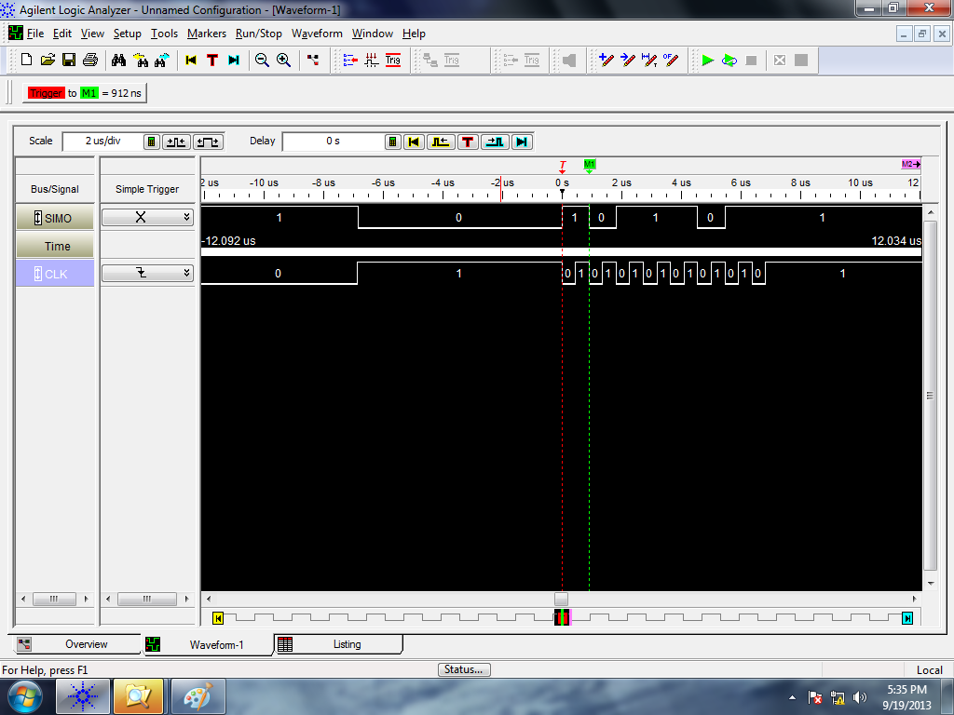
Logic Analyzer
Sending 0xBB once (0x1011 1011) [MSB first!]
Note how the clock default state is high and data is read on the second clock edge - consistent with our settings.

Slide 29
UART

Slide 30

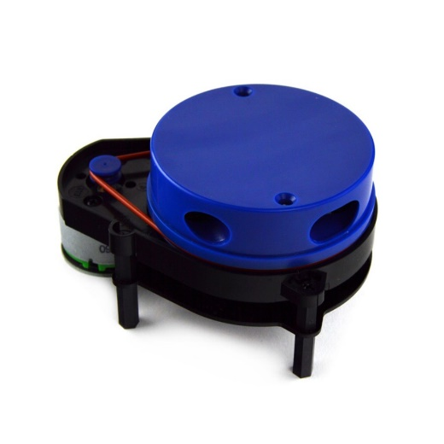
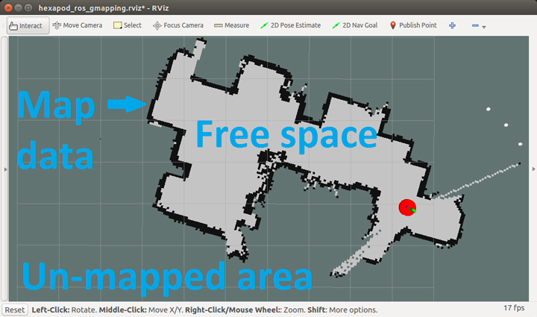
UART
The universal asynchronous receiver-transmitter (UART) takes bytes of data and transmits the individual bits in a sequential fashion
Although the protocol defines all kinds of things, I have ALWAYS used 8 bits, no parity, one stop bit (8N1)
The blue top spins 360 degs at 5 Hz and for every degree provides distances to obstacles up to 12m to map rooms
Data rate: 230400 bps

Slide 31
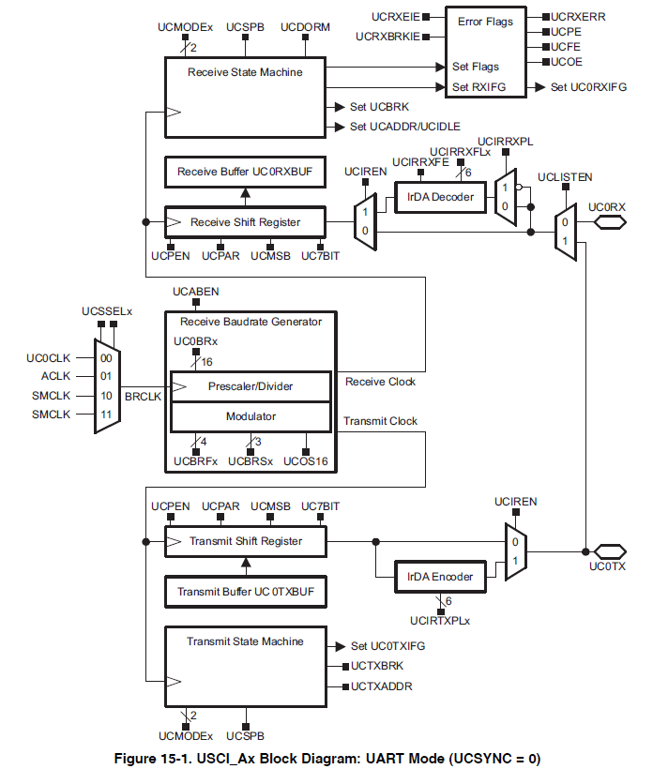
UART
It is common for serial to be tied to specific HW pins
P1.1
USCI_Ax for UART
USCI_Bx for I2C or SPI
P1.2

Slide 32
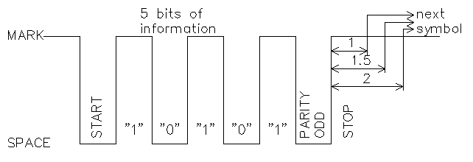
UART Serial Protocol
Example of 5O1 (not common at all)
5 bits
Odd parity (odd #1’s: 0 or even #1’s:1)
1 stop bit
Data bit closes to START is the LSb
Most common is 8N1
8 bits
N: no parity bit
1 stop bit

Slide 33
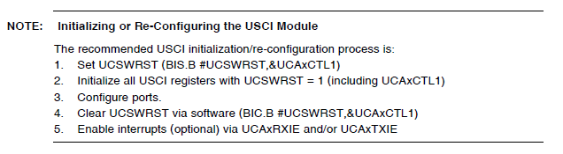
Setup
Remember to set the TX and RX pins too!

Slide 34
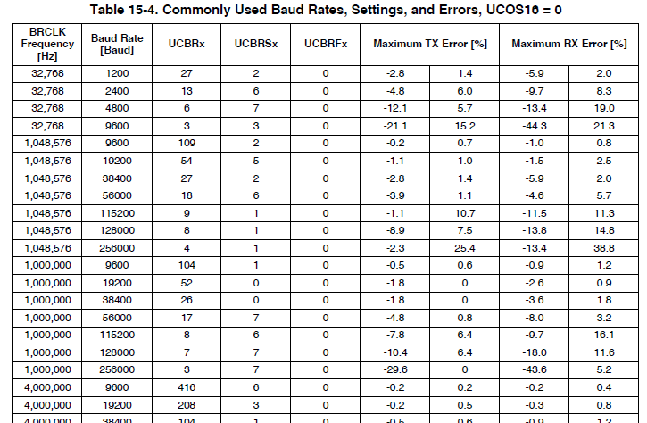
UART Datarate Settings
Common when using the SMCLK
Common serial data rates for a 1MHz clock
9600 8N1 very common

Slide 35
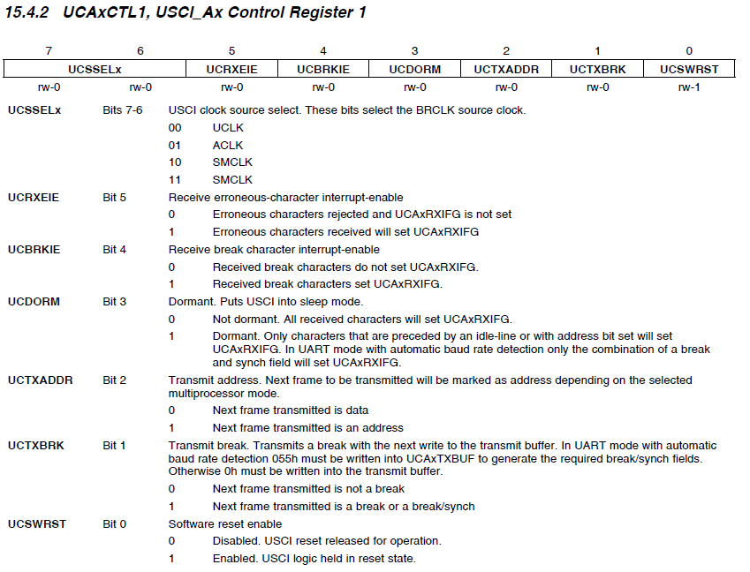
Serial CTL

Slide 36
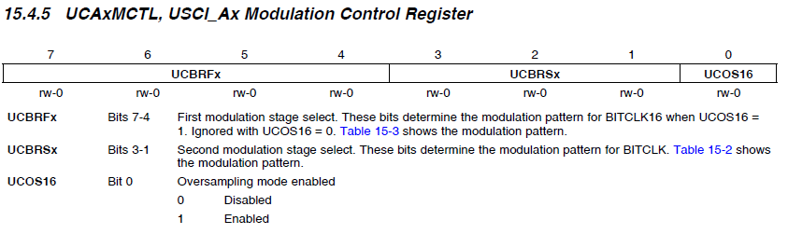
UART
These come from that big table above or p 424 Fam User Guide

Slide 37
UART Setup
Steps:
Set P1SEL/P1SEL2 for P1.1 and P1.2 for the UCA0
Hold the USCI with UCA0CTL1 = UCSWRST;
Set clock to SMCLK
Set UCA0CTL/1 correctly
Set UCA0MCTL correctly (p 424 Fam User Guide)
Take USCI out of reset with UCA0CTL1 &= ~UCSWRST;
Example: 9600 8N1
UCA0CTL1 |= UCSSEL_2; // select BRCLK = SMCLK
UCA0CTL0 = 0; // 8N1
UCA0BR0 = 104; // p 424 1MHz@9600
UCA0BR1 = 0; // p 424 1MHz@9600
UCA0MCTL = UCBRS0; // UCBRSx=1

Slide 38
TX
Simple put character function:
// wait for TX to be ready for sending
void uart_putc(const int8_t c){
while (!(IFG2 & UCA0TXIFG)); // USCI_A0 TX buffer ready?
UCA0TXBUF = c; // TX
}
Now, you could easily expand this into transmitting strings or (char* or int8_t*) or char[]
You can declare char arrays like this:
char my_str[] = “hello”; // compiler will allocate the array size
Now C will create an array of: [‘h’,’e’,’l’,’l’,’o’,’\x00’]
’\x00’ is the same as 0 … it is just a string terminator and you can look for it in a for loop!

Slide 39
RX
Simple get character (8 bits)
We won’t be using this for Lab 4
int8_t getchar(void) {
while(!(IFG2 & UCA0RXIFG)); // anything to get?
IFG2 &= ~UCA0RXIFG; // clear the flag
return UCA0RXBUF; // get the data
}
Again, you can expand this out into grabbing a string of characters, a bunch of bytes until you get a certain stop sequence, or even a fixed number of bytes
It is common in serial communications to define data packet formats uses them when you are doing TX/RX

Slide 40
I2C

Slide 41
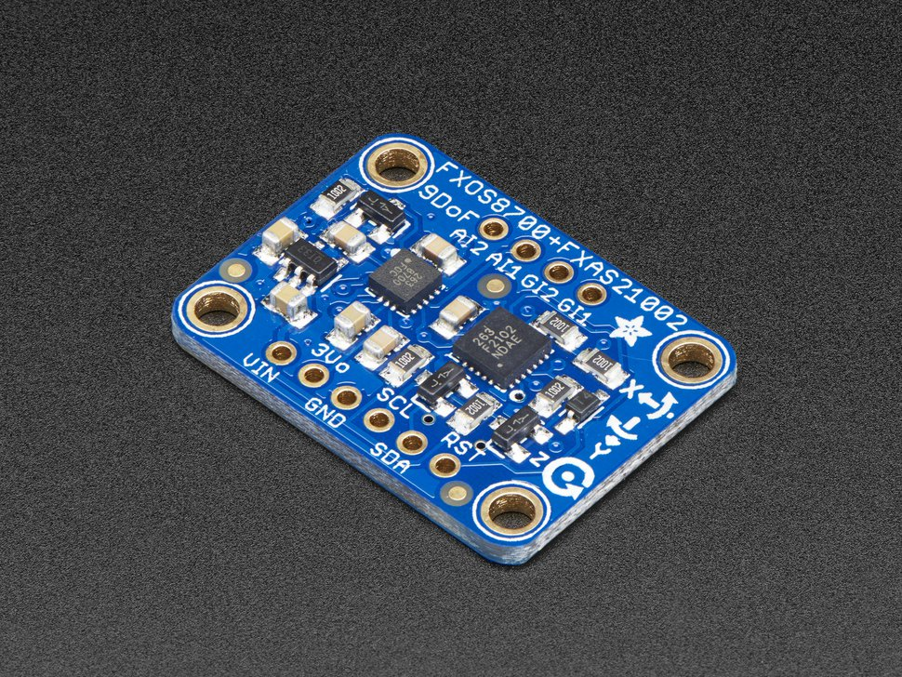
I2C Sensors
I2C is common protocol for embedded systems
Common applications:
Camera adjustments
Inertial measurement units
Temperature sensors
Pressure sensors
EEPROM
etc
Cellphone IMU ($14)

Slide 42
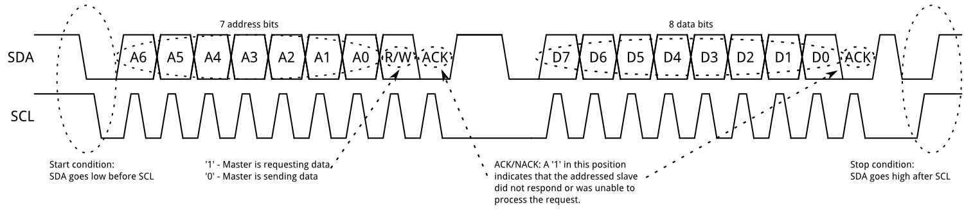
Format
I2C is a packet based protocol with a 7b address
Allows 128 devices on network
More complex than UART and SPI
Popular in a variety of applications
Memory, MUXes, ADCs, etc
Only need 2 wires (no SS link on SPI)

Slide 43
Initialize the I2C Subsystem
void i2c_init(void){
UCB0CTL1 = UCSWRST; // hold in reset while configuring
UCB0CTL0 = UCMST | UCMODE_3 | UCSYNC; // set to master
/**
* Set to 100kHz when sourcing from SMCLK
* where SMCLK = 1MHz
*/
UCB0BR0 = 10;
UCB0BR1 = 0;
UCB0CTL1 |= UCSSEL_2; // set clock to SMCLK
UCB0CTL1 &= ~UCSWRST; // take out of reset
}

Slide 44
TX/RX
The transmitting data
int i2c_transfer(uint8_t addr, uint8_t *buf, size_t nbytes){
UCB0I2CSA = addr; // set slave address
UCB0CTL1 |= UCTR | UCTXSTT; // set start condition
while ((UCB0CTL1 & UCTXSTT) && ((IFG2 & UCB0TXIFG) == 0));
err = _check_ack(dev); // check for ACK … defined elsewhere
while ((err == 0) && (nbytes > 0)) {
UCB0TXBUF = *buf;
while ((IFG2 & UCB0TXIFG) == 0) {
err = _check_ack(dev);
if (err < 0) break;
}
buf++; // grab next byte
nbytes--;
}
return err; // 0: good, -1: error occurred
}
RX will be similar but not the same

Slide 45
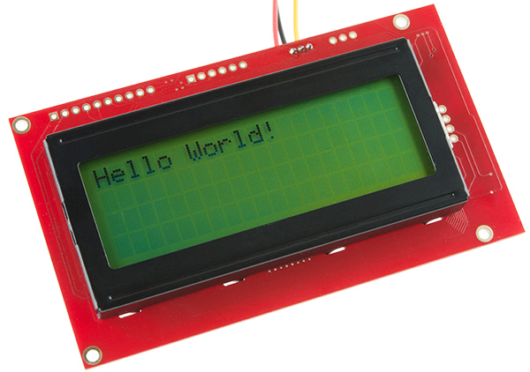
ICE: UART Serial LCD
Use the code examples in this lesson to:
Setup your MSP430 for serial comm
9600 bps 8N1
Have the LCD display “Hello” repeatedly
When you fill up the LCD clear it
Take a look at the LCD datasheet
Clear the screen
Debugging, might be useful to blink an led or two … up to you
Getting this working will help you in Lab 4

Slide 46
Picture of setup

Slide 47
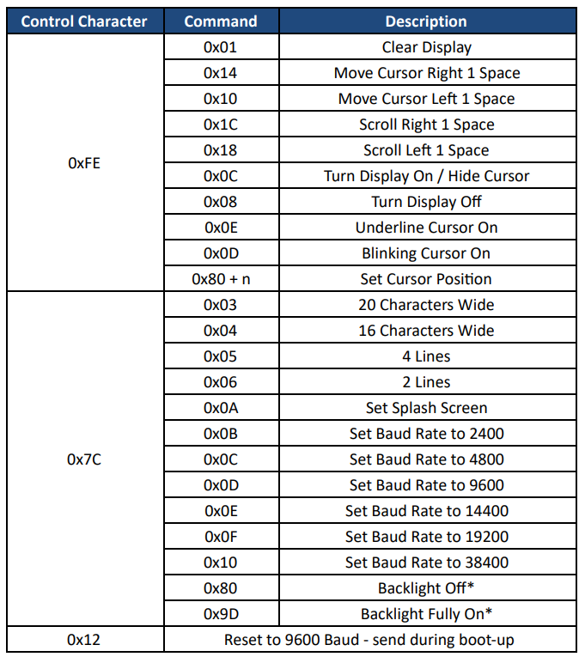
Serial LCD Commands
Suggest you read the LCD datasheet, here is the command summary

Slide 48
BACKUPS

