Slide 1

HQ U.S. Air Force Academy
ECE 382 Lesson7
1

Slide 2
Overview
Assembly directives
Code Composer Studio (CCS)
hello_world.asm

Slide 3
Watchdog Timer
TI MSP 430 User’s Manual pp 341-347
If not disarmed, How long to reset?
It counts 32768 clock cycles, then resets
How much time is that?
15 | 14 | 13 | 12 | 11 | 10 | 9 | 8
WDTPW
7 | 6 | 5 | 4 | 3 | 2 | 1 | 0
WDTHOLD | WDTNMIES | WDTNMI | WDTTMSEL | WDTCNTCL | WDTSSEL | WDTISx

Slide 4
Watchdog Timer
;disable watchdog timer
mov #WDTPW, r10 ; to prevent inadvertent writing, the watchdog has a password - if you write without the password in the upper 8 bits, you'll initiate a PUC.
;the password is 0x5a in the upper 8 bits. if you read from the password, you'll read 0x69.
bis #WDTHOLD, r10 ; next, we need to bis the password with the bit that tells the timer to hold, not count
mov r10, &WDTCTL ; next, we need to write that value to the WDTCTL - this is a static address in memory (not relative to our code), so we need

Slide 5
Assembler Directives
.cdecls C,LIST,"msp430.h"
.text ;put code in the text section - maps to FLASH (ROM)
StopWDT mov.w #WDTPW|WDTHOLD
.data ;put code into the data section - maps to RAM
.sect ".reset" ;put this at the reset vector
.sect .stack ;make this the location of the stack
MY_RESULTS: .space 20 ; reserves 20 bytes
-----------------
To use:
mov #MY_RESULTS, r5 ; pointer address into r5
mov #0xfefe, &MY_RESULT ; put fefe into 1st two bytes

Slide 6
Assembler Directives
; Can initialize ROM; cannot initialize RAM
;initialize sequence of bytes
bytes: .byte 9,8,7,6,5,4,3,2,1
;initialize sequence of words
words: .word 0x1111,0x2222,0x3333,0x4444
;initialize strings
myStr: .string "hello, world!"
;initialize characters
Chars: .char 'a','b','c','d‘
; see in CCS

Slide 7
Assembler Directives
; .equ ← assign a label to a particular value
SEVENTEEN: .equ 0x11
;align a variable with a particular multiple of bytes (useful to ensure word on even address)
.align 2
;probably won't use these often, but they're available
.float ;floating point value
.int ;16-bit int
.short ;16-bit int
.long ;32-bit int

Slide 8
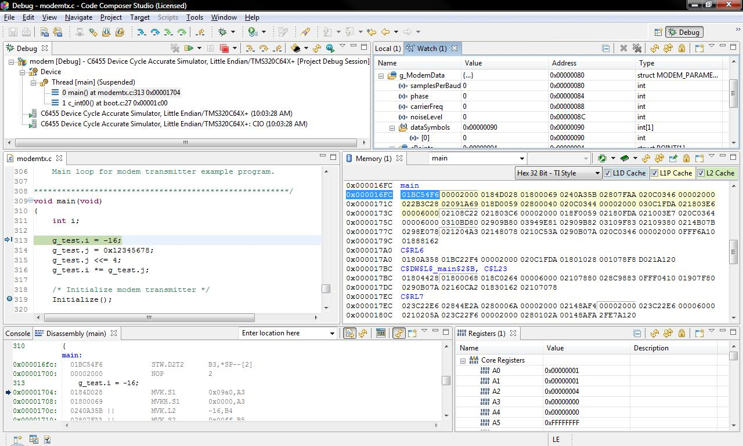
CCS
We have CCS 8 installed which will allow us to build either ASM or C program and install them onto the MSP430

Slide 9

Tools
The IDE uses the GNU Compiler Collection (gcc) to produce executable binary files for the uC
gcc v6.4 released 4 July 2017
gcc is probably the most common compiler used for embedded systems because it is free (no $$$) and open (easy to adapt to a new processor)

Slide 10
Structured Design
Guiding Principle: Get one small thing working
Don't write the entire program in one go, then press go, and hope it works. When the entire program is the space you're looking for a bug, it makes debugging really hard.
Modularity
Modularity is the practice of breaking down a larger program into smaller tasks.
Makes code more reusable
Makes code more readable
Make individual task more manageable
Focus on simpler tasks
Tough to hold a big problem in your brain

Slide 11
Testing and Debugging
How do we know when we're done with a task? Testing!
You should specify the tests you'll run on the code you're going to write in advance of writing the code. It's a little more work up front, but will save you time debugging down the road.
Write tests that cover all cases - particularly edge cases.
Being able to debug your own code is an objective of this class. I will make EVERY effort to never look at your code, but I will act as a supervisor and ask you questions for you to research

Slide 12
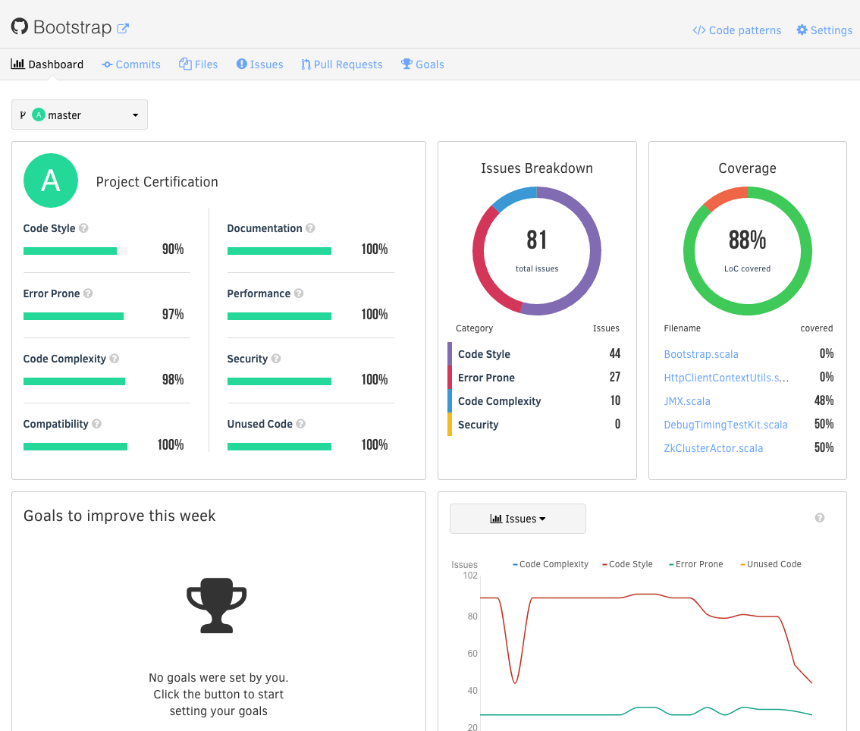
Continuous Integration
Real programmers use CI
Automated metrics to help you understand where your issues/bugs are coming from
git hooks run CI
Automated metrics on unit test coverage
You push to repo
Automated linters designed to look for common programming errors and security vulnerabilities
Unfortunately these typically do not support assembly, just higher level languages like C/C++, python, ruby, javascript, go, etc

Slide 13
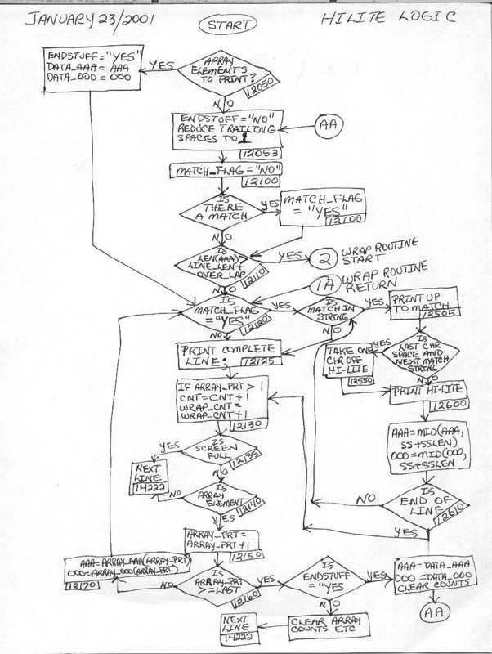
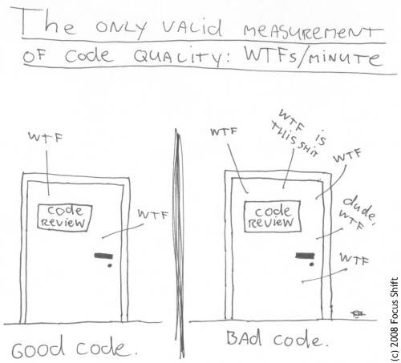
Do Some Sort of Flow Chart
Assembly programs are hard to write and read (I am talking about me reading your code). Always start with some sort of idea for how your program will work. When things break, I will ask how your program works and a flow chart can help.

Slide 14
Let’s Open CCS
Let’s try to get something to compile

