Slide 1

ECE382
Lesson 13
1

Slide 2
Overview
Lesson Outline
Peripherals
Memory-Mapped IO
Ports
GPIO
Multiplexing

Slide 3
Peripherals
What are Peripherals?
MSP430G2xx Peripherals?
MSP430 wikipedia:
Watchdog Timer
Universal Serial Communication Interface (USCI)
Implements UART, SPI, and I2C protocols
Pulse Width Modulation (PWM)
Temperature Sensor
Multiplexers
Too many capabilities, not enough pings
Capacitive Touch I/O
For working with touch screens, etc

Slide 4

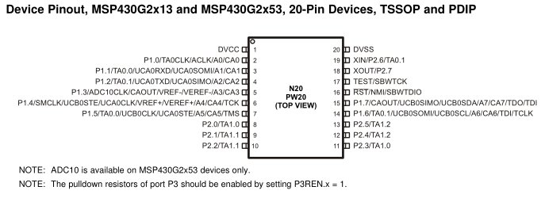
Ports
What are Ports?
Your LaunchPad Board has…
Port 1, Pin 0 to Pin 7
Port 2, Pin 0 to Pin 5
External
World
Ship
(uC)
Goods
(Data)

Slide 5
Multiplexing
Only 20 Pins !!! But want access to many more signals
Therefore, each pin shares several signals → multiplexing
You learned about multiplexers in ECE281
Use PxSEL1 and PxSEL2 to select signal for each pin
The details are in the MSP430G2x53 2x13 Mixed Signal MCU Datasheet.

Slide 6
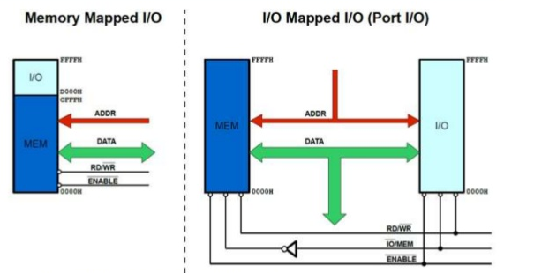
Ports
Motorola
I/O and memory share
Intel
I/O and memory have separate space
Memory-Mapped I/O
Advantage
Fewer instructions
Can use all addressing modes
Disadvantage
Lose memory to IO
Programmer mistakes
Port-Mapped I/O
Advantage
Don't lose memory for IO.
Protects coder from mistakes.
Disadvantage
Need More Instructions (like In/Out)
More restrictive addressing modes

Slide 7
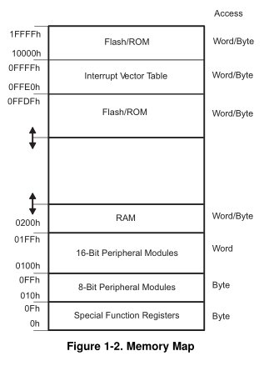
MSP430
MSP430 has Memory-Mapped I/O
How to use
mov #0x55, &P1OUT
mov #0x55, &0x0021
Why does the address have &?
User’s Guide p 333, Table 8-2

Slide 8
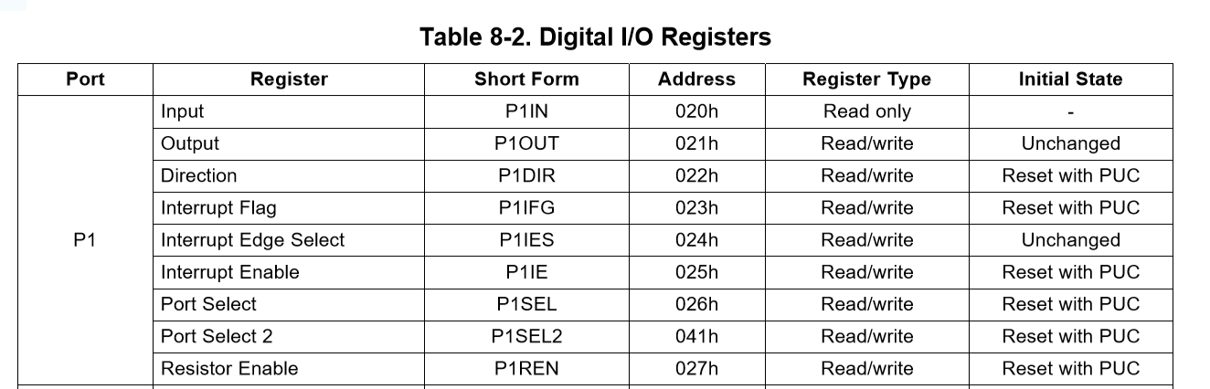
GPIO Port Control
The registers used to configure GPIO are PxDIR, PxREN, PxOUT, and PxIN
PxDIR configures which pins are input and which pins are output
1 corresponds to output, 0 to input
PxREN controls pull up / pull down resistors to avoid floating inputs.
Writing to PxOUT controls the output of each pin
PxIN allows you to read the values on these pins
PxDIR
Port 1 or 2
Family Users Guide p 328

Slide 9
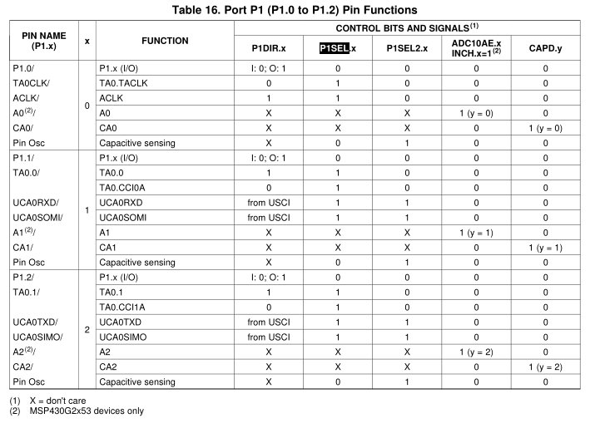
GPIO Pin Setup (Muxes!)
P1.x
Pin 0-7
Let’s setup UCA0SOMI on port 1
PxDIR
Port 1 or 2
bis.b #BIT1, &P1SEL bis.b #BIT1, &P1SEL2

Slide 10
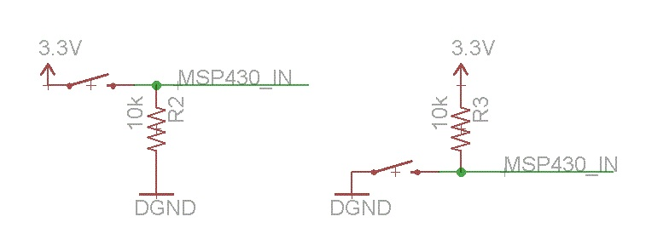
Avoiding Floating Inputs
Pull-up and pull-down resistors
You should know this from ECE231 ☺
When a system starts up, there is a period where inputs could have random states (floating) because external HW hasn’t initialized things yet
You may not want to your uC to act on that random input
Pull-up/down always keep your inputs in a known state
Pull-up
Input is always HIGH
Pull-down
Input is always LOW

Slide 11
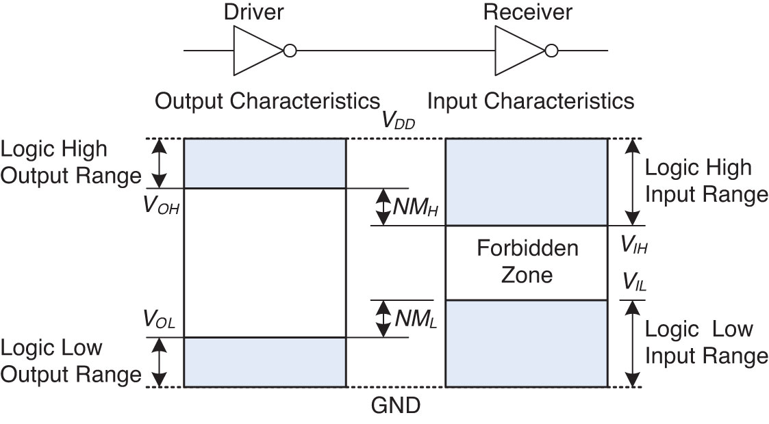
Floating
Voltage Levels and Noise Margins
Remember this from ECE281?

Slide 12
Toggle LED
Let's write a program that controls the onboard LEDs with the onboard push button
bis.b #BIT0|BIT6, &P1DIR
bic.b #BIT3, &P1DIR
check_btn: bit.b #BIT3, &P1IN ;push button is LOW on push
jz set_lights
bic.b #BIT0|BIT6, &P1OUT
jmp check_btn
set_lights: bis.b #BIT0|BIT6, &P1OUT
jmp check_btn
Family Users Guide p 328

Slide 13
BACKUPS

Slide 14
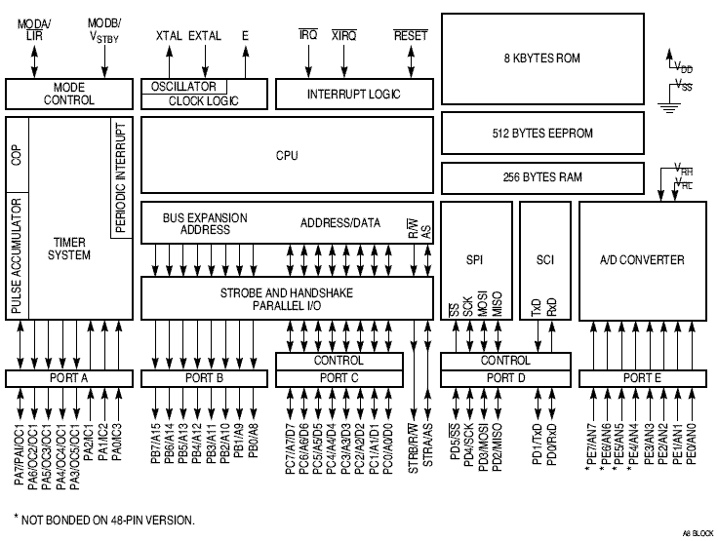
68HC11

Slide 15
How do we talk to Ports? Do I/O?
Port-Mapped I/O (Intel)
I/O and memory have their own separate address space
Advantage
Don't lose memory for IO.
Protects coder from mistakes.
Disadvantage
Need More Instructions (like In/Out)
More restrictive addressing modes
How to use
Out #0x55, &PORT1

Slide 16
Example Program
Input was FLOATING!
bis.b #BIT0|BIT6, &P1DIR ; output pin direction
bic.b #BIT3, &P1DIR ; input pin direction
bis.b #BIT3, &P1REN ; enable pin 3’s resistor
bis.b #BIT3, &P1OUT ; make it a pull-up? (trick)
check_btn: bit.b #BIT3, &P1IN
jz set_lights
bic.b #BIT0|BIT6, &P1OUT
jmp check_btn
set_lights: bis.b #BIT0|BIT6, &P1OUT
jmp check_btn

Slide 17
How do we talk to Ports? Do I/O?
Two classic methods
Memory-Mapped I/O (Motorola)
Port-Mapped I/O [or Isolated IO] (Intel)
Memory-Mapped I/O
I/O and memory SHARE the same space
Advantage
Fewer instructions
Can use all addressing modes
Disadvantage
Lose memory to IO
Programmer mistakes
How to use
Mov #0x55, &P1OUT
Mov #0x55, &0x0021
User’s Guide p 333, Table 8-2
Watchdog Timer, page 341

Slide 18
Pull-up/Pull-down
Input was FLOATING!

