Slide 1

ECE382
Lesson 35
1

Slide 2
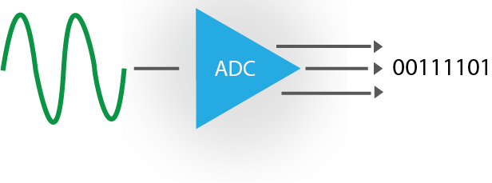
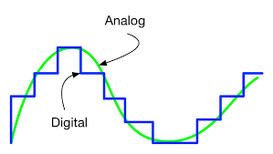
Overview
Lesson Outline
Analog to Digital Converter (ADC)
Discrete signal out (data is parallel)
Continuous signal in
Note how the digital representation isn’t a perfect copy of the analog signal

Slide 3
BLUF
3 steps in the Analog to Digital Conversion (ADC) Process:
Sample (snapshot in time)
Quantize (assign voltage level)
Encode (convert to bits)
Sampling (time) and Resolution (voltage) are independent

Slide 4
ADC
Sampling: Snapshots at discrete times (x-axis)
Quantization: Round to discrete voltage levels (resolution)(y-axis)
Encoding: convert decimal levels to binary (convert to bits)
Encode in 5 bits: 10011
D
Digital
Analog
Resolution
Sampling
What does the computer assume between samples?

Slide 5
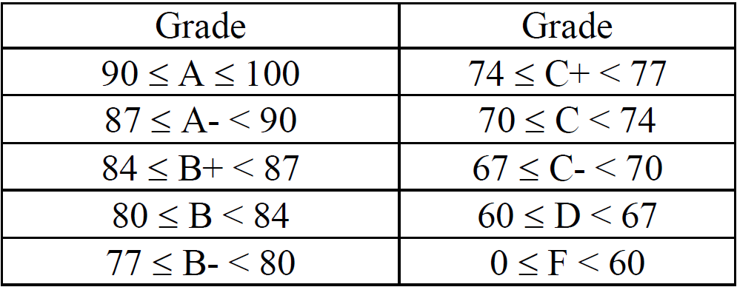
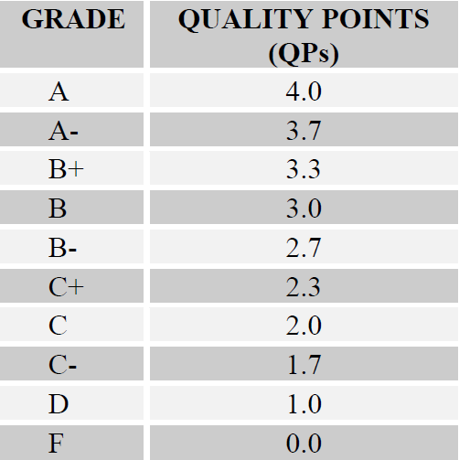
What is Your Class Score?
Sample
At Prog or Final?
Every 5 lessons?
Quantize
Encode

Slide 6
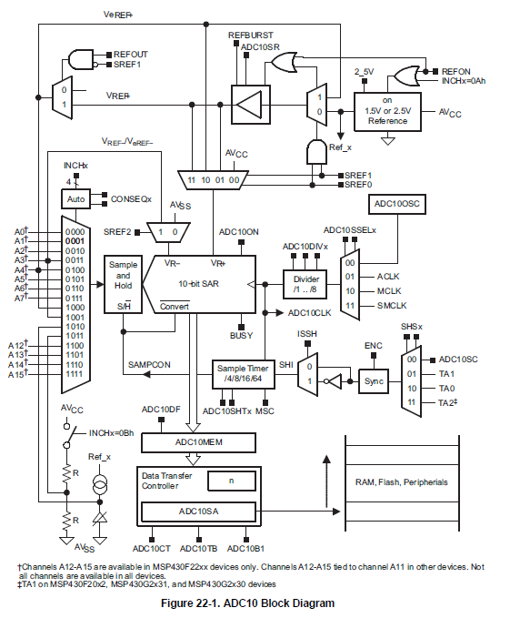
ADC10
Inputs
MSP430G2553 has 8 inputs or channels

Slide 7
ADC Example Code
// TI example code
#include <msp430g2553.h>
void main(void)
{
WDTCTL = WDTPW + WDTHOLD; // Stop WDT
ADC10CTL0 = ADC10SHT_3 + ADC10ON + ADC10IE; // ADC10ON, interrupt enabled
ADC10CTL1 = INCH_4; // input A4
ADC10AE0 |= BIT4; // P1.4 ADC Analog enable
ADC10CTL1 |= ADC10SSEL1|ADC10SSEL0; // Select SMCLK
P1DIR |= 0x01; // Set P1.0 to output direction
while (1)
{
ADC10CTL0 |= ENC + ADC10SC; // Sampling and conversion start
__bis_SR_register(CPUOFF + GIE); // LPM0, ADC10_ISR will force exit
if (ADC10MEM < 0x1FF)
P1OUT &= ~0x01; // Clear P1.0 LED off
else
P1OUT |= 0x01; // Set P1.0 LED on
}
}
// ADC10 interrupt service routine
#pragma vector=ADC10_VECTOR
__interrupt void ADC10_ISR(void)
{
__bic_SR_register_on_exit(CPUOFF); // Clear CPUOFF bit from 0(SR)
}
Setup
Sample, Quantize, and Encode
Read Encoded Value
This just turns an LED on or off based on the input voltage level … for Lab4 you will adjust a PWM signal based on an input voltage

Slide 8
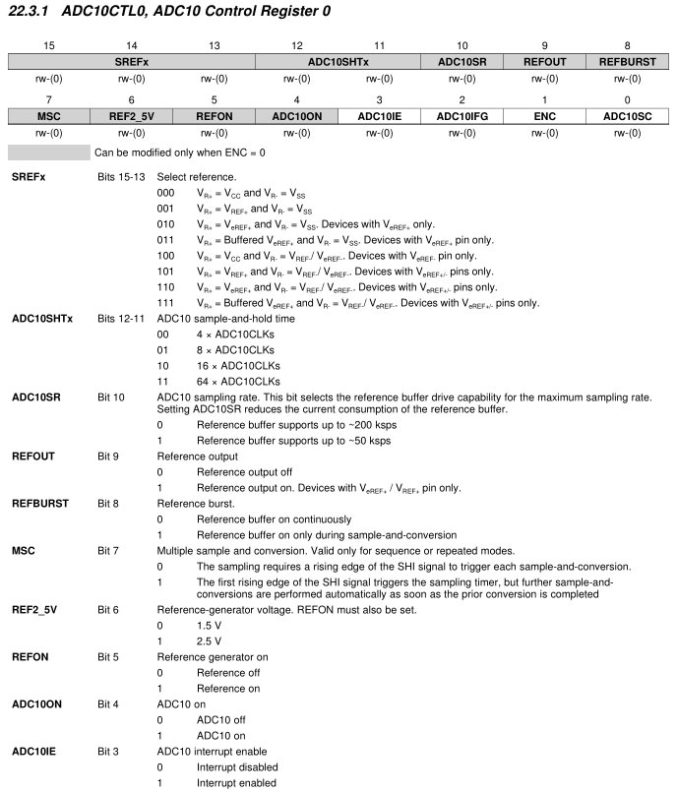
ADC10CTL0
ADC10CTL0 = ADC10SHT_3 + ADC10ON + ADC10IE; // ADC10ON, interrupt enabled
ADC10CTL1 = INCH_4; // input A4
ADC10AE0 |= BIT4; // P1.4 ADC Analog enable
ADC10CTL1 |= ADC10SSEL1|ADC10SSEL0; // Select SMCLK
P1DIR |= 0x01; // Set P1.0 to output direction

Slide 9
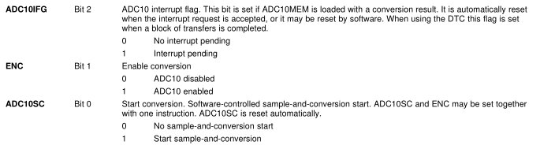
ADC10CTL0 Register Cont.

Slide 10
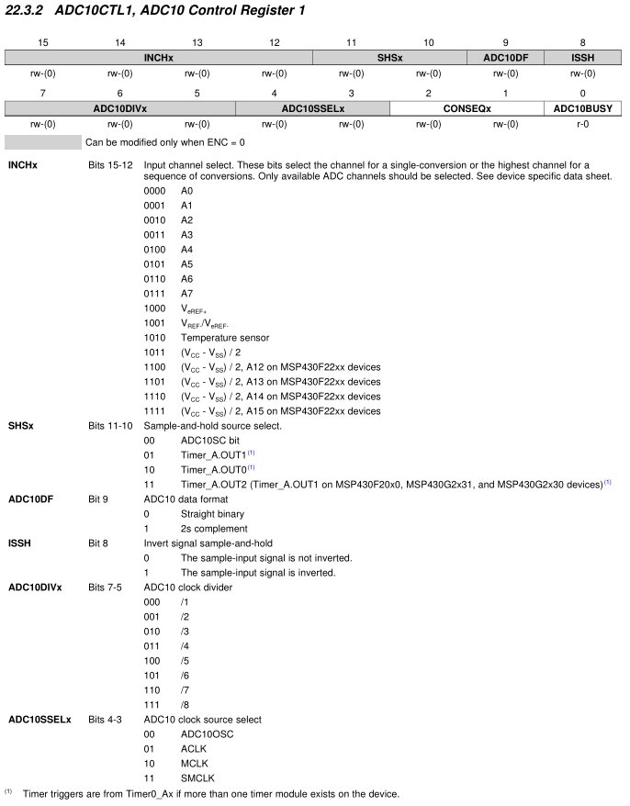
ADC10CTL1
ADC10CTL0 = ADC10SHT_3 + ADC10ON + ADC10IE; // ADC10ON, interrupt enabled
ADC10CTL1 = INCH_4; // input A4
ADC10AE0 |= BIT4; // P1.4 ADC Analog enable
ADC10CTL1 |= ADC10SSEL1|ADC10SSEL0; // Select SMCLK
P1DIR |= 0x01; // Set P1.0 to output direction

Slide 11
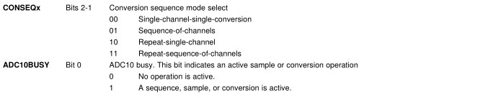
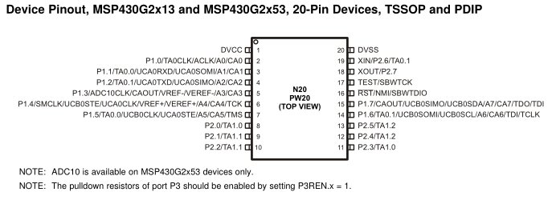
ADC10CTL1 Register Cont.
Note:
Port 1: analog muxed
Port 2: timer muxed

Slide 12
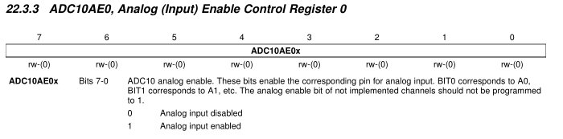
ADC10AE0 Register
ADC10CTL0 = ADC10SHT_3 + ADC10ON + ADC10IE; // ADC10ON, interrupt enabled
ADC10CTL1 = INCH_4; // input A4
ADC10AE0 |= BIT4; // P1.4 ADC Analog enable
ADC10CTL1 |= ADC10SSEL1|ADC10SSEL0; // Select SMCLK
P1DIR |= 0x01; // Set P1.0 to output direction

Slide 13
ADC10CTL1
ADC10CTL0 = ADC10SHT_3 + ADC10ON + ADC10IE; // ADC10ON, interrupt enabled
ADC10CTL1 = INCH_4; // input A4
ADC10AE0 |= BIT4; // P1.4 ADC Analog enable
ADC10CTL1 |= ADC10SSEL1|ADC10SSEL0; // Select SMCLK
P1DIR |= 0x01; // Set P1.0 to output direction

Slide 14
While Loop (Sample, Quantize, & Encode)
while (1)
{
ADC10CTL0 |= ENC + ADC10SC; // Sampling and conversion start
__bis_SR_register(CPUOFF + GIE); // LPM0, ADC10_ISR will force exit
if (ADC10MEM < 0x1FF)
P1OUT &= ~0x01; // Clear P1.0 LED off
else
P1OUT |= 0x01; // Set P1.0 LED on
}
}

Slide 15
ADC10
Inputs

Slide 16
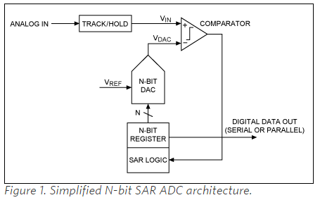
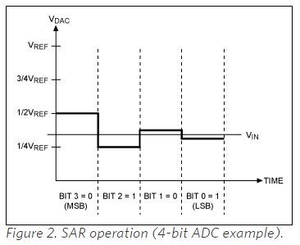
Successive-approximation-register(SAR)
https://www.maximintegrated.com/en/app-notes/index.mvp/id/1080
As the name implies, the SAR ADC basically implements a binary search algorithm. Therefore, while the internal circuitry may be running at several megahertz (MHz), the ADC sample rate is a fraction of that number due to the successive-approximation algorithm.

Slide 17
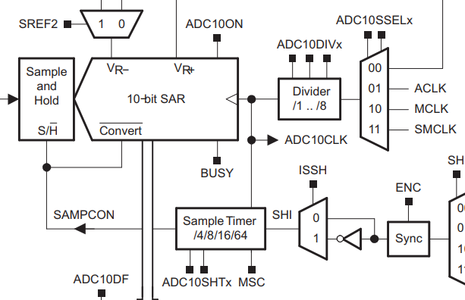
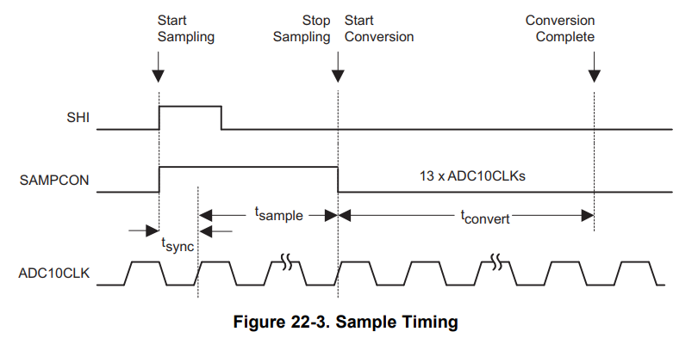
Clocks
SMCLK and ADC10DIVx drive our sampling rate and influence ADC10SHTx for … they are not independant

Slide 18
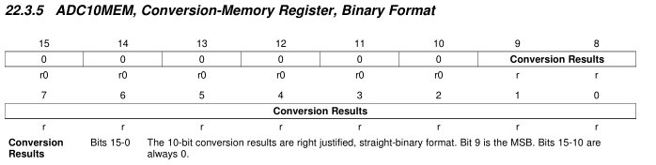
While Loop (Disable CPU for Low Power)
while (1)
{
ADC10CTL0 |= ENC + ADC10SC; // Sampling and conversion start
__bis_SR_register(CPUOFF + GIE); // LPM0, ADC10_ISR will force exit
if (ADC10MEM < 0x1FF)
P1OUT &= ~0x01; // Clear P1.0 LED off
else
P1OUT |= 0x01; // Set P1.0 LED on
}
}
// ADC10 interrupt service routine
#pragma vector=ADC10_VECTOR
__interrupt void ADC10_ISR(void)
{
__bic_SR_register_on_exit(CPUOFF); // Clear CPUOFF bit from 0(SR)
}
10b
How many bits?
What is the max value?
0x3FF
(or 1023)

Slide 19
While Loop (Read Encoded Input Memory)
while (1)
{
ADC10CTL0 |= ENC + ADC10SC; // Sampling and conversion start
__bis_SR_register(CPUOFF + GIE); // LPM0, ADC10_ISR will force exit
if (ADC10MEM < 0x1FF)
P1OUT &= ~0x01; // Clear P1.0 LED off
else
P1OUT |= 0x01; // Set P1.0 LED on
}
}
// ADC10 interrupt service routine
#pragma vector=ADC10_VECTOR
__interrupt void ADC10_ISR(void)
{
__bic_SR_register_on_exit(CPUOFF); // Clear CPUOFF bit from 0(SR)
}

Slide 20
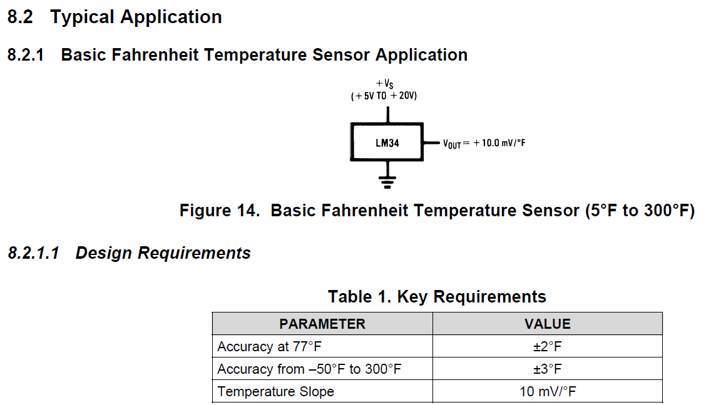
LM34 Temperature Sensor
At 77F, what voltage do I expect?
0.01*77+.5 = 1.27V

Slide 21
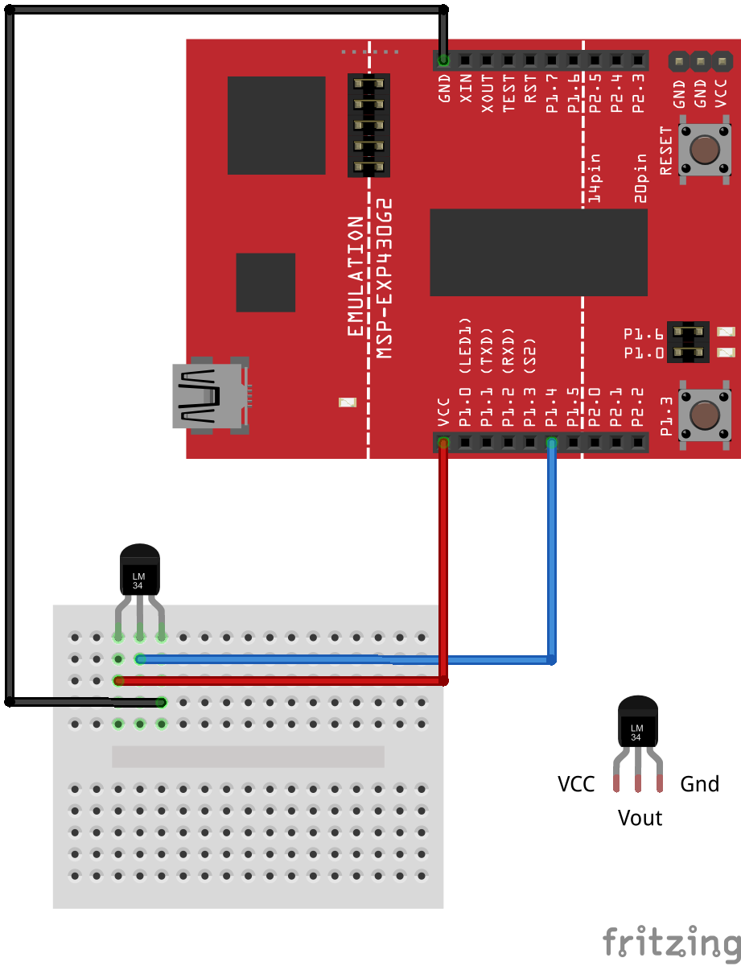
ADC Temperature Schematic

Slide 22
Changes to ADC10CTL0 Register for LM34
ADC10CTL0 |= SREF_1 | ADC10SHT_3 | ADC10ON | REFON | ADC10IE; // ADC10ON, interrupt enabled

Slide 23
ADC10CTL1 Register
ADC10CTL1 |= INCH_4 | ADC10DIV_7; // input ch A4, Div by 8

Slide 24
BACKUPS

