Slide 1

ECE382
Lesson 24+25
1

Slide 2
Overview
Lesson Outline
Interrupts

Slide 3
Interrupts
What is an interrupt?
Why is it better than polling?

Slide 4
Interrupts
What is an interrupt?
Why is an interrupt worse than polling?
Polling guarantees a set delay response to a change
Why is it better than polling?
Polling is inefficient… wastes CPU resources
Interrupts can free the processor to do more useful work
Interrupts can save power
For example: In low-power mode, processor can go to sleep, until the time wakes it up to do something, and then go back to sleep
How do interrupts work?

Slide 5
Interrupts
How do interrupts work?
Initialize interrupt
Interrupt Vector
Interrupt Service Routine (ISR) – function that runs
Interrupt Flag (clear before use)
Interrupt Enable (turn it on)
Run normal program
Interrupt Occurs !!!!
Processor saves its state
Jumps to ISR
Do ISR work
Clear Flag
Restores the state
Return to normal program

Slide 6
Interrupts
Have you used an interrupt yet?
Yes…. RESET
RESET mov.w #__STACK_END,SP ; Initialize stackpointer
StopWDT mov.w #WDTPW|WDTHOLD,&WDTCTL ; Stop watchdog timer
;
; YOUR CODE
;
;------------------------------------------------------------------
; Interrupt Vectors
;------------------------------------------------------------------
.sect ".reset" ; MSP430 RESET Vector
.short RESET
What if we didn’t define this interrupt vector?
Where are these interrupt vectors located?

Slide 7
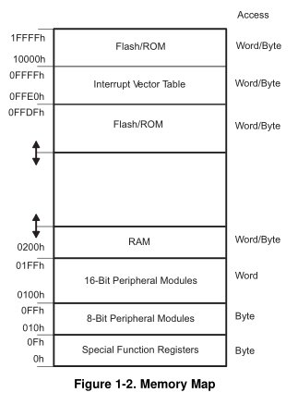
Interrupt Vector Table
Interrupts live here in memory
They are prioritized

Slide 8
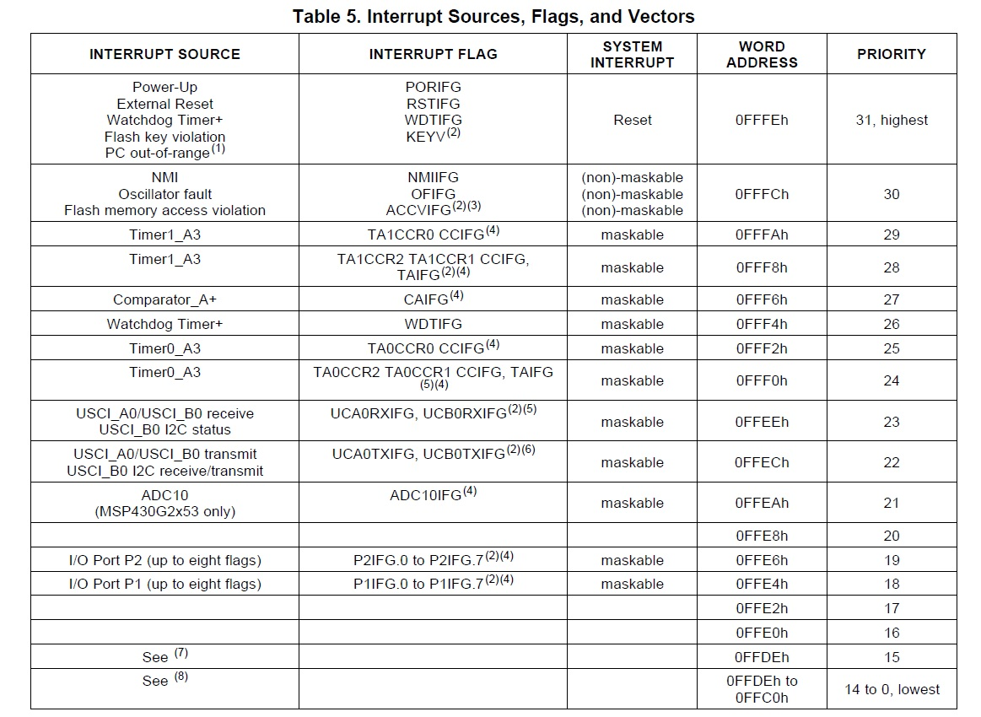
pp 11 of Device Specific
Maskable: turn on/off
Non-Maskable: always on

Slide 9
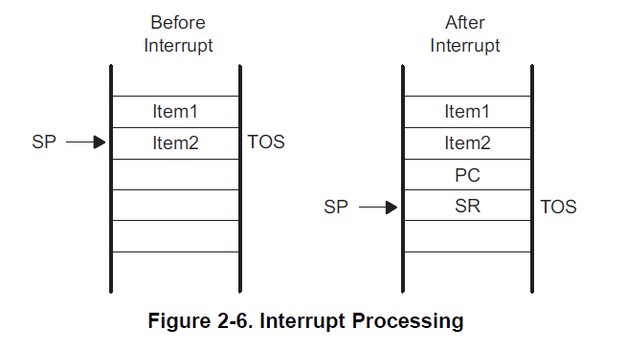
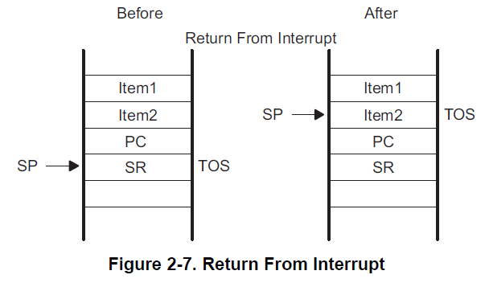
What happens on an Interrupt
On Interrupt:
Currently executing instruction is completed.
PC is pushed onto the stack.
SR is pushed onto the stack.
Selects highest priority interrupt.
If single interrupt, interrupt request flag reset.
Multiple interrupts, flag remains set.
SR is cleared - terminates low-power mode and disables maskable interrupts.
Interrupt vector content loaded into PC.
What about preserving other registers?
On ISR Completion:
Pop SR off stack - restoring previous settings.
Pop PC off stack - resume execution
at previous point.

Slide 10
Maskable vs Non-maskable Interrupts
Remember the Status Register?
GIE: General Interrupt Enable
Setting this bit Enables maskable interrupts
How to control in “C”?
__enable_interrupt()
__disable_interrupt()
15 | 14 | 13 | 12 | 11 | 10 | 9 | 8 | 7 | 6 | 5 | 4 | 3 | 2 | 1 | 0
Reserved |  |  |  |  |  |  | V | SCG1 | SCG0 | OSCOFF | CPUOFF | GIE | N | Z | C

Slide 11
Interrupt Service Routines (ISRs)
#pragma vector=XXXXX_VECTOR
__interrupt void XXXXX_ISR(void)
{
// do some stuff in response to an interrupt
}
#pragma vector=PORT1_VECTOR
__interrupt void Port_1_ISR(void)
{
P1IFG &= ~BIT3; // P1.3 IFG cleared
P1OUT ^= BIT0; // P1.0 = toggle
}
What if we didn’t clear P1IFG?
Caution: Spend as little time as possible inside an ISR! Why do you think I say this?
This name doesn’t have to match the interrupt vector name, but we generally make it similar

Slide 12
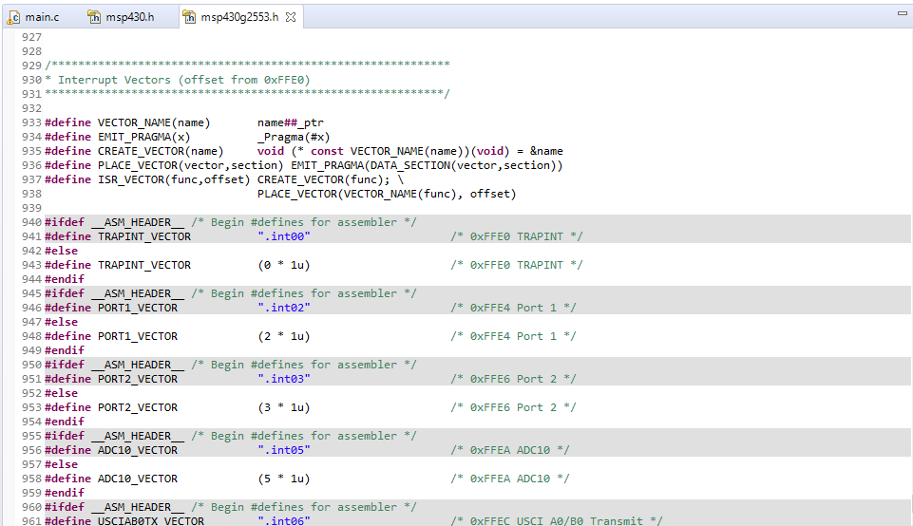
Interrupt Vector Names
Since the user guides are written in assembly, they don’t seem to show the C defines in them. The only way I know to find all of the interrupt vector names is to look at the header

Slide 13
Interrupts: Programmer's Job
Initialize
Configure subsystem
Set parameters to generate the interrupt you're interested in
Clear interrupt flag
Clear the flag for the interrupt you're interested in
Make sure an interrupt isn't generated immediately once you enable it
Turn on local switch
Set the interrupt enable bit for the interrupt you're interested in
Turn on global switch
Set the GIE bit in the SR
Write ISR
Include #pragma vector statement and subroutine itself
#pragma vector loads address into interrupt vector table
Clear interrupt flag
Accomplish task
Give interrupt opportunity to occur
It might take some time!

Slide 14
Example: P1 Interrupt
Go to pp 331 of Family Users Guide.
P1IFG
Contains flags for each pin specifying whether or not an interrupt has occurred
P1IES
Selects the edge to trigger on
0 - low-to-high transition (0 is where you start)
1 - high-to-low transition
P1IE
Enables / disables the associated interrupt
0 - disabled
1 - enabled
This should make you think of the logic analyzer and when you select the triggering mode
Lab 3

Slide 15
Example Push Button Interrupt
char interruptFlag = 0; // global variable? Bad or good?
void main(void) {
WDTCTL = WDTPW|WDTHOLD; // stop the watchdog timer
P1DIR |= BIT0|BIT6; // set LEDs to output
P1DIR &= ~BIT3; // set button to input
P1REN |= BIT3; // enable internal pull-up/pull-down network
P1OUT |= BIT3; // configure as pull-up
P1IES |= BIT3; // configure interrupt to sense falling edges
P1IFG &= ~BIT3; // clear P1.3 interrupt flag
P1IE |= BIT3; // enable the interrupt for P1.3
__enable_interrupt();
// main program loop
while (1) {}
}
#pragma vector=PORT1_VECTOR
__interrupt void Port_1_ISR(void) {
P1IFG &= ~BIT3; // clear P1.3 interrupt flag
P1OUT ^= BIT0|BIT6; // toggle LEDs
interruptFlag = 1; // you could use this tell the main() something
}

Slide 16
Multiple Push Button Interrupts
void main(void) {
WDTCTL = WDTPW|WDTHOLD;
// stop the watchdog timer
P1DIR |= BIT0|BIT6;
// set LEDs to output
P1DIR &= ~(BIT1|BIT2|BIT3);
// set buttons to input
P1IE |= BIT1|BIT2|BIT3;
// enable the interrupts
P1IES |= BIT1|BIT2|BIT3;
// config interrupt for falling edges
P1REN |= BIT1|BIT2|BIT3;
// enable pull-up/pull-down network
P1OUT |= BIT1|BIT2|BIT3;
// configure as pull-up
P1IFG &= ~(BIT1|BIT2|BIT3);
// clear flags
__enable_interrupt();
while (1) {}
}
#pragma vector=PORT1_VECTOR
__interrupt void Port_1_ISR(void) {
if (P1IFG & BIT1) // is bit 1 set?
{
P1IFG &= ~BIT1; // clear flag
P1OUT ^= BIT6; // toggle LED 2
}
if (P1IFG & BIT2)
{
P1IFG &= ~BIT2; // clear flag
P1OUT ^= BIT0; // toggle LED 1
}
if (P1IFG & BIT3)
{
P1IFG &= ~BIT3; // clear P1.3
// interrupt flag
P1OUT ^= BIT0|BIT6; // toggle LEDs
}
}

Slide 17
In Class Exercise
Create a new C project
Setup the interrupts to read a button presses
When you press the button on the Launchpad, the red LED is toggled on/off
Meanwhile, the green LED turns itself on/off about every second
You can use: __delay_cycles(cycles);
Show your instructor when you are done

Slide 18
BACKUPS

Slide 19
Lesson 25 Polling - Example Code
Main.c
#include <msp430g2553.h>
void main(void) {
WDTCTL = WDTPW | WDTHOLD; // Stop watchdog timer
BCSCTL1 = CALBC1_8MHZ; // Set SMCLK 8 MHz
DCOCTL = CALDCO_8MHZ;
P1DIR = BIT6; // Set the green LED as an output
TACCR0 = 256 - 1; // Set the interval
TA0CTL &= ~TAIFG; // Clear any rollover flag
TA0CTL |= ID_0 | TASSEL_2 | MC_1; // Important Timer stuff!
while(1) {
while ((TA0CTL & TAIFG) == 0); // Polling timer flag? Would this be good for pong game?
TA0CTL &= ~TAIFG; // Clear rollover flag
P1OUT ^= BIT6; // toggle LED
} // end infinite loop
}
Notes:
Let's examine what's going on here.
The first line of code moves r1 (the stack pointer) into r4. The compiler is using r4 as the frame pointer. When you call a function (main() in this case), all of its local variables are allocated on the stack. We call the space on the stack used by a function a stack frame. However, the stack pointer changes as you allocate more variables on the stack. So a variable that was at 4(r1) at one point in your function could later be at 8(r1) if the stack pointer changes. The frame pointer ensures a consistent address for the same variable throughout the function. If we store the address of the base of the stack frame in the frame pointer, each variable will always be stored at the same place relative to the frame pointer - so a variable at 4(r4) will always be accessible at 4(r4).
So the first line of code is setting the frame pointer. Next, the compiler adds 2 to the frame pointer. In most functions, the first thing you do is push the frame pointer onto the stack via push r4 - main is the exception. Adding two puts the base of the stack frame below this value, which is what we want.
Next, the compiler subtracts two from the stack pointer. This is because we're allocating our int variable on the stack, so we're giving it two bytes. If we allocated two ints, the compiler would subtract 4 from the stack pointer.
Our first four instructions are identical to our first sample program. We're setting up the frame pointer and allocating our variable on the stack.
Next, we're moving our variable into r15. Remember, our ABI says that the first parameter to a function should be passed in through r15 - so we move our there.
Next, we call the recursiveSummation subroutine the compiler has created.
Once inside the recursiveSummation subroutine, we push the framePointer onto the stack so we don't destroy it. Then, we establish a new frame pointer and allocate a variable on the stack - just like we did in main.
Next, the compiler moves the parameter we passed in r15 into the variable we established. It compares the variable to 1.
If it's greater than or equal to 1, we jump to .L3 - the label that holds the code in our else case. We move our parameter into r15 (the register that holds the first parameter we pass to functions), subtract one, and call our recursiveSummation subroutine again. This code is the recursiveSummation(numberToSum - 1) piece of our code. The final instruction adds the current parameter to the result passed back in r15. This code is the return numberToSum + piece of our code.
If it's less than 1, we're finished. We move 0 into r15, deallocate our variable from the stack, retrieve the frame pointer we pushed initially, and return.
If you're interested in learning more, check out this Wikipedia reading on the Call Stack.
After we're done, we'll add 2 to the stack pointer to deallocate int variable since we're done using it.

Slide 20
Lesson 25 Interrupt - Example Code
#include <msp430.h>
char flag = 0; // global variable to share info between main and ISR
void main(void)
{
WDTCTL = WDTPW|WDTHOLD; // stop the watchdog timer
P1DIR |= BIT0|BIT6; // set LEDs to output
TA0CTL &= ~(MC1|MC0); // stop timer
TA0CTL |= TACLR; // clear TAR
TA0CTL |= TASSEL_2; // configure for SMCLK - what's the frequency (roughly)?
TA0CTL |= ID_3; // divide clock by 8 - what's the frequency of interrupt?
TA0CTL &= ~TAIFG; // clear interrupt flag
TA0CTL |= MC_1; // set count mode to continuous
TA0CTL |= TAIE; // enable interrupt
__enable_interrupt(); // enable maskable interrupts
int count = 0;
while(1)
{
// do other useful stuff
// respond to interrupt if it occurred
// flag is global variable used to share information between main and the ISR
if (flag)
{
flag = 0;
P1OUT ^= BIT0;
if (count)
{
P1OUT ^= BIT6;
count = 0;
} else
count++;
}
}
}
// Flag for continuous counting is TAIFG
#pragma vector=TIMER0_A1_VECTOR
__interrupt void TIMER0_A1_ISR()
{
TA0CTL &= ~TAIFG; // clear interrupt flag
flag = 1;
}
Notes:
Let's examine what's going on here.
The first line of code moves r1 (the stack pointer) into r4. The compiler is using r4 as the frame pointer. When you call a function (main() in this case), all of its local variables are allocated on the stack. We call the space on the stack used by a function a stack frame. However, the stack pointer changes as you allocate more variables on the stack. So a variable that was at 4(r1) at one point in your function could later be at 8(r1) if the stack pointer changes. The frame pointer ensures a consistent address for the same variable throughout the function. If we store the address of the base of the stack frame in the frame pointer, each variable will always be stored at the same place relative to the frame pointer - so a variable at 4(r4) will always be accessible at 4(r4).
So the first line of code is setting the frame pointer. Next, the compiler adds 2 to the frame pointer. In most functions, the first thing you do is push the frame pointer onto the stack via push r4 - main is the exception. Adding two puts the base of the stack frame below this value, which is what we want.
Next, the compiler subtracts two from the stack pointer. This is because we're allocating our int variable on the stack, so we're giving it two bytes. If we allocated two ints, the compiler would subtract 4 from the stack pointer.
Our first four instructions are identical to our first sample program. We're setting up the frame pointer and allocating our variable on the stack.
Next, we're moving our variable into r15. Remember, our ABI says that the first parameter to a function should be passed in through r15 - so we move our there.
Next, we call the recursiveSummation subroutine the compiler has created.
Once inside the recursiveSummation subroutine, we push the framePointer onto the stack so we don't destroy it. Then, we establish a new frame pointer and allocate a variable on the stack - just like we did in main.
Next, the compiler moves the parameter we passed in r15 into the variable we established. It compares the variable to 1.
If it's greater than or equal to 1, we jump to .L3 - the label that holds the code in our else case. We move our parameter into r15 (the register that holds the first parameter we pass to functions), subtract one, and call our recursiveSummation subroutine again. This code is the recursiveSummation(numberToSum - 1) piece of our code. The final instruction adds the current parameter to the result passed back in r15. This code is the return numberToSum + piece of our code.
If it's less than 1, we're finished. We move 0 into r15, deallocate our variable from the stack, retrieve the frame pointer we pushed initially, and return.
If you're interested in learning more, check out this Wikipedia reading on the Call Stack.
After we're done, we'll add 2 to the stack pointer to deallocate int variable since we're done using it.

Slide 21
In-Class Programming Exercise
Create a project around interruptTones.c. This C program utilizes interrupts to Blink the Green LED (P1.0 using Timer A at 440Hz Modify the program to do the following:
Put a speaker or headphones on P1.6 to listen to the 440Hz 'A' Tone using the following schematic.
Implement another interrupt from a button press (P1.3) to toggle the Red LED (P1.0) and then increment through each tone in the counts array.
Use the button interrupt to increment through the counts array to be output the different tones on a speaker.
(see interruptTones.c)

Slide 22
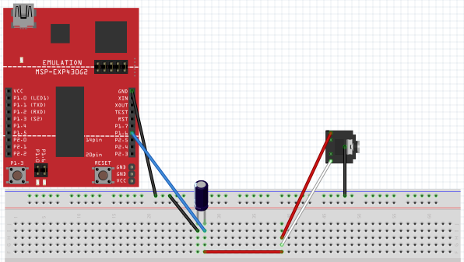
In-Class Programming Exercise
(see interruptTones.c)
Setup for the hooking up 3.5mm Audio Jack to the MSP430 Launchpad Board
without Volume Control

Slide 23
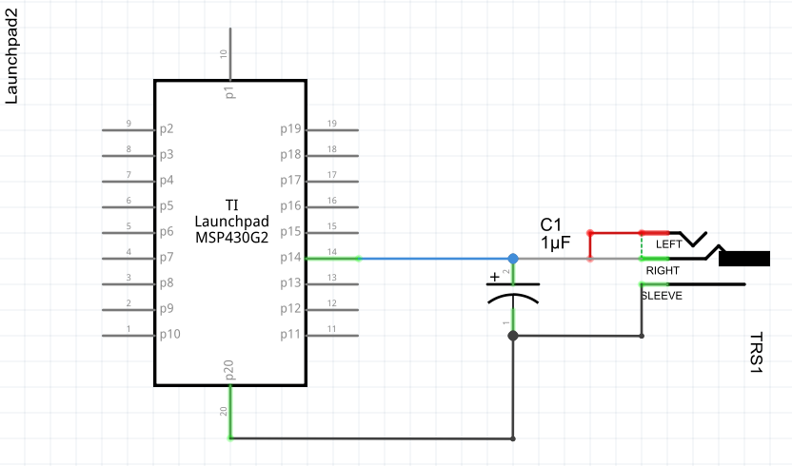
In-Class Programming Exercise
(see interruptTones.c)
Setup for the hooking up 3.5mm Audio Jack to the MSP430 Launchpad Board
without Volume Control

Slide 24
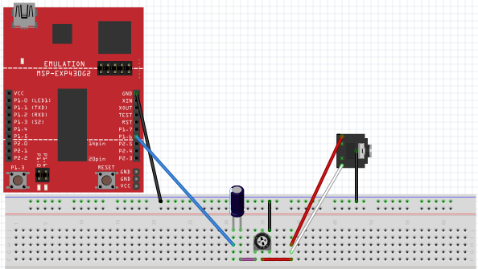
In-Class Programming Exercise
(see interruptTones.c)
Setup for the hooking up 3.5mm Audio Jack to the MSP430 Launchpad Board
with Volume Control

Slide 25
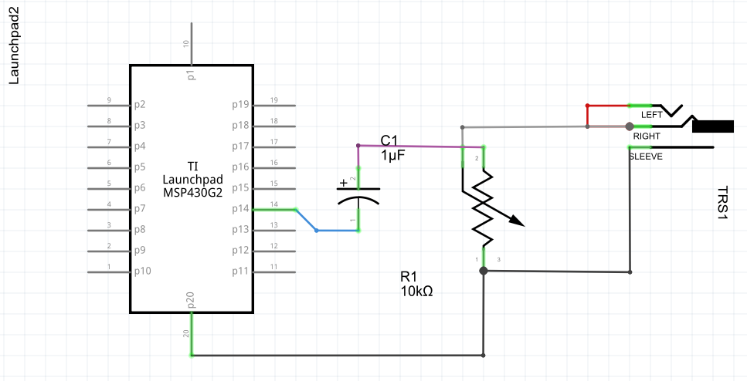
In-Class Programming Exercise
(see interruptTones.c)
Setup for the hooking up 3.5mm Audio Jack to the MSP430 Launchpad Board
with Volume Control

