Slide 1
In-Class Programming Exercise
Create a project around interruptTones.c. This C program utilizes interrupts to Blink the Green LED (P1.0 using Timer A at 440Hz Modify the program to do the following:
Put a speaker or headphones on P1.6 to listen to the 440Hz 'A' Tone using the following setup
Implement another interrupt from a button press (P1.3) to toggle the Red LED (P1.0) and then increment through each tone in the counts array
Use the button interrupt to increment through the counts array to be output the different tones on a speaker
Use a 1k potentiometer to control the speaker volume

Slide 2
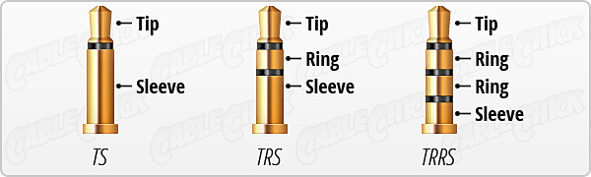
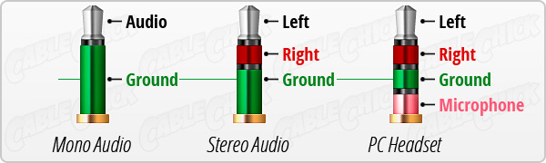
Speaker Connectors
Our connectors are TRRS:
Tip: signal
Sleeve: Gnd
Our speakers have this connection and are stereo, but we will produce a mono sound

Slide 3
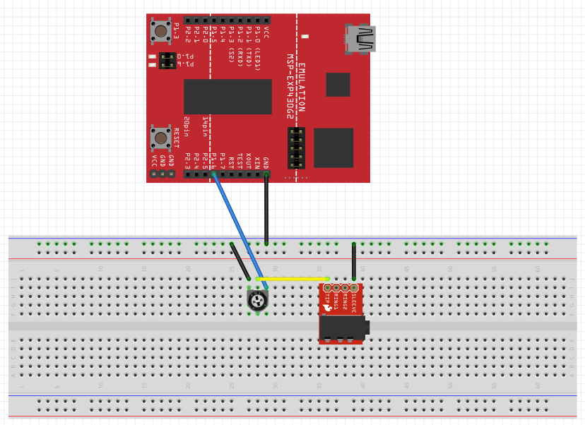
In-Class Programming Exercise
Our connectors are TRRS:
Tip: signal
Sleeve: Gnd
Potentiometer will control the volume. It is just a variable resistor:
more resistance, weaker signal

