Slide 1

ECE382
Lesson 26+27+28
1

Slide 2
Overview
Lesson Outline
Serial vs Parallel
Types of serial communication
Serial Communications
UART
SPI
I2C

Slide 3
Serial Communication
Parallel versus Serial?
Serial Advantages?
Serial Disadvantages?

Slide 4
Serial Communication
Parallel versus Serial?
Serial Advantages?
Simple interface – less hardware, less pins, less cost
Faster clock speed per wire (no “cross-talk”)
Longer Distance (no “cross-talk”)
Serial Disadvantages?
Slower
Overhead
On-chip hardware to encode/decode serial signal

Slide 5
Common Types of Serial Comm
CANBUS: common in cars
RS-485: single master, multiple slave
MIL-STD-1553: common in aircraft and spacecraft
UART: Similar to RS232, but uses TTL, one-to-one
SPI: common in embedded systems (e.g., cellphones)
I2C: common in embedded systems (e.g., cellphones)

Slide 6
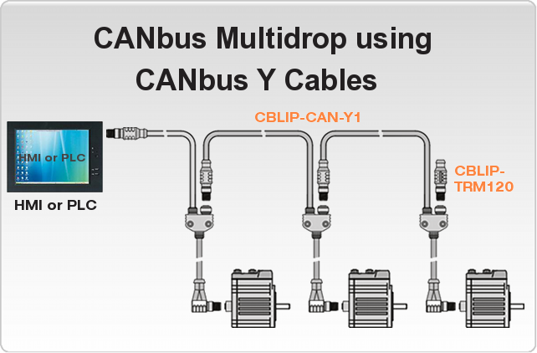
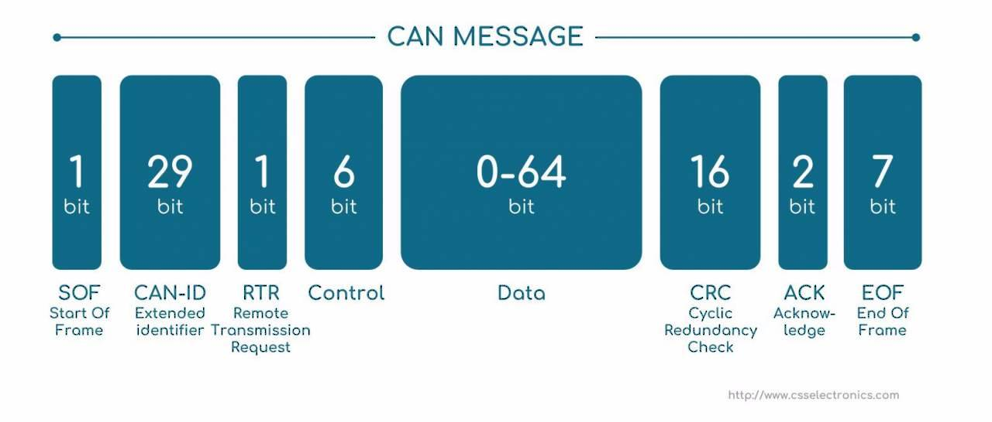
CAN Bus
A Controller Area Network (CAN bus) is a robust vehicle bus standard designed to allow microcontrollers and devices to communicate with each other in applications without a host computer. It is a message-based protocol, designed originally for multiplex electrical wiring within automobiles to save on copper, but is also used in many other contexts.
USAFA is doing research on the CAN bus and a Tesla car

Slide 7
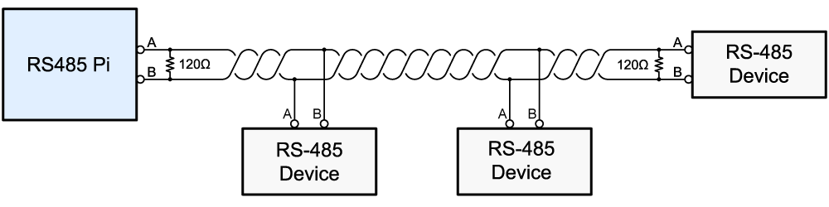
RS-485
RS-485 supports inexpensive local networks and multidrop communications links, using the same differential signaling over twisted pair
Slave
Master
Slave
Slave
This is actually diagram for how to hook up a Raspberry Pi to a 485 network

Slide 8
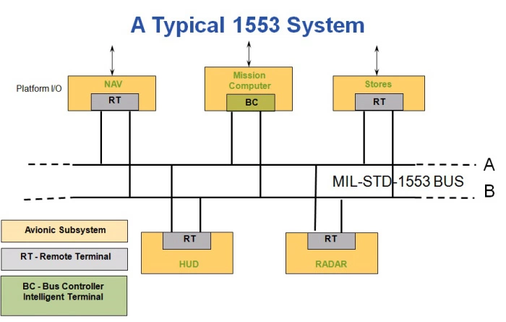
MIL-STD-1553
MIL-STD-1553 is a military standard that defines the mechanical, electrical, and functional characteristics of a serial data bus. It is used in aircraft and spacecraft on-board data handling (OBDH) subsystems. It features multiple (commonly dual) redundant balanced line physical layers, a (differential) network interface, time division multiplexing, half-duplex command/response protocol, and can handle up to 30 Remote Terminals (devices).

Slide 9
UART

Slide 10

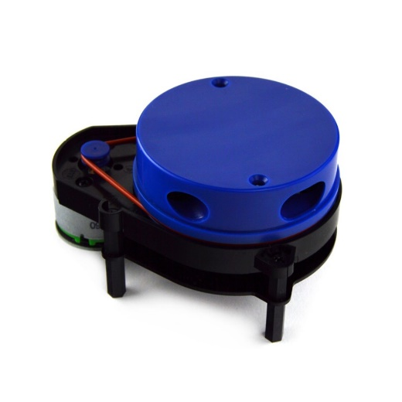
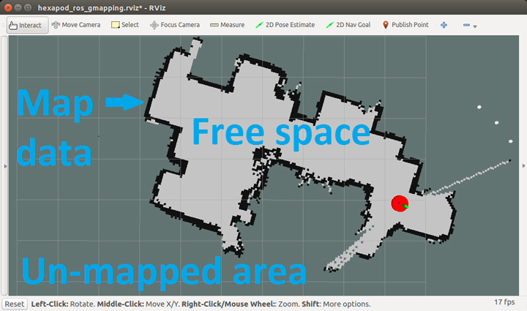
UART
The universal asynchronous receiver-transmitter (UART) takes bytes of data and transmits the individual bits in a sequential fashion
Although the protocol defines all kinds of things, I have ALWAYS used 8 bits, no parity, one stop bit (8N1)
The blue top spins 360 degs at 5 Hz and for every degree provides distances to obstacles up to 12m to map rooms
Data rate: 230400 bps

Slide 11
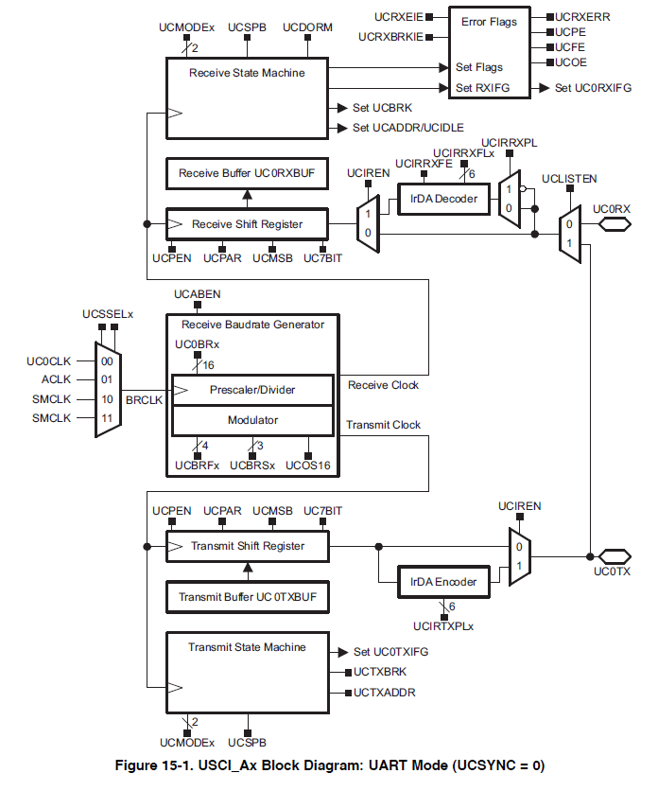
UART
It is common for serial to be tied to specific HW pins
P1.1
USCI_Ax for UART
USCI_Bx for I2C or SPI
P1.2

Slide 12
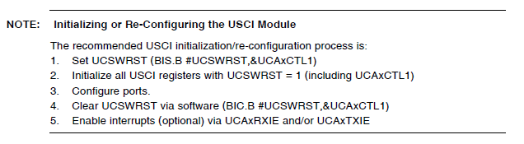
Setup
Remember to set the TX and RX pins too!

Slide 13
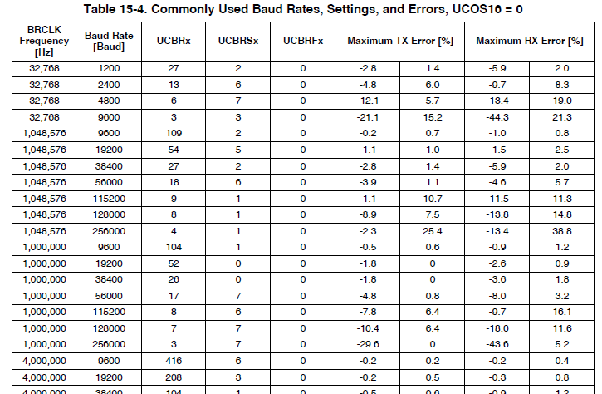
UART Datarate Settings
Common serial data rates for a 1MHz clock

Slide 14
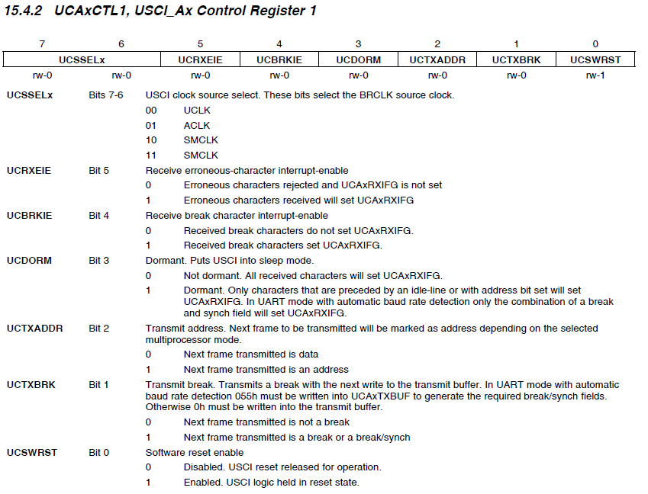

Slide 15
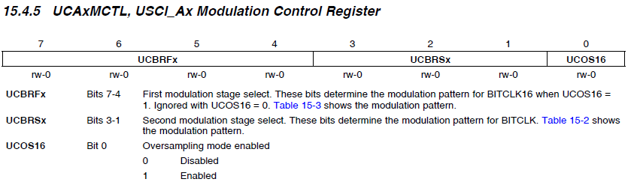
UART

Slide 17
SPI

Slide 18
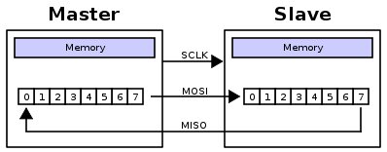
Serial Peripheral Interface (SPI)
Simple: with each clock cycle, a single bit is transferred from the MSB of one shift register to the other
Is this a half-duplex or full-duplex protocol?
Synchronous or Asynchronous protocol?
How many clocks cycles to transfer a byte?
Signals
MOSI: Master Out Slave In
MISO: Master In Slave Out
SCLK: Clock
SS: Slave Select
TI renamed these:
MOSI = SIMO
MISO = SOMI

Slide 19
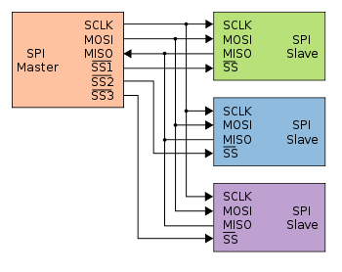

Serial Peripheral Interface (SPI)
Slave Select signal allows the master to potentially use the same interface to potentially interact with multiple slaves. It's usually active low

Slide 20
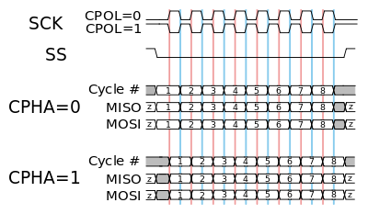
Serial Peripheral Interface (SPI)
Page 35 of LCD Driver
Can we just tie SS low?
Configurable Elements:
Clock frequency
Clock polarity
Clock phase
On the MSP430:
MSB first or LSB first
you'll pretty much always want MSB first, which isn't the default
8-bits or 7-bits per transmission
7-bits is justified toward the LSB
3-pin or 4-pin modes
Control Register: Page 445 of the Family User Guide
SPI: Page 436 of the Family User Guide

Slide 21
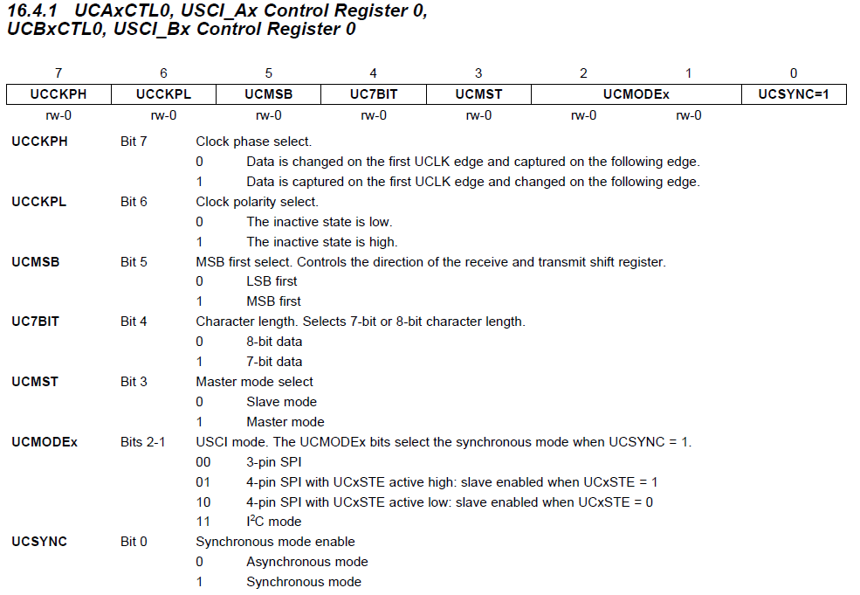
UCA/B Control Register 0
Control Register: Page 445 of the Family User Guide

Slide 22
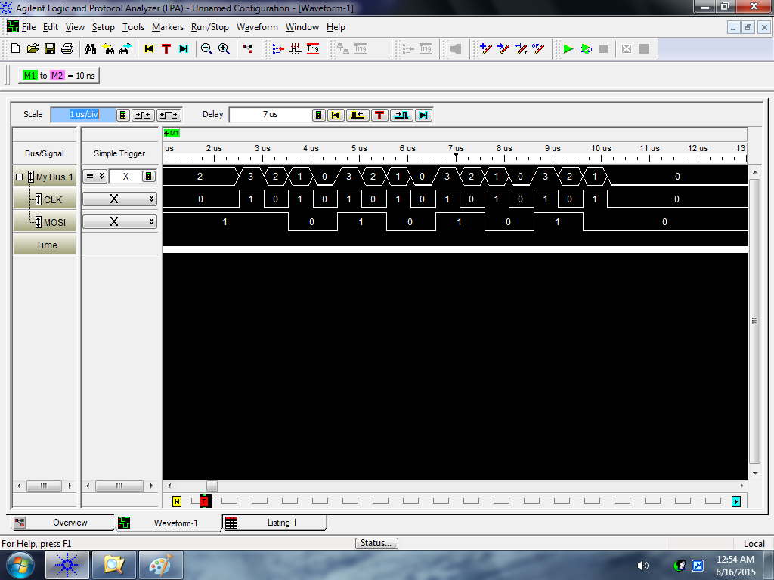
Phase = 0 and Polarity = 0
Change
Capture
Input = 0xAA
bis.b #UCMSB|UCMST|UCSYNC, &UCA0CTL0 ; UCCKPH = 0, UCCKPL = 0

Slide 23
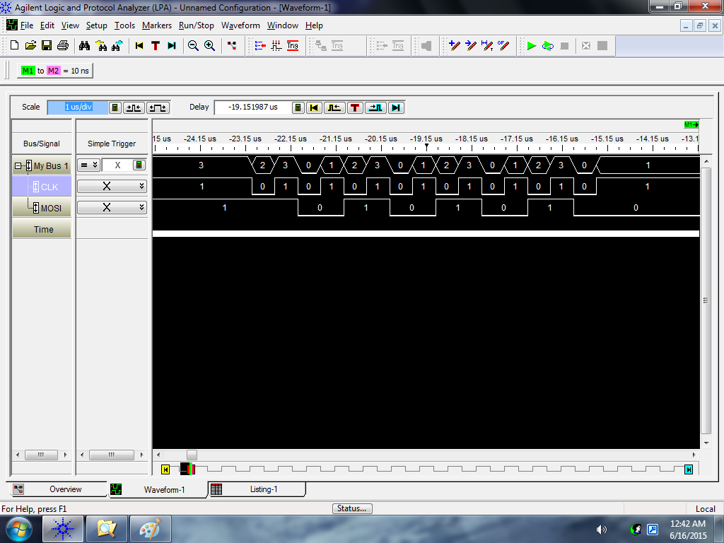
Phase = 0 and Polarity = 1
Change
Capture
Input = 0xAA
bis.b #UCCKPL|UCMSB|UCMST|UCSYNC, &UCA0CTL0 ; UCCKPH = 0, UCCKPL = 1

Slide 24

Phase = 1 and Polarity = 0
Change
Capture
Input = 0xAA
bis.b #UCCKPH|UCMSB|UCMST|UCSYNC, &UCA0CTL0 ; UCCKPH = 1, UCCKPL = 0

Slide 25
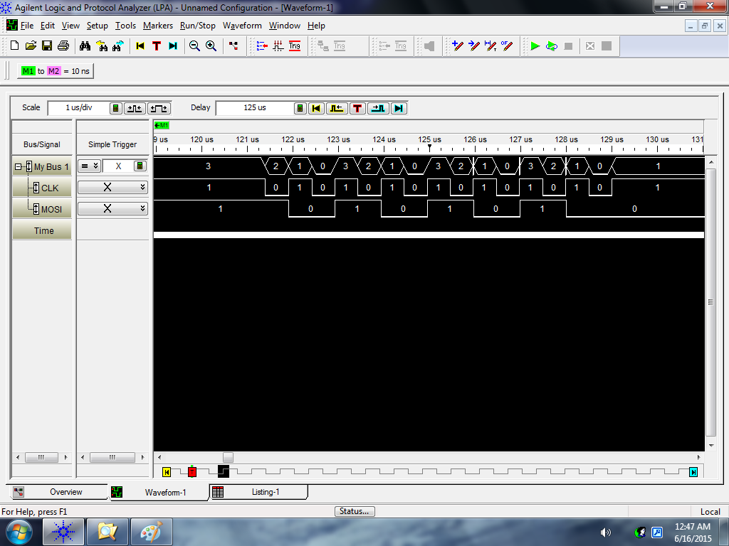
Phase = 1 and Polarity = 1
Change
Capture
Input = 0xAA
bis.b #UCCKPH|UCCKPL|UCMSB|UCMST|UCSYNC, &UCA0CTL0 ; UCCKPH = 1, UCCKPL = 1

Slide 26
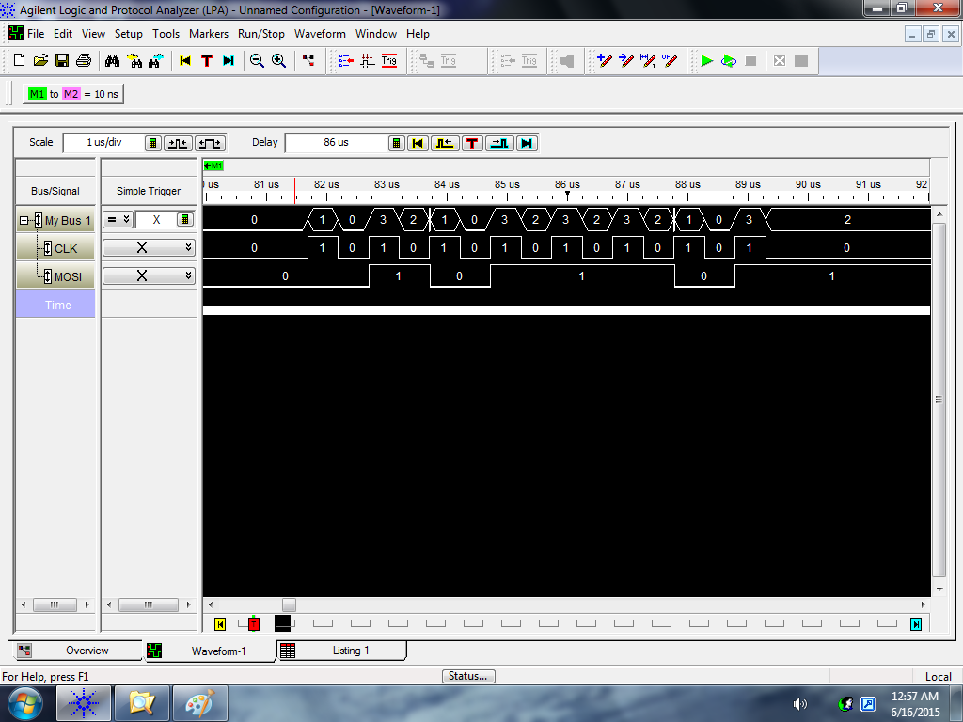
Phase = 0 and Polarity = 0
Change
Capture
Input = 0x5D
bis.b #UCMSB|UCMST|UCSYNC, &UCA0CTL0 ; UCCKPH = 0, UCCKPL = 0

Slide 27
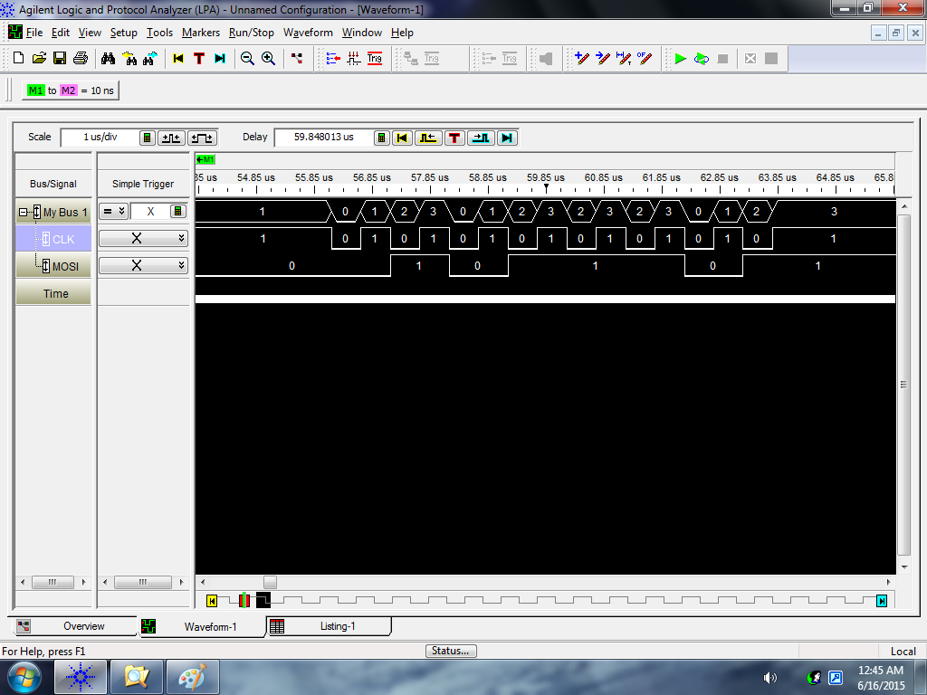
Phase = 0 and Polarity = 1
Change
Capture
Input = 0x5D
bis.b #UCCKPL|UCMSB|UCMST|UCSYNC, &UCA0CTL0 ; UCCKPH = 0, UCCKPL = 1

Slide 28
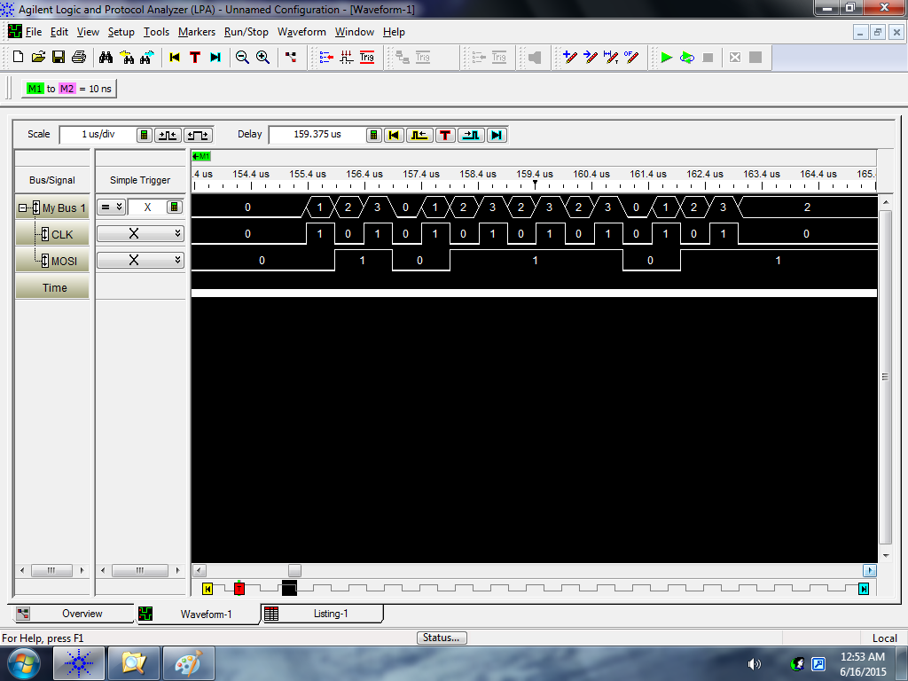
Phase = 1 and Polarity = 0
Change
Capture
Input = 0x5D
bis.b #UCCKPH|UCMSB|UCMST|UCSYNC, &UCA0CTL0 ; UCCKPH = 1, UCCKPL = 0

Slide 29

Phase = 1 and Polarity = 1
Change
Capture
Input = 0x5D
bis.b #UCCKPH|UCCKPL|UCMSB|UCMST|UCSYNC, &UCA0CTL0 ; UCCKPH = 1, UCCKPL = 1

Slide 30
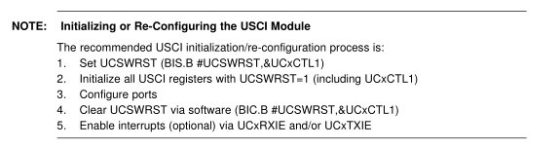
Universal Serial Communication Interface (USCI)
On the MSP430:
Two Universal Serial Communication Interfaces (USCI), A and B
Can do multiple protocols (one is SPI), defined by configuration registers
UCA0 and UCB0
datasheet - control registers (pp 435-448)
Page 436 or 452 of the Family User Guide

Slide 31
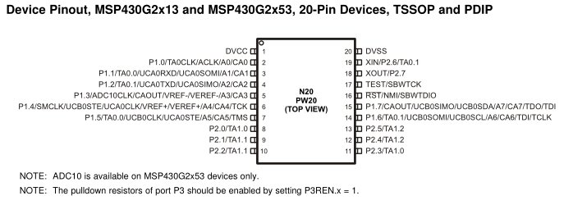
Universal Serial Communication Interface (USCI)
i.e (SW reset)
Step 1
Setting the UCSWRST bit in the CTL1 register [16.4.2] resets the subsystem into a known state until it is cleared. All the registers will hold their default values.
Step 2
Set the appropriate bits in the control registers to configure our signal the way we want.
Remember, you've got to set UCSYNC for the system to function!
CTL0 [bit 7 phase; bit 6 polarity; bit 3 master/slave; bit 0 UCSYNC = 1 ] [16.4.1]
CTL1 [bit 7&6 clock; bit 0 UCSWRST][16.4.2]
UCBRx [clock speed] [16.4.3 & 16.4.4]
STAT [16.4.5]
Step 3
All the ports on our MSP430 are multiplexed! We need to set the PxSEL and PxSEL2
Step 4
Clear the UCSWRST bit in the CTL1 register - releases the system to operate.
pp 437 for Block Diagram

Slide 32
Example SPI Setup for Lab 3
1) bis.b #UCSWRST, &UCB0CTL1
2) mov #UCCKPH|UCMSB|UCMST|UCSYNC, &UCB0CTL0
bis #UCSSEL_2, &UCB0CTL1
bis #BIT0, &UCB0BR0
clr &UCB0BR1
3) bis #LCD_SCLK_PIN|LCD_MOSI_PIN|LCD_MISO_PIN, &P1SEL
bis #LCD_SCLK_PIN|LCD_MOSI_PIN|LCD_MISO_PIN, &P1SEL2
4) bic.b #UCSWRST, &UCB0CTL1

Slide 33
Universal Serial Communication Interface (USCI)
Step 5
Use the subsystem!
To send a byte, just write to the TXBUF register. [16.4.6]
To read a received byte, read from the RXBUF register. [16.4.7]
How do you know “you’ve got mail” or last transmission is done?
You've got to monitor the flags in the IFG2 register [16.4.9] to know when it's safe the send
TXIFG
Set when TXBUF is ready for a byte
Cleared on write
Just because the TXBUF is ready for another byte doesn't mean that the transmission is complete! It's double-buffered!
RXIFG
Set when RXBUF has received a complete character
Cleared on read
This is what you should monitor to determine a transmission has completed!

Slide 34
Example (loopback)
bis.b #UCSWRST, &UCA0CTL1
bis.b #UCCKPL|UCMSB|UCMST|UCSYNC, &UCA0CTL0 ; don't forget UCSYNC!
bis.b #UCSSEL1, &UCA0CTL1 ; select a clock to use!
bis.b #UCLISTEN, &UCA0STAT ; enables internal loopback
bis.b #BIT4, &P1SEL ; make UCA0CLK available on P1.4
bis.b #BIT4, &P1SEL2
bis.b #BIT2, &P1SEL ; make UCA0SSIMO available on P1.2
bis.b #BIT2, &P1SEL2
bis.b #BIT1, &P1SEL ; make UCA0SSOMI available on P1.1
bis.b #BIT1, &P1SEL2
bic.b #UCSWRST, &UCA0CTL1 ; enable subsystem
send mov.b #0xBB, &UCA0TXBUF ; place a byte in the TX buffer
wait bit.b #UCA0RXIFG, &IFG2 ; wait for receive flag to be set (operation complete)
jz wait
mov.b &UCA0RXBUF, r4 ; read RX buffer to clear flag
jmp send ; send another byte

Slide 35
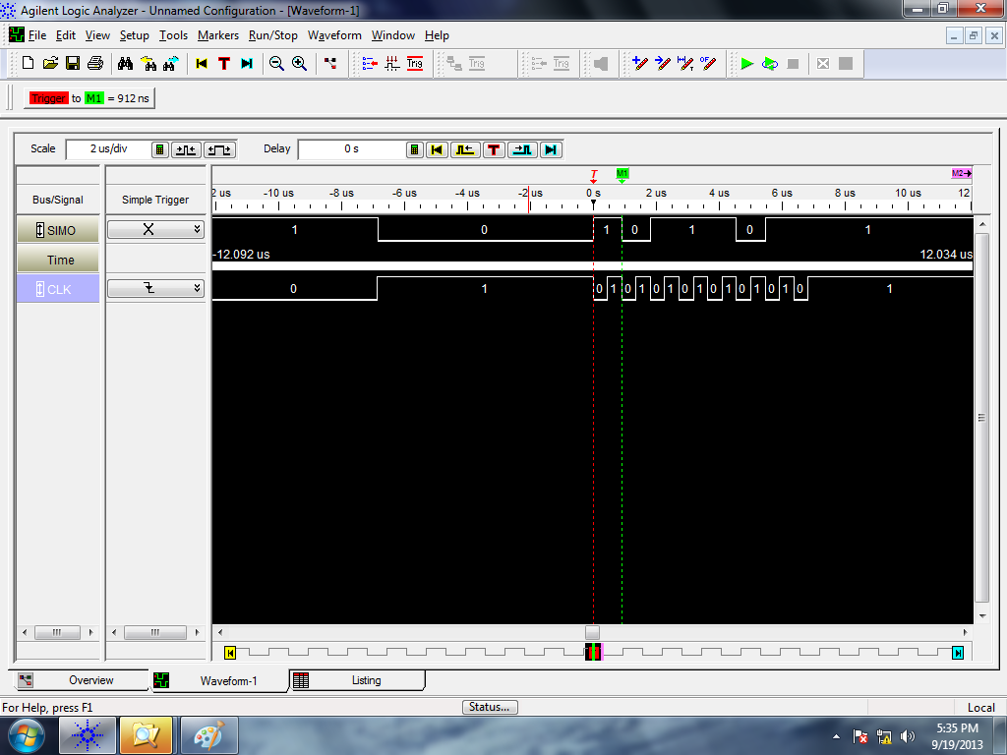
Logic Analyzer
Sending 0xBB once (0x1011 1011) [MSB first!]
Note how the clock default state is high and data is read on the second clock edge - consistent with our settings.

Slide 36
I2C

Slide 37
BACKUPS

