Slide 1

ECE382
Lesson 14+15
1

Slide 2
Overview
Lesson Outline
Polling
Debouncing
Intro to Logic Analyzer

Slide 3
Talking with HW
What is Polling?
What are Interrupts?

Slide 4
Polling vs Interrupts
Polled I/O requires CPU to ask a device if the device state has changed, say from HIGH to LOW
Consumes lots of CPU cycles
Can provide a quick response (guaranteed response delay)
Interrupts allow a CPU to do other things until the device has changed in some way
Device gets the CPUs attention
CPU doesn’t have to waist time checking if the device is ready
Interrupts can happen at any time, so the programmer has to write code to account for that
Response delay is not guarrenteed
In reality, if your CPU has a OS, you already live in an interrupt driven world, you just may not know it

Slide 5
Polling
Polling Example
bic.b #BIT3, &P1DIR
bis.b #BIT3, &P1REN
bis.b #BIT3, &P1OUT
poll_button: bit.b #BIT3, &P1IN
jnz poll_button
; Do useful stuff after button press
forever jmp forever
So basically we sit around and wait for something to happen … boring and a waist of CPU time!
When we get to interrupts, we will fix this waste of time

Slide 6
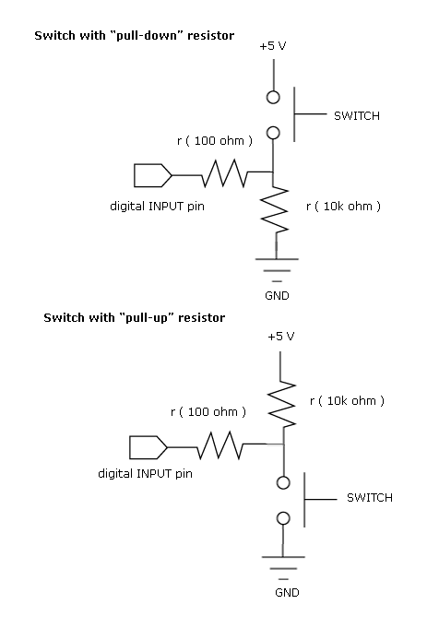
Digital Input Signals
Often …

Slide 7
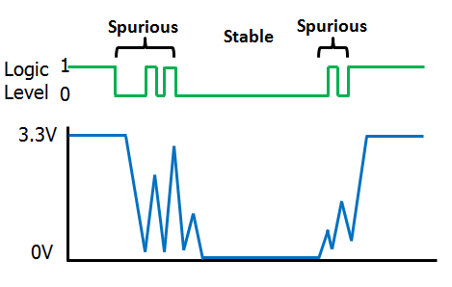
Debouncing
Most buttons, switches, relays, etc are mechanical devices and experience bouncing
As the metal switch starts to close, arcing will occur on and off between the contacts until the switch is closed
In software, we can wait (sleep) between input reads to negate the effects of this. Is this good or bad way to handle?

Slide 8
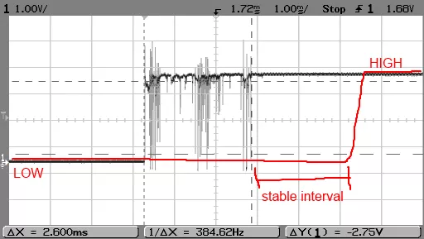
Debouncing
Notice how this looks like high frequency noise. How do we remove high frequency noise …. think ECE231 or ECE315

Slide 9
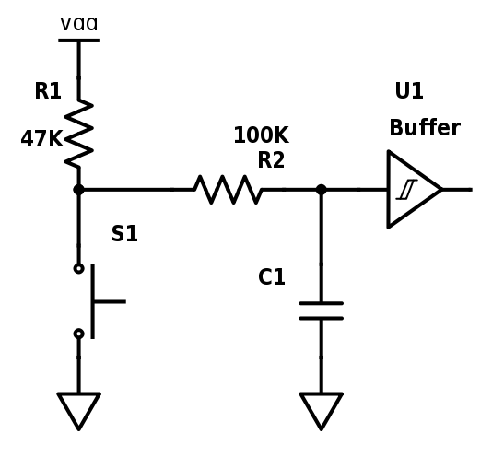
Debouncing in HW
RC Filter
(low pass)
Pull-up
uC
When the button is pressed, what value does the uC see?
Input pins generally go through buffers
ECE231 Material

Slide 10
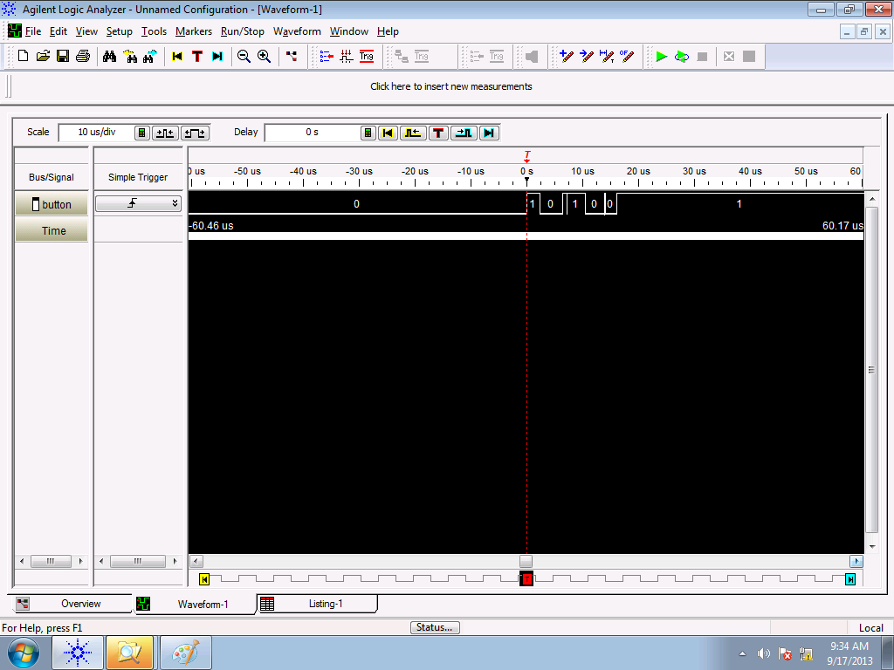
Logic Analyzer

Slide 11
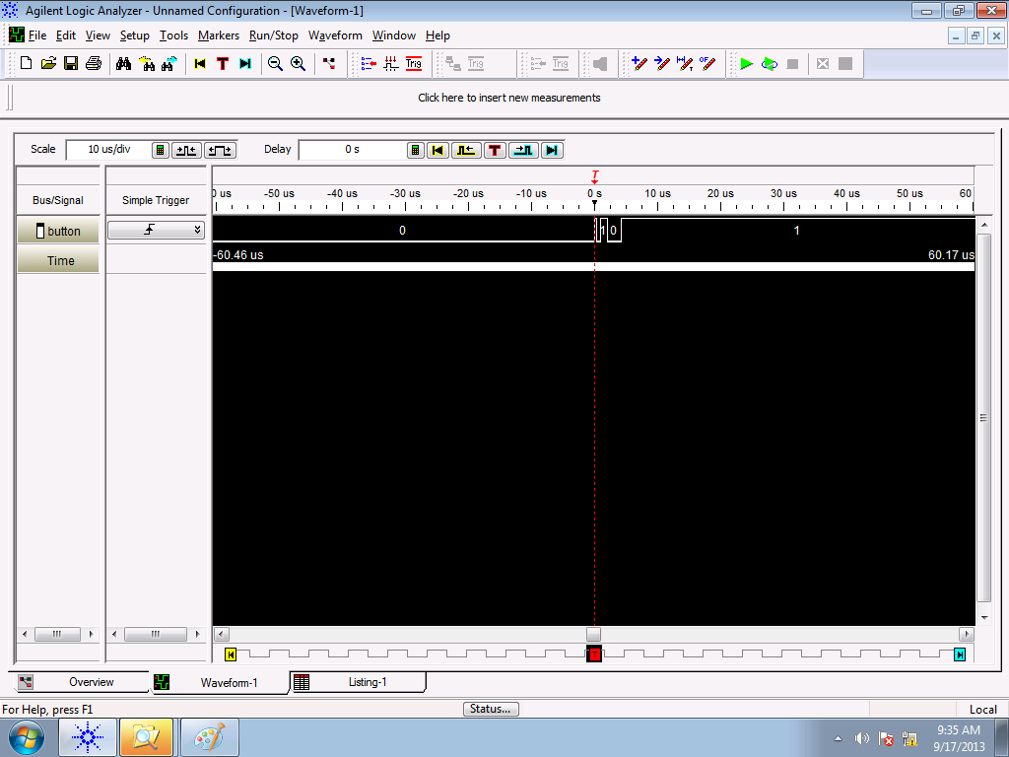
Logic Analyzer
Debouncing: random bounces each time…

Slide 12
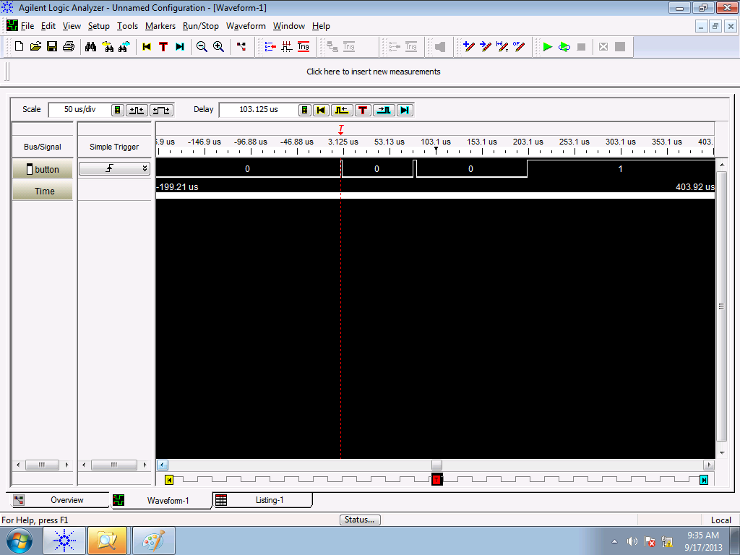

Slide 13
Debouncing and Polling
bis.b #BIT3, &P1OUT
bis.b #BIT3, &P1REN
bic.b #BIT3, &P1DIR
clr r4
check_btn: bit.b #BIT3, &P1IN
jz btn_pushed
jmp check_btn
btn_pushed: inc r4
wait: bit.b #BIT3, &P1IN
jz wait
inc r4
jmp check_btn
Polling for button press
Subroutine to handle button press
So how does bouncing effect this software?

Slide 14
Example Software Delay Routine
How long is this software delay?
call #software_delay
software_delay:
push r5
mov.w #0xaaaa, r5
delay: dec r5
jnz delay
pop r5
ret
MSP430 Family Users Guide Section 3.4.4, p 60 for cycles per instruction
Remember when we talked about timing?

Slide 15
Example Software Delay Routine
How long is this software delay?
call #software_delay ; 5 cycles
software_delay:
push r5 ; 3 cycles
mov.w #0xaaaa, r5 ; 2 cycles
delay: dec r5 ; 2 cycles?
; no 1 cycle !!!
jnz delay ; 2 cycles
pop r5 ; 2 cycles
ret ; 2 cycles?
; no 3 cycles !!!
5 + 3 + 2 + (0xaaaa * (1 + 2)) + 2 + 3 = 131085 total clock cycles
Only variable is r5… if I change r5 by “one”, how many cycles is this?
So, How long in time is this?

Slide 16
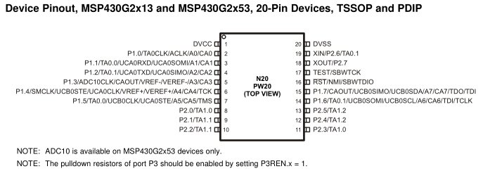
MSP430’s Digitally Controlled Oscillator
MSP430’s Clock = Digitally Controlled Oscillator (DCO)
Advantage: It is tunable. Can run at many different frequencies
Disadvantage: It is an RC oscillator, so can be inaccurate
Default: 1 MHz, with significant variance (0.8MHz - 1.5MHz)
Fix: At the factory, each chip is calibrating with a more accurate quartz crystal resonator. TI stores the proper calibrated values for DCOCTL and BCSCTL1 for 1MHz, 8MHz, 12MHz, and 16MHz in protected memory.
We can measure clock speed (SMCLK) on P1.4

Slide 17
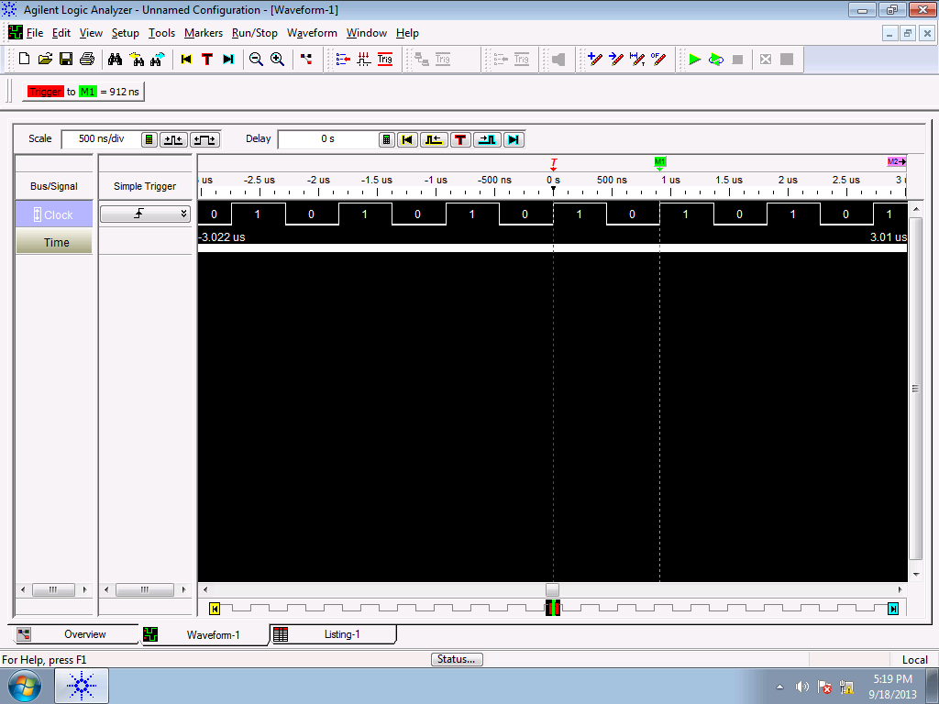
SMCLK
bis.b #BIT4, &P1DIR
bis.b #BIT4, &P1SEL
forever jmp forever
If Clock period is 912ns, how long is
131085 clock cycles?
BB Pg. 126

Slide 18
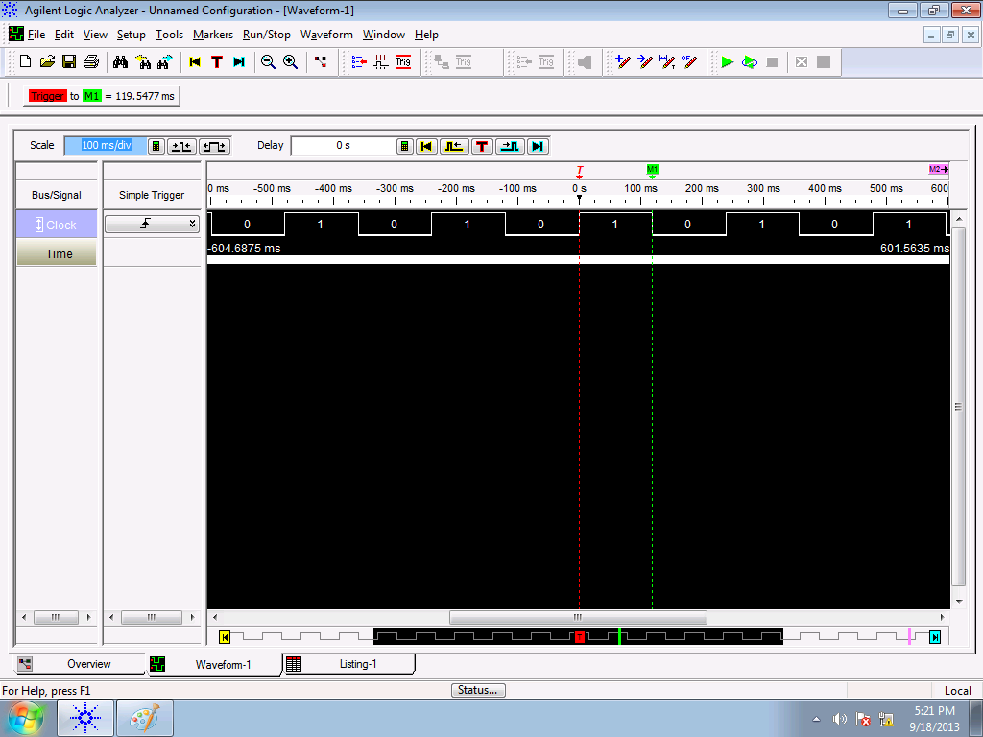
Measure SW delay routine
bis.b #BIT4, &P1DIR
bis.b #BIT4, &P1SEL
forever jmp forever
If Clock period is 912ns, how long is
131085 clock cycles?

Slide 19
Debounced code with SW delay
; Setup P1.3 for button input
bis.b #BIT3, &P1OUT
bis.b #BIT3, &P1REN
bic.b #BIT3, &P1DIR
clr R4 ; Variable to hold the number of button pushes
; Increment Btn Counter on Btn press
; A delay is used immediately after the press and release
check_btn: bit.b #BIT3, &P1IN
jnz check_btn
inc R4
call #software_delay
jmp btn_pushed
btn_pushed: bit.b #BIT3, &P1IN
jz btn_pushed
; Btn released
call #software_delay
jmp check_btn
Button is push detected
Call a delay (sleep) to wait for bouncing to settle down before reading again

Slide 20
Debounced code with SW delay
; -------------------------------------------
; Software delay
; Purpose: Delays code based on value of R5
; R5 is currently hard coded as 0xAAAA
; Destroyed: None
; Returned: None
; -------------------------------------------
software_delay:
push r5
mov.w #0xaaaa, r5
delay: dec r5
jnz delay
pop r5
ret
; End Software delay ---------------------------
For your uC, you need to determine how fast your oscillator is and set #0xaaaa to a value you want for debouncing
It might also be useful to pass in an argument for how long you want to delay instead of having it hardcoded

Slide 21
BACKUPS

Slide 22
Review: Multiplexing
Only 20 Pins !!! But want access to many more signals
Therefore, each pin shares several signals → multiplexing
Use PxSEL1 and PxSEL2 to select signal for each pin
The details are in the MSP430G2x53 2x13 Mixed Signal MCU Datasheet.
Reference:
Page 43 of Device Specific (BB pp 124)
And/Or Page 333 of Family User Guide (BB pp 41)

Slide 23
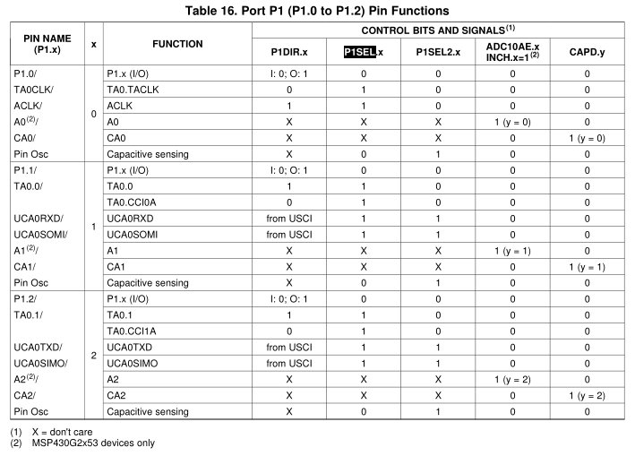
Pitfall !!!
Let's say I wanted to make the UCA0SOMI function available on P1.1:
; 'from USCI' means this bit is set automatically by the USCI when enabled
bis.b #BIT1, P1SEL
bis.b #BIT1, P1SEL2
Reference: Page 43 of Device Specific

Slide 24
Review
What are some of the important registers we talked about last time?
PxIN PxOUT PxSEL PxSEL2 PxREN PxDIR
Modify this program so the two LEDs always have the opposite value
bis.b #BIT0|BIT6, &P1DIR ; output pin direction
bic.b #BIT3, &P1DIR ; input pin direction
bis.b #BIT3, &P1REN ; enable pin 3’s resistor
bis.b #BIT3, &P1OUT ; make it a pull-up or down?

Slide 25
Review
What do these commands do?
mov.b #0b00001111, &P1DIR
bis.b #0b00001111, &P1OUT
mov.b #0xff, &P1OUT
mov.b &P1IN, r5

Slide 26
Emulated Instructions
Emulated Instruction | Assembly Instruction | Notes
NOP | MOV r3, r3 | Any register from r3 to r15 would do the same thing.
POP dst | MOV @SP+, dst
BR dst | MOV dst, PC | BR dst
RET | MOV @SP+, PC | RET
CLRC | BIC #1, SR
SETC | BIS #1, SR
CLRZ | BIC #2, SR
SETZ | BIS #2, SR
CLRN | BIC #4, SR
SETN | BIS #4, SR
DINT | BIC #8, SR
EINT | BIS #8, SR

Slide 27
More Emulated Instructions
Emulated Instruction | Assembly Instruction
RLA(.B) | ADD(.B) dst, dst
RLC(.B) | ADDC(.B) dst, dst
INV(.B) dst | XOR(.B) #-1, dst
CLR(.B) dst | MOV(.B) #0, dst
TST(.B) dst | CMP(.B) #0, dst
DEC(.B) dst | SUB(.B) #1, dst
DECD(.B) dst | SUB(.B) #2, dst
INC(.B) dst | ADD(.B) #1, dst
INCD(.B) dst | ADD(.B) #2, dst
ADC(.B) dst | ADDC(.B) #0, dst
DADC(.B) dst | DADD(.B) #0, dst
SBC(.B) dst | SUBC(.B) #0, dst
:

Slide 28
Measure Software Delay Routine
bis.b #BIT0, &P1DIR
blinkLED: bic.b #BIT0, &P1OUT
call #software_delay
bis.b #BIT0, &P1OUT
call #software_delay
jmp blinkLED
software_delay:
push r5
mov.w #0xaaaa, r5
delay: dec r5
jnz delay
pop r5
ret

