Slide 1

HQ U.S. Air Force Academy
ECE 382 Lesson7
1

Slide 2
Overview
Assembly directives
Code Composer Studio (CCS)
hello_world.asm

Slide 3
Assembly Directives
Blah …

Slide 4
Watchdog Timer

Slide 5
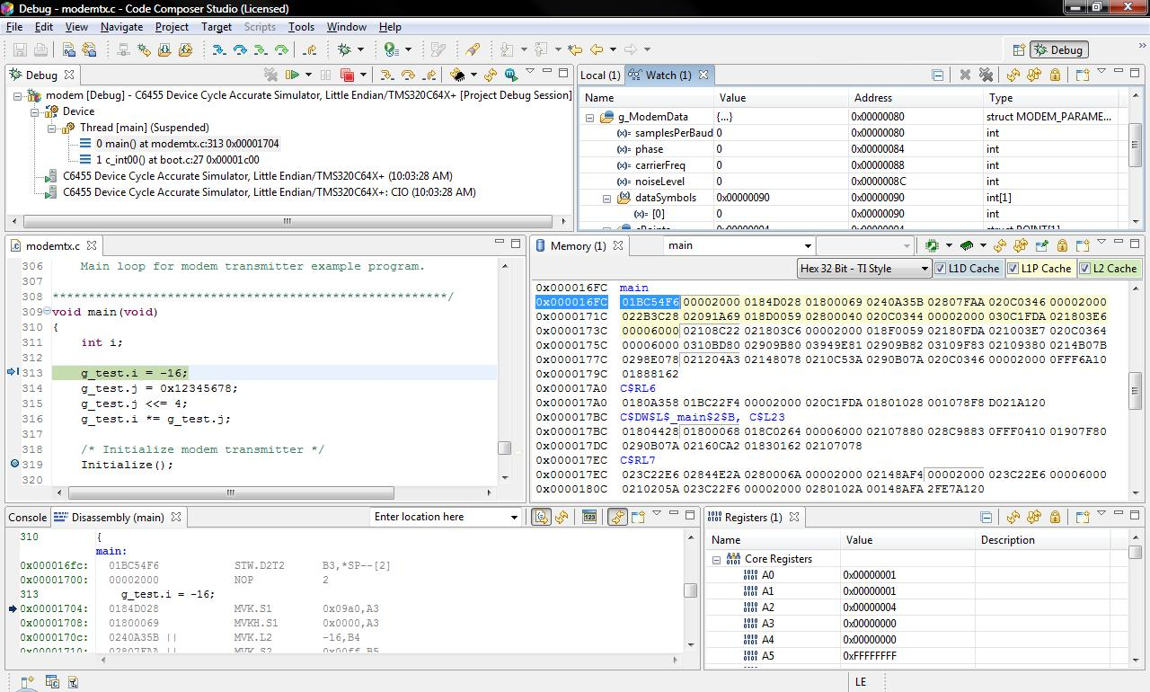
CCS
We have CCS 8 installed which will allow us to build either ASM or C program and install them onto the MSP430

Slide 6

Tools
The IDE uses the GNU Compiler Collection (gcc) to produce executable binary files for the uC
gcc v6.4 released 4 July 2017
gcc is probably the most common compiler used for embedded systems because it is free (no $$$) and open (easy to adapt to a new processor)

