Slide 1

ECE382
Lesson 22+23
1

Slide 2
Overview
Lesson Outline
Data Structures
Structures
Pointers
Arrays
Unions

Slide 3
C Language: structs
Struct: similar to an “object” from C++ or python. They allow you to group related data together and treat it as a variable
This is fine:
struct <name>
{
<type> <var1>;
<type> <var2>;
...
};
struct <name> <variable_name>;
<variable_name>.<var1> = <value>;
<variable_name>.<var2> = <value>;
Better:
typedef struct
{
<type> <var1>;
<type> <var2>;
...
} <name>;
<name> <variable_name>;
typdef struct {
uint8_t x, y;
} point_t;
typedef struct {
point_t center;
uint8_t radius;
} circle_t;
void main(void){
// create and initialize like this:
point_t myCenter = {20, 7};
circle_t myCircle = {myCenter, 5};
// dot notation to access variables:
myCenter.x = 10;
myCircle.radius = 25;
myCircle.center.x = 12;
}

Slide 4
C Language: Pointers
Examples:
int a = 10; // declaring an integer
Pointer: A pointer is a variable that holds a memory address.
An address “points” to a value in memory.
In assembly: mov 0(r5), r6 ; is r5 or r6 the pointer?
int * aPtr; // declaring a pointer to an integer
typedef struct{
uint8_t x, y;
} point_t;
aPtr = &a; // setting the value of aPtr to the address of a
*aPtr = 20; // sets a to 20 by dereferencing aPtr
point_t myPoint = {1,2}; // declaring a structure of point_t, initializing
// with constants
point_t * myPointPtr; // declaring a pointer to a point_t
myPointPtr = &myPoint; // setting the value of myPointPtr to address of
// myPoint
myPoint.x = 5; // sets myPoint.x to 5
(*myPointPtr).x = 10; // sets myPoint.x to 10 by dereferencing myPointPtr
myPointPtr->x = 20; // sets myPoint.x 10 20 by dereferencing myPointPtr
// (alternative method)

Slide 5
C Language: Pointers
Pointer: A pointer is a variable that holds a memory address.
An address “points” to a value in memory.
In assembly: mov 0(r5), r6 ; is r5 or r6 the pointer?
Examples:
int16_t x = 0x1234, y = 0x5678; //assume put at 0x200
int16_t *xPtr; // gcc typically initializes to 0 (NULL)
int16_t *yPtr;
xPtr = &x; //what is in xPtr?
y = *xPtr; //what is in y?
x = y; //what is in x?
*xPtr = 0x2019; //what is x?
xPtr = 0x0206;
*xPtr = y; //where is this stored?
Token | Context | Description
& | Assignment statement | Returns the address of the variable after this token
* | Variable declaration | Variable contains the address pointing to a variable of type var_type
* | Assignment statement | Allows you to access the contents of the variable at which the pointer is pointing
-> | Structure | Access a structure's elements through a structure pointer (instead of the "." notation). Also can use (*structure).element.
Addr | Value
0x200
0x201
0x202
0x203
0x204
0x205
0x206
0x207

Slide 6
C Language: Pointers
Examples:
uint8_t x = 0x25; // address of x is 0x1000
uint16_t y = 0x1234; // address of y is 0x1001 - 0x1002
uint8_t * xPtr = &x; // address of xPtr is 0x1003 - 0x1004
uint8_t * yPtr = &y; // address of yPtr is 0x1005 - 0x1006
Examples: // Questions are independent - reset variables
to original state
xPtr++; // xPtr = ?
x = *xPtr + 1; // x = ?
// Reset variables to original state
*xPtr = 0x12; // x = ? xPtr = ?
// Reset variables to original state
y = yPtr + *yPtr; // y = ? yPtr = ?
Addr | Value
0x1000
0x1001
0x1002
0x1003
0x1004
0x1005
0x1006
0x1007

Slide 7
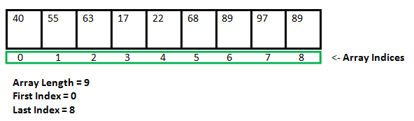
C Language: Arrays
Array: a collection of elements of the same data type stored in consecutive memory locations.
Index counting starts at 0
Max index is NUM_ELEMENTS - 1
<data_type> array_name[NUM_ELEMENTS]; // Uninitialized
<data_type> array_name[] = {val0, val1, ...}; // Initialized
array_name decays into a pointer to the first element in the array
<data_type> lets the compiler know how much to "jump" between elements in the array
Examples:
uint16_t a[9] = {40,55,63,17,22,68,89,97,89};
a is a pointer of size 16b and points the first element of the array (value 40)

Slide 8
C Language: Arrays
Examples:
uint16_t a[3]; // address of a[0] is 0x1000,
// address of a[1] is 0x1002,
// address of a[2] is 0x1004
uint16_t * myPtr; // myPtr is 0x1006
uint16_t x;
a[0] = 0x1234;
a[1] = 0x5678;
a[2] = 0x9ABC;
x = a[0];
myPtr = a; // can I do this?
x = *myPtr;
x = myPtr[1];
x = *(myPtr + 2); // tricky?
a = myPtr; // you can’t do that
Addr | Value
0x1000
0x1001
0x1002
0x1003
0x1004
0x1005
0x1006
0x1007
0x1008
0x1009

Slide 9
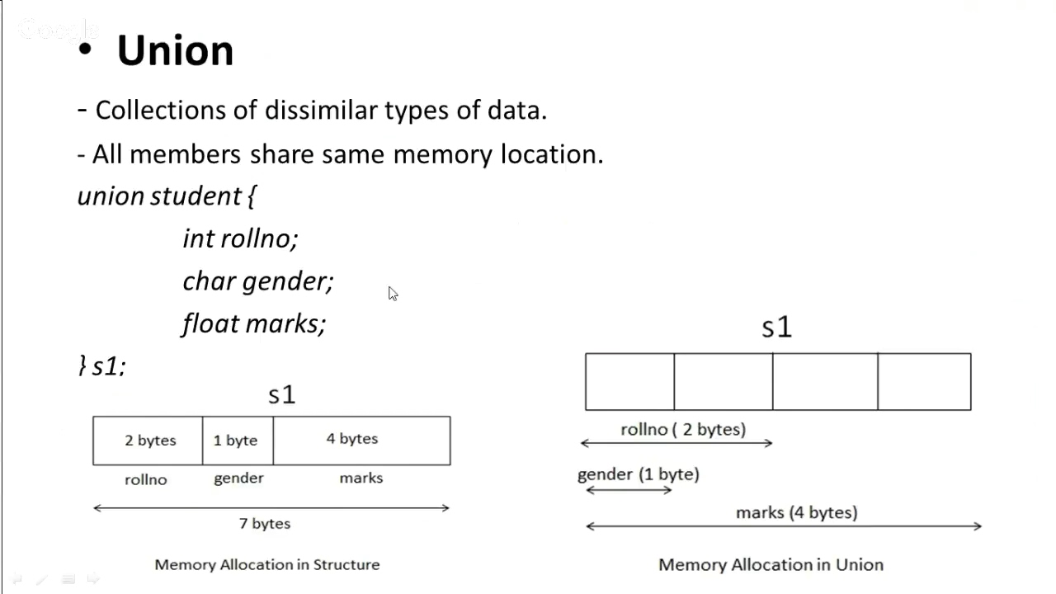
Unions

Slide 10
Union
typedef union {
uint8_t byte[2];
uint16_t word;
} ByteWord;
uint8_t h, l;
Uint16_t w;
ByteWord bob;
bob.word = 22689;
h = bob.byte[1]; // this is: 88
l = bob.byte[0]; // this is: 161
bob.word; // 22689
w = (h << 8) + l // 22689
Now you can double check this in matlab, python, whatever with: (88<<8) + 161 = 22689
Unions allow you to do cool things like byte word manipulation without having to do the underlying math
Manipulating data like this is a common use of unions in HW drivers or networking code
Unions are not as common as the previous data structures

Slide 11
C Language: Practice
uint8_t x = 0xFF; // Memory location 0x0800 = 0xFF
uint8_t y[3] = {0x23,0x56,0x89}; // starts at memory location 0x0801
uint8_t* letter_ptr = 0; // Memory locations: 0x0804 - 0x0805
letter_ptr = 0xABCD;
Question: What values would be assigned using the following statements?
// Questions are independent - reset variables to original state
x = y[2];
letter_ptr = y;
x = *(letter_ptr + 1);
letter_ptr = &x;
y[2] = *(letter_ptr + 1);
Addr | Value
0x800
0x801
0x802
0x803
0x804
0x805

Slide 12
BACKUPS

