Slide 1

ECE382
Lesson 3,4,5
1

Slide 2
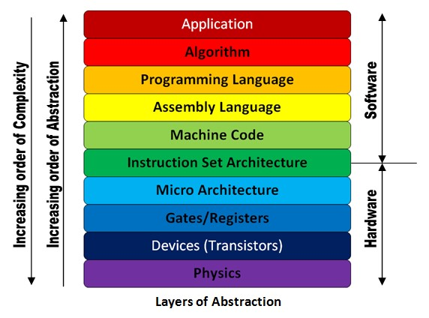
Outline
Objectives
MSP430 Instructions
Types of assembly instructions
How they work
Go from ASM -> machine code (remember ECE281??)
Assembly clock cycles
ISA
HW not due until lsn 6

Slide 3
MSP430’s ISA
Types of Instructions (16b)
Single-operand: Instr <reg>
SWPB r12
Two-operand: Instr <reg>, <reg>
add r5, r6
add src, dst
Jump: JMP <Addr>
JMP loop
Emulated Instructions
These are instructions that live within the IDE and are designed to make your life (the programmer) easier.
However, if you change IDE’s these might not be available!
These instructions are (invisible to you) made up of actual instructions listed above

Slide 4
MSP430’s ISA
Immediate Values
#10
What's the # mean?
What base is this number in?
#0x10
What base is this number in?
#0b10
What base is this number in?
Assembler does the work of base conversion for you.
The default is always assumed to be decimal

Slide 5
MSP430 Instruction Set
MSP430 Instruction Set
All instructions are 16 bits long. Their binary format looks like this:
15 | 14 | 13 | 12 | 11 | 10 | 9 | 8 | 7 | 6 | 5 | 4 | 3 | 2 | 1 | 0
0 | 0 | 0 | 1 | 0 | 0 | Opcode |  |  | W=0/ B=1 | Ad |  | Dest reg
0 | 0 | 1 | Condition |  |  | PC offset (10 bit)
Opcode |  |  |  | Source reg |  |  |  | Ad | W=0/B=1 | As |  | Dest reg
Which row corresponds to each format?
:
Double-Operand (Format I)
Single-Operand (Format II)
Jumps (Format III)

Slide 6
One Operand Instructions
Opcode | Assembly Instruction | Description
000 | RRC(.B) | 9-bit rotate right through carry. C->msbit->...->lsbit->C. Clear the carry bit beforehand to do a logical right shift.
001 | SWPB | Swap 8-bit register halves. No byte form, only word.
010 | RRA(.B) | Badly named, this is an arithmetic right shift - meaning the most significant bit is preserved.
011 | SXT | Sign extend 8 bits to 16. No byte form, only word.
100 | PUSH(.B) | Push operand on stack. Push byte decrements SP by 2. Most significant byte not overwritten.
101 | CALL | Fetch operand, push PC, then assign operand value to PC. Note the immediate form is the most commonly used. There is no easy way to perform a PC-relative call; the PC-relative addressing mode fetches a word and uses it as an absolute address. This has no byte form.
110 | RETI | Pop SR, then pop PC. Note that because flags like CPUOFF are in the stored status register, the CPU will normally return to the low-power mode it was previously in. This can be changed by adjusting the SR value stored on the stack before invoking RETI (see below). The operand field is unused.
111 | Unused
:

Slide 7
Two Operand Instructions
Opcode | Assembly Instruction | Description | Notes
0100 | MOV src, dest | dest = src | The status flags are NOT set.
0101 | ADD src, dest | dest += src
0110 | ADDC src, dest | dest += src + C
0111 | SUBC src, dest | dest += ~src + C
1000 | SUB src, dest | dest -= src | Implemented as dest += ~src + 1
1001 | CMP src, dest | dest - src | Sets status only; the destination is not written.
1010 | DADD src, dest | dest += src + C, BCD (Binary Coded Decimal)
1011 | BIT src, dest | dest & src | Sets status only; the destination is not written.
1100 | BIC src, dest | dest &= ~src | The status flags are NOT set.
1101 | BIS src, dest | dest |=src | The status flags are NOT set.
1110 | XOR src, dest | dest ^= src
1111 | AND src, dest | dest &= src
:
These unary commands (dest += src) actually means dest = src OP dest.

Slide 8
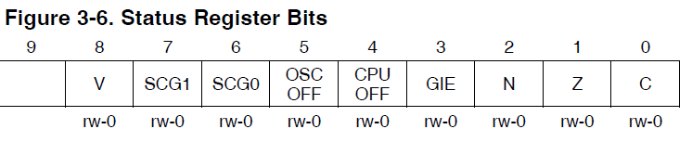
Relative Jumps
Condition Code | Assembly Instruction | Description
000 | JNE/JNZ | Jump if Z==0 (if !=)
001 | JEQ/Z | Jump if Z==1 (if ==)
010 | JNC/JLO | Jump if C==0 (if unsigned <)
011 | JC/JHS | Jump if C==1 (if unsigned >)
100 | JN | Jump if N==1 - Note there is no jump if N==0
101 | JGE | Jump if N==V (if signed >=)
110 | JL | Jump if N!=V (if signed <)
111 | JMP | Jump unconditionally
:

Slide 9
Emulated Instructions
Emulated Instruction | Assembly Instruction | Notes
NOP | MOV r3, r3
POP dst | MOV @SP+, dst
BR dst | MOV dst, PC | BR dst
RET | MOV @SP+, PC | RET
CLRC | BIC #1, SR
SETC | BIS #1, SR
CLRZ | BIC #2, SR
SETZ | BIS #2, SR
CLRN | BIC #4, SR
SETN | BIS #4, SR
DINT | BIC #8, SR
EINT | BIS #8, SR
:

Slide 10
More Emulated Instructions
Emulated Instruction | Assembly Instruction
RLA(.B) | ADD(.B) dst, dst
RLC(.B) | ADDC(.B) dst, dst
INV(.B) dst | XOR(.B) #-1, dst
CLR(.B) dst | MOV(.B) #0, dst
TST(.B) dst | CMP(.B) #0, dst
DEC(.B) dst | SUB(.B) #1, dst
DECD(.B) dst | SUB(.B) #2, dst
INC(.B) dst | ADD(.B) #1, dst
INCD(.B) dst | ADD(.B) #2, dst
ADC(.B) dst | ADDC(.B) #0, dst
DADC(.B) dst | DADD(.B) #0, dst
SBC(.B) dst | SUBC(.B) #0, dst
ECE281: remember, this is just a subtraction and sets flags
:

Slide 11
How does r8 change?
mov #0xbeef, r8 ; r8=??
swpb r8 ; r8=??
and #0x00ff, r8
mov r8, r9
inv r8
dec r8
R8 = 0xbeef
R8 = 0xbeef
R8 = 0x00be
R8 = 0x00be (no change for r8)
R8 = 0xff41
R8 = 0xff40

Slide 12
Let's write a MSP430 program
Our chip version: Msp430g2553
; This program sets all pins on Port 1 to output and high. Since LEDs 1 and 2 are connected to P1.0 and P1.6 respectively, they will light up. This program turns the LEDs on and off
.text
; turning off watchdog timer NOT shown
main:
bis.b #0xFF, &P1DIR ; set port1 direction to output
Turn_on:
bis.b #0xFF, &P1OUT ; turn on leds at port1, bis?
Turn_off:
bic.b #0xFF, &P1OUT ; turn on leds at port1, bic?
jmp Turn_on ; loop forever
← what?
Where do programs go? RAM or ROM?

Slide 13
Sample Program
c010: 7a 40 75 00 mov.b #117, r10 ;#0x0075
c014: 7a 50 c7 00 add.b #199, r10 ;#0x00c7
c018: 0a 63 adc r10
c01a: 7a e3 xor.b #-1, r10 ;r3 As==11
c01c: 3a 40 aa 00 mov #170, r10 ;#0x00aa
c020: 8a 11 sxt r10
c022: 3a e3 inv r10
c024: 8a 10 swpb r10
c026: 09 4a mov r10, r9
c028: f3 3f jmp $-24 ;abs 0xc010
1: Emulated Instruction
2: Jump Instruction
3: Double Operand Instruction
4: Single Operand Instruction
5: Double Operand Instruction with extension word
5
4
1
3
2
Over the next several slides, we will turn these 5 commands into machine code

Slide 14
MSP430 Instruction Set
MSP430 Instruction Set
All instructions are 16 bits long. Their binary format looks like this:
15 | 14 | 13 | 12 | 11 | 10 | 9 | 8 | 7 | 6 | 5 | 4 | 3 | 2 | 1 | 0
0 | 0 | 0 | 1 | 0 | 0 | Opcode |  |  | W=0/ B=1 | As |  | Dest reg
0 | 0 | 1 | Condition |  |  | PC offset (10 bit)
Opcode |  |  |  | Source reg |  |  |  | Ad | W=0/B=1 | As |  | Dest reg
Opcode: instruction
Ad: destination addressing mode
As: source addressing mode
PC: program counter
Double-Operand (Format I)
Single-Operand (Format II)
Jumps (Format III)
:

Slide 15
Basic addressing modes
As/Ad | Addressing Mode | Description | Example
00/0 | Rn | Register direct | mov r8, r9
01/1 | offset(Rn) | Register Indexed | mov 2(r8), r9
10/- | @Rn | Register indirect | mov @r8, r9
11/- | @Rn+ | Register indirect with post-increment | mov @r8+, r9
memory
registers
203 | 56
202 | 78
201 | 12
200 | 34
r8 | 0200
r9 | 0000

Slide 16
Basic addressing modes
As/Ad | Addressing Mode | Description | Example
00/0 | Rn | Register direct | mov r8, r9
01/1 | offset(Rn) | Register Indexed | mov 2(r8), r9
10/- | @Rn | Register indirect | mov @r8, r9
11/- | @Rn+ | Register indirect with post-increment | mov @r8+, r9
memory
registers
203 | 56
202 | 78
201 | 12
200 | 34
r8 | 0200
r9 | 0200

Slide 17
Basic addressing modes
As/Ad | Addressing Mode | Description | Example
00/0 | Rn | Register direct | mov r8, r9
01/1 | offset(Rn) | Register Indexed | mov 2(r8), r9
10/- | @Rn | Register indirect | mov @r8, r9
11/- | @Rn+ | Register indirect with post-increment | mov @r8+, r9
memory
registers
203 | 56
202 | 78
201 | 12
200 | 34
r8 | 0200
r9 | 0000

Slide 18
Basic addressing modes
As/Ad | Addressing Mode | Description | Example
00/0 | Rn | Register direct | mov r8, r9
01/1 | offset(Rn) | Register Indexed | mov 2(r8), r9
10/- | @Rn | Register indirect | mov @r8, r9
11/- | @Rn+ | Register indirect with post-increment | mov @r8+, r9
memory
registers
0200
+ 2
0202
203 | 56
202 | 78
201 | 12
200 | 34
r8 | 0200
r9 | 5678
How about: mov.w 2(r6), 6(r5) ???

Slide 19
Basic addressing modes
As/Ad | Addressing Mode | Description | Example
00/0 | Rn | Register direct | mov r8, r9
01/1 | offset(Rn) | Register indexed | mov 2(r8), r9
10/- | @Rn | Register indirect | mov @r8, r9
11/- | @Rn+ | Register indirect with post-increment | mov @r8+, r9
memory
registers
203 | 56
202 | 78
201 | 12
200 | 34
r8 | 0200
r9 | 0000

Slide 20
Basic addressing modes
As/Ad | Addressing Mode | Description | Example
00/0 | Rn | Register direct | mov r8, r9
01/1 | offset(Rn) | Register Indexed | mov 2(r8), r9
10/- | @Rn | Register indirect | mov @r8, r9
11/- | @Rn+ | Register indirect with post-increment | mov @r8+, r9
memory
registers
203 | 56
202 | 78
201 | 12
200 | 34
r8 | 0200
r9 | 1234
Like a pointer
Is this the same as: mov 0(r8), r9 ???

Slide 21
Basic addressing modes
As/Ad | Addressing Mode | Description | Example
00/0 | Rn | Register direct | mov r8, r9
01/1 | offset(Rn) | Register Indexed | mov 2(r8), r9
10/- | @Rn | Register indirect | mov @r8, r9
11/- | @Rn+ | Register indirect with post-increment | mov @r8+, r9
memory
registers
203 | 56
202 | 78
201 | 12
200 | 34
r8 | 0200
r9 | 0000

Slide 22
Basic addressing modes
As/Ad | Addressing Mode | Description | Example
00/0 | Rn | Register direct | mov r8, r9
01/1 | offset(Rn) | Register Indexed | mov 2(r8), r9
10/- | @Rn | Register indirect | mov @r8, r9
11/- | @Rn+ | Register indirect with post-increment | mov @r8+, r9
memory
registers
203 | 56
202 | 78
201 | 12
200 | 34
r8 | 0202
r9 | 1234
Now, what if we called mov @r8+, r9 again, what happens?

Slide 23
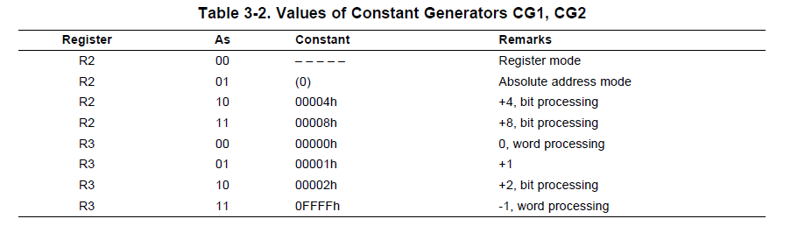
Values of Constant Generators CG1(SR), CG2
TI has optimized some commonly used immediate numbers
Now uses a register (see below) instead of adding an extension word to the command
SR
CG2
Family User Guide 3.2.4 pp46

Slide 24
Absolute and Symbolic Addressing
Absolute:
&addr
Uses the SR register
Typically use with Ports or other HW you are directly accessing
Ex: &P1OUT
Symbolic
PC relative for labels and jump commands
TI actually does indexed addressing
Ex: mov LoopCtr, r6

Slide 25
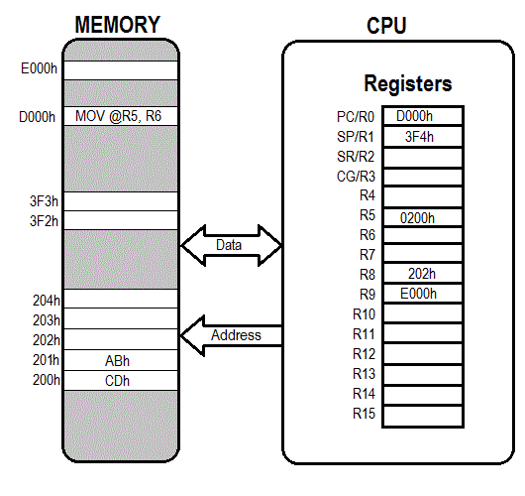
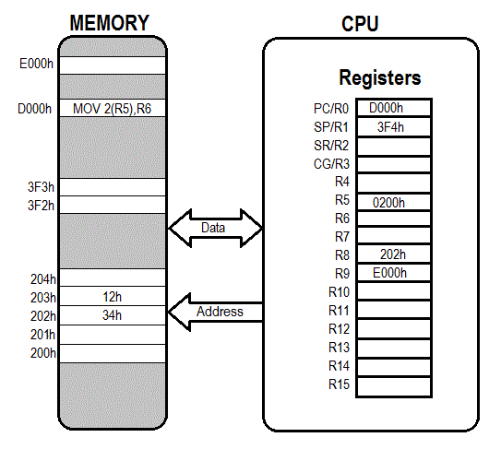

Addressing Modes
Given this instruction, how does the memory and CPU change?
Now, go ahead and take a couple minutes and fill out the tables on your sheet of paper. I will call some people to answer them

Slide 26
MSP430 Instruction Set
MSP430 Instruction Set
All instructions are 16 bits long. Their binary format looks like this:
15 | 14 | 13 | 12 | 11 | 10 | 9 | 8 | 7 | 6 | 5 | 4 | 3 | 2 | 1 | 0
0 | 0 | 0 | 1 | 0 | 0 | Opcode |  |  | W=0/ B=1 | As |  | Dest reg
0 | 0 | 1 | Condition |  |  | PC offset (10 bit)
Opcode |  |  |  | Source reg |  |  |  | Ad | W=0/B=1 | As |  | Dest reg
Double-Operand (Format I)
Single-Operand (Format II)
Jumps (Format III)
:
Let’s talk about how to assemble this instructions
ASM -> machine code

Slide 27
Sample Program
c010: 7a 40 75 00 mov.b #117, r10 ;#0x0075
c014: 7a 50 c7 00 add.b #199, r10 ;#0x00c7
c018: 0a 63 adc r10
c01a: 7a e3 xor.b #-1, r10 ;r3 As==11
c01c: 3a 40 aa 00 mov #170, r10 ;#0x00aa
c020: 8a 11 sxt r10
c022: 3a e3 inv r10
c024: 8a 10 swpb r10
c026: 09 4a mov r10, r9
c028: f3 3f jmp $-24 ;abs 0xc010
1: Emulated Instruction
2: Jump Instruction
3: Double Operand Instruction
4: Single Operand Instruction
5: Double Operand Instruction with extension word
5
4
1
3
2
Let’s finally do this!

Slide 28
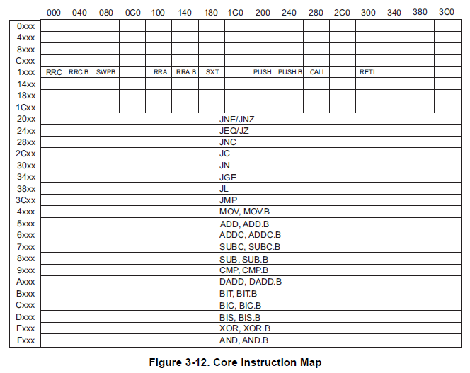
Core Instruction Map
The beginning of every 16b instruction tells us what it is
Honestly I find this table can be a little confusing
Figure 3-12
Family User Guide 3.4.5 pp62

Slide 29
Single-Operand Instruction
SXT r10
All instructions are 16 bits long. Their binary format looks like this:
Let’s assemble this instruction (SXT r10) into binary machine code
Remember doing this in ECE281 … it’s back!!!!
15 | 14 | 13 | 12 | 11 | 10 | 9 | 8 | 7 | 6 | 5 | 4 | 3 | 2 | 1 | 0
0 | 0 | 0 | 1 | 0 | 0 | Opcode |  |  | W=0/ B=1 | Ad |  | Dest reg
:

Slide 30
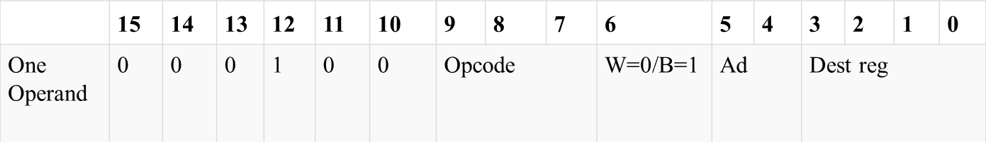
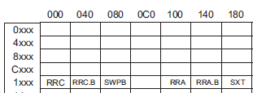
Single-Operand Instruction: Register
no .b
register mode
SXT r10
All instructions are 16 bits long. Their binary format looks like this:
As
0 0 0 1 0 0 0 1 1 0 0 0 1 0 1 0
_ _ _ _ _ _ _ _ _ _ _ _ _ _ _ _
:
1 1 8 A
Figure 3-12
Family User Guide 3.4.5 pp62

Slide 31
Relative Jumps
Condition Code | Assembly Instruction | Description
000 | JNE/JNZ | Jump if Z==0 (if !=)
001 | JEQ/Z | Jump if Z==1 (if ==)
010 | JNC/JLO | Jump if C==0 (if unsigned <)
011 | JC/JHS | Jump if C==1 (if unsigned >)
100 | JN | Jump if N==1 - Note there is no jump if N==0
101 | JGE | Jump if N==V (if signed >=)
110 | JL | Jump if N!=V (if signed <)
111 | JMP | Jump unconditionally
:
How many bits do we have for offset in a jump?
What is the range of signed numbers?

Slide 32
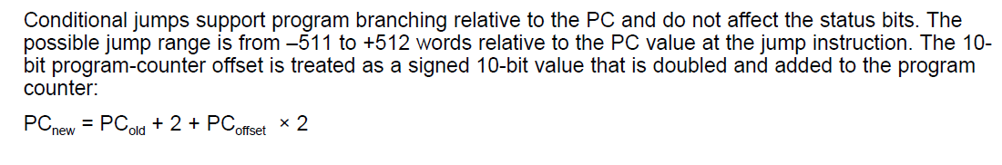
Relative Jump Instruction
JMP $-024
All instructions are 16 bits long. Their binary format looks like this:
15 | 14 | 13 | 12 | 11 | 10 | 9 | 8 | 7 | 6 | 5 | 4 | 3 | 2 | 1 | 0
0 | 0 | 1 | Condition |  |  | PC offset (10 bit)
10b: 13=0000001101
2’s comp: 1111110010
+ 1
1111110011
Figure 3-12
Family User Guide 3.4.5 pp62
:
_ _ _ _ _ _ _ _ _ _ _ _ _ _ _ _
0011 11/11 1 1 1 1 0 0 1 1
C/3 =F F 3
-24 = 2+PC*2
PC = (-24-2)/2 = -13
Family User Guide 3.4.5 pp59

Slide 33
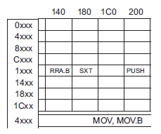
Two Operand Instruction: Register
no .b
register mode
MOV r10, r9
All instructions are 16 bits long. Their binary format looks like this:
 | 15 | 14 | 13 | 12 | 11 | 10 | 9 | 8 | 7 | 6 | 5 | 4 | 3 | 2 | 1 | 0
Two Operand | Opcode |  |  |  | Source reg |  |  |  | Ad | W=0/B=1 | As |  | Dest reg
register mode
:
0 1 0 0 1 0 1 0 0 0 0 0 1 0 0 1
_ _ _ _ _ _ _ _ _ _ _ _ _ _ _ _
4 A 0 9

Slide 34
Two-Operand Instruction: Immediate
yes .b
Register mode → 0
Immediate: As →11
add.b #0xC7, r10
15 | 14 | 13 | 12 |  | 11 | 10 | 9 | 8 | 7 | 6 | 5 | 4 | 3 | 2 | 1 | 0
Opcode |  |  |  |  | Source reg |  |  |  | Ad | W=0/B=1 | As |  | Dest reg
Source or Destination 15:0
Destination 15:0
????
***Immediate mode so Source is the PC (i.e. 0000)
An extension word follows this word and it contains the immediate value of 0xC7
:
Figure 3-12
Family User Guide 3.4.5 pp62
0 1 0 1 0 0 0 0 0 1 1 1 1 0 1 0
_ _ _ _ _ _ _ _ _ _ _ _ _ _ _ _
5 0 7 A
Notes:
The source and destination of an instruction are defined by the following fields:
src The source operand defined by As and S-reg
dst The destination operand defined by Ad and D-reg
As The addressing bits responsible for the addressing mode used for the source (src)
S-reg The working register used for the source (src)
Ad The addressing bits responsible for the addressing mode used for the destination (dst)
D-reg The working register used for the destination (dst)
B/W Byte or word operation:
0: word operation
1: byte operation

Slide 35
Two Operand Instruction: Indexed
no .b
indexed register mode
mov.w 2(r6), 6(r5)
 | 15 | 14 | 13 | 12 | 11 | 10 | 9 | 8 | 7 | 6 | 5 | 4 | 3 | 2 | 1 | 0
Two Operand | Opcode |  |  |  | Source reg |  |  |  | Ad | W=0/B=1 | As |  | Dest reg
Source or Destination 15:0
Destination 15:0
indexed register mode
An extension words follows this word for both the 2 and the 6
Figure 3-12
Family User Guide 3.4.5 pp62
0 1 0 0 0 1 1 0 1 0 0 1 0 1 0 1
_ _ _ _ _ _ _ _ _ _ _ _ _ _ _ _
4 6 9 5

Slide 36
What is going on here???
mov.w #0x200, r6
mov.w #0xbeef, 2(r6) ;places 0xbeef at address 0x0202
mov.w r6, r5
mov.w 2(r6), 6(r5)
Remember, this is little endian. So 00 02 is actually 0x0200 … right?
Instructions
Disassembled:
c01c: 36 40 00 02 mov #512, r6 ;#0x0200, immediate number after instr
c020: b6 40 ef be mov #-16657,2(r6) ;#0xbeef, 0x0002(r6)
c024: 02 00
c026: 05 46 mov r6, r5
c028: 95 46 02 00 mov 2(r6), 6(r5) ;0x0002(r6), 0x0006(r5)
c02c: 06 00
Extension Words: tell the relative offset of Indexed Addr Mode, always 16b numbers

Slide 37
Operands
So as we have just seen, addressing modes and numbers effect memory size
Register direct: none
Register indexed: add 1 16b number per use
Register indirect: none
Register indirect w/post incr: what do you think, why?
Immediate Numbers: add 1 16b number per use
As/Ad | Addressing Mode | Description | Example
00/0 | Rn | Register direct | mov r8, r9
01/1 | offset(Rn) | Register Indexed | mov 2(r8), r9
10/- | @Rn | Register indirect | mov @r8, r9
11/- | @Rn+ | Register indirect with post-increment | mov @r8+, r9

Slide 38
Try These
Turn the following into machines code
For each of these, break the instruction up into the 4B/16b like we did with the previous instructions
RRC r6
MOV r11, r10
SWPB r10
Sub #100, 2(r7) ; 100 dec = 0x64
MOV @r7, r8
Xor &100, 8(r9)
You must understand the process to get the right answer on a quiz or test. Practice is the best answer and you can always double check your answer with Code Composer Studio (CCS)

Slide 39

Assembly Clock Cycles
How long do instructions take to execute?
Tables 3-14, 3-15, 3-16 and para 3.4.4.3
Table 4-7 for emulated instructions
What is an emulated instruction?

Slide 40
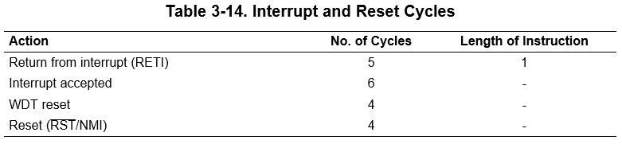
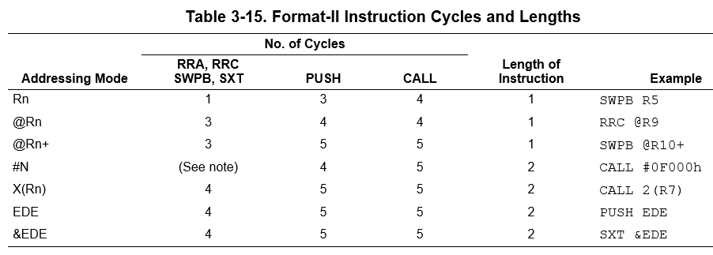
Assembly Clock Cycles
Single Operand

Slide 41
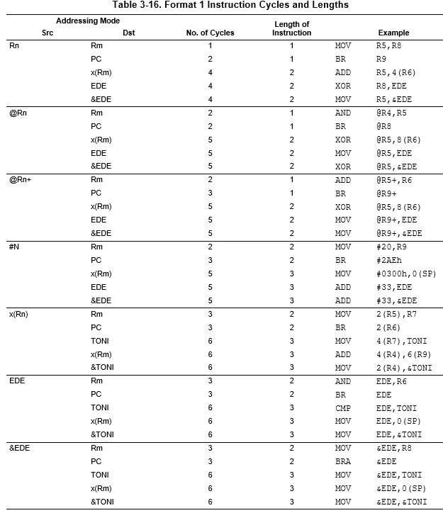
Assembly Clock Cycles
Double Operand
Based on addressing modes, different instructions take different times
BR is branch to destination
Emulated command: mov dst, PC
See Fam User Guide 3.4.6.8

Slide 42
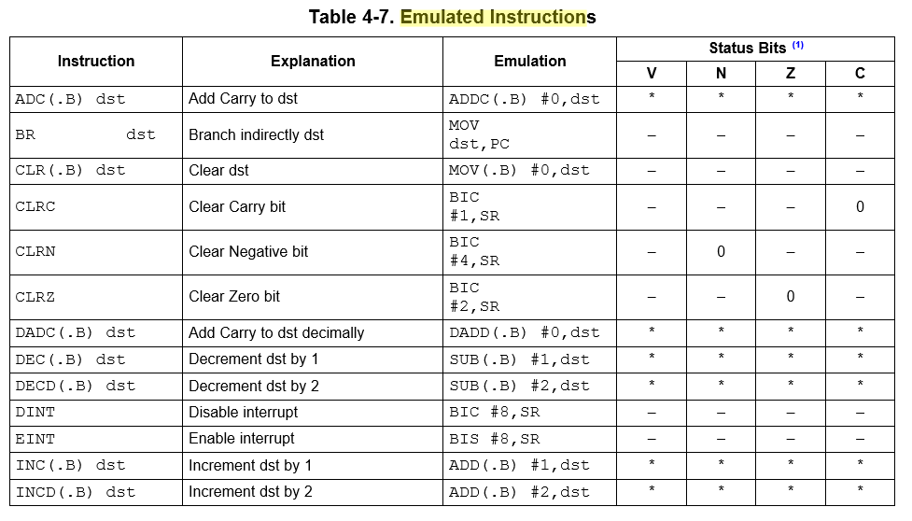
Assembly Clock Cycles
This is the real command, so use the previous tables to figure out how long they take

Slide 43
Assembly Clock Cycles
How long is this software delay?
call #software_delay ; 5 cycles
software_delay:
push r5 ; 3 cycles
mov.w #0xaaaa, r5 ; 2 cycles
delay: dec r5 ; 2 cycles?
; no 1 cycle !!!
jnz delay ; 2 cycles
pop r5 ; 2 cycles
ret ; 2 cycles?
; no 3 cycles !!!
5 + 3 + 2 + (0xaaaa * (1 + 2)) + 2 + 3 = 131085 total clock cycles
Only variable is r5… if I change r5 by “one”, how many cycles is this?
(ie., precision of delay?)
So, How long in time is this?

Slide 44
Deskwork
Given the following instructions, determine the number of clock cycles
Add r5, 4(r6)
Mov 4(r7), BOB ; BOB is a label
Cmp TOM, BOB ; TOM is also a label
Mov &BOB, r8
Push BOB
4
6
6
3
5

Slide 45
Backups

Slide 46
What does this program do? Where’s the BEEF?
; first thing's first - how do we create a comment?
mov.w #0x0200, r5
mov.w #0xbeef, r6
fill mov.w r6, 0(r5) ; anyone know what this syntax means?
incd r5
cmp.w #0x0400, r5 ; what does this instruction do?
jne fill
forever jmp forever
BEEF is a magic number used in programming. Specific values are written to memory, so it is possible to tell whether they have become corrupted, and to make it obvious when values are taken from uninitialized memory.

Slide 47
Debugging Example Using breakpoints
; example program to add the numbers 10+9+8+...+1 and put result into 0x0200
mov.w #10, r6
mov.w #0, r5
summation: add.w r6, r5
dec r6
jnz summation
mov.w r5, &0x0200
forever: jmp forever

Slide 48
Sample Program
repeat:
mov.b #0x75, r10
add.b #0xC7, r10
;result should be 0x13c, so we should see 3c in r10 and carry bit set
adc r10 ;since carry bit was set, this should increment r10 to 3d
inv.b r10 ;invert, so r10 should be c2
mov.w #0x00aa, r10
sxt r10 ;sign extend should clear upper 8 bits
inv r10
swpb r10
mov.w r10, r9
jmp repeat
c010: 7a 40 75 00 mov.b #117, r10 ;#0x0075
c014: 7a 50 c7 00 add.b #199, r10 ;#0x00c7
c018: 0a 63 adc r10
c01a: 7a e3 xor.b #-1, r10 ;r3 As==11
c01c: 3a 40 aa 00 mov #170, r10 ;#0x00aa
c020: 8a 11 sxt r10
c022: 3a e3 inv r10
c024: 8a 10 swpb r10
c026: 09 4a mov r10, r9
c028: f3 3f jmp $-24 ;abs 0xc010
Hex
Decimal

Slide 49
Sample Program
repeat:
mov.b #0x75, r10
add.b #0xC7, r10
;result should be 0x13c, so we should see 3c in r10 and carry bit set
adc r10
;since carry bit was set, this should increment r10 to 3d
inv.b r10
;invert, so r10 should be c2
mov.w #0x00aa, r10
sxt r10
;sign extend should clear upper 8 bits
inv r10
swpb r10
mov.w r10, r9
jmp repeat
PC_{NEW}
c010: 7a 40 75 00 mov.b #117, r10 ;#0x0075
c014: 7a 50 c7 00 add.b #199, r10 ;#0x00c7
c018: 0a 63 adc r10
c01a: 7a e3 xor.b #-1, r10 ;r3 As==11
c01c: 3a 40 aa 00 mov #170, r10 ;#0x00aa
c020: 8a 11 sxt r10
c022: 3a e3 inv r10
c024: 8a 10 swpb r10
c026: 09 4a mov r10, r9
c028: f3 3f jmp $-24 ;abs 0xc010
PC_{NEW} - PC_{OLD}
PC_{OLD}

