Slide 1

HQ U.S. Air Force Academy
ECE 382 Embedded Computer Systems I
Maj Walchko
Office 2F48
1

Slide 2
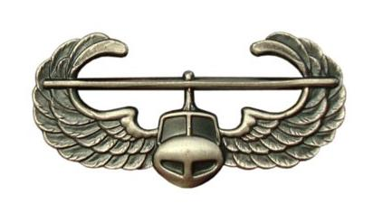



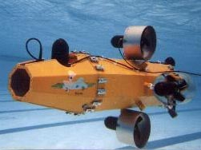


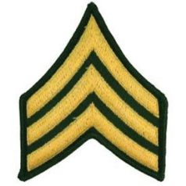
Background – Pre-AF

Slide 3
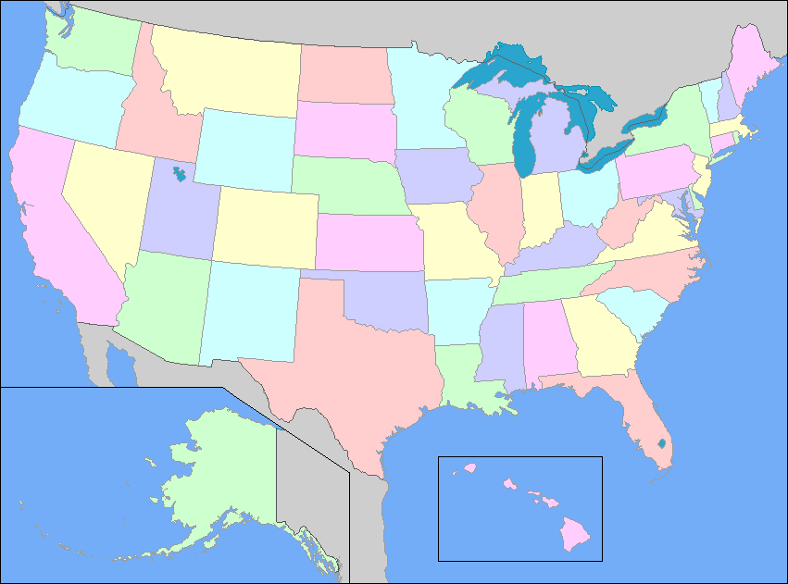
AF Carrier
NSA
Ft Meade, MD
CW/DF
USAFA
Space Superiority
LAAFB
NRO
Chantilly, VA
AFRL Space Vehicles
Kirtland AFB

Slide 4
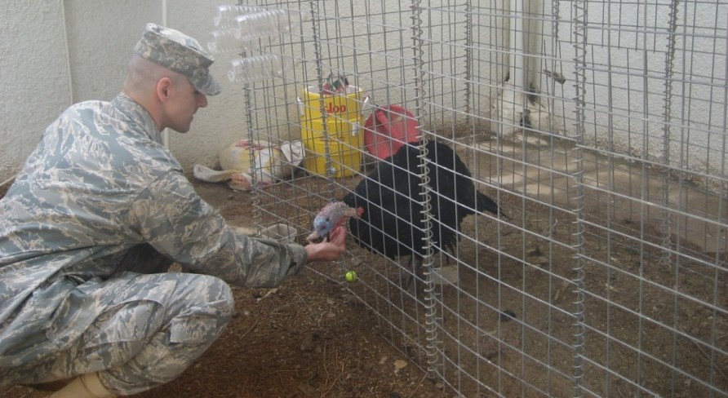
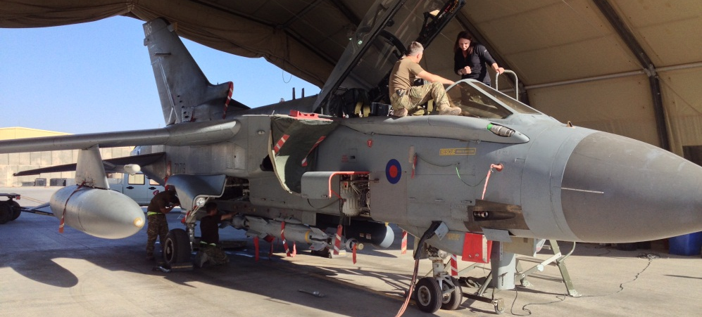
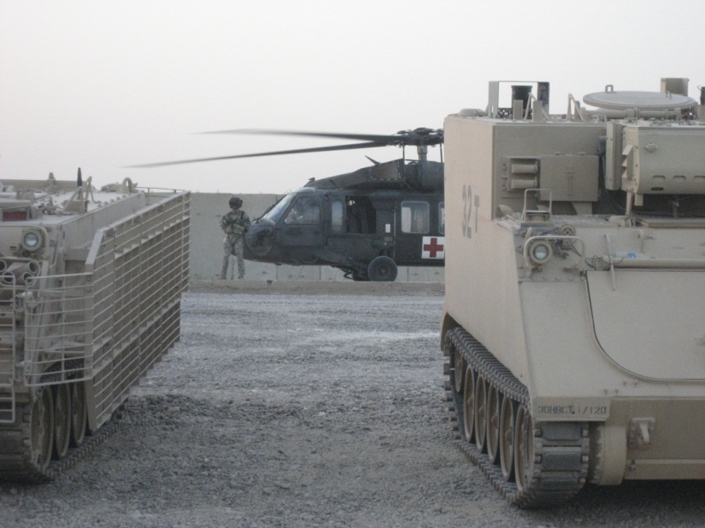
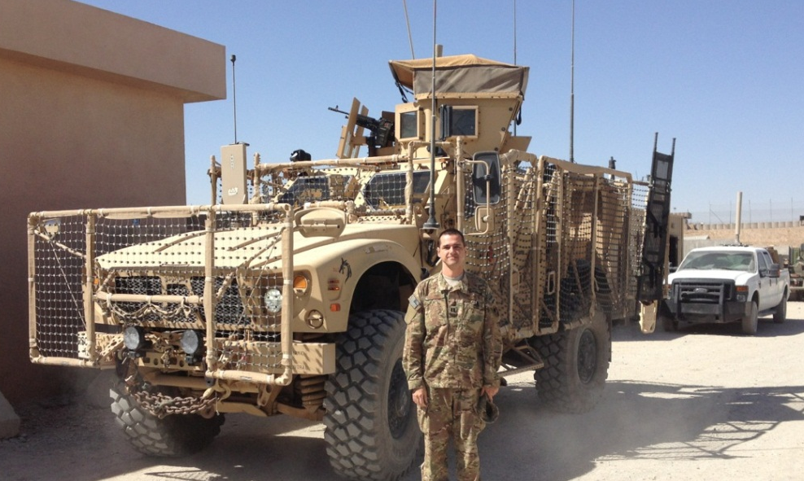



Deployments
Iraq Feb – Aug 09
Afghanistan Sept 13 – Feb 14
DCMA Southern Iraq: LOGCAP
ISAF IJC CJ2: NRO LNO

Slide 5
Roll call & Who are you?
Name
Where are you from?
What is your major?
Desired AFSC?
Why did you join the military?
What fills your time (outside of academics)?
Notes:
Fill out seating chart

Slide 6
ECE 382
In this class, we'll be:
Writing programs in Assembly Language, then C
Learning about and using the functional units of a microcontroller
Using the microcontroller to interface with peripheral devices
In short – this is a hardware class, NOT a software class
Although we will learn assembly and some C, those are just the means to use the HW
This class is very different from previous offerings
6
Notes:
Application of an architecture and microarchitecture

Slide 7
Grades???

Slide 8
Course Policies
Lesson pages (linked from syllabus on-line)
Readings
Lesson ppts
Datasheet pages
Homework
Every lesson has homework (10-20 mins)
Questions come from ppts and readings
Due BOC next lesson unless otherwise stated
I will not grade every homework
Quizzes
Based off of homework and in-class exercises
GRs
Based off quizzes and Labs

Slide 9
What Has Changed?
Hardware
We will actually cover more of the uC
Labs
7 to 4
They are shorter/simpler
No lab write-ups, all demo
You still have to push code to bitbucket
They exercise what we learn in class
Homework
Added them, we really never had but 3 homework before
Every lesson a homework is due
Quizzes (6)
More quizzes and actually listed on the syllabus
GRs (2 + Final)
You cannot keep GRs anymore

Slide 10
Course Text and Website
Required Books (pdfs available on class Webpage):
MSP430x2xx Family Users Guide
MSP430G2x53 MSP430G2x13 Mixed Signal MCU
Course URL - https://marsuniversity.github.io/ece382/
Can you guess which TV show my github Organizations are based off of?
With hardware, you need to read the datasheet, so that is our book for the class
It is your responsibility to read/follow the syllabus and know when things are due

Slide 11
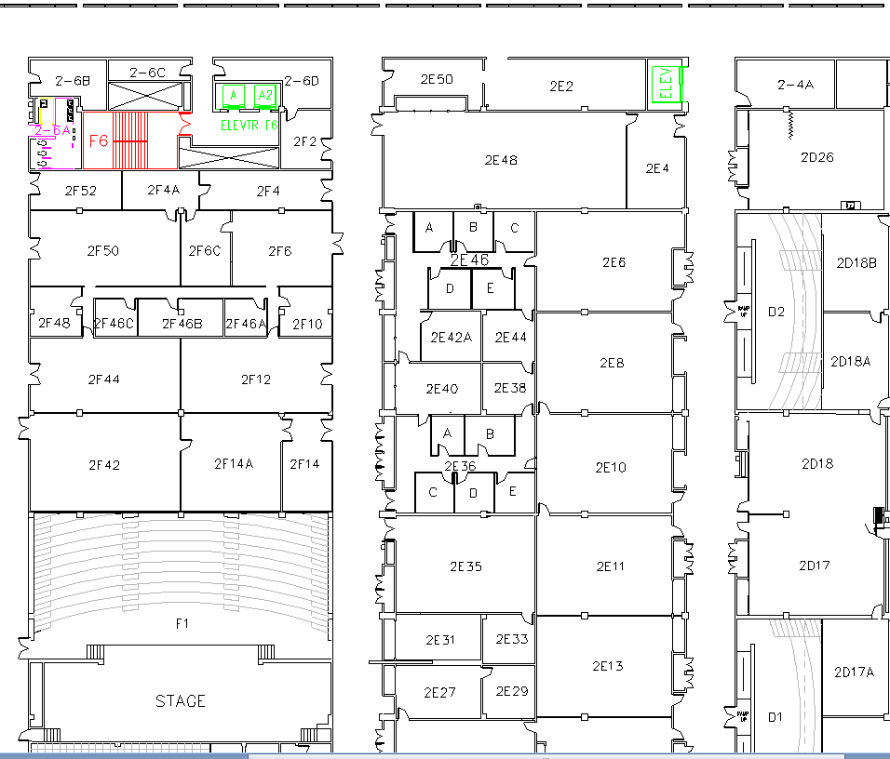
West (Terrazzo) Side
Lab
Capt Johnson
Maj Walchko
Class

Slide 12
Extra Instruction (EI)
M1
T1
Office: 2F48
kevin.walchko@usafa.edu
My schedule is dynamic, so feel free to send me a meeting invite or email for EI
M2
T2
M3
T3
M4
T4
Available
M5
T5
Sometimes Available
M6
T6
Always Unavailable
M7
T7
For the first part of the course I will be covering for Capt Johnson (T3) while he is at SOS

Slide 13
?’s || /* */
(if you are a REAL programmer, this is FUNNY!!!!)

Slide 14
14

Slide 15
Embedded Systems
Embedded Systems
they're built to interact with the real-world and perform very specific functions, often with difficult constraints (timing, power, etc)
15

Slide 16
ECE 382 – Labs
Lab | Language | Description/Goal
Lab 1 – "A Simple Calculator" | Assembly | Goal: Write a program that interprets a series of operands and operations and stores the results - an assembly language calculator!
Lab 2 – Subroutines - "Cryptography" | Assembly | Goal: Write a program that decrypts an encrypted message using a simple encryption technique (with and without key).
Lab 3 – SPI - "I/O" | Assembly | Goal: Write subroutines to interface with an LCD BoosterPack using the SPI subsystem.
Lab 4 – "An LCD Device Driver" | C Code / ASM mix | Goal: Write a program that creates an etch-a-sketch program that utilizes Lab 3 subroutines.

Slide 17
ECE 382 – Labs Continued
Lab | Language | Description/Goal
Lab 5 – Interrupts - "A Simple Game“ | C Code | Goal: Write a program that uses interrupts and the Timer_A subsytem to reverse engineer a remote control as a game controller.
Lab 6 – PWM - "Robot Motion" | C Code | Goal: Write program using the pulse-width modulationed waveforms to control the speed / direction of your robot's motors.
Lab 7 – A/D Conversion - "Robot Sensing" | C Code | Goal: Write a program to interface with an ultrasonic rangefinder on a servo to determine if the robot is approaching a wall on 3 sides.
Lab 8 – Robot Maze Competition | C Code | Goal: Combine what was learned in previous labs to program the robot to autonomously navigate through a maze.

Slide 18
Other Course Policies - Labs
Bitbucket to turn in lab materials bitbucket.org
Class time is provided, but come prepared!
The labs will require debugging—53 minutes goes by quickly
Prelabs due NLT one full duty day prior to lab lesson (unless otherwise stated)
Early feedback critical
Bad plan → bad implementation

Slide 19
Other Course Policies
Quizzes, GRs, and Final
Let me know at least one lesson ahead of time if you’re going to miss a graded evaluation
Food / Drink
No Food in classroom (Hallway OK)
Water in approved containers OK
Bring your laptop and board every lesson
Have fun!

Slide 20
Bitbucket
Create Private Bitbucket Repository
https://bitbucket.org/
Name repo something like “ECE382_LastName_FirstName”
Give your instructor access to the repo
Usernames:
pwarner
Walchko
georgeyork
Example/Template Lab Notebook:
https://github.com/pw4rn3r/ECE_382_Lab_Ex

Slide 21
Other Course Policies - Collaboration
Collaboration
Only instructors and current ECE 382 students
No using work from previous semesters
All graded work must be your own
Document any help/collaboration

Slide 22
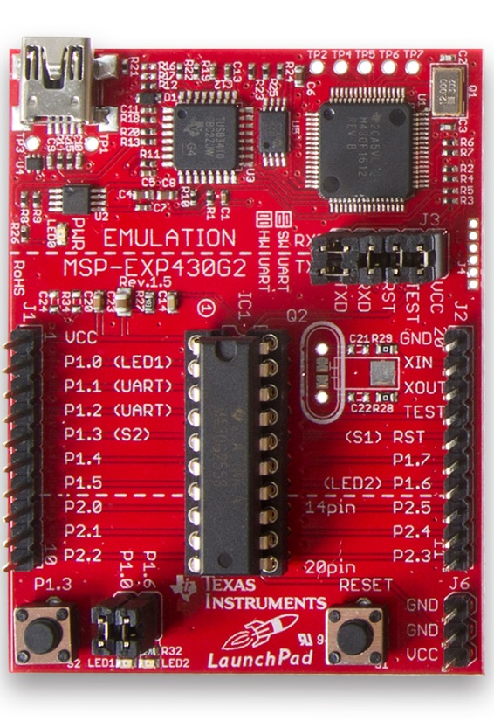
Course Labs Overview
Assembly
Simple calculator
Decrypt secret messages
Etch-a-sketch
C
Create interactive handheld games
Reverse engineer TV remote for wireless control
Create a robot and be the fastest to navigate a maze with sensors!
https://www.youtube.com/watch?v=58dCIdXB4lg&feature=youtu.be

Slide 23
Course Goals
Cadets shall develop the skills to design, implement, test, and debug microcontroller-based systems by developing operational assembly and C language programs that incorporate the built-in microcontroller functions, and by successfully interfacing the microcontroller to the external world.

Slide 24
Course Objectives
By the end of this course, cadets shall be able to:
Utilize the built-in functional units of a specified microcontroller.
Write, assemble, link, and run microcontroller code in assembly language.
Write, compile, assemble, link, and run microcontroller code in the C programming language.
Interpret and explain orally and in writing the functions of a given assembly language or C program as well as laboratory work
Evaluate, analyze, debug, and modify a given program to improve its execution of a specified task
Demonstrate a working knowledge of the on-board hardware components of a microcontroller and implement an interface between a specified microcontroller and other hardware.
Demonstrate the ability to solve well and ill-defined problems

